Slide 1
4차산업혁명 어떻게 대비할까
CNN (Convolutional Neural Network)

Slide 2
Convolution
1
1
1
0
0
0
1
1
1
0
1
0
1
=
4
0
0
1
1
1
convolution
0
1
0
0
0
1
1
0
1
0
1
0
1
1
0
0
filter
feature map
Input or feature map
Convolution 연산 : 같은 위치에 있는 숫자끼리 곱한 후 모두 더함
1x1 + 1x0 + 1x1 + 0x0 + 1x1 + 1x0 + 0x1 + 0x0 + 1x1 = 4
Filter가 옆으로 이동 후 같은 연산 수행
옆으로 모두 이동한 이후에는 아래로 이동 후 같은 연산 수행
1
1
1
0
0
0
1
1
1
0
1
0
1
=
4
3
4
0
0
1
1
1
0
1
0
2
4
3
0
0
1
1
0
convolution
1
0
1
2
3
4
0
1
1
0
0
filter
feature map
Input or feature map

Slide 3
Convolution
Credit : Leonardo’s gitbook

Slide 4
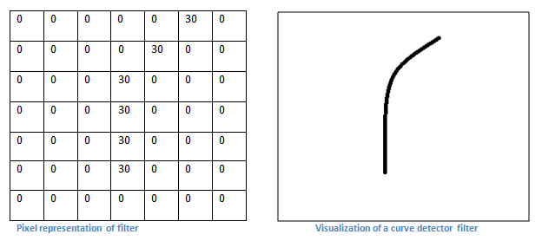
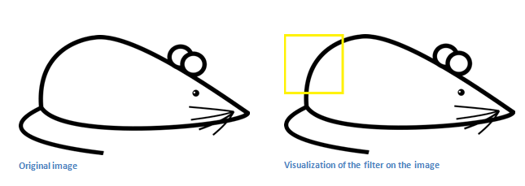
Feature Extractor
Credit : Adit Deshpande’s blog

Slide 5
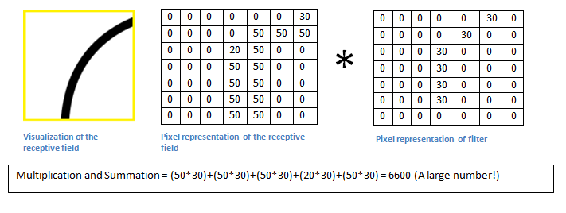
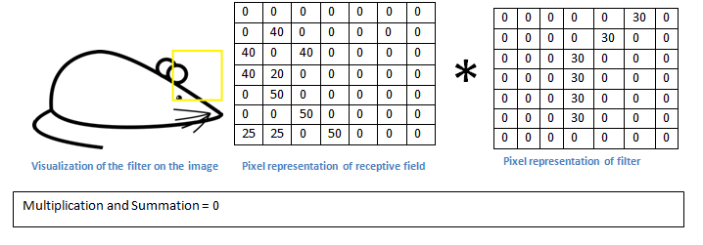
Feature Extractor
Credit : Adit Deshpande’s blog

Slide 6
Convolution (Multi Channel, Many Filters)
0
-1
0
0
1
0
-1
0
0
1
1
1
1
1
0
-1
1
1
0
0
1
1
0
1
0
1
0
-1
1
1
1
1
0
0
0
0
-1
1
-1
1
1
1
1
0
0
-1
0
3
0
1
0
1
1
0
0
1
0
1
=
0
-1
-1
0
0
0
0
1
1
1
1
1
0
-2
0
2
0
0
1
1
0
3
1
0
0
0
1
1
1
0
0
1
1
1
convolution
0
2
3
0
0
1
1
1
0
0
1
1
0
0
0
1
1
0
-1
0
-1
0
1
1
1
0
0
0
-1
0
1
1
0
0
1
0
1
-1
0
1
0
0
-1
1
0
0
0
0
-1
0
-1
1
0
1
0
Input channel : 3
# of filters : 2
Output channel : 2

Slide 7
Convolution (Multi Channel, Many Filters)
1
0
1
1
1
1
0
0
0
1
0
0
1
1
1
0
convolution
1
0
1
0
0
1
1
1
1
0
1
0
0
1
1
0
convolution
0
-1
0
3
0
1
0
1
1
0
0
1
0
1
-2
0
2
0
-1
0
0
2
3
0
1
1
0
1
convolution
-1
1
-1
0
1
1
0
0
0
-1
0
0
0
1
1
0
0
1
0
0
0
1
1
1
convolution
1
1
1
0
0
-1
-1
0
1
-1
1
0
1
0
0
-1
-1
3
1
0
-1
0
0
1
1
1
1
0
convolution
0
1
0
1
1
1
1
0
0
0
-1
0
0
0
1
1
Output channel : 2
0
1
1
1
0
convolution
-1
0
-1
0
1
1
0
0
0
1
0
-1
0
-1
Input channel : 3
# of filters : 2

Slide 8
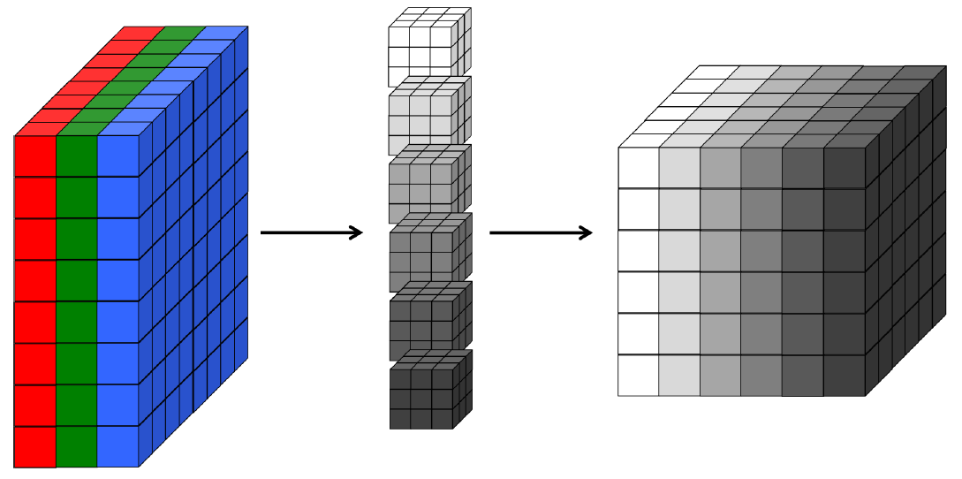
Visualization of a Convolution Layer
Picture Credit : fundamentals of deep learning by Nikhil

Slide 9


ReLU (Rectified Linear Unit)
3
0
1
ReLU
3
0
1
-2
0
2
$$f$$
0
0
2
0
2
3
0
2
3
1
-1
1
ReLU
1
0
1
0
-1
-1
$$f$$
0
0
0
3
1
0
3
1
0

Slide 10
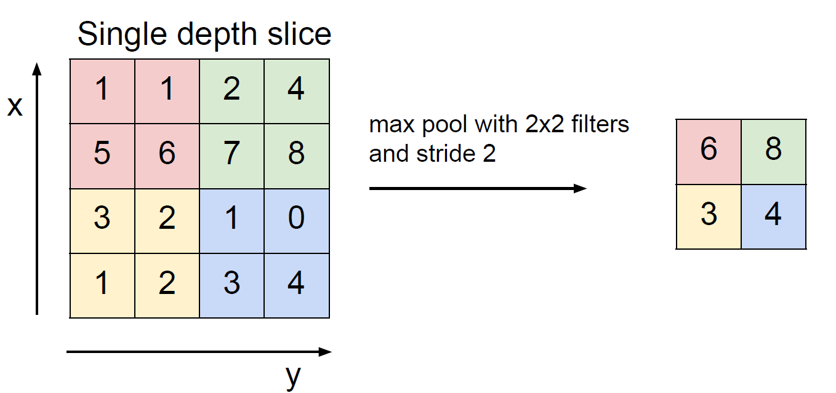
Pooling Layer
Max pooling을 많이 사용함

Slide 11
2x2 Max Pooling with Stride=1
3
0
1
max pooling
3
2
0
0
2
2
3
0
2
3
1
0
1
max pooling
1
1
0
0
0
3
1
3
1
0

Slide 12
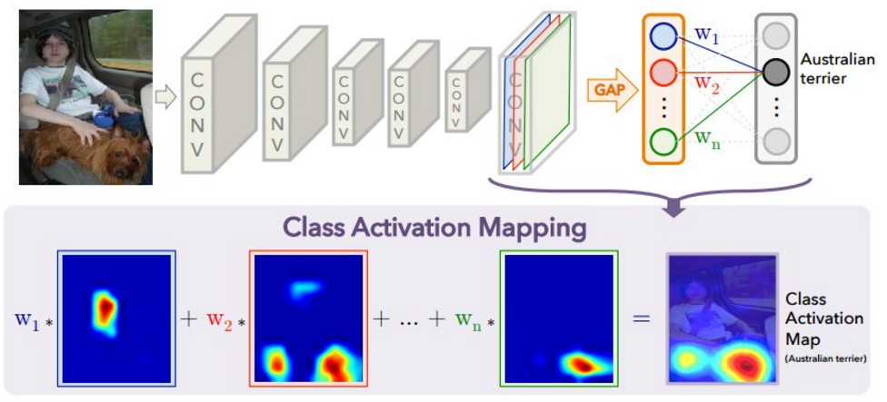
Global Average Pooling : Class Activation Map
Global average pooling을 사용하면, parameter 수를 획기적으로 줄일 수 있음(CNN parameter의 대부분은 fc layer에 있음)
Class activation map을 이용하여, 컴퓨터가 각 class를 어떻게 판단했는지 확인, 해당 class의 대략적 위치도 찾을 수 있음
“Learning Deep Features for Discriminative Localization”

Slide 13
Fully Connected Layer (Dense Layer)
3
2
3
2
2
2
softmax
0.8
Cat
2
3
3
1
1
1
1
0.2
Dog
3
1
1
3
1

Slide 14
Global Average Pooling
3
2
average
2.5
2
softmax
0.8
Cat
2
3
1
1
average
1
0.2
Dog
1.5
3
1

Slide 15
Reference
이진원 / Seoul National University
발표자료 : 인공지능, 기계학습 그리고 딥러닝

