Slide 1
4차산업혁명 어떻게 대비할까
GAN (Generative Adversarial Network)

Slide 2
목적함수

Slide 3
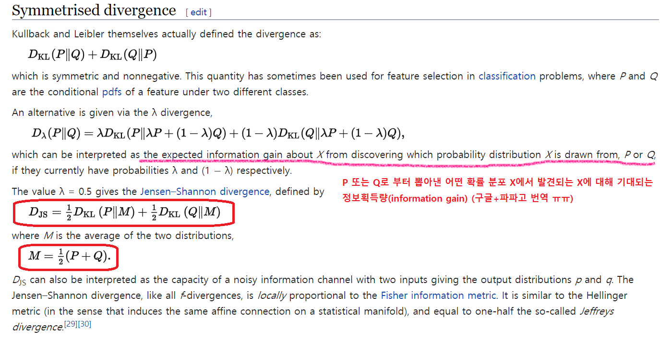

Slide 4
학습법
수식 대해부 (Appendix 강추)
https://www.slideshare.net/YunjeyChoi/generative-adversarial-networks-75916964
GAN
https://www.slideshare.net/ssuser77ee21/generative-adversarial-networks-70896091

Slide 5
Reference
https://www.slideshare.net/YunjeyChoi/generative-adversarial-networks-75916964

