Slide 1
Energy Management of Parallel Mild Hybrid Electric Vehicle
Seminar Electromobility SS 2018
Commercial Vehicle Technology
Jeinil Patel (407374)
Nihal Oza (407633)
Brijesh Varsani (407342)
Guided by
Jun.-Prof. Dr – Ing. Daniel Görges

Slide 2
Contents
Introduction
Definitions
Advantages and Disadvantages
Architectures of Hybrid Electric Vehicles
Operation Modes
Driving cycles
Energy management system
Tool box and controller
Vehicle operation modes
Simulation results
Conclusion

Slide 3
Introduction
Hybrid Vehicle
Definition: Hybrid Vehicle(HV) means a vehicle with at least two different energy converters and two different energy storage systems (on vehicle) for the purpose propulsion
Hybrid Electric Vehicle
Definition: Hybrid electric vehicle (HEV) means a vehicle that, for the purpose of mechanical
propulsion, draws energy from both of the following on-vehicle sources of stored energy/power:
a consumable fuel
an electrical energy/power storage device (e.g. battery, capacitor, flywheel/generator, etc.).

Slide 4
Introduction
Advantages and Disadvantages of HEVs
Advantages
Help reduce the consumption of fossil fuel and work towards ecofriendly driving.
It minimize the emission of greenhouse gases.
With electric source supplementing the ICE, fuel consumption is reduced, making it fuel efficient.
With strict legislative regulation , incentives with tax benefits are provided to encourage electric vehicles.
Disadvantages
The discharge of power is fast which makes it not reliable for long distance travel.
The quantity of charge that can be stored is limited .
The no. of times battery can be charged and discharged is limited causing limited battery life.
Requires many safety instrument to avoid any accidents due to the high voltage system.
Due to high safety and maintenance factor it is expensive compared to conventional vehicle.

Slide 5
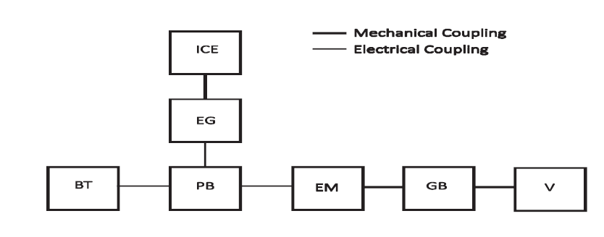
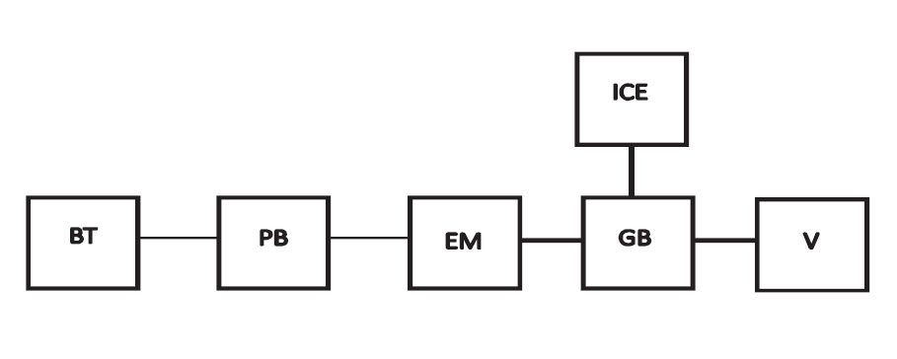
Architecture of HEV
Series Hybrid Vehicle
In series hybrid vehicle, the engine is not directly connected to the transmission
Power from engine is transmitted through the motor
Parallel Hybrid Vehicle
Parallel hybrid vehicle consist of ICE and Electric power supply connected in parallel to the mechanical transmission system
It is found to be very compact as there are only two propulsion devices to power the wheels

Slide 6
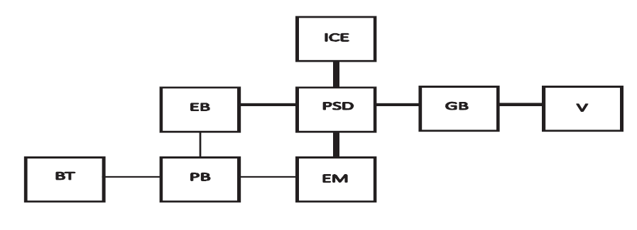
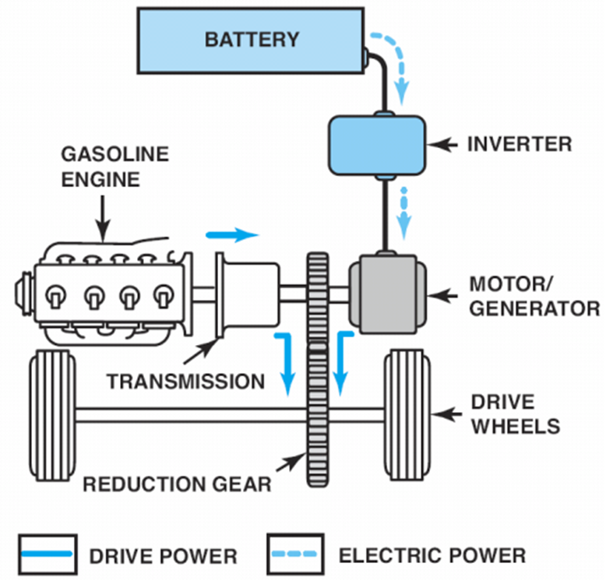
Architecture of HEV
Combined Hybrid Vehicle
It has features of both Series and Parallel HEVs
Medium energy conversion losses
Medium production cost and weight
High complexity
Parallel mild Hybrid Vehicle
The power to the wheel is generated by combining a conventional ICE propulsion system with an electric drive system
As motor is not connected to the engine directly, it is efficient during start/stop mode of the vehicle
The electric motor can work both as generator during regeneration and as motor during electric driving

Slide 7
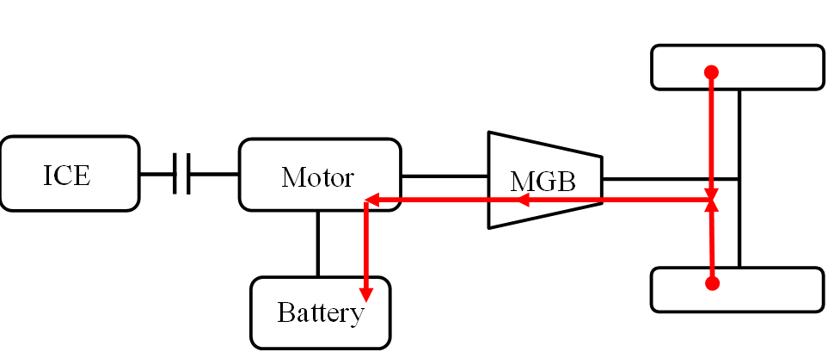
Driving mode
Engine Start/Stop
Engine consumes more fuel during idling
Stopping the engine instead of idling can substantially decrease fuel consumption
Regeneration
Kinetic energy is dissipated to heat in friction braking and engine braking
Kinetic energy can be stored in the battery by using the motor as generator in regenerative braking

Slide 8
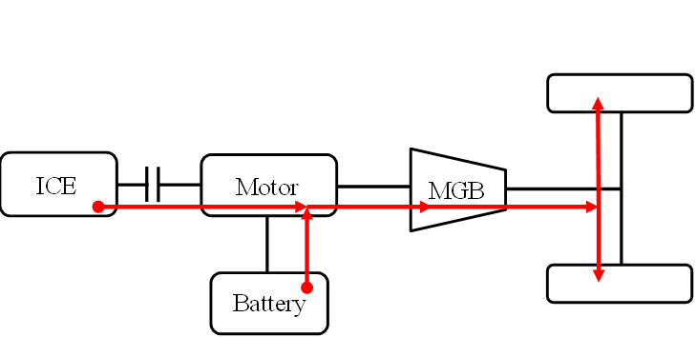
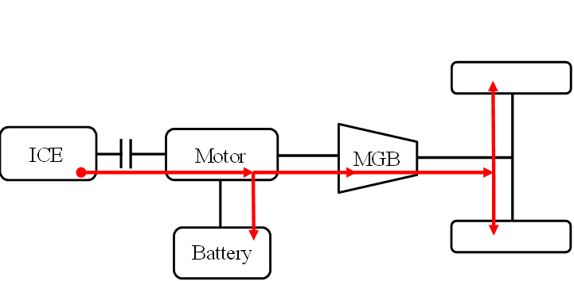
Driving mode
Engine load Point Shifting (0 ≤ 𝑢 < 1 : Motor mode; 𝑢 < 0 : Generator mode)
Engine efficiency strongly depends on the load (low efficiency at low loads due to throttling losses etc.)
Pollutant emissions also strongly depend on the load
Engine efficiency and pollutant emissions can be improved by shifting the load with the motor
Load can be increased by operating the motor in generator mode and charging the battery
Load can be decreased by operating the motor in motor mode and discharging the battery
(i)Motor Mode
(ii)Generator Mode

Slide 9
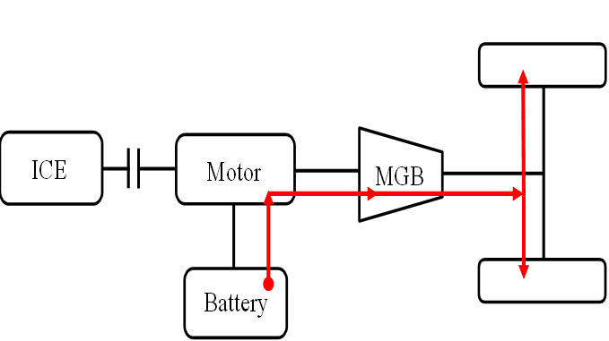
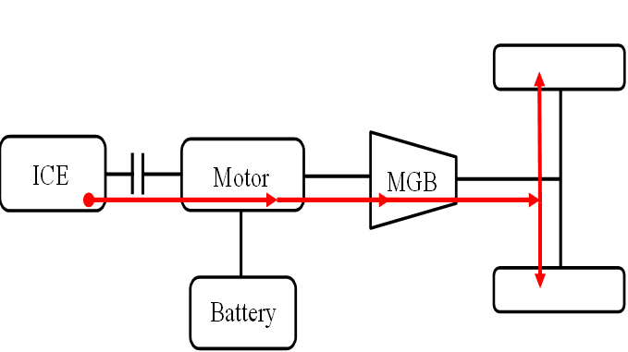
Driving mode
Electric Driving (𝑢 = 1)
Engine efficiency is very low at very low loads (e.g. in cities at low speeds)
Electric driving at very low loads and recharging the battery at low and intermediate loads
Electric driving can then be considered as a variant of engine load point shifting
Conventional Driving (𝑢 = 0 )
In conventional driving, only combustion engine provides torque for the wheels

Slide 10
Driving cycles
EU New European Driving Cycle (NEDC)
New European Driving Cycle (NEDC) is the European standard for operation and control of emission in passenger vehicles
Set to control the emission of greenhouse gases and fuel consumption. Low to moderate torque expectation
Consists of four repeated urban driving cycles (UDC) and one Extra-Urban driving cycle (EUDC)
EPA Federal Test Procedure (FTP-75)
It is the vehicle standard implemented in America and its neighboring countries
US Environmental Protection Agency (EPA) is the organization that defines the standard for the vehicle
The tests are based on different road condition with city roads and highways
The procedure contains the “cold star’’ at the beginning, then “stabilized phase” and “hot start" cycle at the end

Slide 11
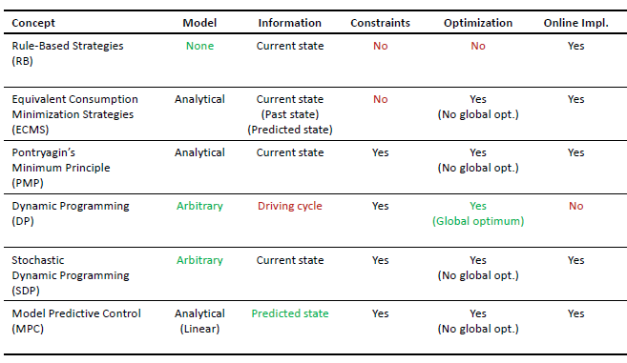
Energy management strategy
Different strategies can be implemented

Slide 12
Proposed control strategy
Rule Based Control Strategy
Rule based strategy requires less computational time when compared to Dynamic Programming(DP)
It is based on concept of load leveling and state of charge
The load level strategy is to shift the ICE operating point close to optimal point of efficiency or emission at particular speed
In this strategy the ICE is used as the primary source of power and the BT is used as secondary source
Both the sources are used as per different power, torque and efficiency
For low torque requirements, only the motor is used provided that battery charge is sufficient
Engine shuts off when the power demand falls below a limit at the operating speed to prevent inefficient operation
If the demanded power is greater than the maximum engine power at its operating speed, the motor is used to produce excess power

Slide 13
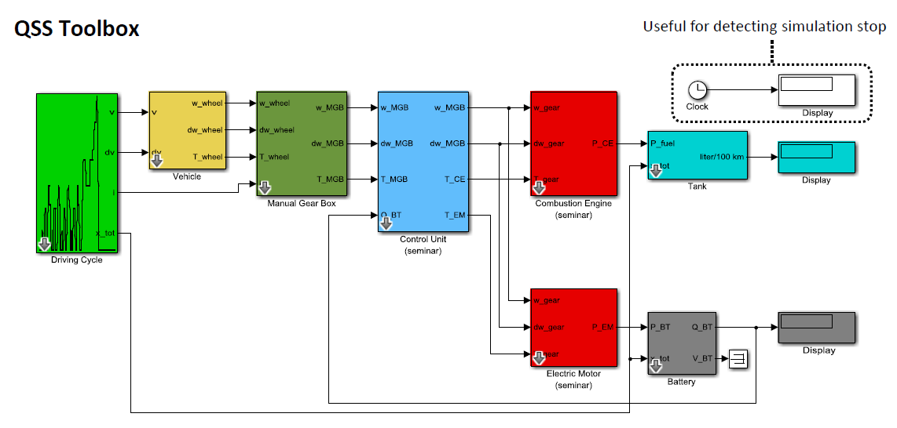
QSS Toolbox
The Quasi Static Simulation (QSS) toolbox gives the flexibility to design the powertrain systems quickly and calculate the fuel consumption of different systems under different strategies

Slide 14
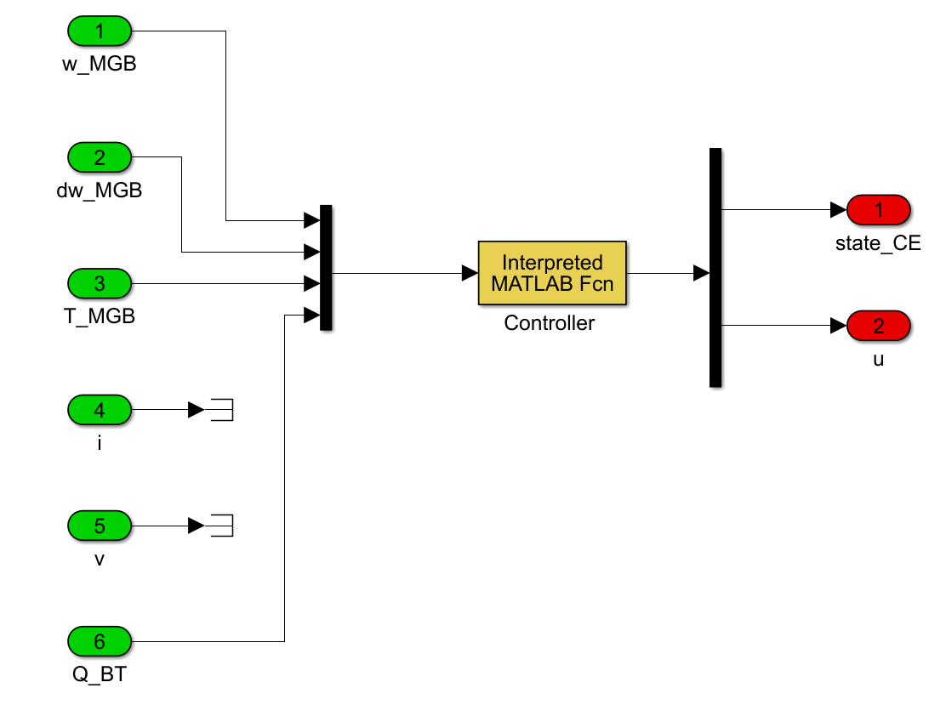
Controller
Controller structure
The controller block consist of controller that is designed for start-stop of engine and other mode (Electric driving, regeneration, etc.)
Angular velocity, gearbox torque, angular acceleration and battery charge are used as input

Slide 15

Vehicle operation mode
Start/Stop mode
Requirements
Constraint of the engine, T_MGB < 0, 0 < T_MGB < 29, must be regarded
Constraint of the battery, SoC > 0.35 , must be regarded
Results
If these constraints result as true then 𝑠𝑡𝑎𝑡𝑒_CE= 0, i.e. combustion engine will be stopped
This in turn will enforce the fuel cutoff in engine
If the above constraints are false then 𝑠𝑡𝑎𝑡𝑒_CE= 1, i.e. combustion engine will be started
Regeneration
Requirements
Kinetic energy can be stored in battery by regenerative braking
The constraint of the engine T_MGB < 0$,$ must be regarded
Results
The motor works as generator and stores maximum possible energy

Slide 16
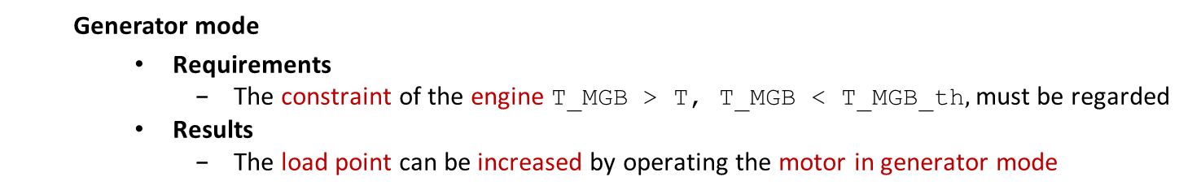
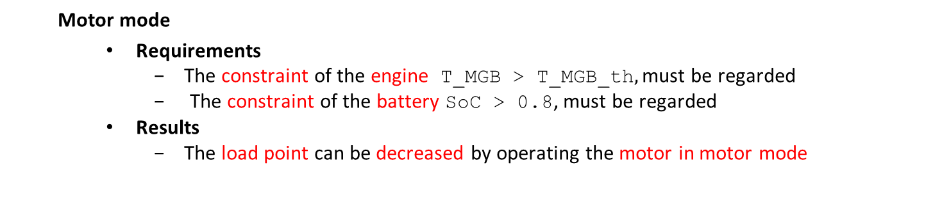
Vehicle operation mode
Load point shifting
The efficiency improvement must be larger than conversion losses suggesting an optimization
Motor mode
Requirements
The constraint of the engine T_MGB > T_MGB_th$,$ must be regarded
The constraint of the battery SoC > 0.8, must be regarded
Results
The load point can be decreased by operating the motor in motor mode
Generator mode
Requirements
The constraint of the engine T_MGB > T, T_MGB < T_MGB_th$,$ must be regarded
Results
The load point can be increased by operating the motor in generator mode

Slide 17
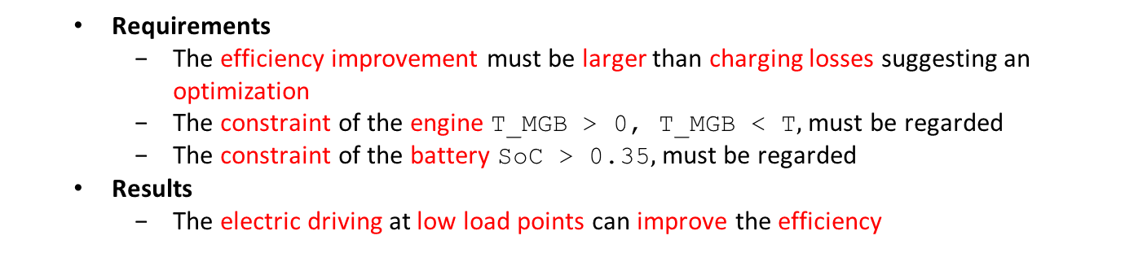
Vehicle operation mode
Electric drive
Requirements
The efficiency improvement must be larger than charging losses suggesting an optimization
The constraint of the engine T_MGB > 0, T_MGB < T$,$ must be regarded
The constraint of the battery SoC > 0.35$,$ must be regarded
Results
The electric driving at low load points can improve the efficiency
Engine drive
Requirements
The vehicle will be in this mode if none of the above constraints are satisfied
The constraint, Torque split ratio 𝑢 = 0, is regarded
Results
The engine driving can then be considered as a variant of load point shifting

Slide 18
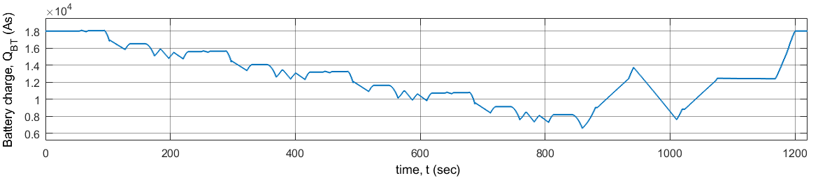
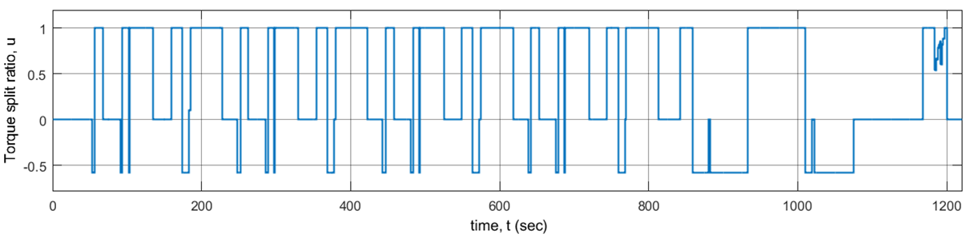
Results for NEDC cycle
Results for NEDC Cycle
Charge sustained
From the simulation graph of State of charge vs. Time we can say :
ICE and electric motor optimize the power balance
Charge is sustained at later part of driving cycle.
System charges and discharges at various mode of operation.
Smooth operation at start and stop mode.
State of charge vs time
Torque split ratio vs time

Slide 19
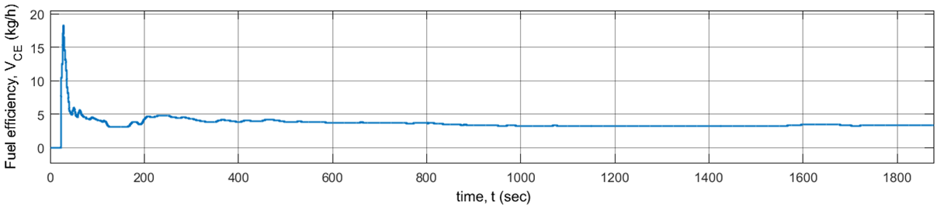
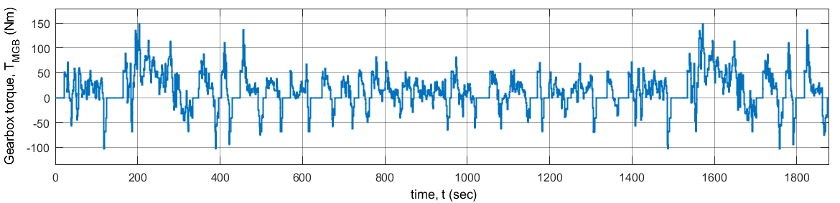
Results for NEDC cycle
Results for NEDC Cycle
From the graph of Fuel efficiency and Gearbox torque Vs. Time :
We can observe reduction in fuel consumption in Parallel HEVs at later stage of driving.
The torque graph describes the braking and acceleration during the cycle .
At the end, it is found that system is in regenerative mode .
Fuel efficiency vs time
Gear box torque vs time

Slide 20
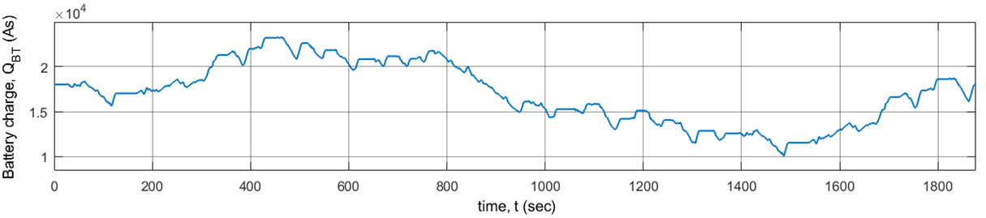
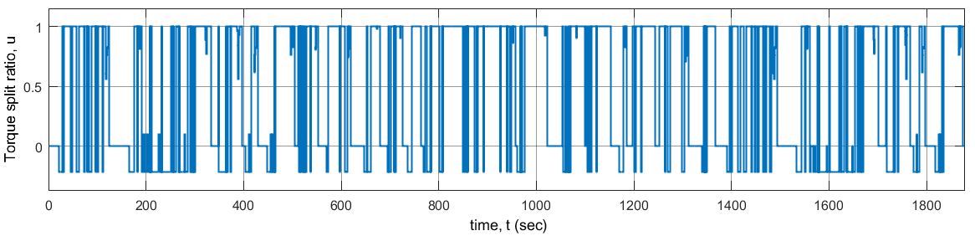
Results for FTP-75 cycle
Results for FTP-75 Cycle
From the following simulation graph of State of charge vs. Time we can say :
ICE and electric motor optimize the power balance
Charge is marginally sustained at end of the cycle.
Start-stop is frequent compared to NEDC cycle.
State of charge vs time
Torque split ratio vs time

Slide 21
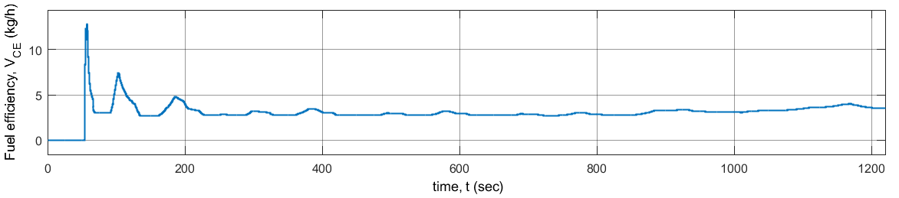
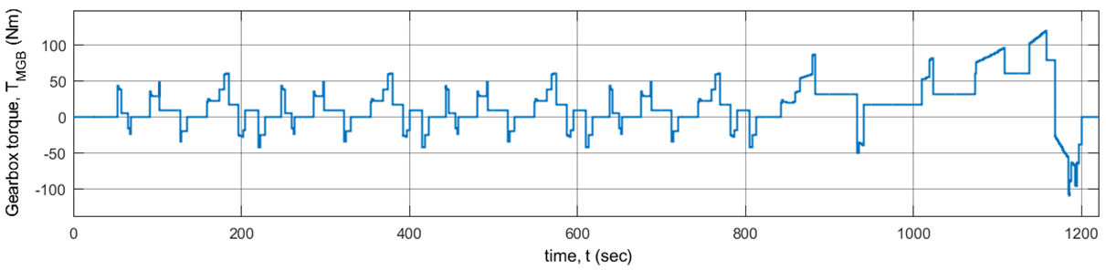
Results for FTP-75 cycle
Results for FTP-75 Cycle
From the graph of Equivalent Fuel Consumption and Torque Vs. Time :
We can observe reduction in fuel consumption in Parallel HEVs at later stage of driving.
The torque graph describes the braking and acceleration during driving
At the end, it is found that system is in regenerative mode .
Fuel efficiency vs time
Gear box torque vs time

Slide 22
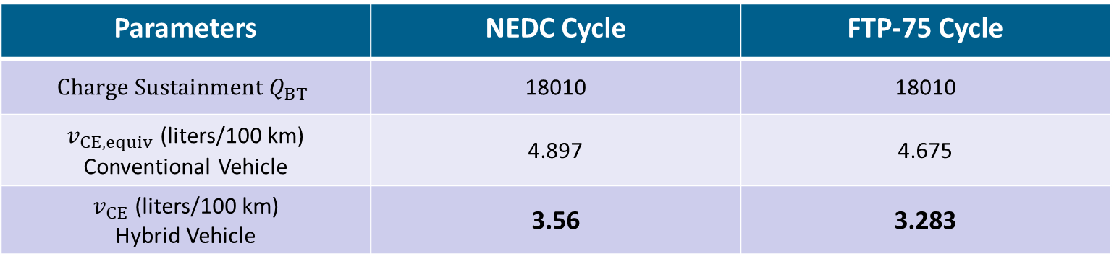
Simulation Results
Parameters | NEDC Cycle | FTP-75 Cycle
$${Charge Sustainment Q}_{BT}$$ | 18010 | 18010
$v_{CE, equiv}$ (liters/100 km) Conventional Vehicle | 4.897 | 4.675
$v_{CE}$ (liters/100 km) Hybrid Vehicle | 3.56 | 3.283
NEDC
FTP-75
31
29
27
29.77 %
27.30 %
25
% Saving

Slide 23
Reference
Lino Guzzella and Antonio Sciarretta. Vehicle Propulsion Systems: Introduction to Modeling and Optimization.Springer,Heidalberg, 3rd edition,2013.
D. Görges, "Seminar Electromobility (Summer Term 2018)," Lecture Notes, Juniorprofessorship for Electromobility, Department of Electrical and Computer Engineering, University of Kaiserslautern, Kaiserslautern, Germany, 2018.
L Guzzella and A. Amstutz, The QSS Toolbox Manual, Institute for Dynamic Systems and Control, Department of Mechanical and Process Engineering, ETH Zürich , Zürich, switzerland, 2005, http://www.idsc.ethz.ch/research-guzzell-onder/downloads.html (Last call on 12 June 2018).
Michiel Koot, Bram de Jager, Maarten Steinbuch.Energy Management Strategies for Vehicular Electric Power Systems. IEEE Transactions on Vehicular Technology, Vol.54, No.3,May 2005.
Pierluigi Pisu and Giorgio Rizzoni. A Comparative Study of Supervisory Control Strategies for Hybrid Electric Vehicles. IEEE Transactions on Control Systems Technology, Vol.15, No.3, May 2007.

Slide 24
Thank you for your attention!!

