Slide 1
IIBA East Tennessee Members Meeting
December 10, 2024
7:00 – 8:00 PM EST

Slide 2
Agenda
Overview
Thank You!
2024 Quick Review
2025 Planning
Chapter Leadership Overview
Volunteering
Next Steps

Slide 3
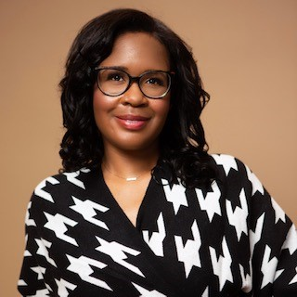

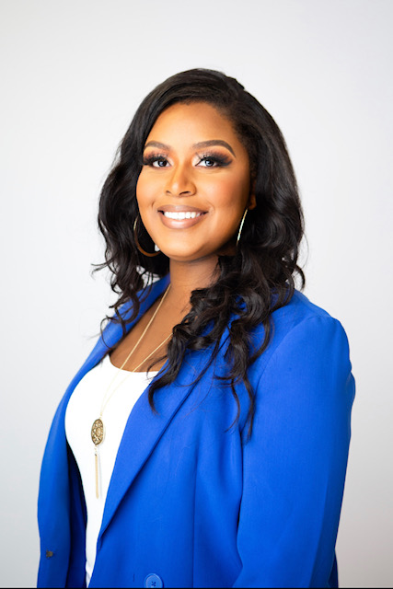

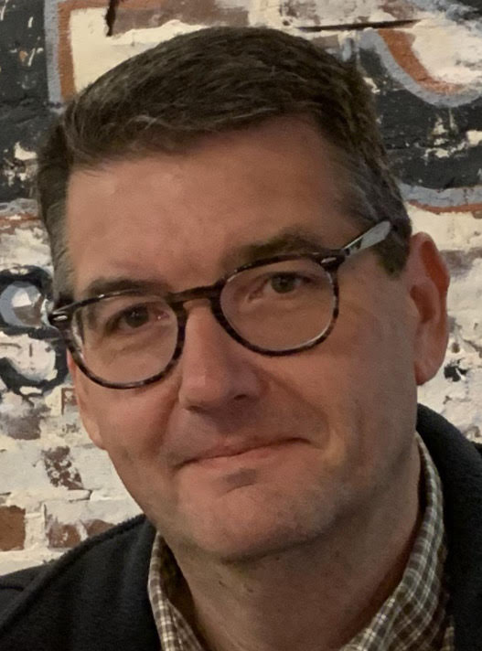
Courtney Bramlett
Treasurer
Jordan Eisenback
VP – Communications & Marketing
Shawnice Beard
VP – Professional Development
2024
Board of Directors
Thank you!
Justin Smith
VP - Membership
David Thomson
President

Slide 4
2024 Quick Review
Chapter Meetings
Chattanooga BA Networking Event
Interviewing Skills for Business Analysis Roles – Tara Tillman
New website: https://easttennessee.iiba.org/
Survey
Study Sessions
BABOK Knowledge Areas and Techniques
Agile Extension
Certification Overview
Product Ownership Analysis
Joint event with Nashville chapter
Product Ownership Analysis Class with Bluegrass Chapter

Slide 5
Potential for 2025
Chapter Meetings (virtual and in-person)
Knoxville and Chattanooga Events
Joint Events (Nashville / Bluegrass / PMI, etc.)
BABOK / Certification Study Sessions
Business Analysis Development Day (BADD) – explore options
Monthly newsletter (email)

Slide 6
Chapter Leadership Team
IIBA Active Membership Required
Open Board of Director Roles:
Vice President of Communications and Marketing
Vice President of Professional Development
Vice President of Membership
Vice President of Sponsorship
Vice President of Event Planning
Treasurer
President

Slide 7
Role of Past President
The immediate Past President shall serve as a member ex-officio of the Board of Directors, with a right to participate in all discussions and all committees. The Past President shall not have a vote on the Board of Directors or the Committees.

Slide 8
Board Role Descriptions
Treasurer is responsible for the management of funds for duly authorized purposes of the Chapter. The Treasurer is responsible to the Board of Directors and will submit the books for audit each year.
Vice President of Communications & Marketing is responsible for the timely dissemination of information both to and from the Chapter membership, using appropriate means to accomplish the objective and is also responsible for the promotion of the local Chapter and IIBA to internal and external publications.
Secretary keeps the records of all business meetings of the Chapter and meetings of the Board. The Secretary is also responsible for all official correspondence with the members and IIBA, except for committee correspondence.
Vice President of Professional Development will be responsible for promoting Business Analysis Professionalism through the organization and delivery of educational publications, seminars, and informational updates, including changes to the BA Body of Knowledge to help Business Analysts in the Business Analysis profession. Chapters are prohibited from offering training developed by the Chapter but may host a training session offered by an IIBA Endorsed Education Provider.
Vice President of Sponsorship will be responsible for sourcing sponsors and maintaining the relationships. Sponsorship will allow the Chapter a source of income to further the goals and objectives of the Chapter as well as bringing the community together.
Vice President of Membership will be responsible for the growth and sustainment of the memberships affiliated with the Chapter, as well as managing the Chapter's relationship with its members, corporations and academic institutes.

Slide 9
Volunteering and Voting
President
Volunteer:
Treasurer
Volunteer:
Vice President of Communications and Marketing
Volunteer:
Vice President of Professional Development
Volunteer:
Vice President (VP) Membership
Volunteer:
Vice President (VP) Sponsorship
Volunteer:
Vice President (VP) Event Planning
Volunteer:

Slide 10
Next Steps
Jordan and David voted to extend their board terms to Jan 31, 2025 to help with the transition to either a new board or the decommissioning of East Tennessee chapter.
Validate with Courtney on renewing IIBA membership and continuing with the board into 2025
Get financial data from Courtney as Treasurer to provide IIBA
Close out ORNL Credit Union account finally
Provide requested info back to Chapter Support at IIBA on Chapter Health Report and mention about lack of board member interest and future of East TN Chapter
Reach out to Pilot and Clayton teams and Tara Tillman at Blue Cross to gauge interest about IIBA board and continuing the chapter
Talk to Nashville chapter about merging or collaborating

