Slide 1
IIBA East Tennessee Skills Not Titles – A BA Career Conversation with Ron Edwards
April 30, 2025
6:30 – 7:30 PM EDT

Slide 2
Agenda
2025 Chapter Leadership
2025 Plans
Skills Not Titles – A BA Career Conversation with Ron Edwards

Slide 3
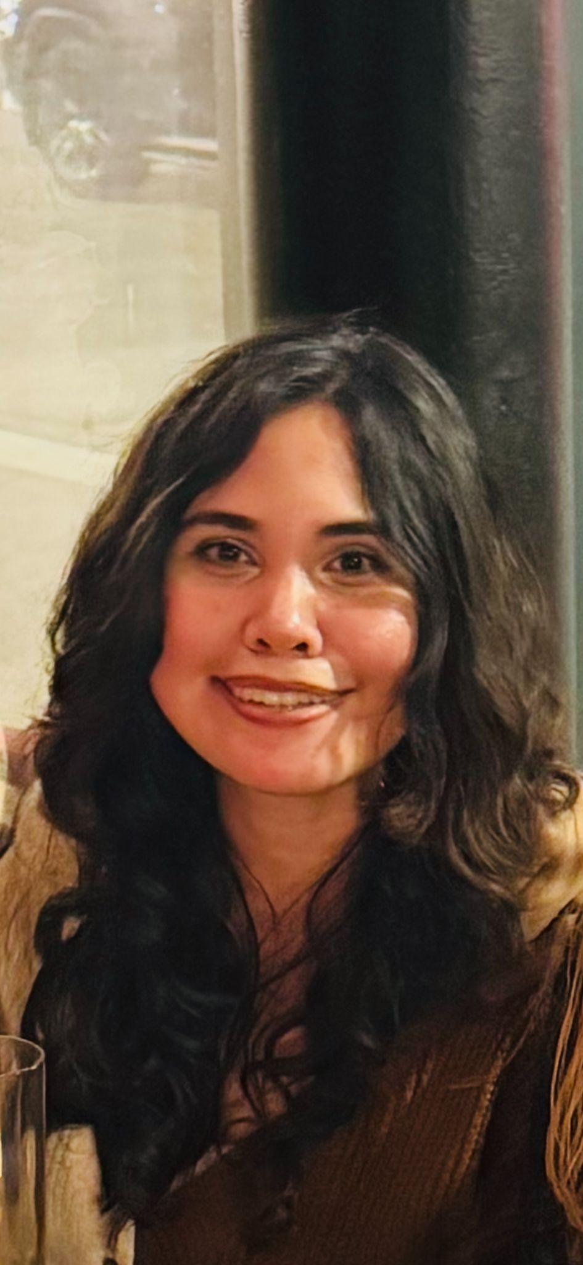

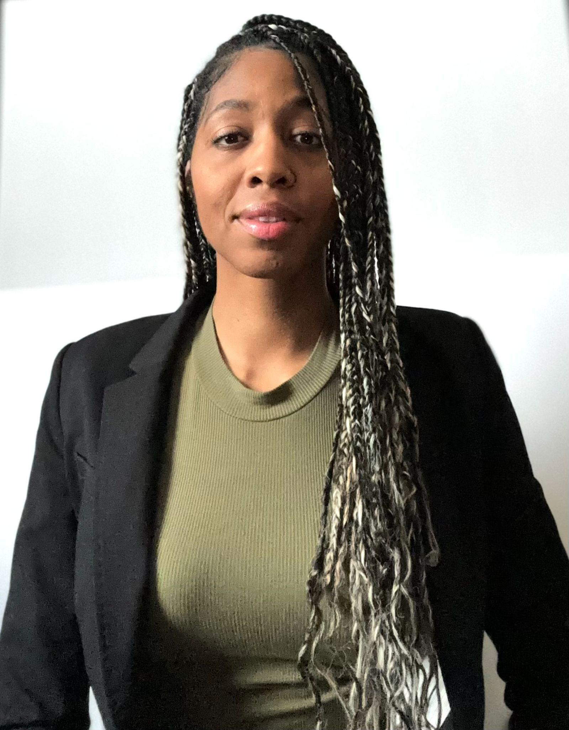
Board of Directors - 2025
Jessica Lear
Treasurer
treasurer@easttennessee.iiba.org
Warren Green
VP – Communications & Marketing
vpmarketing@easttennessee.iiba.org
Sheri Smith
VP – Professional Development
vpeducation@easttennessee.iiba.org
Jordan Eisenback
President
president@easttennessee.iiba.org
Deedee Chism
VP - Sponsorship
sponsorship@easttennessee.iiba.org
Heather McGlinchy
VP - Operations
operations@easttennessee.iiba.org
Olivia Marcum
VP - Events
vptechnology@easttennessee.iiba.org

Slide 4
2025 Plans
Website: https://easttennessee.iiba.org/
Goals
Boosting Member Engagement & Feedback
Regular surveys (Link)
Establishing Regular, Transparent Communication
Monthly newsletter
Creating Meaningful Events & Member Spotlights
Networking events
Joint event with PMI Q3/Q4
Mechanism for member spotlights (nominations / self-nominate)?

Slide 5


