Slide 1

Cryptocurrencies forecasting approach based on ARIMA, ANN and technical analysis indicators
Jeison Roa

Slide 2
Overview
Crypto Time Series
ARIMA
ARIMA Implementation
Hardware and Time
LSTM ANN
LSTM Implementation

Slide 3
Crypto Time Series
High volatility
Non Linear
Dependency on exogenous variables (Political, economical)

Slide 4

Datasets
Bitstamp data from Nov 2020 / Nov 2022 (Open Value for ARIMA) (All Columns for LSTM). BTC/USD and XRP/USD
Source: Bitstamp is a cryptocurrency exchange based in Luxembourg. It allows trading between fiat currency, bitcoin and other cryptocurrencies.

Slide 5
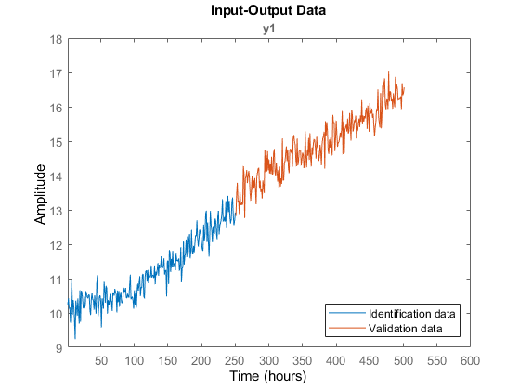
ARIMA
An autoregressive integrated moving average, is a statistical analysis model that uses time series data to either better understand the data set or to predict future trends.

Slide 6
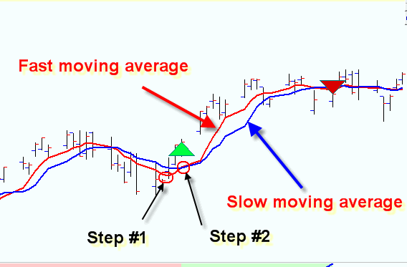
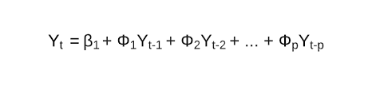
ARIMA
Autoregression (AR): refers to a model that shows a changing variable that regresses on its own lagged, or prior, values.
Integrated (I): represents the differencing of raw observations to allow the time series to become stationary (i.e., data values are replaced by the difference between the data values and the previous values).
Moving average (MA): incorporates the dependency between an observation and a residual error from a moving average model applied to lagged observations.

Slide 7
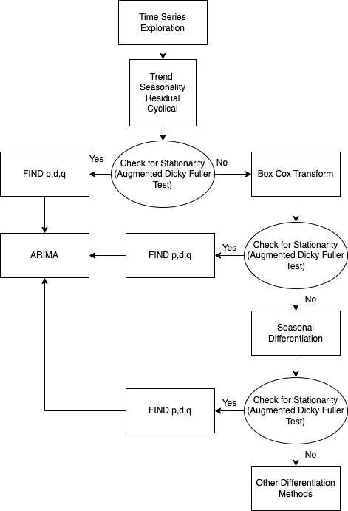
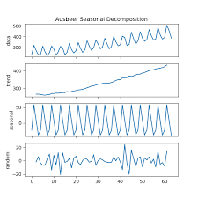
Pre-Processing

Slide 8





ARIMA IMPLEMENTATION

Slide 9


Used Hardware
Macbook Pro 2,9 GHz 6-Core Intel Core i9, 32 GB Ram
OS: Ventura
Google Collab and Jupyter as a backend
Times:
10 Minutes for each LSTM architecture.
2 Minutes for each ARIMA model.

Slide 10
ARIMA NOTEBOOKS

Slide 11
LSTM ANN
The name of LSTM refers to the analogy that a standard RNN has both "long-term memory" and "short-term memory". The connection weights and biases in the network change once per episode of training, analogous to how physiological changes in synaptic strengths store long-term memories; the activation patterns in the network change once per time-step, analogous to how the moment-to-moment change in electric firing patterns in the brain store short-term memories. The LSTM architecture aims to provide a short-term memory for RNN that can last thousands of timesteps, thus "long short-term memory"

Slide 12
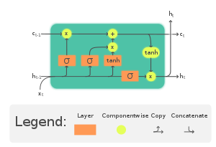
LSTM ANN

Slide 13
Why LSTM?
Good: RNNs can keep track of arbitrary long-term dependencies in the input sequences.
Bad: LSTM networks can still suffer from the exploding gradient problem.

Slide 14
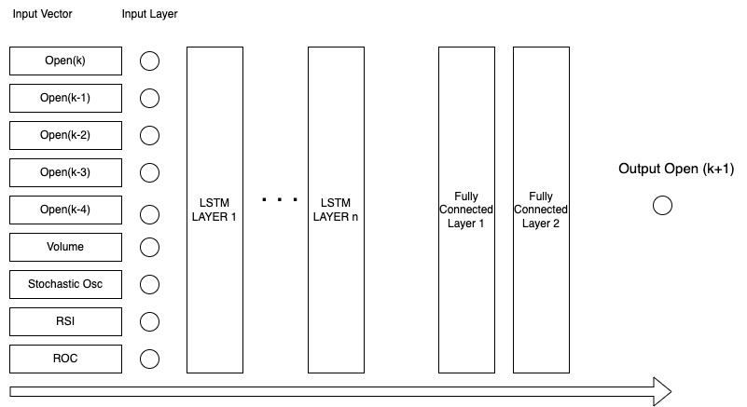
LSTM ARCHITECTURE

Slide 15
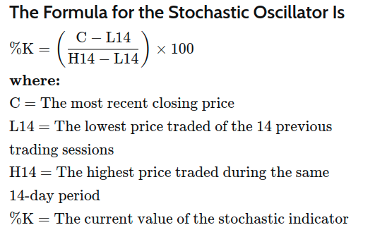
STOCHASTIC OSCILLATOR
The Stochastic Oscillator is a momentum indicator that shows the location of the close relative to the high-low range over a set number of periods.
The indicator can range from 0 to 100.
The closing price tends to close near the high in an uptrend and near the low in a downtrend.
If the closing price then slips away from the high or the low, then momentum is slowing.
Stochastics are most effective in broad trading ranges or slow moving trends.

Slide 16
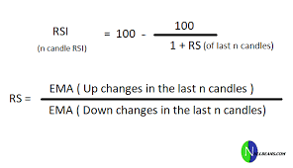
RSI OSCILLATOR
The relative strength index (RSI) is a momentum indicator used in technical analysis. RSI measures the speed and magnitude of a security's recent price changes to evaluate overvalued or undervalued conditions in the price of that security.
The RSI is displayed as an oscillator (a line graph) on a scale of zero to 100.
The indicator was developed by J. Welles Wilder Jr. and introduced in his seminal 1978 book, New Concepts in Technical Trading Systems.

Slide 17
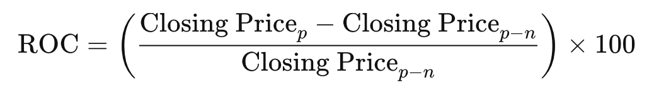
PRICE RATE OF CHANGE
The Price Rate of Change (ROC) is a momentum-based technical indicator that measures the percentage change in price between the current price and the price a certain number of periods ago.
The ROC indicator is plotted against zero, with the indicator moving upwards into positive territory if price changes are to the upside, and moving into negative territory if price changes are to the downside.
The indicator can be used to spot divergences, overbought and oversold conditions, and centerline crossovers.

Slide 18



LSTM ANN IMPLEMENTATION

Slide 19
LSTM NOTEBOOKS

Slide 20
Thank you!!

