Slide 1

Big Data Final Project
Jeison Roa
Armando Benavides
Lemlem Fereia

Slide 2
Pairs Algorithm – Pseudo code
Mapper()>
method map(docid id, doc d)
for all term u in record r do
for all neighbor v in Window(u) do
Emit(Pair(u, v), 1)
Emit(Pair(u, *), 1)
Reducer()>
method initialize()
sum = 0
method reduce(Pair (u,v), Integer values [c1, c2, ...])
count = 0
for all c in values do
count = count + c
if(v == "*")
sum = count
else
Emit( (u,v), count/sum )

Slide 3
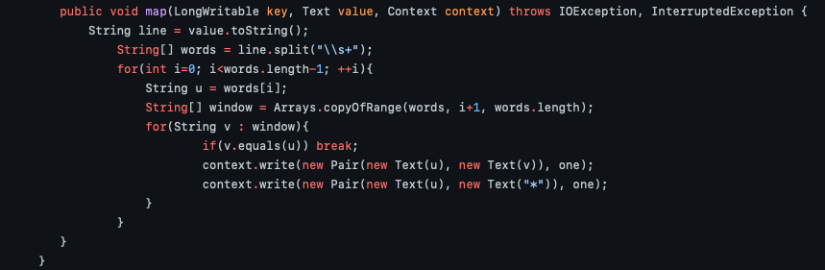
Pairs Algorithm – Mapper

Slide 4
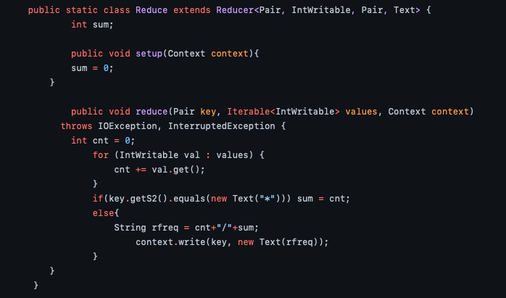
Pairs Algorithm – Reducer

Slide 5
Stripes Approach– Pseudo code
Mapper()>
method map(docid id, doc d)
for all term u in record r do
H = new AssociativeArray()
for all v in Window(u) do
if v not in H do
H{v} = 1;
else do
H{v} = H{v} + 1;
Emit(u, H);
Reducer()>
method reduce(term u, Stripe H [H1, H2, …])
Hf = new AssociativeArray()
for all h in H do
Hf = Hf + h //element-wise addition
s = sum(Hf) //sum all elements in Hf
Emit(key, Hf / s); //divide all elements by s

Slide 6
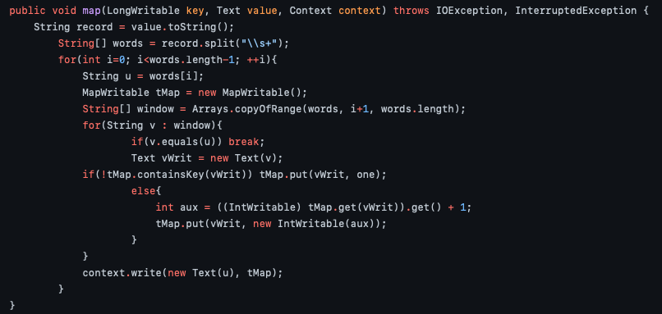
Pairs Algorithm – Mapper

Slide 7
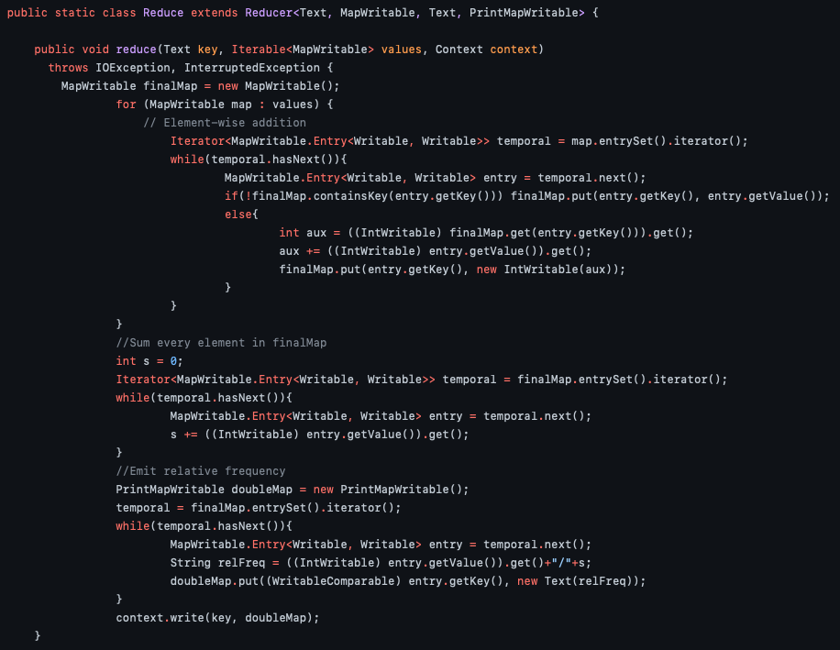
Pairs Algorithm – Reducer

Slide 8
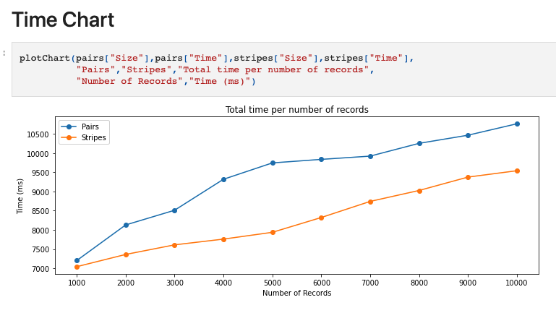
Empirical Comparison

Slide 9
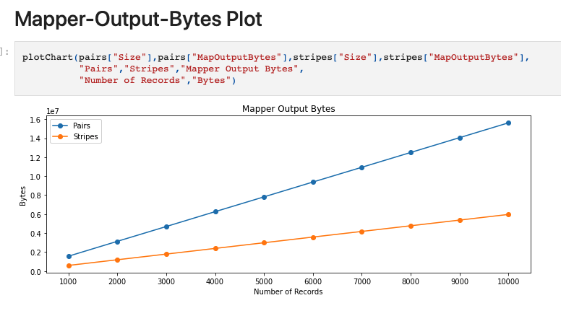
Empirical Comparison

Slide 10
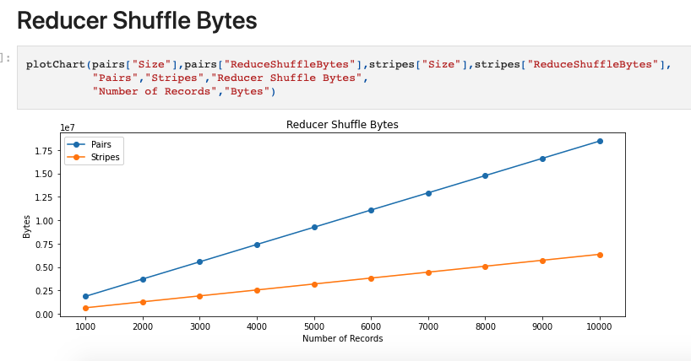
Empirical Comparison

Slide 11
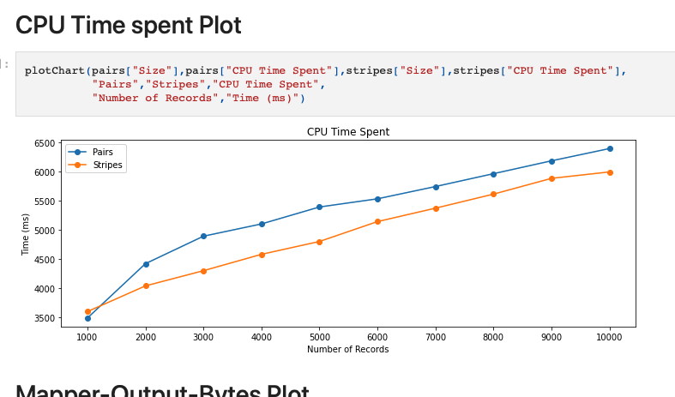
Empirical Comparison

Slide 12

Spark - Scala

Slide 13
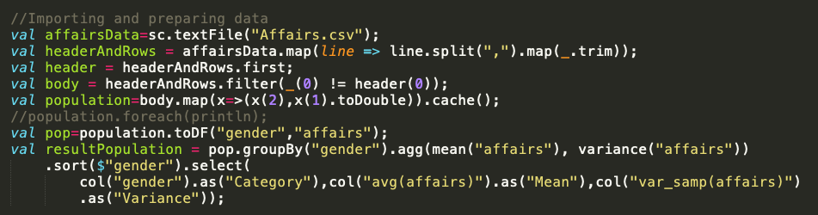
Importing Data

Slide 14
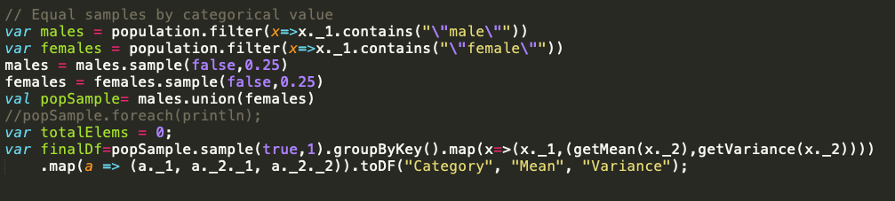
Sampling

Slide 15
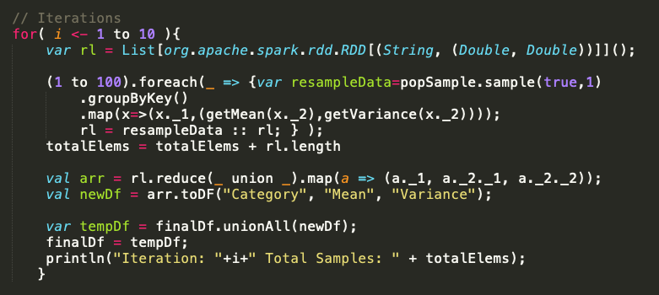
Iterate

Slide 16

Thanks

