Slide 1


Proyecto Integrado V
Entrega 3
Jeisson Araque
Sergio bustos
Junio 2025

Slide 2

Objetivo de la Presentación
Integrar resultados finales del proyecto.
Explicar funcionamiento del código, modelo, y análisis.
Demostrar claridad técnica y síntesis.

Slide 3
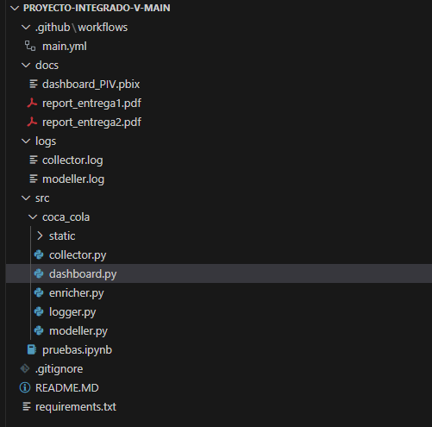


Estructura del Código
flujo general del sistema.
Herramientas y librerías utilizadas.

Slide 4
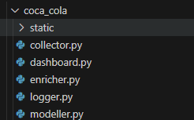

Estructura del Código
Componentes: collector, modeller, workflows, logging.

Slide 5


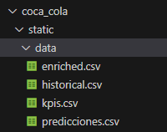
Indicador Económico
Fuente y calidad de datos.
Transformaciones realizadas.

Slide 6
Historical.csv
Date | Open | High | Low | Close | Volume | Dividends | Stock Splits
2011-07-25 00:00:00-03:00 | 5.621.433.852.775.230 | 6.026.988.506.317.130 | 5.621.433.852.775.230 | 6.026.988.506.317.130 | 31200 | 0.0 | 0.0
2011-07-26 00:00:00-03:00 | 6.026.988.506.317.130 | 6.026.988.506.317.130 | 6.026.988.506.317.130 | 6.026.988.506.317.130 | 0 | 0.0 | 0.0
2011-07-27 00:00:00-03:00 | 6.026.988.506.317.130 | 6.026.988.506.317.130 | 6.026.988.506.317.130 | 6.026.988.506.317.130 | 0 | 0.0 | 0.0
2011-07-28 00:00:00-03:00 | 6.026.988.506.317.130 | 6.026.988.506.317.130 | 6.026.988.506.317.130 | 6.026.988.506.317.130 | 0 | 0.0 | 0.0
2011-07-29 00:00:00-03:00 | 6.026.988.506.317.130 | 6.026.988.506.317.130 | 6.026.988.506.317.130 | 6.026.988.506.317.130 | 0 | 0.0 | 0.0
2011-08-01 00:00:00-03:00 | 6.026.988.506.317.130 | 6.026.988.506.317.130 | 6.026.988.506.317.130 | 6.026.988.506.317.130 | 0 | 0.0 | 0.0
2011-08-02 00:00:00-03:00 | 6.026.988.506.317.130 | 6.026.988.506.317.130 | 6.026.988.506.317.130 | 6.026.988.506.317.130 | 0 | 0.0 | 0.0
2011-08-03 00:00:00-03:00 | 6.026.988.506.317.130 | 6.026.988.506.317.130 | 6.026.988.506.317.130 | 6.026.988.506.317.130 | 0 | 0.0 | 0.0
2011-08-04 00:00:00-03:00 | 6.026.988.506.317.130 | 6.026.988.506.317.130 | 6.026.988.506.317.130 | 6.026.988.506.317.130 | 0 | 0.0 | 0.0

Slide 7
Kpis.csv
Year | Tasa de variaciÃ³n diaria promedio (%) | Media mÃ³vil 5 dÃ­as promedio | Volatilidad 20 dÃ­as promedio | DesviaciÃ³n estÃ¡ndar del precio de cierre | Retorno acumulado (%)
2011 | 0.26 | 6.71 | 0.01 | 0.46 | 23.42
2012 | 0.08 | 8.25 | 0.01 | 1.02 | 17.8
2013 | 0.12 | 10.09 | 0.01 | 0.84 | 31.01
2014 | 0.08 | 11.65 | 0.01 | 1.07 | 20.86
2015 | 0.19 | 17.06 | 0.01 | 2.34 | 55.38
2016 | -0.08 | 19.36 | 0.01 | 1.62 | -18.81
2017 | 0.06 | 18.6 | 0.01 | 1.2 | 16.19
2018 | 0.11 | 22.66 | 0.01 | 2.58 | 30.94
2019 | 0.09 | 28.16 | 0.01 | 2.91 | 28.54
2020 | 0.12 | 37.15 | 0.02 | 3.05 | 29.03
2021 | 0.08 | 43.47 | 0.01 | 2.8 | 20.56
2022 | 0.04 | 48.84 | 0.02 | 2.46 | 4.52
2023 | -0.06 | 47.37 | 0.01 | 2.04 | -14.31
2024 | 0.14 | 56.21 | 0.01 | 6.72 | 33.61
2025 | 0.06 | 65.81 | 0.01 | 2.92 | 5.51

Slide 8
Enriched.csv
Date | Open | High | Low | Close | Volume | Dividends | Stock Splits | daily_return | cumulative_return | moving_avg_5 | moving_avg_20 | volatility_20 | price_change | Day | Month | Year | Weekday
2011-08-22 00:00:00-03:00 | 6.026.988.506.317.130 | 6.026.988.506.317.130 | 6.026.988.506.317.130 | 6.026.988.506.317.130 | 0 | 0.0 | 0.0 | 0.0 | 1.0 | 6.026.988.506.317.130 | 6.026.988.506.317.130 | 0.0 | 0.0 | 22 | 8 | 2011 | Monday
2011-08-23 00:00:00-03:00 | 6.026.988.506.317.130 | 6.026.988.506.317.130 | 6.026.988.506.317.130 | 6.026.988.506.317.130 | 0 | 0.0 | 0.0 | 0.0 | 1.0 | 6.026.988.506.317.130 | 6.026.988.506.317.130 | 0.0 | 0.0 | 23 | 8 | 2011 | Tuesday
2011-08-24 00:00:00-03:00 | 6.026.988.506.317.130 | 6.026.988.506.317.130 | 6.026.988.506.317.130 | 6.026.988.506.317.130 | 0 | 0.0 | 0.0 | 0.0 | 1.0 | 6.026.988.506.317.130 | 6.026.988.506.317.130 | 0.0 | 0.0 | 24 | 8 | 2011 | Wednesday
2011-08-25 00:00:00-03:00 | 6.026.988.506.317.130 | 6.026.988.506.317.130 | 6.026.988.506.317.130 | 6.026.988.506.317.130 | 0 | 0.0 | 0.0 | 0.0 | 1.0 | 6.026.988.506.317.130 | 6.026.988.506.317.130 | 0.0 | 0.0 | 25 | 8 | 2011 | Thursday
2011-08-26 00:00:00-03:00 | 6.026.988.506.317.130 | 6.026.988.506.317.130 | 6.026.988.506.317.130 | 6.026.988.506.317.130 | 0 | 0.0 | 0.0 | 0.0 | 1.0 | 6.026.988.506.317.130 | 6.026.988.506.317.130 | 0.0 | 0.0 | 26 | 8 | 2011 | Friday

Slide 9
Predicciones.csv
Date | Open | High | Low | Close | Volume | Dividends | Stock Splits | daily_return | cumulative_return | moving_avg_5 | moving_avg_20 | volatility_20 | price_change | Day | Month | Year | Weekday | predicted_close
2011-08-22 00:00:00-03:00 | ########## | ########## | ########## | ########## | 0 | 0.0 | 0.0 | 0.0 | 1.0 | ########## | ########## | 0.0 | 0.0 | 22 | 8 | 2011 | Monday | 6.022.415.548.037.200
2011-08-23 00:00:00-03:00 | ########## | ########## | ########## | ########## | 0 | 0.0 | 0.0 | 0.0 | 1.0 | ########## | ########## | 0.0 | 0.0 | 23 | 8 | 2011 | Tuesday | 6.022.415.548.037.200
2011-08-24 00:00:00-03:00 | ########## | ########## | ########## | ########## | 0 | 0.0 | 0.0 | 0.0 | 1.0 | ########## | ########## | 0.0 | 0.0 | 24 | 8 | 2011 | Wednesday | 6.022.415.548.037.200
2011-08-25 00:00:00-03:00 | ########## | ########## | ########## | ########## | 0 | 0.0 | 0.0 | 0.0 | 1.0 | ########## | ########## | 0.0 | 0.0 | 25 | 8 | 2011 | Thursday | 6.022.415.548.037.200
2011-08-26 00:00:00-03:00 | ########## | ########## | ########## | ########## | 0 | 0.0 | 0.0 | 0.0 | 1.0 | ########## | ########## | 0.0 | 0.0 | 26 | 8 | 2011 | Friday | 6.022.415.548.037.200

Slide 10
Análisis de KPIs Finales
KPIs seleccionados e interpretación.
Visualización en el dashboard.
Conclusiones derivadas de los KPIs.

Slide 11
Conclusiones Generales
Lecciones aprendidas del proyecto.
Recomendaciones y mejoras futuras.
Valor generado por el modelo y dashboard.

Slide 12



Créditos / Repositorio
Enlace al repositorio y página web.
Participación de los integrantes.
Agradecimientos.

