Slide 1


MMSU
CommuteHub
A mobile commute planning app
for MMSU student commuters
Design Thinking and UI/UX
Research, prototype feedback and app walkthrough
MMSU CommuteHub
01
Notes:
Template and artwork: MMSU-CommuteHub-Sequence-Final.pptx supplied by the user. Research figures updated from the supplied CSV.

Slide 2

INTRODUCTION
Why we chose commuters
We chose MMSU student commuters as the users
for our design thinking project.
We explored their daily travel challenges to
design an IT solution that helps them plan
when, where and what to ride.
MMSU CommuteHub
02
Notes:
Project framing based on the user request and 195ppt.pdf. The project applies design thinking to MMSU student commuters.

Slide 3
SURVEY INTERVIEW
Interview questions
1. Walk us through a typical daily commute from start to finish for you.
2. Can you describe a specific moment during your commute this week when you felt completely stuck or delayed?
3. What is the most challenging, unpredictable, or exhausting part of your travel routine?
4. How do you currently decide when to leave, what routes or rides to take, or how to handle unexpected delays?
5. If you had a magic wand to change one thing about your current commuting process, what would it be and why?
MMSU CommuteHub
03
Notes:
Source: supplied CSV, substantive questions I–V. Also verified in Google Forms: https://docs.google.com/forms/d/1liEG3PRR3uXq0MT-cCLoXSEfarbTrqgJ3puwW15mKtA/edit#responses . Consent and year-level questions omitted as requested.

Slide 4
SURVEY INTERVIEW
Understanding the commuting problem
To establish a clearer understanding of the problem,
we conducted a survey interview among MMSU students.
Students shared their daily commuting challenges,
grievances and perspectives.
74 survey responses
Five open-ended commuting questions
MMSU CommuteHub
04
Notes:
Source: /Users/jeiwinfrey/Downloads/Untitled form.csv. 74 submitted responses. Manual multi-label thematic coding of Q3 and Q5, with one count per response per theme. Percentage = coded answers / 74 × 100, rounded to one decimal. Themes overlap. All submissions retained, including repeated wording; unique respondent identity was not independently verified. Year level, consent, and other personal fields excluded. Coding audit: {"Waiting or ride availability (Q3)":[2,3,5,6,8,10,11,15,17,18,19,21,22,24,25,28,30,32,33,34,35,36,37,38,40,43,44,45,46,47,48,50,51,53,58,59,61,65,66,69,70,71,72,74],"Traffic or road congestion (Q3)":[1,3,13,20,21,27,28,30,31,32,33,34,39,41,43,46,49,51,52,53,55,60,62],"Crowding or seat availability (Q3)":[1,2,4,5,17,19,22,24,28,29,33,35,47,48,59,60,61,67,69,72],"Weather or heat (Q3)":[9,11,20,22,24,25,27,28,32,33,36,61,64],"Transfers (Q3)":[18,26,28,33,42],"Transport information, tracking or arrival information (Q5)":[8,14,15,24,26,27,28,30,32,33,34,35,36,37,45,48,49,50,58,59,61],"More available rides (Q5)":[3,11,17,21,31,32,38,44,51,53,68]}.

Slide 5
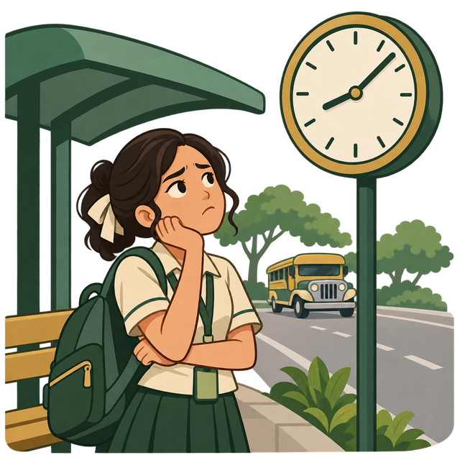
01 EMPATHIZE
What commuters experience
59.5% (44/74) mentioned waiting or ride availability
31.1% (23/74) mentioned traffic or road congestion
27.0% (20/74) mentioned crowding or seat availability
17.6% (13/74) mentioned weather or heat
Q3 themes overlap. One answer can mention several challenges.
MMSU CommuteHub
05
Notes:
Source: /Users/jeiwinfrey/Downloads/Untitled form.csv. 74 submitted responses. Manual multi-label thematic coding of Q3 and Q5, with one count per response per theme. Percentage = coded answers / 74 × 100, rounded to one decimal. Themes overlap. All submissions retained, including repeated wording; unique respondent identity was not independently verified. Year level, consent, and other personal fields excluded. Coding audit: {"Waiting or ride availability (Q3)":[2,3,5,6,8,10,11,15,17,18,19,21,22,24,25,28,30,32,33,34,35,36,37,38,40,43,44,45,46,47,48,50,51,53,58,59,61,65,66,69,70,71,72,74],"Traffic or road congestion (Q3)":[1,3,13,20,21,27,28,30,31,32,33,34,39,41,43,46,49,51,52,53,55,60,62],"Crowding or seat availability (Q3)":[1,2,4,5,17,19,22,24,28,29,33,35,47,48,59,60,61,67,69,72],"Weather or heat (Q3)":[9,11,20,22,24,25,27,28,32,33,36,61,64],"Transfers (Q3)":[18,26,28,33,42],"Transport information, tracking or arrival information (Q5)":[8,14,15,24,26,27,28,30,32,33,34,35,36,37,45,48,49,50,58,59,61],"More available rides (Q5)":[3,11,17,21,31,32,38,44,51,53,68]}. Interpretation: uncertain access to a ride creates stress even when students leave early.

Slide 6

02 DEFINE
The problem to solve
MMSU student commuters need accessible,
reliable transport information to decide
when to leave and which ride to take.
59.5% described waiting or availability problems.
28.4% (21/74) wanted transport information,
tracking or arrival information.
How might we make commute decisions clearer?
MMSU CommuteHub
06
Notes:
Source: /Users/jeiwinfrey/Downloads/Untitled form.csv. 74 submitted responses. Manual multi-label thematic coding of Q3 and Q5, with one count per response per theme. Percentage = coded answers / 74 × 100, rounded to one decimal. Themes overlap. All submissions retained, including repeated wording; unique respondent identity was not independently verified. Year level, consent, and other personal fields excluded. Coding audit: {"Waiting or ride availability (Q3)":[2,3,5,6,8,10,11,15,17,18,19,21,22,24,25,28,30,32,33,34,35,36,37,38,40,43,44,45,46,47,48,50,51,53,58,59,61,65,66,69,70,71,72,74],"Traffic or road congestion (Q3)":[1,3,13,20,21,27,28,30,31,32,33,34,39,41,43,46,49,51,52,53,55,60,62],"Crowding or seat availability (Q3)":[1,2,4,5,17,19,22,24,28,29,33,35,47,48,59,60,61,67,69,72],"Weather or heat (Q3)":[9,11,20,22,24,25,27,28,32,33,36,61,64],"Transfers (Q3)":[18,26,28,33,42],"Transport information, tracking or arrival information (Q5)":[8,14,15,24,26,27,28,30,32,33,34,35,36,37,45,48,49,50,58,59,61],"More available rides (Q5)":[3,11,17,21,31,32,38,44,51,53,68]}. 59.5% uses Q3 waiting/availability code. 28.4% uses Q5 information code. Problem statement is the team’s synthesis, not a direct survey item.

Slide 7

03 IDEATE
Ideas for the IT solution
28.4% wanted transport information (21/74).
Chosen concept: MMSU CommuteHub.
Waiting and full rides: tracking and seat status
Traffic and weather: reports and alerts
Uncertain timing: departure planning
Multiple rides: routes, stops and fare estimates
MMSU CommuteHub
07
Notes:
Source: /Users/jeiwinfrey/Downloads/Untitled form.csv. 74 submitted responses. Manual multi-label thematic coding of Q3 and Q5, with one count per response per theme. Percentage = coded answers / 74 × 100, rounded to one decimal. Themes overlap. All submissions retained, including repeated wording; unique respondent identity was not independently verified. Year level, consent, and other personal fields excluded. Coding audit: {"Waiting or ride availability (Q3)":[2,3,5,6,8,10,11,15,17,18,19,21,22,24,25,28,30,32,33,34,35,36,37,38,40,43,44,45,46,47,48,50,51,53,58,59,61,65,66,69,70,71,72,74],"Traffic or road congestion (Q3)":[1,3,13,20,21,27,28,30,31,32,33,34,39,41,43,46,49,51,52,53,55,60,62],"Crowding or seat availability (Q3)":[1,2,4,5,17,19,22,24,28,29,33,35,47,48,59,60,61,67,69,72],"Weather or heat (Q3)":[9,11,20,22,24,25,27,28,32,33,36,61,64],"Transfers (Q3)":[18,26,28,33,42],"Transport information, tracking or arrival information (Q5)":[8,14,15,24,26,27,28,30,32,33,34,35,36,37,45,48,49,50,58,59,61],"More available rides (Q5)":[3,11,17,21,31,32,38,44,51,53,68]}. The feature mapping is a design proposal, not evidence of measured app effectiveness. Information themes include availability, schedules, tracking, traffic updates and arrival or travel-time information. Ideas such as fixed schedules or more vehicles also require operator participation.

Slide 8

04 PROTOTYPE
Feedback and improvements
Positive feedback
Accurate route navigation and organized UI
Smooth flow with clear step-by-step actions
Suggested improvements
Add other notable stops
Add a clearer jeep location indicator
Qualitative prototype feedback. Evaluator count was not supplied.
MMSU CommuteHub
08
Notes:
Source: 195ppt.pdf, pages 2–3. The document reports positive feedback on route navigation, UI organization, navigation flow and step-by-step actions, plus requests for more notable stops and an indicator of the jeep whereabouts. No evaluator sample size, raw evaluation responses, or percentages were supplied. These are documented qualitative findings, not results calculated from the 74-response needs survey. Proposed actions: expand the stop list and clarify the vehicle marker and status on the tracking screen.

Slide 9
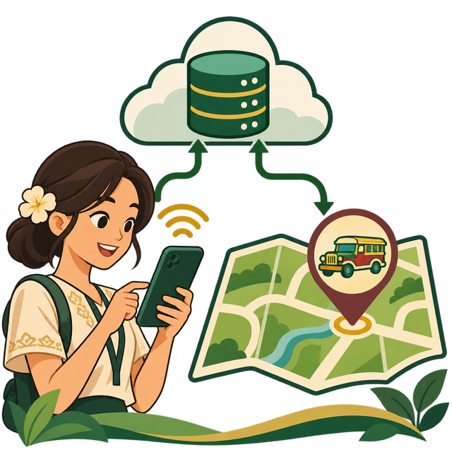
FINAL APP
MMSU CommuteHub
A mobile app for MMSU student commuters
Find routes, pickup points and fare estimates
Plan departures and review trips
Read community reports and alerts
Vehicle movement and arrival estimates
are simulated in this build.
MMSU CommuteHub
09
Notes:
Source: supplied presentation, system design and app demo slides. Vehicle movement is simulated. Screens in this section show the demonstrated app build, not a validated live transport service.

Slide 10

FINAL APP
Login screen
Functional Google sign-in
Sign in with your Google account
CLASS CONNECTION
TAM: familiar entry reduces effort
MMSU CommuteHub
10
Notes:
Source: MMSU-CommuteHub-Sequence-Final.pptx, corresponding app feature slide. Template artwork retained. Describe and demonstrate only the supported behavior in this build. Tracking, availability and arrival values are simulated, not verified live vehicle data.

Slide 11

FINAL APP
Onboarding
Illustrations explain each step
Set preferences and alert choices
CLASS CONNECTION
UI/UX: visual guidance, progress and clear feedback
MMSU CommuteHub
11
Notes:
Source: MMSU-CommuteHub-Sequence-Final.pptx, corresponding app feature slide. Template artwork retained. Describe and demonstrate only the supported behavior in this build. Tracking, availability and arrival values are simulated, not verified live vehicle data.

Slide 12

FINAL APP
Routes
Choose origin and destination
Review the supported route and stops
CLASS CONNECTION
Task-Technology Fit and helpful empty states
MMSU CommuteHub
12
Notes:
Source: MMSU-CommuteHub-Sequence-Final.pptx, corresponding app feature slide. Template artwork retained. Describe and demonstrate only the supported behavior in this build. Tracking, availability and arrival values are simulated, not verified live vehicle data.

Slide 13

FINAL APP
Pickup point
Choose a candidate pickup point
Set the proximity alert radius
CLASS CONNECTION
UI/UX: user control and helpful error guidance
MMSU CommuteHub
13
Notes:
Source: MMSU-CommuteHub-Sequence-Final.pptx, corresponding app feature slide. Template artwork retained. Describe and demonstrate only the supported behavior in this build. Tracking, availability and arrival values are simulated, not verified live vehicle data.

Slide 14

FINAL APP
Vehicles and fares
Compare available simulated rides
Check arrival, crowding and fare estimates
CLASS CONNECTION
Clear comparisons and useful next-step messages
MMSU CommuteHub
14
Notes:
Source: MMSU-CommuteHub-Sequence-Final.pptx, corresponding app feature slide. Template artwork retained. Describe and demonstrate only the supported behavior in this build. Tracking, availability and arrival values are simulated, not verified live vehicle data.

Slide 15

FINAL APP
Tracking
Watch simulated progress along the route
Confirm boarding when ready
CLASS CONNECTION
UI/UX: visible progress and clear trip status
MMSU CommuteHub
15
Notes:
Source: MMSU-CommuteHub-Sequence-Final.pptx, corresponding app feature slide. Template artwork retained. Describe and demonstrate only the supported behavior in this build. Tracking, availability and arrival values are simulated, not verified live vehicle data.

Slide 16

FINAL APP
Trips
Review the active trip
Confirm completion and inspect history
CLASS CONNECTION
UI/UX: illustrated empty states and action feedback
MMSU CommuteHub
16
Notes:
Source: MMSU-CommuteHub-Sequence-Final.pptx, corresponding app feature slide. Template artwork retained. Describe and demonstrate only the supported behavior in this build. Tracking, availability and arrival values are simulated, not verified live vehicle data.

Slide 17

FINAL APP
Departure planner
Enter the class arrival goal
Compare departures and save a plan
CLASS CONNECTION
Task fit, visual guidance and input feedback
MMSU CommuteHub
17
Notes:
Source: MMSU-CommuteHub-Sequence-Final.pptx, corresponding app feature slide. Template artwork retained. Describe and demonstrate only the supported behavior in this build. Tracking, availability and arrival values are simulated, not verified live vehicle data.

Slide 18

FINAL APP
Community
Read reports for the relevant route
Inspect confirmation, reporting and resolution controls
CLASS CONNECTION
UTAUT: peer sharing and clear feedback
MMSU CommuteHub
18
Notes:
Source: MMSU-CommuteHub-Sequence-Final.pptx, corresponding app feature slide. Template artwork retained. Describe and demonstrate only the supported behavior in this build. Tracking, availability and arrival values are simulated, not verified live vehicle data.

Slide 19

FINAL APP
Alerts
Review relevant in-app updates
Check the report or plan behind an alert
CLASS CONNECTION
UI/UX: reassuring empty states and relevant updates
MMSU CommuteHub
19
Notes:
Source: MMSU-CommuteHub-Sequence-Final.pptx, corresponding app feature slide. Template artwork retained. Describe and demonstrate only the supported behavior in this build. Tracking, availability and arrival values are simulated, not verified live vehicle data.

Slide 20

FINAL APP
Profile
Review preferences and notification controls
Keep account actions under user control
CLASS CONNECTION
User control, clear labels and confirmations
MMSU CommuteHub
20
Notes:
Source: MMSU-CommuteHub-Sequence-Final.pptx, corresponding app feature slide. Template artwork retained. Describe and demonstrate only the supported behavior in this build. Tracking, availability and arrival values are simulated, not verified live vehicle data.

Slide 21

CLOSING & Q&A
Thank you
Questions and answers
Research, design choices and the app
MMSU CommuteHub
21
Notes:
PRESENTER: Jeiwinfrey
TIME: 30 seconds
MMSU CommuteHub brings our Design Thinking and UI/UX lessons into one commute planning experience. We started with student commuters' concerns and designed features to help them compare rides, choose a pickup, and plan around class. Through clear information, meaningful illustrations, and helpful feedback, we aim to make commute decisions easier for MMSU students. On behalf of our group, thank you for your time and attention. We are now ready for your questions.
SOURCES: ; UI/UX lecture: visual guidance, feedback and clear instructions; current feature screens

