Slide 1


MMSU
CommuteHub
A mobile commute planning app
for MMSU student commuters
Design Thinking and UI/UX
Research, design and live demonstration
Jeiwinfrey · 45 seconds
01
Notes:
PRESENTER: Jeiwinfrey
TIME: 45 seconds
Good day, everyone. We are presenting MMSU CommuteHub, a mobile app designed around the daily decisions of student commuters. Our starting point is a simple concern: students need to know which ride to take and when to leave for class. We will explain our research, our design decisions, and then demonstrate one connected journey. Our presentation follows the Empathize, Define, and Ideate stages of Design Thinking. During the demonstration, each member will explain a feature and connect it to our lessons on usability, visual guidance, and feedback. Together, these features support a clearer and more organized commute experience.
SOURCES: ; UI/UX lecture: visual guidance, feedback and clear instructions; current feature screens

Slide 2

EMPATHIZE & DEFINE
The commuting concern
100 student respondents
Survey: 22-24 September 2026
70% live at least 5 km from school
Aira · 55 seconds
02
Notes:
PRESENTER: Aira
TIME: 55 seconds
Our community concern is the uncertainty students face when using public transportation to attend class. We had 100 student respondents in our survey, conducted from September 22 to 24, 2026. Seventy percent live at least five kilometers from school, so planning their commute is an important part of their day. In Design Thinking, empathizing means understanding users' needs, experiences, and behavior before choosing features. The survey helped us focus on the decisions students make before and during a trip. It gave us a starting point for designing a mobile app around the information they need to travel to school.
SOURCES: Survey analysis, p. 1; Design Thinking Module 3, pp. 8–9; UI/UX lecture: visual guidance, feedback and clear instructions; current feature screens

Slide 3
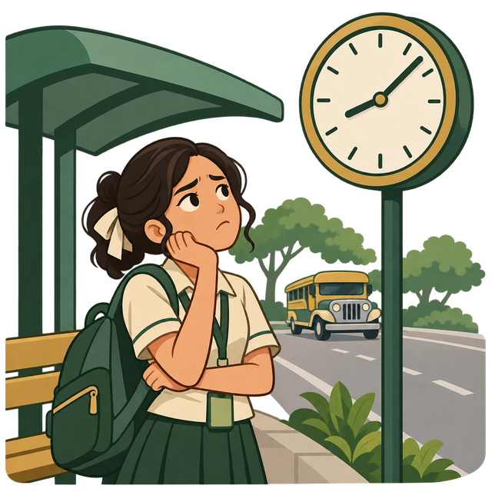
EMPATHIZE & DEFINE
Waiting affects class attendance
65% selected long waits
57% selected overcrowding
54% wait 15+ minutes at peak hours
38% are late often or always
Ashley · 55 seconds
03
Notes:
PRESENTER: Ashley
TIME: 55 seconds
The results show why this concern matters. Sixty-five percent selected long waits as a frustration, while fifty-seven percent selected overcrowding. Fifty-four percent reported peak-hour waits of at least fifteen minutes. Thirty-eight percent said transportation issues make them late often or always. Half reported having missed a class or examination at least once. Another important finding is that fifty-seven percent wait and see to learn about delays. Together, these findings point to a need for clearer travel information. We used these insights to prioritize features that help students compare rides, understand their options, and plan when to leave for class.
SOURCES: Survey analysis, p. 2; multi-select frustration percentages may exceed 100%; UI/UX lecture: visual guidance, feedback and clear instructions; current feature screens

Slide 4

EMPATHIZE & DEFINE
Our problem statement
Need: clearer route, fare and departure information
Concern: uncertain waits and crowding
How might we help students decide when, where and what to ride?
Kathrina · 55 seconds
04
Notes:
PRESENTER: Kathrina
TIME: 55 seconds
We grouped the research into three themes: time uncertainty, difficulty comparing rides, and scattered information. This is how the Define stage turns observations into a focused problem. Our problem statement is: MMSU student commuters need clearer route, fare, and departure information because uncertain waits and crowding make planning for class difficult. Our design question is: how might we help them decide when, where, and what to ride? This gives every feature a clear purpose. It also connects to our user-interview lesson: understanding a commuter's actual experience helps us ask better questions and design around the tasks that matter to them.
SOURCES: Design Thinking Module 3, pp. 13–14; Conducting User Interviews, pp. 1–2; survey analysis, p. 2; UI/UX lecture: visual guidance, feedback and clear instructions; current feature screens

Slide 5

IDEATE & SYSTEM DESIGN
Ideas and the chosen solution
Timetable page: simple, limited during changes
Group chat: easy sharing, scattered updates
Chosen: one app for commute decisions
Jeiwinfrey · 60 seconds
05
Notes:
PRESENTER: Jeiwinfrey
TIME: 60 seconds
The Ideate stage encourages exploring several approaches to a problem. A timetable page can organize route and schedule information. A commuter group chat can make sharing updates easy. An integrated mobile app brings route comparison, trip planning, and commuter reports into one experience. Our design combines these useful ideas into CommuteHub. The survey supports the feature priorities: ninety-three respondents selected tracking, sixty-one selected crowd indicators, and forty-eight selected fare estimates. These preferences helped guide the core solution. We focused on giving students relevant information at each stage, from finding a ride to choosing a pickup point and preparing for class.
SOURCES: Design Thinking Module 3, pp. 15–16; survey analysis, pp. 2–3; UI/UX lecture: visual guidance, feedback and clear instructions; current feature screens

Slide 6
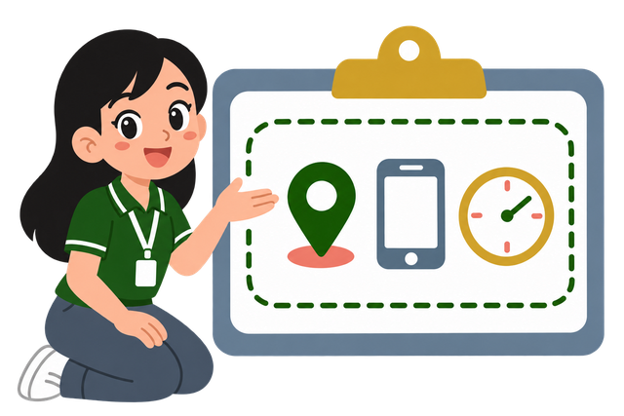
IDEATE & SYSTEM DESIGN
Features for commuter tasks
Find a ride: routes and fare estimates
Prepare to board: pickup and tracking
Plan for class: departures and reminders
Stay informed: reports and alerts
Michaella · 60 seconds
06
Notes:
PRESENTER: Michaella
TIME: 60 seconds
Our value proposition is to help students make commute decisions in one place. Routes and vehicles support comparison. Pickup and tracking guide the waiting stage. The planner works backward from a class arrival goal, while community reports and alerts keep updates accessible. This connects to Task-Technology Fit: each feature supports a specific commuter task. TAM guides our focus on usefulness and ease of use. UTAUT highlights the value of helpful information, manageable steps, and support for users. Across the app, illustrations introduce tasks, empty states explain what to do next, and feedback helps users understand the result of their actions.
SOURCES: Reviewer, pp. 3–6; survey analysis, p. 3; app feature ownership and architecture; UI/UX lecture: visual guidance, feedback and clear instructions; current feature screens

Slide 7
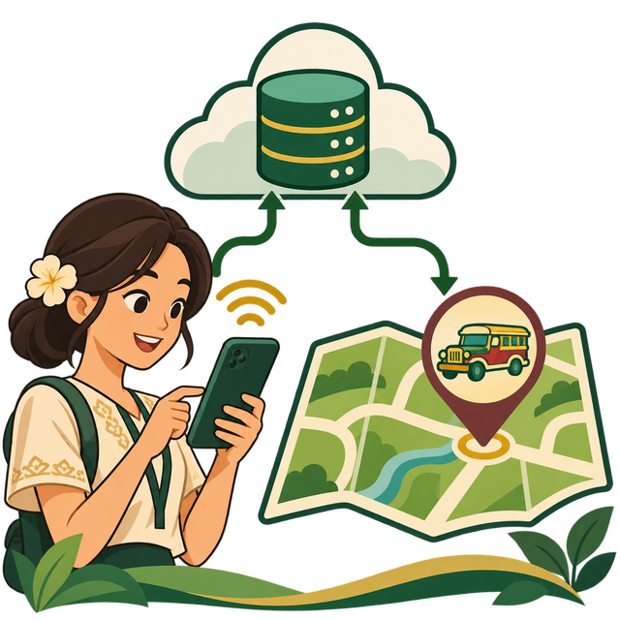
SYSTEM DESIGN
How the prototype works
A mobile app for student commuters
Plan trips and compare ride options
Follow simulated vehicle movement
Save trips, plans and preferences
France · 30 seconds
07
Notes:
PRESENTER: France
TIME: 30 seconds
MMSU CommuteHub is a mobile app that helps students plan and manage their commute. Users can explore routes, compare ride options, choose a pickup point, and save a departure plan. Vehicle movement is simulated to demonstrate the tracking experience. Trips, preferences, community reports, and alerts connect the journey in one place. We will now walk through these features.
SOURCES: App docs/architecture.md; docs/implementation-status.md; UI/UX lecture: visual guidance, feedback and clear instructions; current feature screens

Slide 8

LIVE DEMO
Login screen
Functional Google sign-in
Sign in with your Google account
CLASS CONNECTION
TAM: familiar entry reduces effort
Russel · 25 seconds
08
Notes:
PRESENTER: Russel
TIME: 25 seconds
This is our functional Google sign-in screen. Users can sign in with their Google account and access their saved information. The familiar sign-in option connects to TAM's perceived ease of use. The illustration introduces the commute theme, while loading and error messages provide clear feedback during sign-in.
DEMO ACTION: Open /sign-in and demonstrate Google sign-in.
SOURCES: App src/features/auth/screen.tsx; UI/UX lecture; Reviewer; Prospect Theory module; UI/UX lecture: visual guidance, feedback and clear instructions; current feature screens

Slide 9

LIVE DEMO
Onboarding
Illustrations explain each step
Set preferences and alert choices
CLASS CONNECTION
UI/UX: visual guidance, progress and clear feedback
Aira · 30 seconds
09
Notes:
PRESENTER: Aira
TIME: 30 seconds
Onboarding uses illustrations to explain finding a ride, choosing a pickup, and setting preferences. This applies our UI/UX lesson on visual guidance: images reinforce the instructions and make each step easier to understand. Progress indicators show where users are, while input messages help them complete their details. Across the app, illustrated empty states and clear error messages continue this guidance.
DEMO ACTION: Open /onboarding; show the steps, set preferences, and continue.
SOURCES: App src/features/onboarding/screen.tsx; UI/UX lecture; Reviewer; Prospect Theory module; UI/UX lecture: visual guidance, feedback and clear instructions; current feature screens

Slide 10
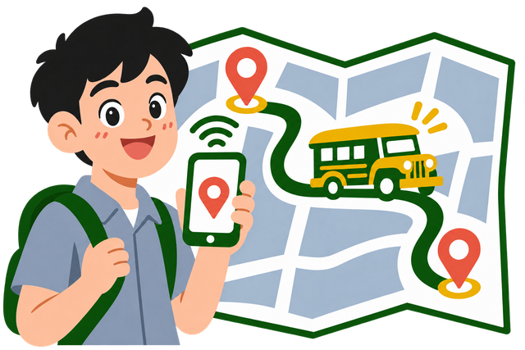
LIVE DEMO
Routes
Choose origin and destination
Review the supported route and stops
CLASS CONNECTION
Task-Technology Fit and helpful empty states
Ashley · 25 seconds
10
Notes:
PRESENTER: Ashley
TIME: 25 seconds
Here we select an origin and destination, then review the route and stops. This applies Task-Technology Fit by supporting the route decision directly. When a search has no matching route, an illustrated empty state explains the result and suggests another choice, helping the user continue.
DEMO ACTION: Open /commute; choose a supported origin–destination pair.
SOURCES: App src/features/routes/screen.tsx; UI/UX lecture; Reviewer; Prospect Theory module; UI/UX lecture: visual guidance, feedback and clear instructions; current feature screens

Slide 11

LIVE DEMO
Pickup point
Choose a candidate pickup point
Set the proximity alert radius
CLASS CONNECTION
UI/UX: user control and helpful error guidance
Kathrina · 25 seconds
11
Notes:
PRESENTER: Kathrina
TIME: 25 seconds
The pickup screen lets commuters choose a pickup point and set an alert radius. This supports user control, a key UI/UX principle. The map makes the selection visible, and a helpful message guides users toward the route or a listed stop when they need to adjust their pickup point.
DEMO ACTION: Open /commute/pickup; choose a point and radius, then continue to vehicle selection.
SOURCES: App src/features/pickup/screen.tsx; UI/UX lecture; Reviewer; Prospect Theory module; UI/UX lecture: visual guidance, feedback and clear instructions; current feature screens

Slide 12

LIVE DEMO
Vehicles and fares
Compare available simulated rides
Check arrival, crowding and fare estimates
CLASS CONNECTION
Clear comparisons and useful next-step messages
Jeiwinfrey · 30 seconds
12
Notes:
PRESENTER: Jeiwinfrey
TIME: 30 seconds
We compare simulated vehicles using arrival, crowding, and fare estimates. Our Prospect Theory lesson connects to making the differences between choices easy to notice. Clear labels support comparison, while an empty result explains the available next step so users can adjust their search.
DEMO ACTION: Open /commute/vehicles; inspect a vehicle and its fare breakdown.
SOURCES: App src/features/vehicles/screen.tsx; UI/UX lecture; Reviewer; Prospect Theory module; UI/UX lecture: visual guidance, feedback and clear instructions; current feature screens

Slide 13

LIVE DEMO
Tracking
Watch simulated progress along the route
Confirm boarding when ready
CLASS CONNECTION
UI/UX: visible progress and clear trip status
France · 30 seconds
13
Notes:
PRESENTER: France
TIME: 30 seconds
The tracking screen shows vehicle progress, the route, and the current trip status. This applies our UI/UX lesson on visibility and feedback. The simulated marker helps users follow the journey, while boarding and completion controls let them update their trip. Clear status messages guide them through each stage.
DEMO ACTION: Open /commute/tracking; point to the moving marker and confirm boarding.
SOURCES: App src/features/tracking/screen.tsx; UI/UX lecture; Reviewer; Prospect Theory module; UI/UX lecture: visual guidance, feedback and clear instructions; current feature screens

Slide 14

LIVE DEMO
Trips
Review the active trip
Confirm completion and inspect history
CLASS CONNECTION
UI/UX: illustrated empty states and action feedback
Rocky · 25 seconds
14
Notes:
PRESENTER: Rocky
TIME: 25 seconds
Trips keeps the active journey and completed history in one place. Confirming completion provides feedback and saves the trip in history. For a new user, an illustrated empty state explains where future trips will appear and offers a Find a ride action. This makes the next step clear.
DEMO ACTION: Open /trips; show the active trip, confirm completion, then show history.
SOURCES: App src/features/trips/screen.tsx; UI/UX lecture; Reviewer; Prospect Theory module; UI/UX lecture: visual guidance, feedback and clear instructions; current feature screens

Slide 15

LIVE DEMO
Departure planner
Enter the class arrival goal
Compare departures and save a plan
CLASS CONNECTION
Task fit, visual guidance and input feedback
Michaella · 30 seconds
15
Notes:
PRESENTER: Michaella
TIME: 30 seconds
The planner helps students decide when to leave for class. It considers walking, waiting, ride time, and an arrival buffer using simulated schedules. The calendar illustration introduces the planning task, while input messages guide the form. Comparing departure options applies Task-Technology Fit by connecting the app directly to class-time planning.
DEMO ACTION: Open /planner; use a future class time, compare options, and save.
SOURCES: App src/features/planner/screen.tsx; UI/UX lecture; Reviewer; Prospect Theory module; UI/UX lecture: visual guidance, feedback and clear instructions; current feature screens

Slide 16

LIVE DEMO
Community
Read reports for the relevant route
Inspect confirmation, reporting and resolution controls
CLASS CONNECTION
UTAUT: peer sharing and clear feedback
Kacey · 30 seconds
16
Notes:
PRESENTER: Kacey
TIME: 30 seconds
Community lets commuters share route observations and confirm or flag reports. This connects to social influence in UTAUT, because peers contribute useful travel information. An illustrated empty state invites the first contribution, and clear form messages guide report submission. Confirmation and moderation controls help organize the shared updates.
DEMO ACTION: Open /community and show a sample report and its controls.
SOURCES: App src/features/community/screen.tsx; UI/UX lecture; Reviewer; Prospect Theory module; UI/UX lecture: visual guidance, feedback and clear instructions; current feature screens

Slide 17

LIVE DEMO
Alerts
Review relevant in-app updates
Check the report or plan behind an alert
CLASS CONNECTION
UI/UX: reassuring empty states and relevant updates
Princess · 25 seconds
17
Notes:
PRESENTER: Princess
TIME: 25 seconds
Alerts bring trip, plan, and community updates into one inbox. Opening an alert gives users the relevant details. When the inbox is empty, the illustration and message explain that they are all caught up. This applies our UI/UX lesson on feedback by making both updates and empty states understandable.
DEMO ACTION: Open /alerts; inspect a prepared item and its linked source.
SOURCES: App src/features/alerts/screen.tsx; UI/UX lecture; Reviewer; Prospect Theory module; UI/UX lecture: visual guidance, feedback and clear instructions; current feature screens

Slide 18

LIVE DEMO
Profile
Review preferences and notification controls
Keep account actions under user control
CLASS CONNECTION
User control, clear labels and confirmations
Chadrick · 25 seconds
18
Notes:
PRESENTER: Chadrick
TIME: 25 seconds
Profile brings preferences and notification controls together. Clear labels help users understand their settings, and confirmation messages show when changes succeed. Our loss-aversion lesson connects to explaining the consequences of important account actions. These choices give users control and help them manage their commute experience confidently.
DEMO ACTION: Open /profile; show preferences and notification settings; avoid deletion.
SOURCES: App src/features/profile/screen.tsx; UI/UX lecture; Reviewer; Prospect Theory module; UI/UX lecture: visual guidance, feedback and clear instructions; current feature screens

Slide 19

CLOSING & Q&A
Thank you
Questions & answers
Research, design choices and the live prototype
Jeiwinfrey · 30 seconds
19
Notes:
PRESENTER: Jeiwinfrey
TIME: 30 seconds
MMSU CommuteHub brings our Design Thinking and UI/UX lessons into one commute planning experience. We started with student commuters' concerns and designed features to help them compare rides, choose a pickup, and plan around class. Through clear information, meaningful illustrations, and helpful feedback, we aim to make commute decisions easier for MMSU students. On behalf of our group, thank you for your time and attention. We are now ready for your questions.
SOURCES: ; UI/UX lecture: visual guidance, feedback and clear instructions; current feature screens

