Slide 1

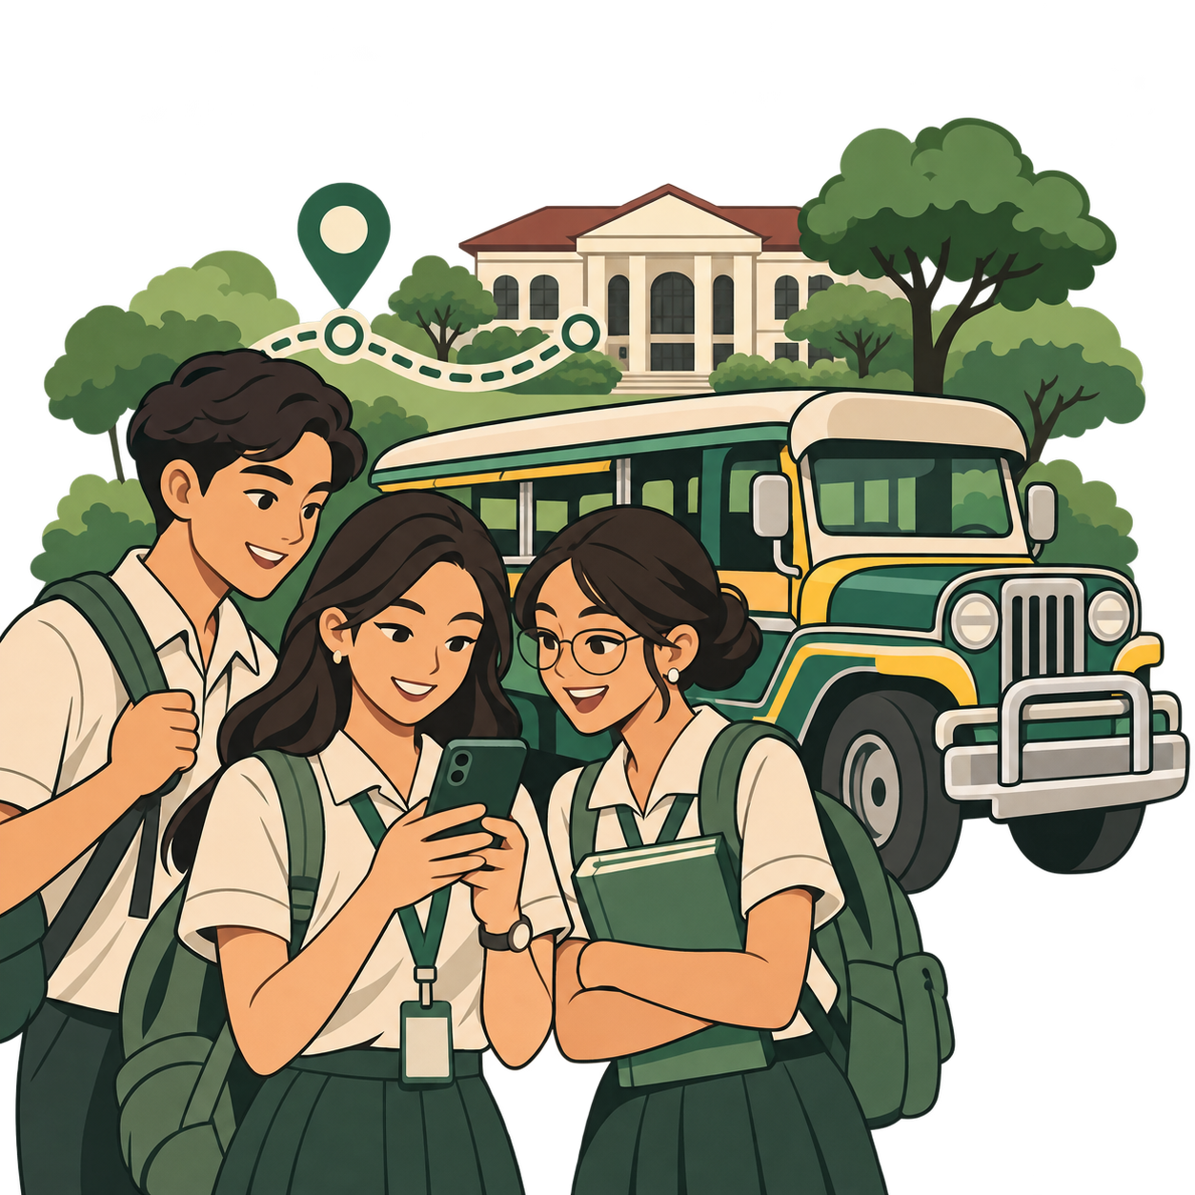
MMSU
CommuteHub
A mobile commute planning app
for MMSU student commuters
Design Thinking
From commuter research to a working app
Design Thinking project
01
Notes:
Good day. We are presenting MMSU CommuteHub, an app we designed by applying Design Thinking to the daily commute of MMSU students. We will walk through our research, how it shaped the app, and then each part of the final app.

Slide 2

INTRODUCTION
Why we chose commuters
We chose MMSU student commuters as the people to apply Design Thinking with, so that we could build an IT solution for them.
Commuting is unpredictable, inconvenient and hard to manage. Understanding it first lets us design a tool that makes each journey clearer and easier.
MMSU CommuteHub · Design Thinking
02
Notes:
Our project applies Design Thinking to a group we belong to: student commuters. The aim is to understand the everyday challenges of travelling to school, then find a practical way technology can make daily journeys more organized, accessible and convenient.

Slide 3
SURVEY INTERVIEW
Interview questions
I. CONTEXT AND ROUTINE
Walk us through a typical daily commute from start to finish for you.
II. STORYTELLING AND RECENT EXPERIENCES
Can you describe a specific moment during your commute this week when you felt completely stuck or delayed?
III. FRICTION POINTS AND UNPREDICTABILITY
What is the most challenging, unpredictable, or exhausting part of your travel routine?
IV. CURRENT TOOLS AND WORKAROUNDS
How do you currently decide when to leave, what routes or rides to take, or how to handle unexpected delays?
V. IDEAL OUTCOMES
If you had a magic wand to change one thing about your current commuting process, what would it be and why?
MMSU CommuteHub · Design Thinking
03
Notes:
These are the five open-ended questions we asked, grouped into five parts: routine, a recent story, friction points, current workarounds, and the ideal outcome. Open questions let students describe their own experience instead of choosing from a fixed list. Source: our Google Form.

Slide 4

SURVEY INTERVIEW
Understanding the problem
To establish a clearer understanding of the problem, a survey interview was conducted among MMSU students. They shared their daily commuting challenges, grievances and perspectives.
74 student responses
5 open-ended questions · 1st to 4th year students
MMSU CommuteHub · Design Thinking
04
Notes:
74 students answered the interview form. Most were 4th-year students (42 of 74, about 57%), and the rest came from 1st to 3rd year. Each answer was read and grouped into themes. One answer can mention several themes, so the percentages that follow can add up to more than 100%.

Slide 5
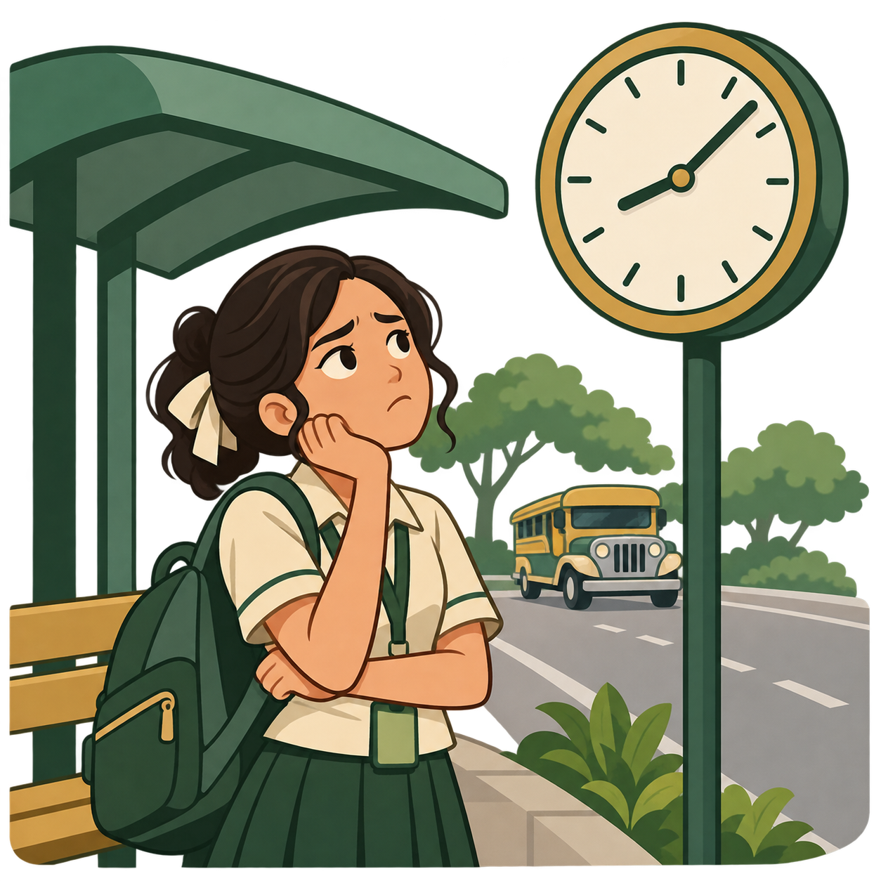
01 EMPATHIZE
What commuters go through
n = 74 responses. One answer can mention several challenges.
47.3% leave earlier “just in case”, yet only 2.7% (2 students) named a map app.
MMSU CommuteHub · Design Thinking
05
Notes:
To empathize, we read what students said about the hardest part of their commute. 59.5% (44 of 74) pointed to waiting or not finding a ride, 31.1% to traffic and road delays, 27.0% to crowded vehicles with no seat, and 17.6% to weather and heat. Students feel anxious because they cannot tell how long they will wait. 47.3% simply leave earlier than needed, and only 2 of 74 named a navigation app, so most plan by guessing. Percentages come from our own manual grouping of the Question 3 answers.

Slide 6

02 DEFINE
The problem to solve
Students lack accessible, reliable, real-time information about rides.
59.5% struggle with waiting or ride availability
28.4% asked for tracking or arrival information
How might we help students decide when to leave, where to wait and what to ride?
MMSU CommuteHub · Design Thinking
06
Notes:
Defining means turning the observations into one clear problem. Students cannot tell when a ride will come, whether there will be a seat, or when to leave. 59.5% described waiting or availability problems, and 28.4% (21 of 74) said what they wished for was transport information, tracking or arrival times. This led to our design question: how might we help students decide when to leave, where to wait and what to ride?

Slide 7

03 IDEATE
From problems to ideas
59.5% wait, no ride → vehicle tracking and seat status
31.1% traffic → delay reports and alerts
47.3% leave early → a leave-by planner
28.4% want info → routes, stops and fares
Chosen: one app for commute decisions, MMSU CommuteHub.
MMSU CommuteHub · Design Thinking
07
Notes:
In ideation we matched each finding to an idea. Waiting and missing rides point to live vehicle tracking with seat status. Traffic points to commuter delay reports and alerts. Leaving early just in case points to a planner that tells students when to leave. The request for information points to routes, stops and fare estimates. Other wishes, such as more vehicles (14.9%), depend on operators, so they are outside what an app can change. We combined the ideas into one app.

Slide 8
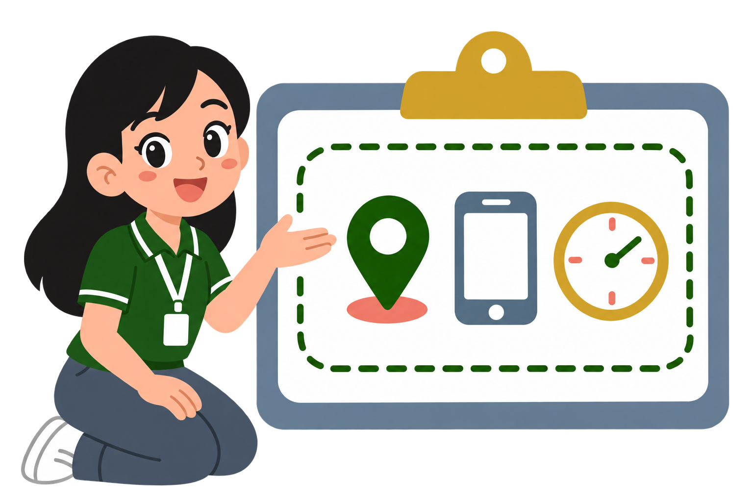
04 PROTOTYPE
Our proposed IT solution
MMSU CommuteHub
A mobile app for student commuters
Vehicle and fare information
Vehicle tracking
Alerts
Departure planner
Community delay reports
MMSU CommuteHub · Design Thinking
08
Notes:
Our prototype is MMSU CommuteHub. Its features are vehicle and fare information, vehicle tracking, alerts, a departure planner and community delay reports.

Slide 9
04 PROTOTYPE
What testers told us
Students installed the app and used it as if it were already released while we observed and noted their feedback.
WHAT WORKED
Accurate route navigation
User-friendly, organized UI
Smooth navigation flow
Clear step-by-step actions
WHAT TO IMPROVE
Add other notable stops
Add an indicator for where the jeep is
Now in the app: named pickup spots and an incoming-vehicle status.
MMSU CommuteHub · Design Thinking
09
Notes:
Testers moved through the app without difficulty and were familiar with the technology. There were only a few confusions about the interface and suggestions for the tracking. What worked: accurate route navigation, a user-friendly and organized interface, smooth navigation flow, and clear step-by-step actions. What to improve: add other notable stops, and add an indicator showing where the jeep is. These are qualitative responses, so we report them as feedback rather than percentages. Our latest build adds named pickup spots and an incoming-vehicle status in response.

Slide 10
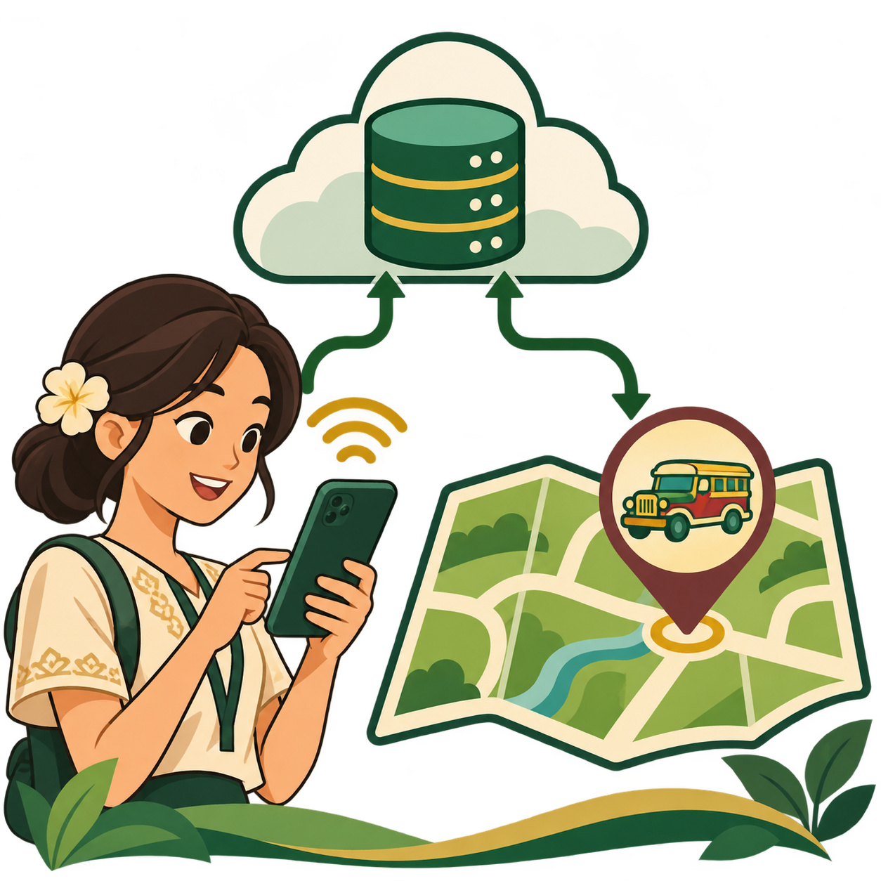
FINAL APP
MMSU CommuteHub
A mobile app for student commuters
Live vehicle ETAs with seat status
A leave-by time that reacts to delay reports
A transfer planner, weather and rush-hour alerts
MMSU CommuteHub · Design Thinking
10
Notes:
This is the final app: a mobile web app you can install on your phone. It shows live vehicle arrival times with seat status, a leave-by time that reacts to delay reports, a transfer planner, and weather and rush-hour alerts. The next slides walk through each part.

Slide 11
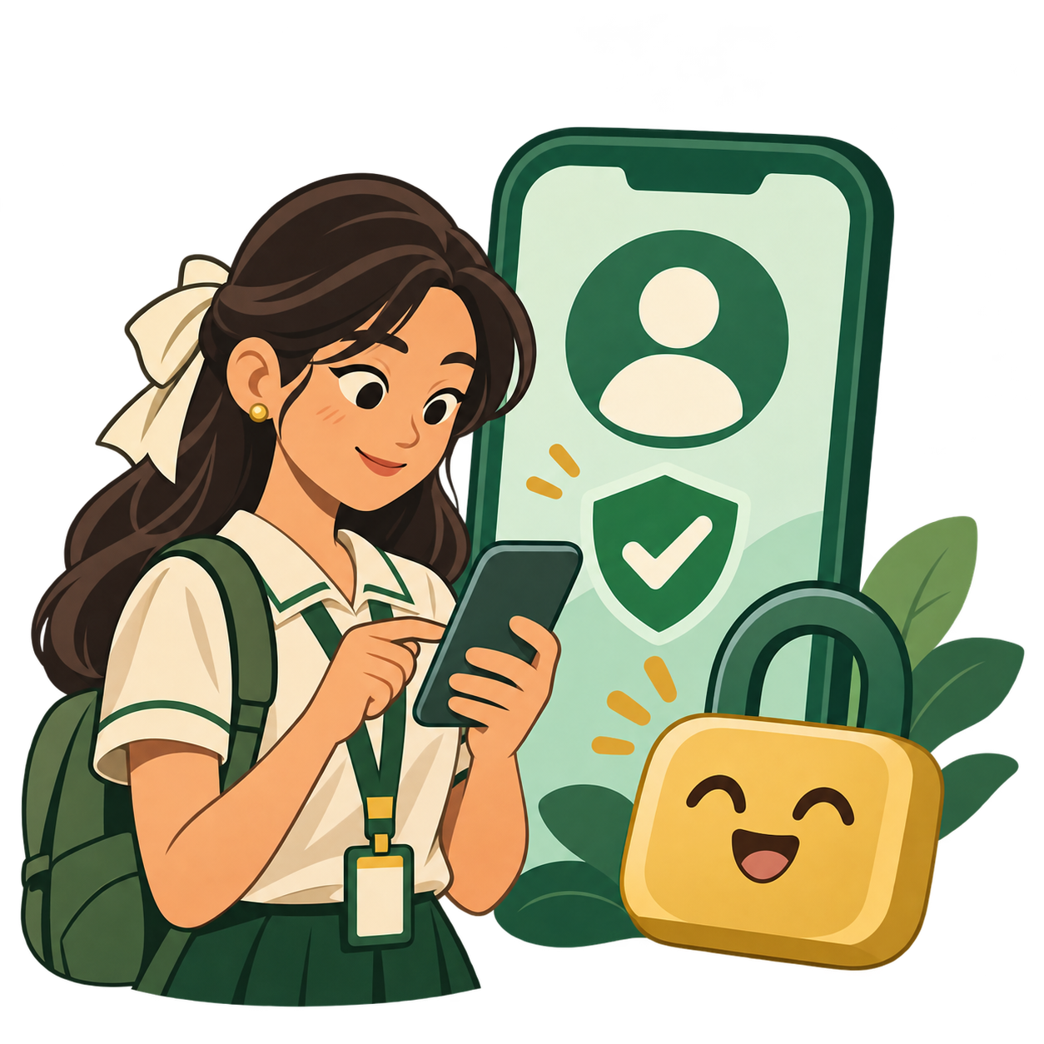
FINAL APP
Sign in
Google sign-in, no new account
Your commute settings are saved to you
ADDRESSES
Quick start and saved preferences
MMSU CommuteHub · Design Thinking
11
Notes:
Students sign in with their Google account, so there is nothing new to remember and their commute settings follow them.

Slide 12

FINAL APP
Set up your commute
Pick your home stop and school
Enter your first class time
Install it to your home screen
ADDRESSES
Personal leave-by and rush-hour alerts
MMSU CommuteHub · Design Thinking
12
Notes:
On first use students set their home stop, school and first class time. The app uses these for the leave-by time and rush-hour alerts, and an install guide adds it to the home screen.

Slide 13
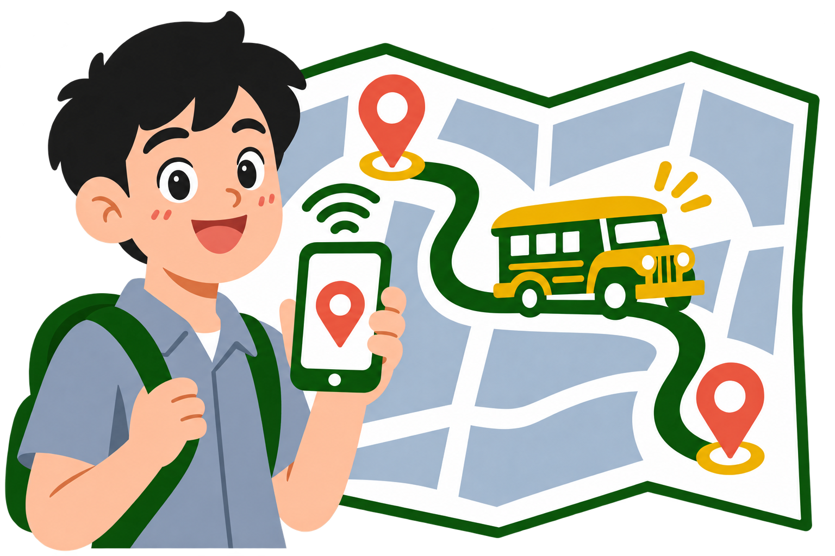
FINAL APP
Choose your route
Pick where you are and where you are going
See the connected route on the map
ADDRESSES
28.4% wanted clear ride information
MMSU CommuteHub · Design Thinking
13
Notes:
On the home map, the student chooses a starting place and a destination. If no ride connects the two places, the app says so and suggests a different pair.

Slide 14

FINAL APP
Set your pickup
Choose a common pickup spot
Or tap the route where you will wait
The pin snaps to the road
ADDRESSES
59.5% struggle with waiting
MMSU CommuteHub · Design Thinking
14
Notes:
Students pick a named pickup spot, or tap the route where they will wait, and the pin snaps to the road. Knowing exactly where to wait is the first step to a shorter wait.

Slide 15

FINAL APP
Choose your ride
Compare jeepney, modern jeepney and bus
See arrival time and seat status
Know if a vehicle is incoming
ADDRESSES
27.0% hit crowded vehicles
MMSU CommuteHub · Design Thinking
15
Notes:
Students compare the rides on their route and pick a vehicle. Each shows how many minutes away it is, whether it is incoming, and seat status, so they know whether a seat is likely before it arrives.

Slide 16

FINAL APP
Alert zone
Set a radius around your pickup pin
Follow the vehicle on the live map
Get alerted when it is near
ADDRESSES
Less waiting at the roadside
MMSU CommuteHub · Design Thinking
16
Notes:
Students draw an alert zone around their pickup point. The app notifies them when the chosen vehicle comes inside it, so they can wait somewhere comfortable instead of watching the road.

Slide 17

FINAL APP
Plan a trip
Total minutes and fare for each option
Direct or with transfers
Warns when a connection is at risk
ADDRESSES
6.8% face several transfers
MMSU CommuteHub · Design Thinking
17
Notes:
The planner lists trips between two places with total time, fare and number of transfers, and flags a connection at risk if the first vehicle may arrive too late for the next.

Slide 18

FINAL APP
Leave-by time
Based on your first class time
Reacts to delay reports
Weather tips: umbrella or water
ADDRESSES
47.3% leave early just in case
MMSU CommuteHub · Design Thinking
18
Notes:
Using the first class time, the app works out when to leave, and updates it when delays are reported. A weather sheet adds tips, such as bringing an umbrella or leaving earlier when it is hot.

Slide 19

FINAL APP
Delay reports
Report roadworks, accidents, traffic or flooding
Reports show how many minutes of delay
They expire automatically
ADDRESSES
31.1% hit traffic and road delays
MMSU CommuteHub · Design Thinking
19
Notes:
Commuters report what they see on the road, and every report carries an estimated delay and expires after a short time so the information stays current for everyone.

Slide 20

FINAL APP
Alerts
Vehicle arrival near your pickup
Weather and rush hour 5 to 6 PM
Delay reports from commuters
ADDRESSES
17.6% affected by weather
MMSU CommuteHub · Design Thinking
20
Notes:
All updates arrive in one inbox: a vehicle nearing the pickup point, weather, the 5 to 6 PM rush hour, and delay reports. When nothing is new, an illustration tells the student they are all caught up.

Slide 21

FINAL APP
Me
Home stop, school and class time
Choose which alerts you receive
Sign out at any time
ADDRESSES
A commute that fits each student
MMSU CommuteHub · Design Thinking
21
Notes:
The Me page keeps the personal settings in one place: home stop, school, first class time and three notification switches for rush hour, weather and delay reports.

Slide 22
CLOSING & Q&A
Thank you
Questions and answers
From commuter research to the final app
MMSU CommuteHub · Design Thinking
22
Notes:
Thank you. We started with student commuters, listened to what they told us, and built CommuteHub around those answers. We are ready for your questions.

