Slide 1
Logistic regression: Systemic Crisis Prediction
Data on Economic and Financial crises in 13 African Countries (1860 to 2014)

Slide 2
Objective
to predict the occurrence of a systemic crisis from the variables Banking Crisis, Domestic Debt in Default, Sovereign External Debt Default, Currency Crisis, Inflation Crisis that occurred in 13 African Countries (1860 to 2014).
Features Definition
Systemic Crisis is a financial crisis that affects the entire financial system.
Banking Crisis is a condition in which the banking system of a country or region experiences serious disruption resulting in the inability of banks to carry out their basic functions, namely providing financial services such as loans, savings, and liquidity to the public and businesses.
Domestic Debt in Default is a failure to pay domestic debt. Domestic debt is issued by the government in local currency.
Sovereign External Debt Default is a failure to pay foreign debt. Foreign debt is issued by the government in foreign currency.
Currency Crisis is a country's currency experiencing a sharp and sudden decline in value.
Inflation Crisis is a rapid and high increase in the price of goods and services on a continuous basis.

Slide 3
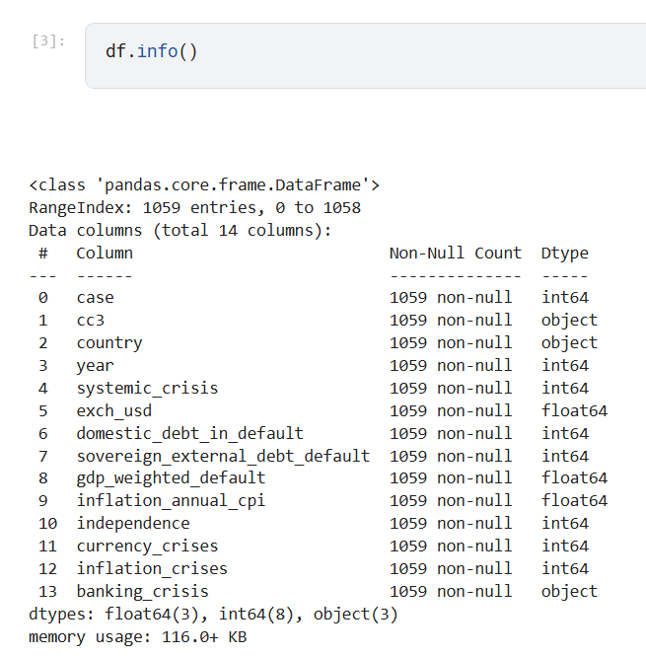
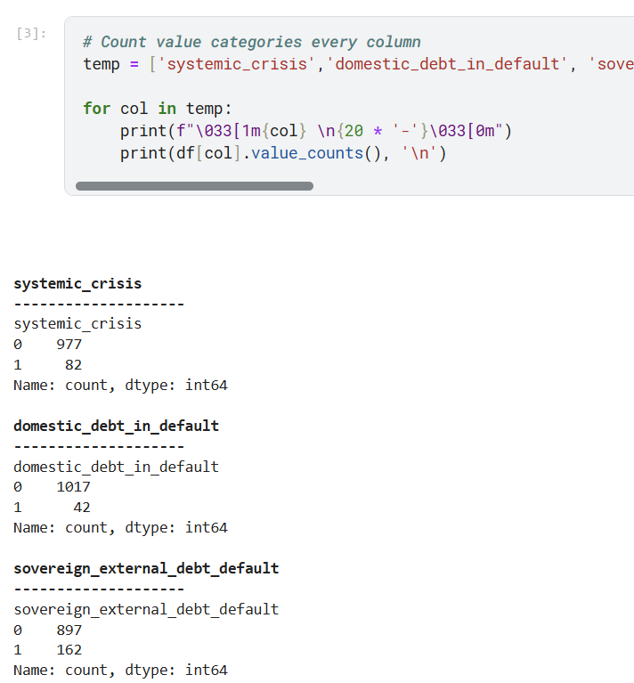
Data Understanding

Slide 4
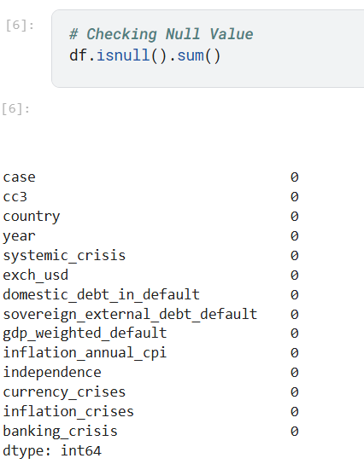
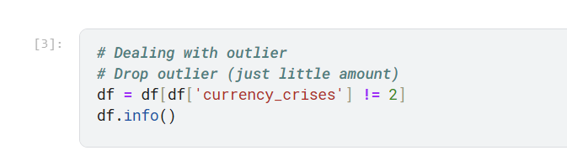
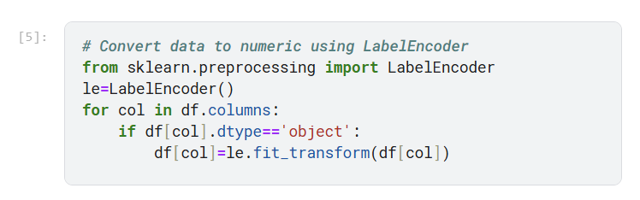
Data Preparation
There are a small number of outliers, so drop the row
Data doesn’t have null value
Change the value of each column to numeric data type

Slide 5
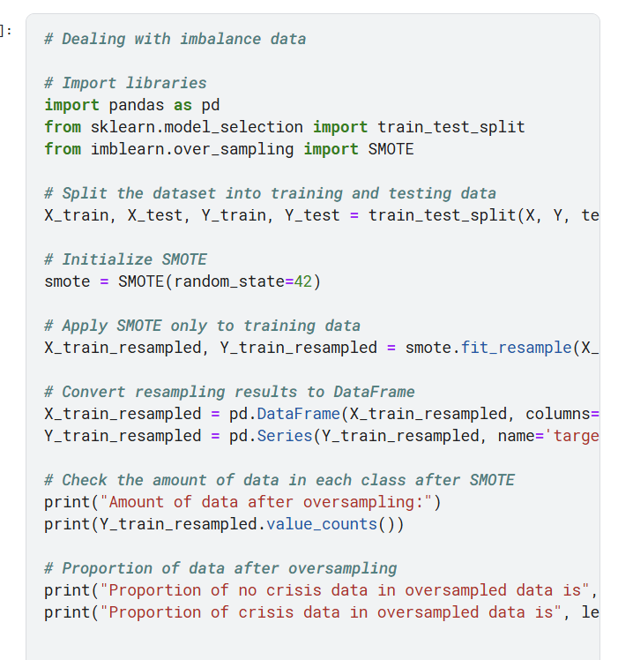
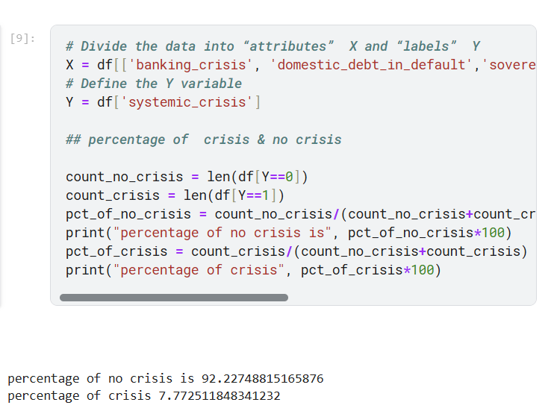
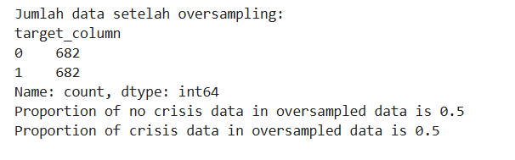
Modeling
Imbalanced data needs to be balanced so that the value of the dependent variable has a balanced proportion.

Slide 6
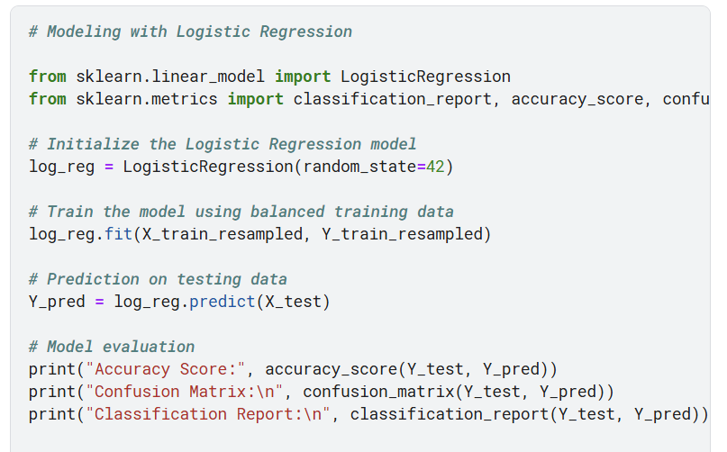
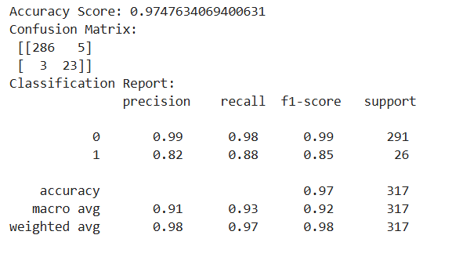
Modeling
Accuracy of logistic regression classifier on test set: 0.97
Confusion Matrix result telling us that we have 286+23 correct predictions and 3+5 incorrect predictions.

Slide 7
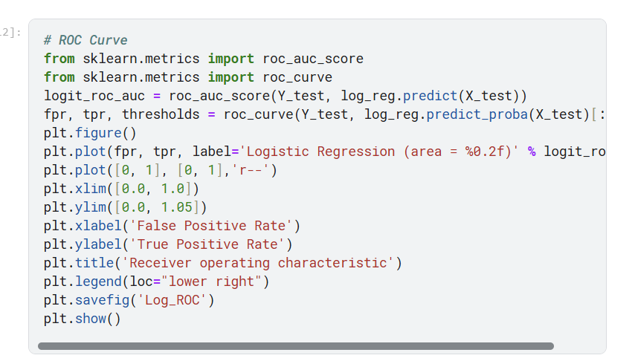
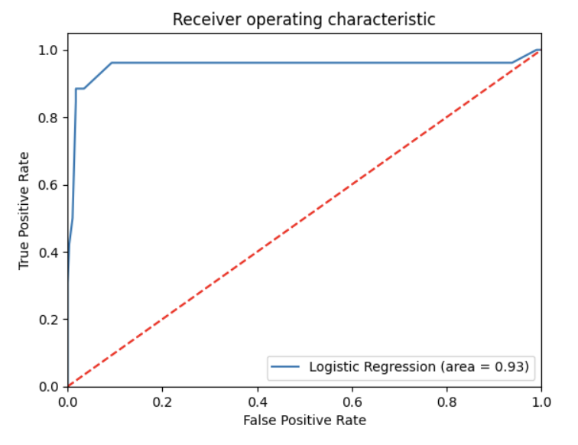
Modeling
The model successfully separates positive and negative well.

Slide 8
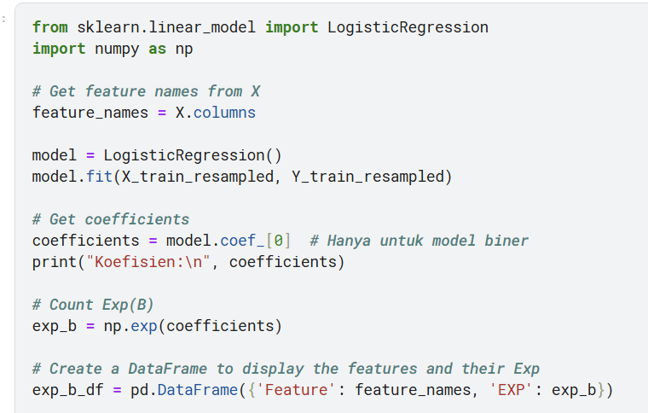
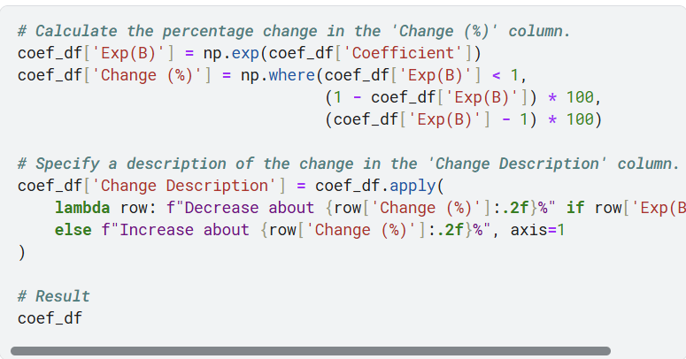
Modeling

Slide 9
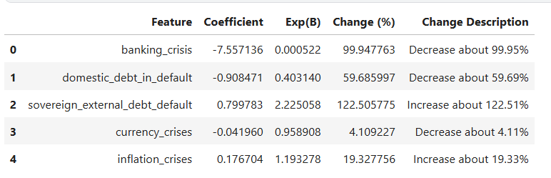
Conclusion
From the results above, it can be seen that if sovereign external debt default increases by one unit, it will increase the probability of a systemic crisis by around 122.51%, assuming other variables are constant. An increase in foreign debt significantly increases the chance of a systemic crisis.
Likewise, the influence of other variables on the possibility of a systemic crisis occurring

