Slide 1
Comparison of natural language processing algorithms in python for journal analysis
Presented by: joseph jabour
Course Instructor: Dr. Ioana Banicescu

Slide 2

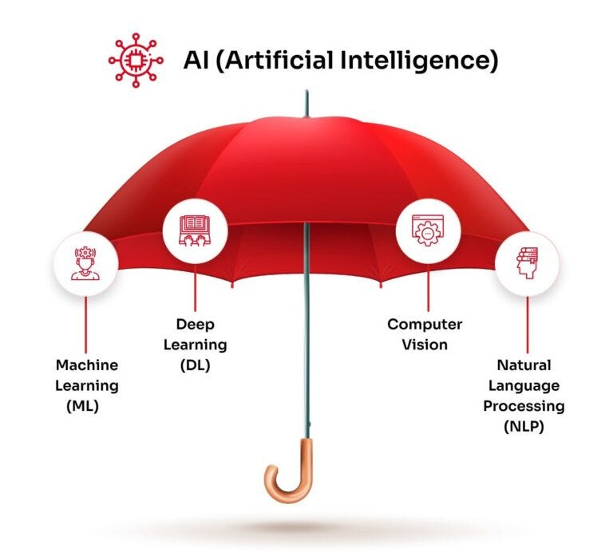


introduction - Me

Slide 3
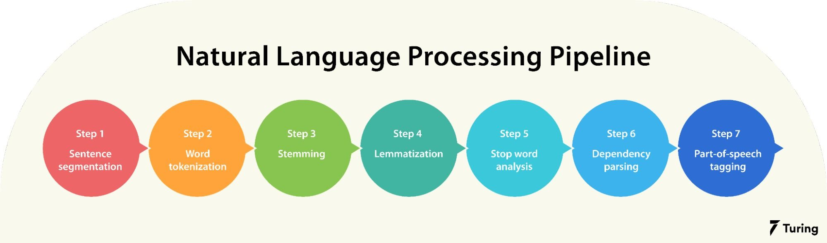
introduction - nlp
Natural Language Processing – A way for a computer to read and comprehend organic language
Notes:
NLP - "a theoretically motivated range of computational techniques for analyzing and representing naturally occurring texts at one of more levels of linguistic analysis for the purpose of achieving human-like language processing for a range of tasks or further applications." (Elizabeth Liddy, 2001)
Dependency parsing – finding grammatical relationships b/w words in a sentence

Slide 4
History - NLP
1957 – Noam Chomsky published Syntactic Structures
States that for a computer to understand language, sentence structures would have to changed to a format computers could use
1964 – The Automatic Processing Advisory Committee (ALPAC) was created to evaluate the progress of NLP.
1966 – ALPAC and the US National Research Council halts funding for for NLP and AI. They were considered dead as there was nothing computationally capable of AI or NLP
1980s – IBM develops several successful statistical models using machine learning
1990s –Recurrent Neural Net models are introduced. In mid-2000s, they’re used for voice and text processing
2001 – Yoshio Bengio proposed the first Neural ”Language” model using feed-forward NN
2011 – Siri is introduced as the world’s first successful NLP/AI assistant.
Notes:
1957 – Chomsky’s book made a style of grammar called Phase-Structure Grammar that could methodically translate natural language to a format useful for computers
1966 – They had been funding research for 12 years and puts $20 million into it, but machine translations at the time were still so much more expensive than humans, and no computer available at the time came close to having enough power to do something like carry a conversation like a chatbot. AI and NLP were considered a dead technology
1980s – Instead of doing deep analytic work, the idea of NLP research was changed to create models that could do simple approximations instead. It became a work of statistics, and towards machine learning algorithms like decision trees, several of which developed by IBM
1990s – As the internet started to rise, statistical NLP models became valuable to keep pace with the influx of online text. N-Grams (means of clumping words together, like San Francisco as a place instead of two words). Recurrent NN – performs the same task for every element of a sequence, and the output is dependent on previous computations, aka using context to solve current computations
2001 – Feed Forward Neural Nets are similar to what we consider a neural network today. They receive an input, perform some calculations, and give an output
2011 – Siri was one of the first successful NLP/AI assistants that could use machine learning to make guesses about what the user wants even if their speech doesn’t match exactly what it knows to look for

Slide 5
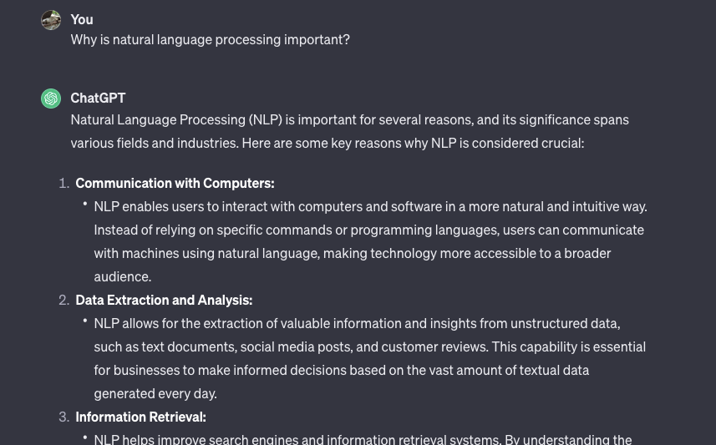
Importance - NLP
Language Models
ChatGPT
Summarizing documents
Answering Questions
Assisted Coding
Research Assistants
Elicit
Open-ended reasoning tool to help researchers
Task Automation
Language translation
Sentiment Analysis
Chatbots
Online search
Grammar and spell checkers
Notes:
Disclaimer: I wrote my bullets before I asked ChatGPT
Healthare applications
Financial analysis
Information Retrieval

Slide 6
Project Goal
160,000 scientific journals in txt format
Find tools capable of reaching parts-of-speech tagging
Perform as identical tasks for chosen tools
Compare and contrast to find most optimal tool
Present results and conclusions

Slide 7
Tools
Natural Language ToolKit (NLTK)
Mature
Extensively used in the NLP world
Comes with datasets
SpaCy
Second most famous library for NLP
“Industrial-strength natural language processing”
Fastest syntactic parser. Written in Cython
Comes with nearly all NLP features, including tokenization, POS tagging, pre-trained word vectors, etc.
Notes:
There are more, including Gensim for semantic modeling, and scikit-learn for machine learning.

Slide 8
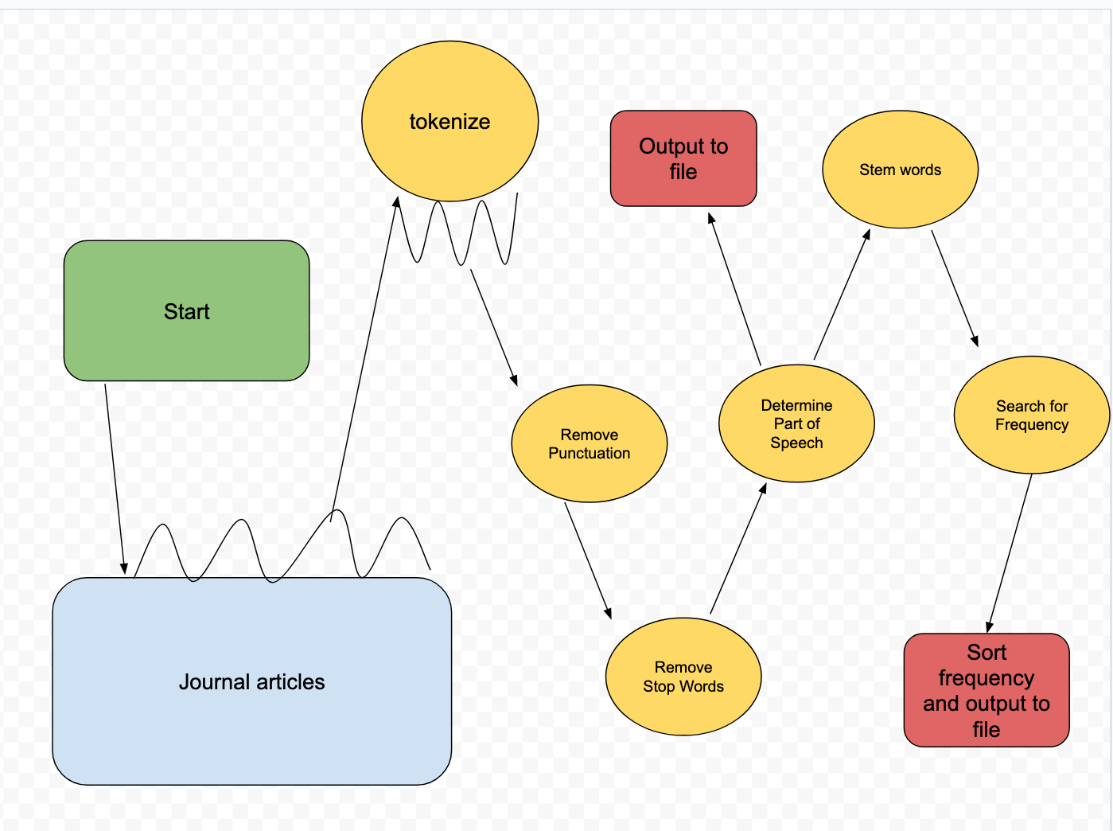
The Process
Notes:
Loop through every journal article
Tokenize every individual word, separate words into their own string
Remove all the punctuation
Remove “stop words”, a, the, an, is, in, this
Determine part of speech - ?
Output the parts of speech to a file, will be useful for later development when working with tools like word2vec for sentiment analysis and word similarity
Originally, we wanted to just search every article for the word “coating”, I decided to stem the words and look for “coat” instead to get more results
Sort those results in descending order, output to file

Slide 9
Time Complexity
Major factors – Number of Journal Articles, and length of journal articles.
Journal articles – N
Length of each article – M
Process of stemming, determining part of speech, removing punctuation, etc are comparisons to set, constant entities
Therefore:
Time Complexity = O(n*m)

Slide 10
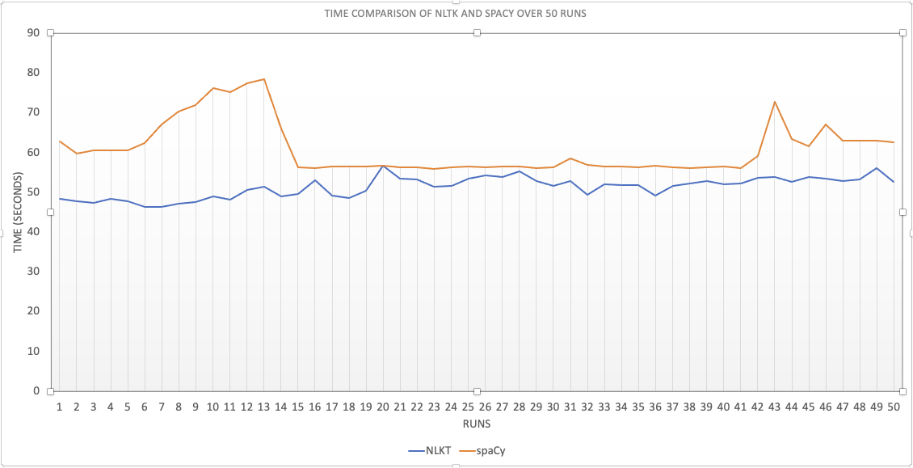
Results - time
100 files, repeated 50 times.
NLTK total time: ~43 minutes
spaCy total time: ~51 minutes
Notes:
NLTK: 2567 seconds, ~42.8 minutes
spaCy: 3055 seconds, ~50.9 minutes Obviously other variables, biggest of which the computer I’m on. Relatively modern MacBook Pro. Currently using the supercomputer to run the same program on the entire set of documents, intend to have those results ready for the final paper. I expect the results to be somewhat similar based on how many times I’ve run these programs, but who knows.

Slide 11
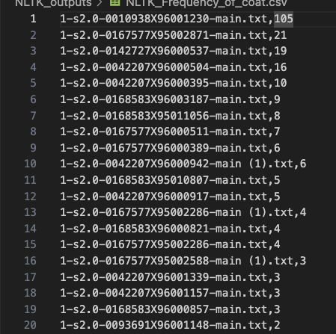
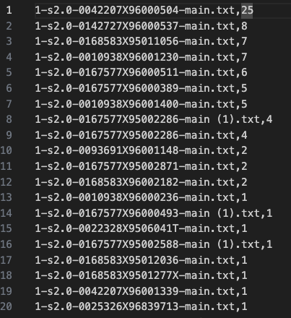
Results – search of “coat”
NLTK
spaCy
Notes:
For some reason, spaCy had results that differed greatly from NLTK. There is one particular file that NLTK seemed to have picked up over 100 instances of the word “coat” after stemming, while spaCy didn’t even detect 10 instances in the same file. At the same time, it detected 9 more instances of the word in a file than NLTK did.

Slide 12
Results – overall
NLTK
Harder to use
More things to download, documentation not as clear
More experienced
Slightly faster
Much better at detection?
spaCy
Easier to use
Website is more user-friendly, built-in features are easier to work with
Newer
Slightly slower
Much worse at detection?
Could be user-error
Not horribly important, other tools can do frequency calculation
Notes:
While NLTK is a bit less user-friendly, the results showed a much higher rate of finding instances of the word ‘coat’ within our documentation
While this s helpful, there are many of other tools that can do that particular task.
We need to perform some more experimentation to find if this is is related to a way that spaCy does stemming or lemmatization, maybe it’s overcorrecting. Our data also needs to be double checked. Results from the supercomputer will be useful input as well.

Slide 13
References
https://dev.to/thedevtimeline/compare-documents-similarity-using-python-nlp-4odp
https://www.nltk.org/
https://www.youtube.com/watch?v=X2vAabgKiuM
https://courses.cs.duke.edu/spring14/compsci290/assignments/lab02.html
https://www.geeksforgeeks.org/removing-stop-words-nltk-python/#
https://blog.devgenius.io/time-complexity-with-examples-from-nlp-60c4feb9f31e
Natural language processing with python /steven bird, Ewan Klei and Edward Loper
https://spacy.io/usage/spacy-101
https://blog.ekbana.com/nlp-for-beninners-using-spacy-6161cf48a229
https://www.digitalocean.com/community/tutorials/python-counter-python-collections-counter
https://linearb.io/blog/what-is-code-complexity
https://towardsdatascience.com/comparing-documents-with-similarity-metrics-e486bc678a7d
https://hbr.org/2022/04/the-power-of-natural-language-processing
https://www.aezion.com/blogs/natural-language-processing-what-it-is-and-why-its-important/
https://www.dataversity.net/a-brief-history-of-natural-language-processing-nlp/
https://medium.com/analytics-vidhya/nlp-libraries-and-pretrained-models-94c9a53a295a

