Slide 1
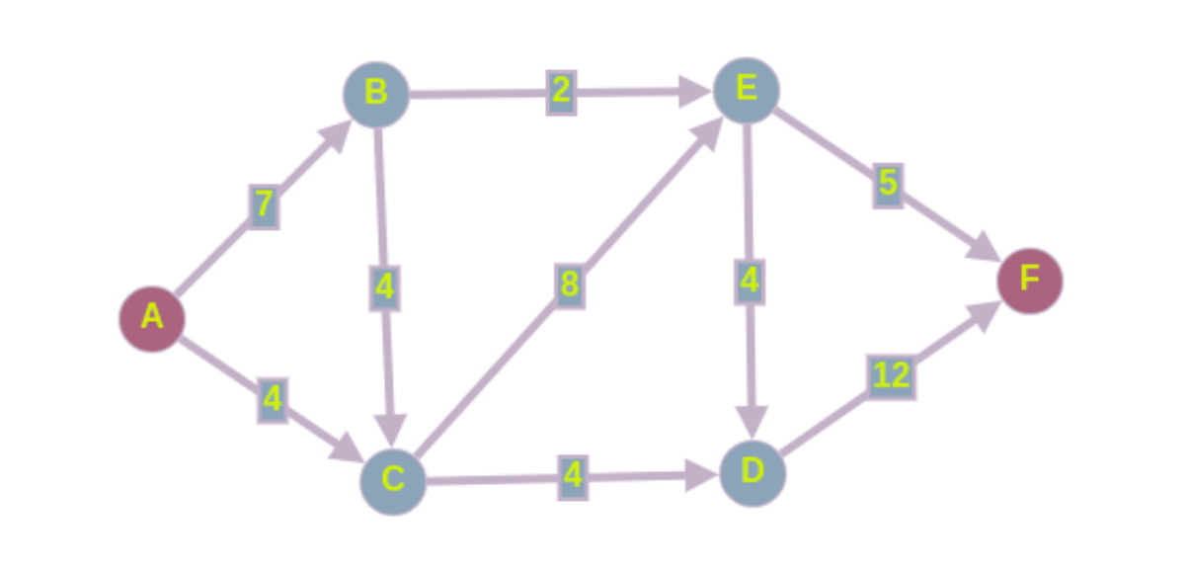
2/0
5/0
7/0
4/0
8/0
4/0
12/0
4/0
4/0

Slide 2
AB->BC->CE->EF
2/0
5/0
7/0
4/0
8/0
4/0
12/0
4/0
4/0

Slide 3
AB->BC->CE->EF(4)
2/0
5/0
7/0
4/0
8/0
4/0
12/0
4/0
4/0

Slide 4
AB->BC->CE->EF(4)
2/0
1/4
3/4
0/4
4/4
4/0
12/0
4/0
4/0

Slide 5
AB->BC->CE->EF(4)
AC->CD->DF
2/0
1/4
3/4
0/4
4/4
4/0
12/0
4/0
4/0

Slide 6
AB->BC->CE->EF(4)
AC->CD->DF(4)
2/0
1/4
3/4
0/4
4/4
4/0
12/0
4/0
4/0

Slide 7
AB->BC->CE->EF(4)
AC->CD->DF(4)
2/0
1/4
3/4
0/4
4/4
4/0
8/4
0/4
0/4

Slide 8
AB->BC->CE->EF(4)
AC->CD->DF(4)
AB->BE->ED->DF
2/0
1/4
3/4
0/4
4/4
4/0
8/4
0/4
0/4

Slide 9
AB->BC->CE->EF(4)
AC->CD->DF(4)
AB->BE->ED->DF(2)
2/0
1/4
3/4
0/4
4/4
4/0
8/4
0/4
0/4

Slide 10
AB->BC->CE->EF(4)
AC->CD->DF(4)
AB->BE->ED->DF(2)
0/2
1/4
1/6
0/4
4/4
2/2
4/8
0/4
0/4

Slide 11
AB->BC->CE->EF(4)
AC->CD->DF(4)
AB->BE->ED->DF(2)
4+4+2=10
0/2
1/4
1/6
0/4
4/4
2/2
4/8
0/4
0/4

