Slide 1
Real estate in Belgium
Web scraping for building a dataset from scratch

Slide 2
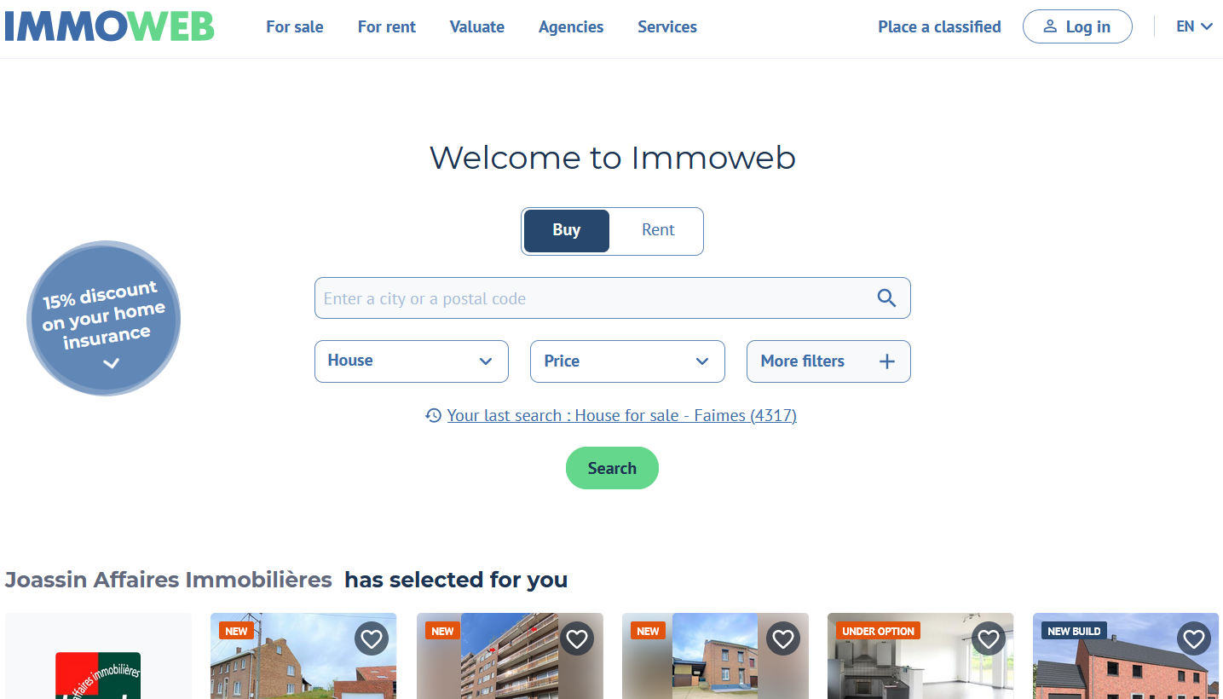
How: the website

Slide 3
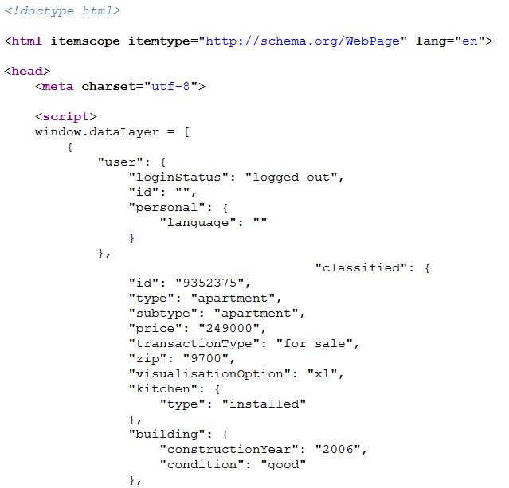
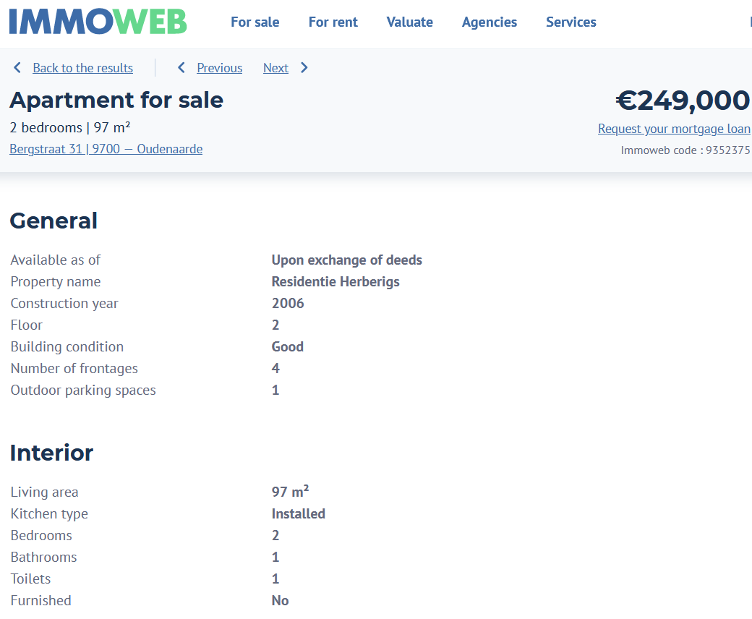

How: from the listing webpage to the required fields
Beautiful Soup

Slide 4
Who did what
Jesus: coding +++ and git management
Dirk: selenium check locally
Lyes: fields for bs4, data check, readme

Slide 5
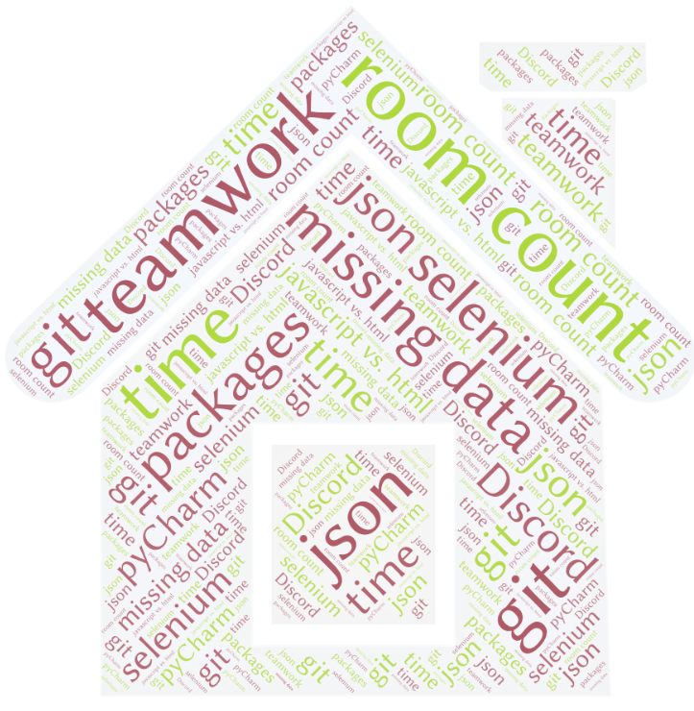
What went wrong

Slide 6
Solutions
Teamwork
“Resilience”
Jesus’ skills +++

