Slide 1
IMMOELISA REAL ESTATE
PREDICTION MODEL
By Jesus Bueno, Pauwel De Wilde

Slide 2
Mission
Predict prices of Belgian real estate

Slide 3


DATAFRAME REVIEW
4762
Sample size
WALLONIA
31,45%
FLANDERS
43,85%
BRUSSELS
24,70%

Slide 4
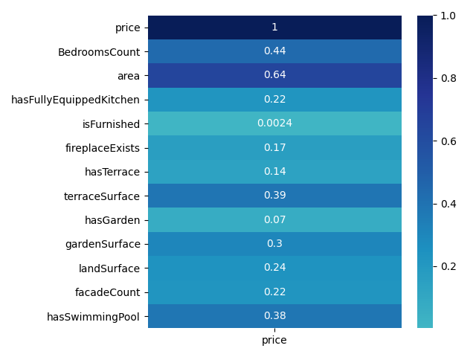
Data cleaning
CORRELATIONS

Slide 5
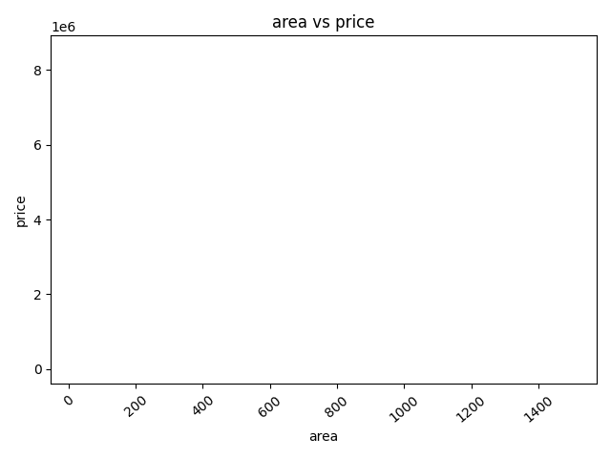
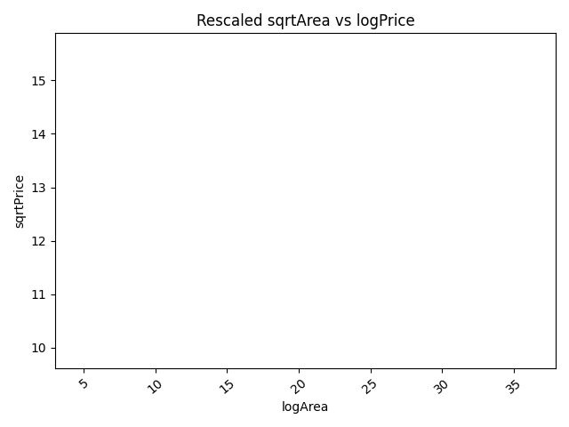
Data cleaning
RESCALING

Slide 6
SCORES
REGRESSION
TRAIN SET
TEST SET
86.70 %
85.22 %

Slide 7
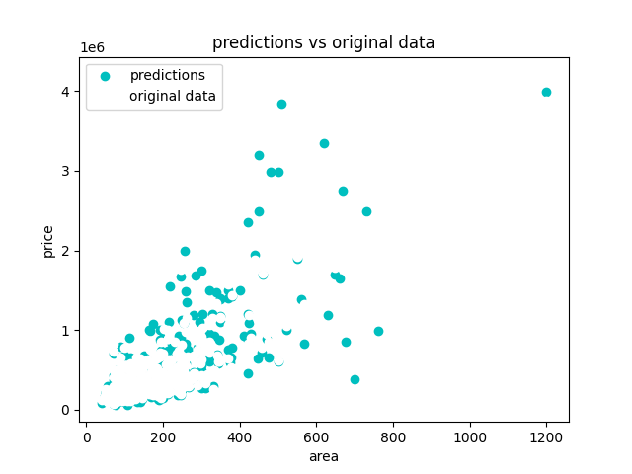
RESULTS
PREDICTIONS

Slide 8
PREDICT WITH NEW DATA
DataRegressor fits it into the model
02
01
03
Pass dataframe to DataCleaner
Get your predictions

Slide 9
WHAT CAN BE ImPROVED?

Slide 10

Does anyone have any questions?

