Slide 1
IMMOELISA REAL ESTATE
PREDICTION MODEL
By Jesus Bueno, Pauwel De Wilde

Slide 2
Mission
Predict prices of Belgian real estate

Slide 3


DATAFRAME REVIEW
4762
Sample size
WALLONIA
31,45%
FLANDERS
43,85%
BRUSSELS
24,70%

Slide 4
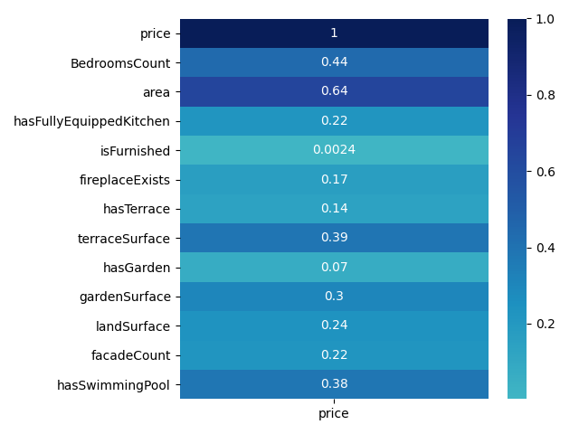
Data cleaning
CORRELATIONS,
OUTLIERS,
AND CATEGORICAL VALUES

Slide 5
SCORES
LINEAR REGRESSION
TRAIN SET
TEST SET
70.42 %
69.69 %

Slide 6
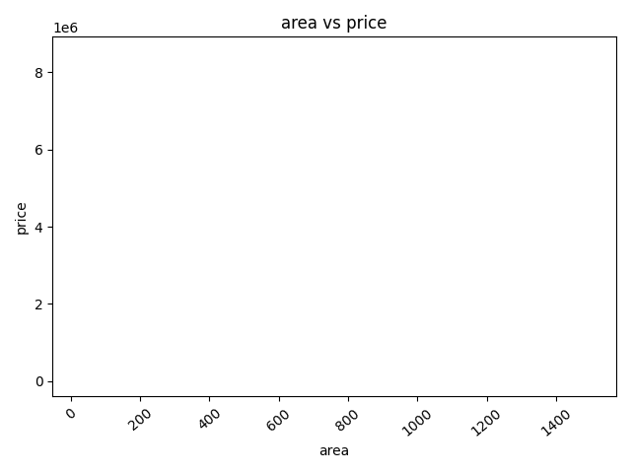
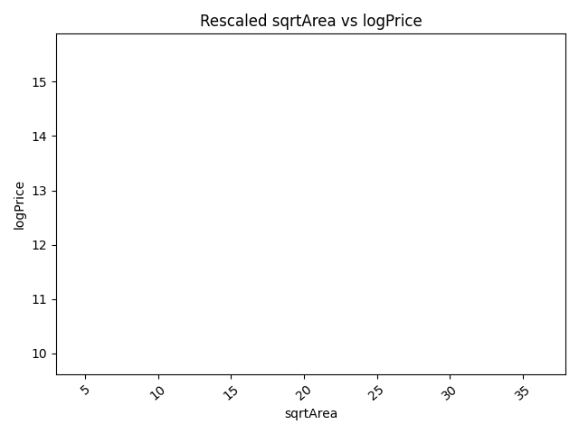
Data cleaning
Rescaling

Slide 7
SCORES
AFTER RESCALING
TRAIN SET
TEST SET
86.70 %
85.22 %

Slide 8
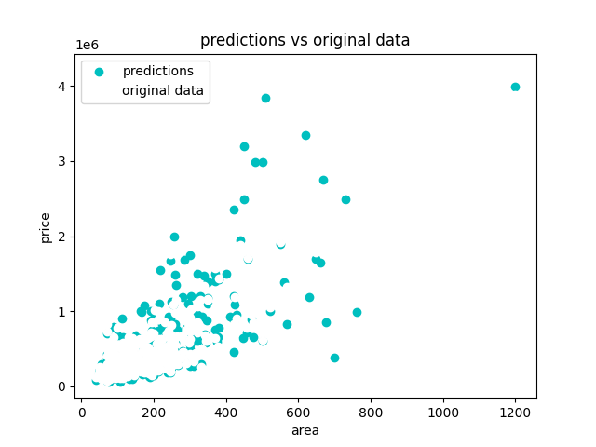
RESULTS
PREDICTIONS

Slide 9
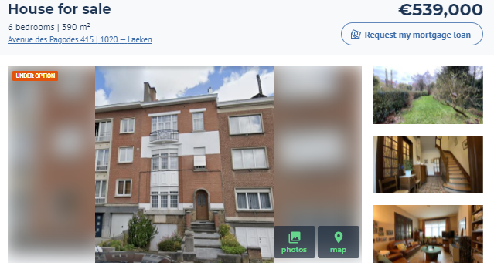
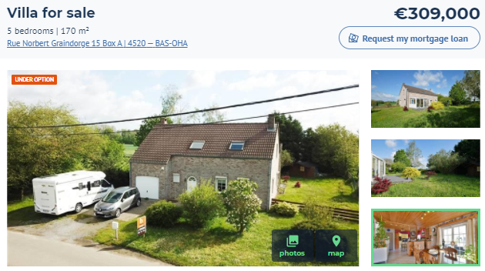
Prediction | Price
791218.42 | 1295000.0
534214.57 | 539000.0
347278.09 | 309000.0
247743.88 | 220000.0
255015.96 | 259500.0

Slide 10
PREDICT WITH NEW DATA
DataRegressor fits it into the model
02
01
03
Pass dataframe to DataCleaner
Get your predictions

Slide 11
WHAT CAN BE ImPROVED?

Slide 12

Does anyone have any questions?

