Slide 1


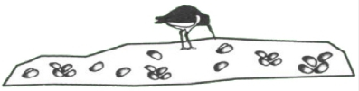
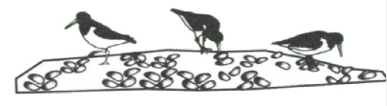
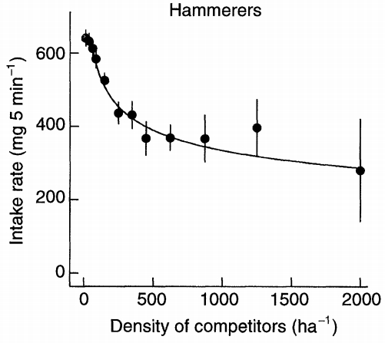
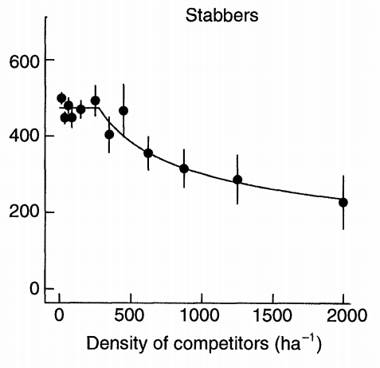
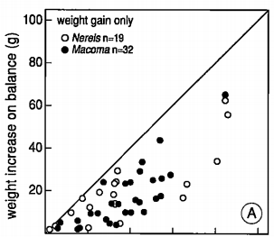

Individuals (randomly drawn):
Basic intake rate
Dominance
Feeding method
Etc...
… each time step...
?
Foraging patches
Availability
Quality
Weather conditions
Temperature
Energy in – Energy out
Death if below threshold

