Slide 1

Fonts : 기본 nunito
외 : Varela round
logo
Nav-links
Nav
Position: sticky
Banner
Background-image
title
Font-family: Varela round
button
Font-family: Varela round

Slide 2
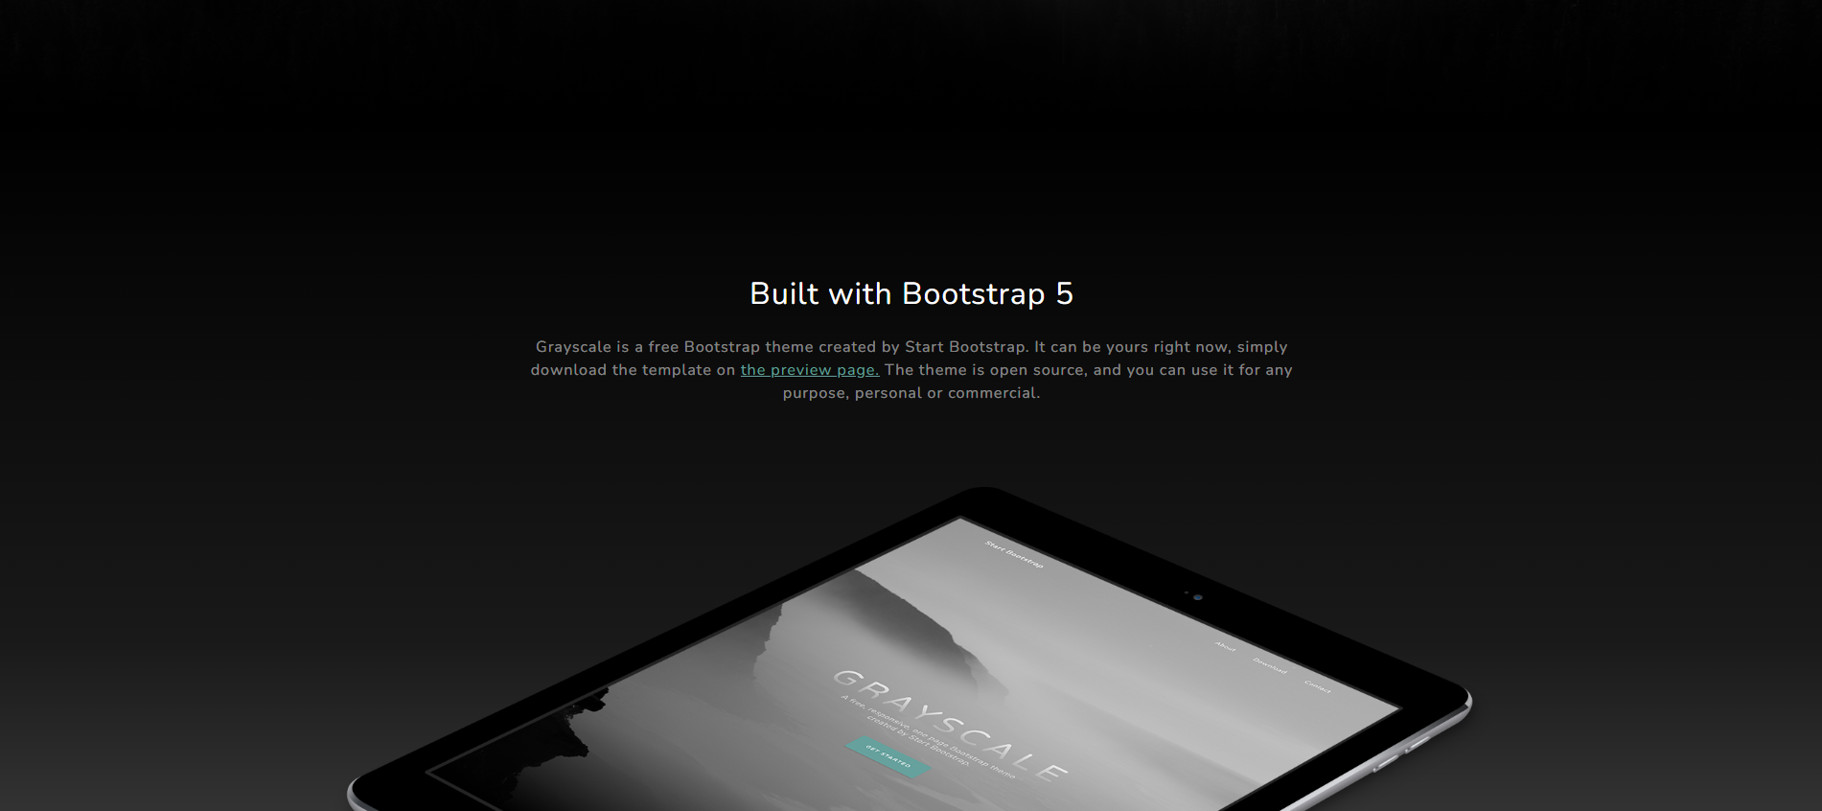
Info
No margin
# about
Both nunito

Slide 3
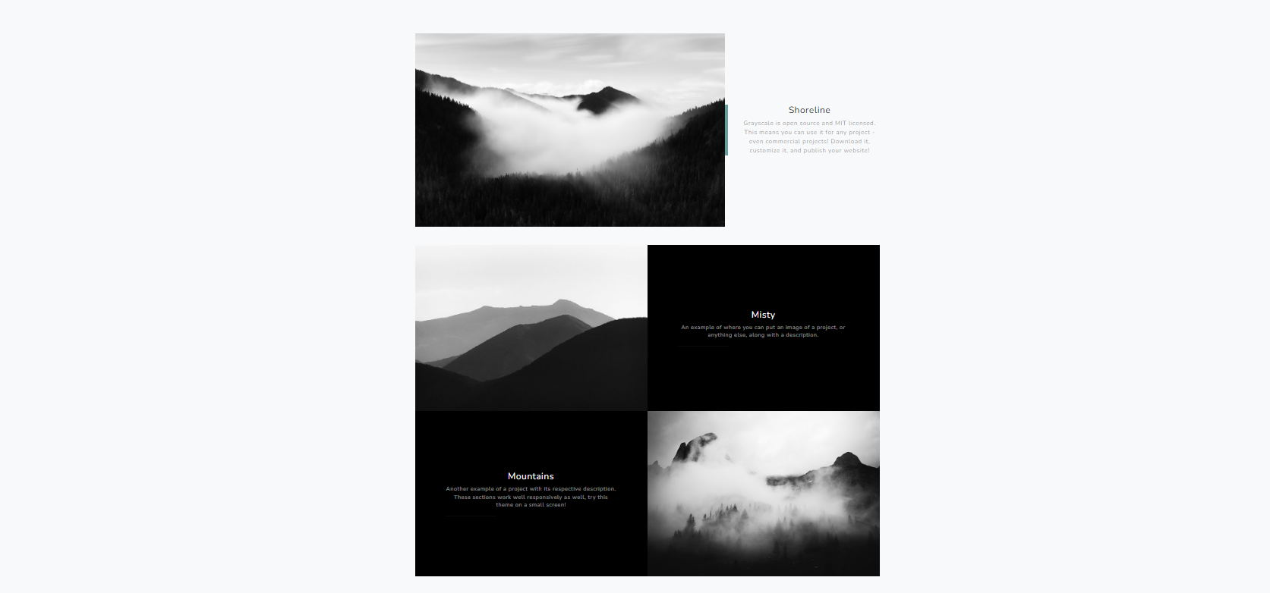
# projects
Min-width: 992px
Span
Line border left

Slide 4

# contact
Sign up section

Slide 5


