Slide 1
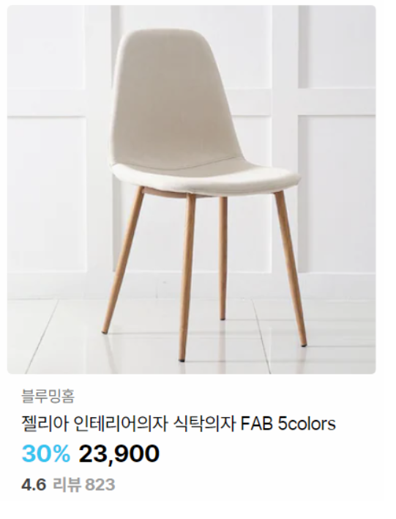
Width: 300px
radius
H3
Color : grey?
H3
Color : black
H3
Font-weight: bold
H3 span
Font-weight: bold
Color: sky blue
H3
Color : black

