Slide 1
[Prospect / Customer Name]
PoC scoping, alignment, and schedule
[Date]
[AE Name] - Enterprise Account Executive
Jek Bao Choo - Senior Sales Engineer

Slide 2
Agenda
PoC Scoping
Review Current & Future States
Gaps & challenges
Desired biz outcomes
Define Success Criteria
Biz flow & use cases
Identify env, services & apps
Tech stack (incl. ver)
Pre-prod, owners & size
Establish roles & responsibilities
Contacts & timebox
Cadence meetings
Next Steps
Why PoC?
What is part of the PoC?
Who would be involved in the PoC?

Slide 3
Current & Future States
Current state
[Description of the gaps & challenges]
[Items to illustrate the gaps & challenges]
    [Sub items to illustrate the gaps & challenges]
Future state
[Description of the desired business outcomes]
[Items to illustrate the desired business outcomes]
    [Sub items to illustrate the desired business outcomes]

Slide 4
Define Success Criteria
Business Use Cases
[Business use cases 1]
[Business use cases 2]
[Business use cases 3]
Success Criteria
[Success criteria 1]
[Success criteria 2]
[Success criteria 3]

Slide 5
MTTD Calculation
Major incidents per year
FTEs per incident
Hours per incident
Total hours per year
Before Datadog
[99]
[12]
[22]
~[19,000]
~[10,368]
With Datadog
[72]
[12]
[12]
% reduction
-
-
-[45]%
-[45]%

Slide 6
Meeting Cadence Alignment
Attend cadence meetings
Frequency: 2x per week
Date & Time:
  …
  …
  …
Comm. channel
Slack / Teams
Showback PoC meeting
Audience: …
Date: TBD

Slide 7
Establish roles & responsibilities
Datadog
[Prospect]
Provide technical consultation in line with the agreed MAP
Setup cadence meetings
Follow up (frequency as agreed)
Assign responsible contacts
Join in cadence meetings
Execute the agreed MAP with the right access to deploy the Datadog Agent and req. config.
Notes
PoC Success
Notes

Slide 8
Establish roles & responsibilities
Contacts
[AE Name]
Enterprise Account Executive
[phone number]
[email]
[Sales Engineer Name]
[Senior Sales Engineer Title]
[Phone number]
[email]
[Champion Name]
VP of Engineering
[phone number]
[email]
[DevOps Engineer Name]
[DevOps Engineer Title]
[phone number]
[email]
[SRE Name]
[SRE Title]
[phone number]
[email]

Slide 9
A glimpse of the PoC kick-off

Slide 10
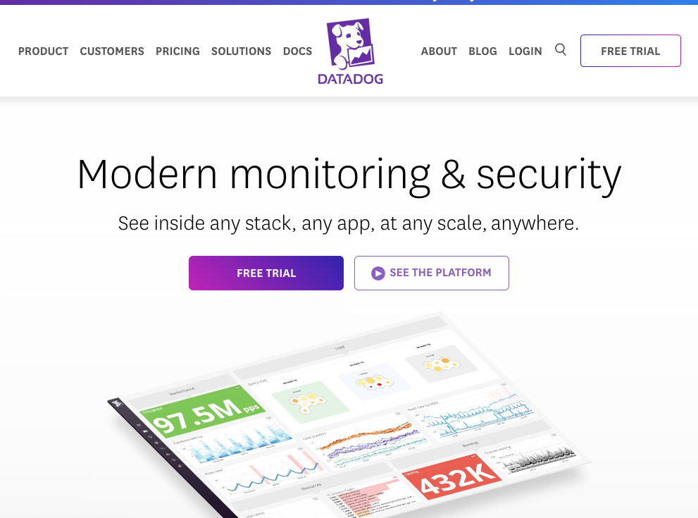
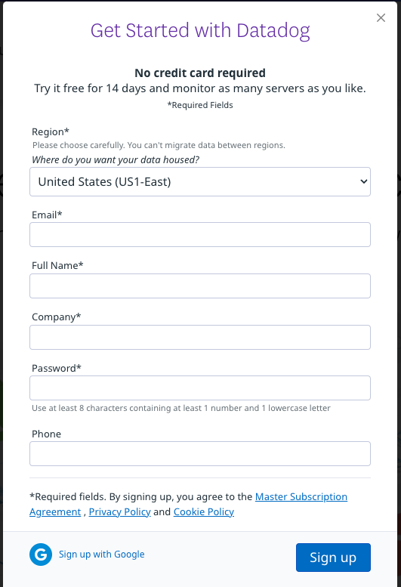

Step 1: Set up one Datadog account
Data Center | URL | Cloud
United States (US1-East) RECOMMENDED | https://app.datadoghq.com/ | AWS
United States (US3-West) | https://us3.datadoghq.com/ | Azure
United States (US5-Central) | https://us5.datadoghq.com/ | GCP
Europe (EU-1) | https://app.datadoghq.eu/ | GCP
Japan (AP-1) | https://ap1.datadoghq.com/ | AWS
1.
2.
www.datadoghq.com
note:
All hyperlinks shown in this document are linked to US1.
Please change to your relevant data center if required.

Slide 11
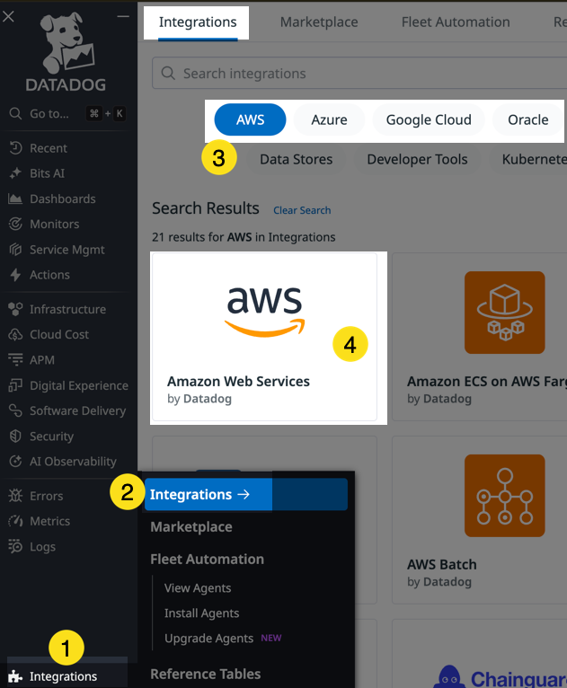
Step 2: Integrate with your cloud providers

Slide 12
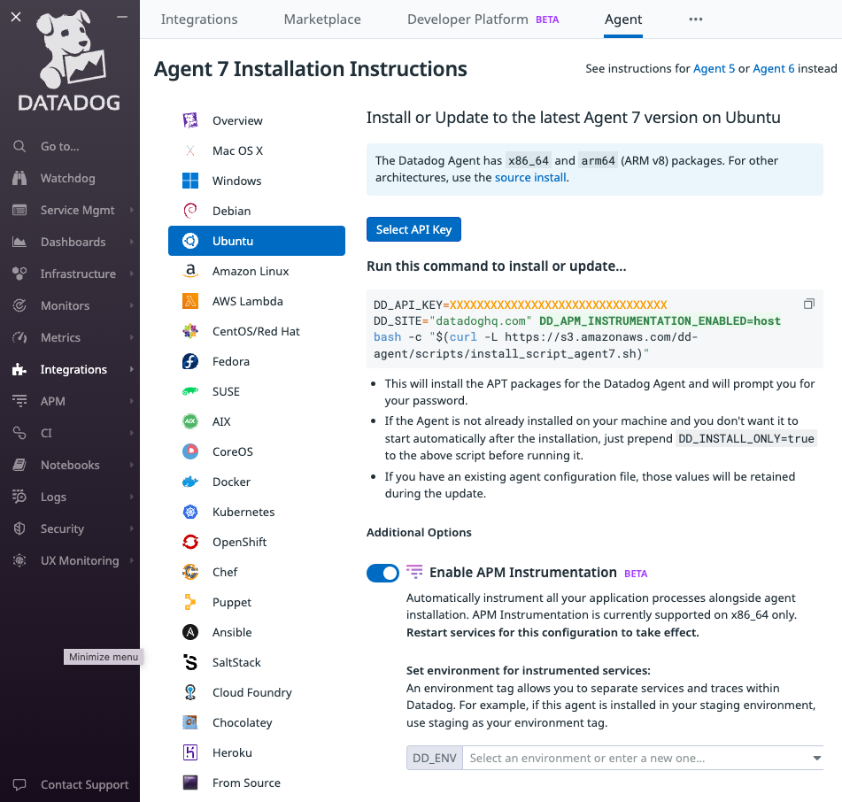
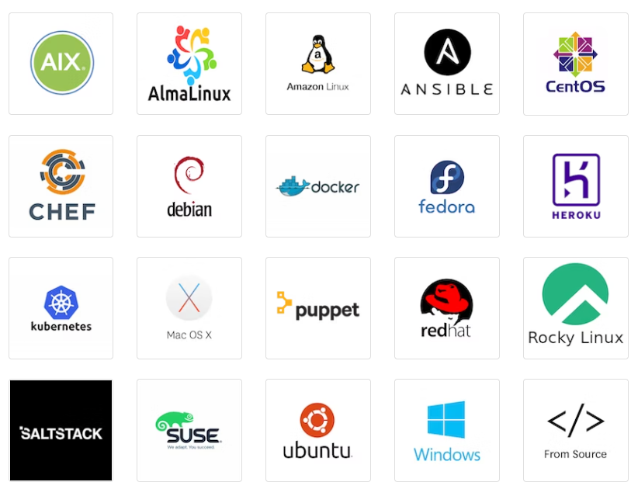
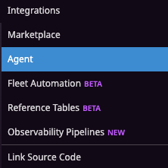
Step 3: Install the Datadog Agents
Check Compatibility Here
Setup Here

Slide 13
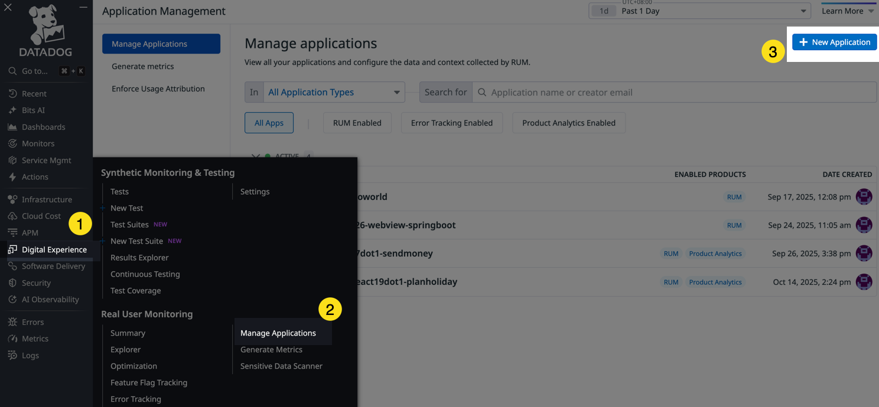
Step 4: Add the Datadog RUM SDKs

Slide 14
Support
How to get help
Raising a Datadog support ticket

Slide 15
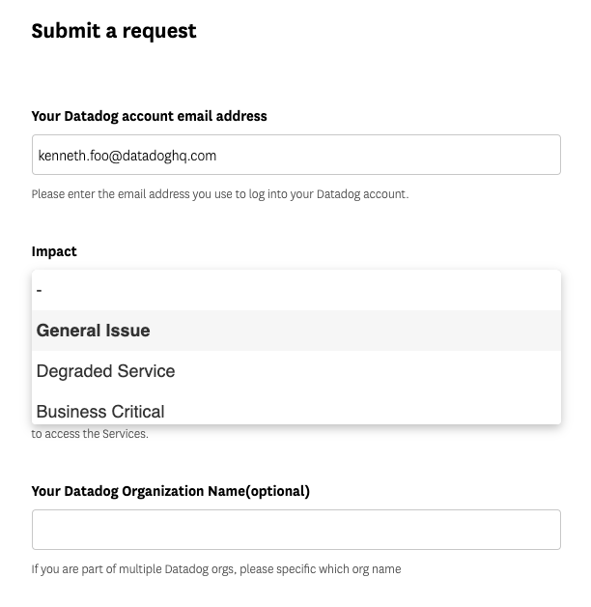
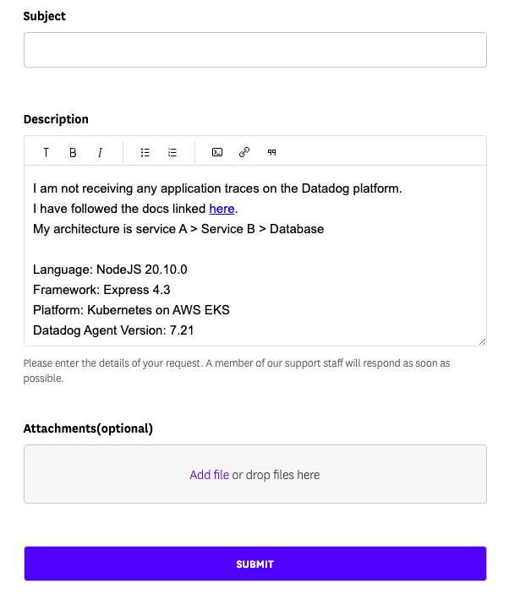
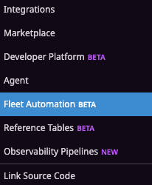
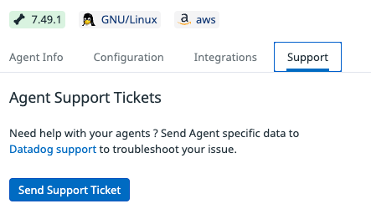

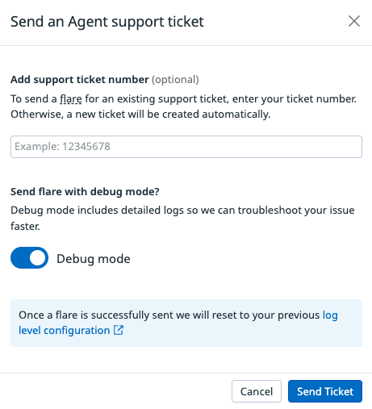
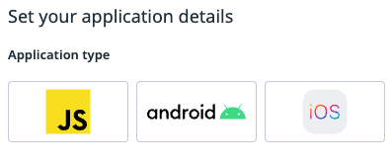
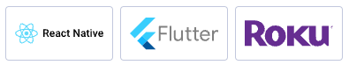
Step 5: How to raise a support ticket
https://help.datadoghq.com/
Step 1:
Open a Ticket
Step 2:
Describe in detail
Step 3:
Upload Logs
Raise a Ticket
Here
Agent Flare
Agent Debug Mode
For APM related issues
Tracer Startup Logs
Tracer Debug Logs

Slide 16
Next steps

Slide 17
Next steps
Attend cadence meetings
Frequency: 2x per week
Date & Time:
  …
  …
  …
Comm. channel
Slack / Teams

Slide 18
Next steps
After today’s PoC scoping Datadog will
Create Mutual Activity Plan
Project plan, setup guide & prerequisites
Agree on the MAP
Review & sign off
Complete Prerequisites
Firewall & etc
PoC kick-off date
Kick off the PoC
PoC kick-off meeting
Time blocking
Next Steps
Execute MAP, cadence & follow up
Playback when done

Slide 19
Thank you
[AE Name] - Enterprise Account Executive
[SE Name] - Sales Engineer

