Slide 1
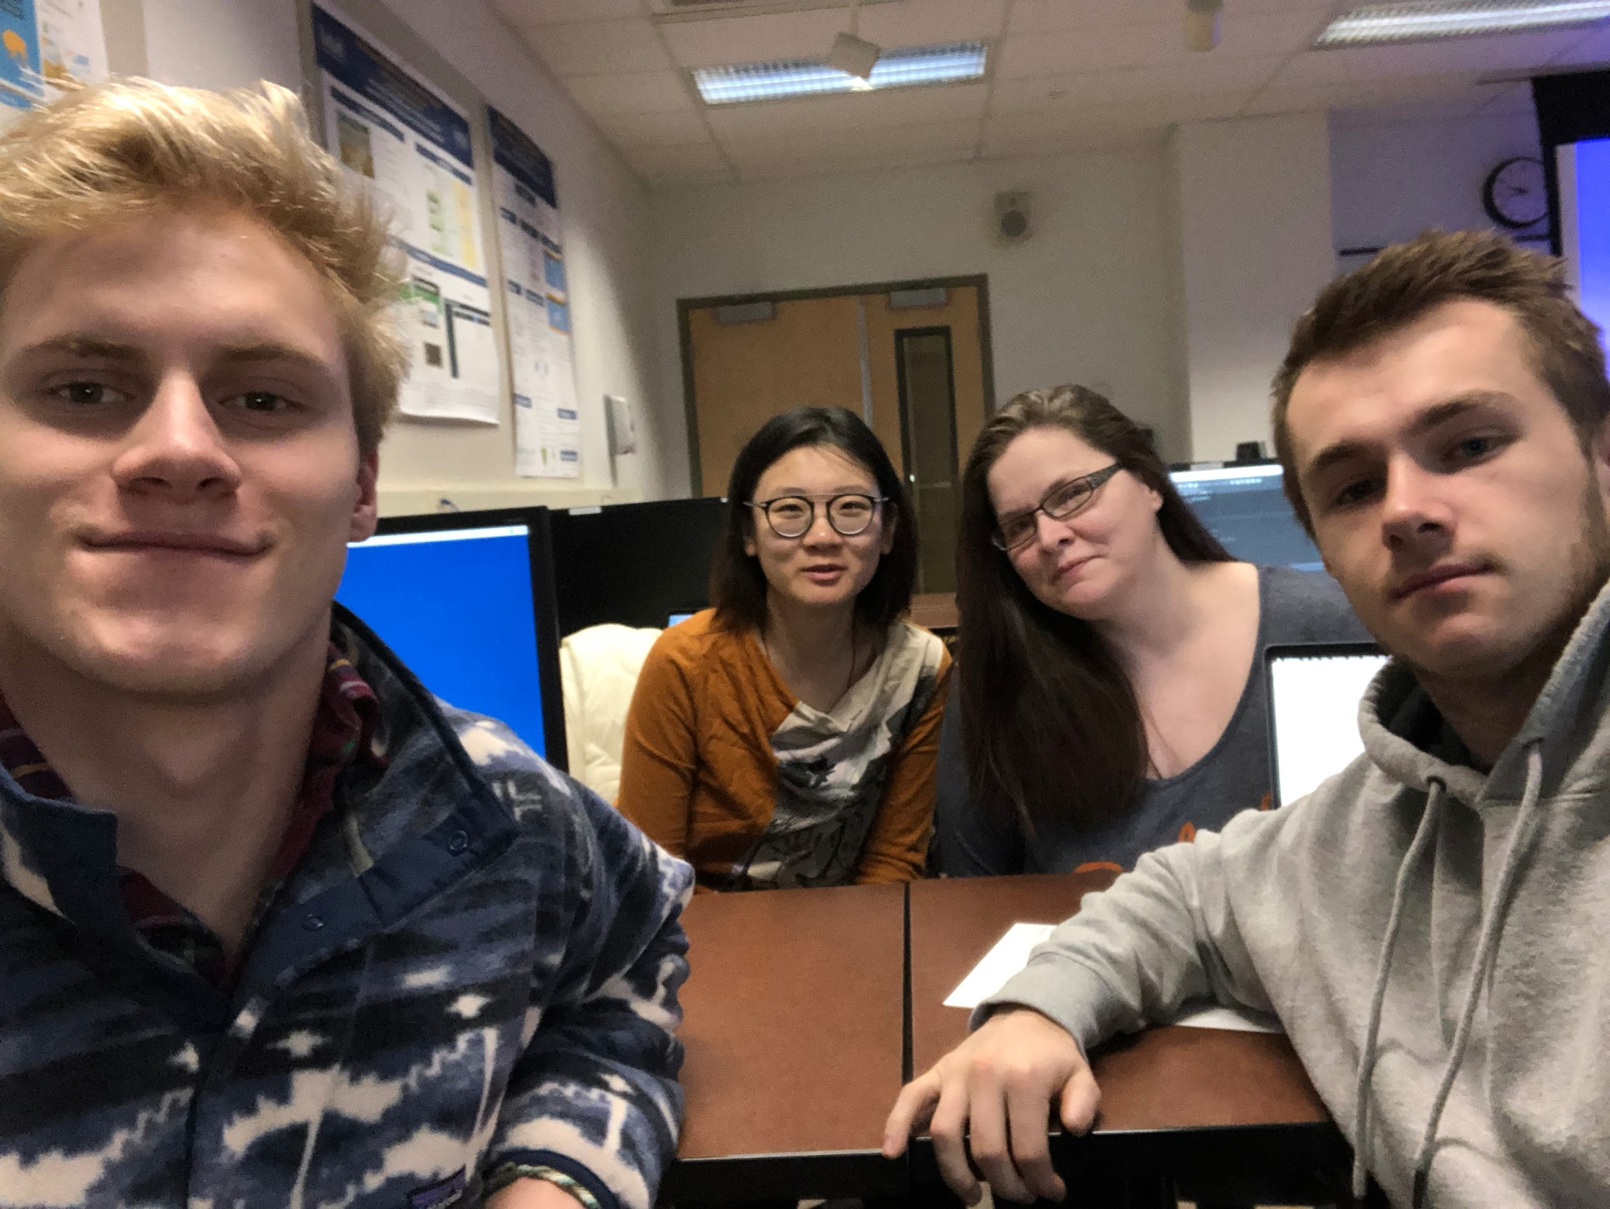
BUno
Team Quatro
Scott, Rachel, Lily, James

Slide 2

Our Game
Bucknell themed UNO!
Play cards with the matching color or symbol
Draw cards if you have nothing to play
You win the round when you run out of cards in your hand
Win the game by reaching 500 points, with points awarded based on the cards left in opponents’ hands at the end of each round
Notes:
Scott

Slide 3
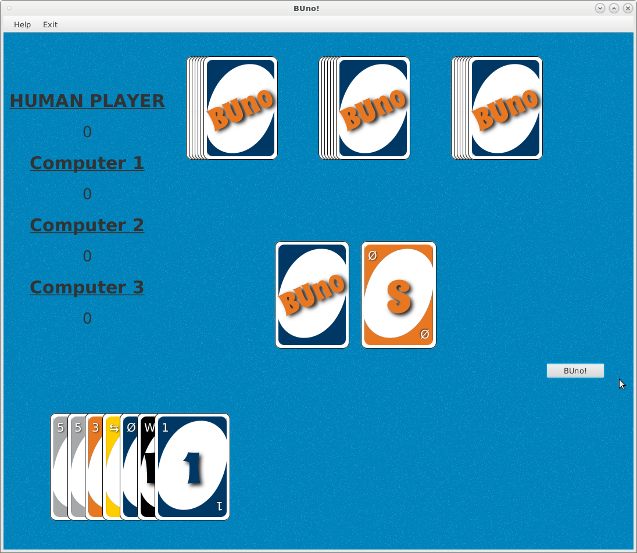
User Interface
Notes:
James

Slide 4
Demonstration
Watch it in action!
Notes:
James

Slide 5
Implementation
We implemented the graphics using JavaFX
Used enums: CardColor, CardType, PlayCommand
Linked list: players
CopyOnWriteArrayList: decks
Notes:
Lily

Slide 6
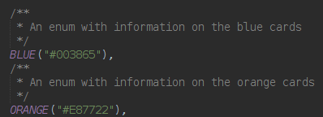
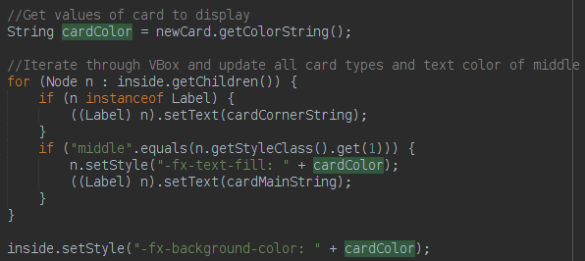
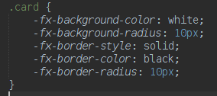

Card generation on the fly
Notes:
Lily

Slide 7
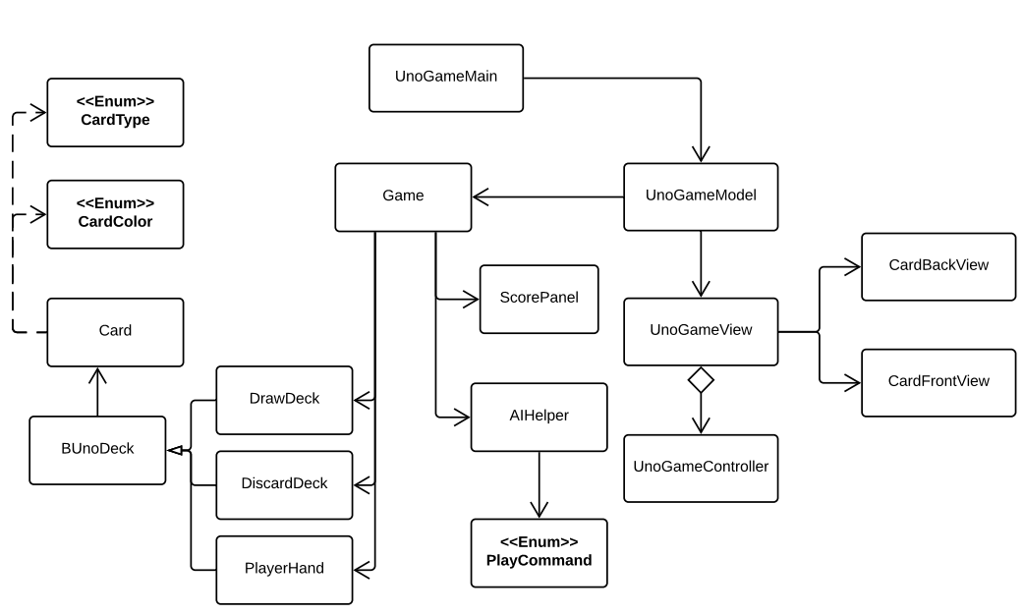
UML Diagram
Notes:
Lily

Slide 8
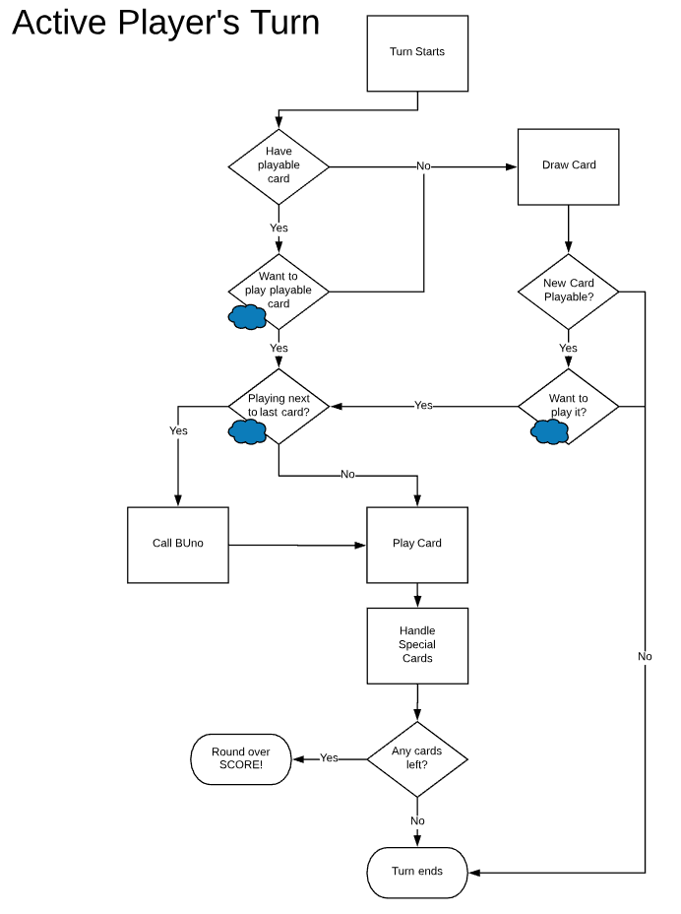
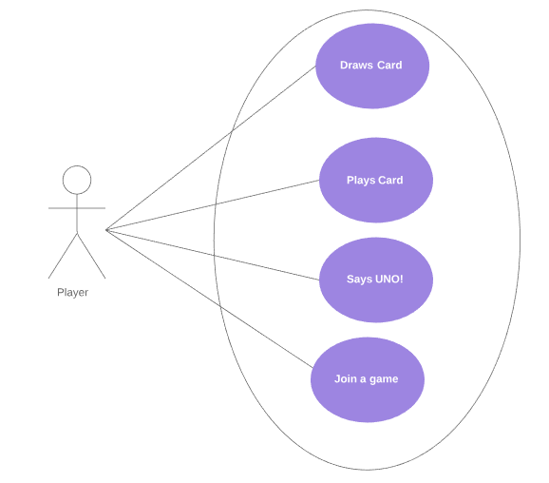
Diagrams
Notes:
Lily

Slide 9
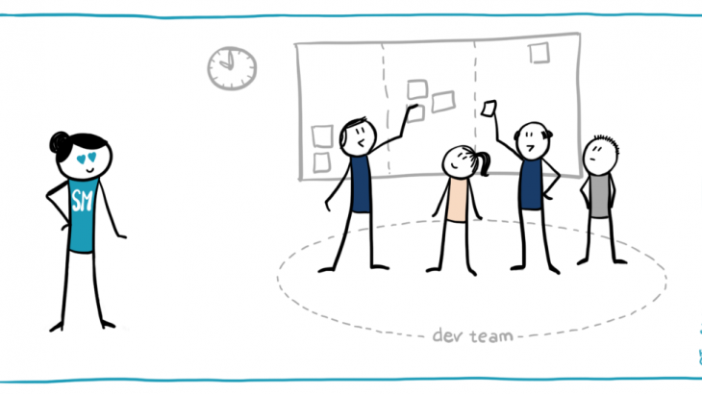
Scrum Experience (1/2)
Key User Stories
Drawing a card
Playing a valid card
Create an AI to play against
Calling BUno when someone has one card left
Notes:
Rachel

Slide 10
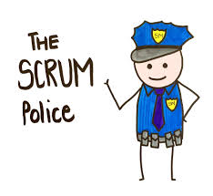
Scrum Experience (2/2)
Strengths
Updating our scrum
Adding effective user stories whenever necessary
Communication
JUnit testing
Weaknesses:
Git commits
Task division at early stages
Attempted networking before we had a basic functional game
Needed better project organization
Notes:
Rachel

Slide 11
What We Learned
Time Management
Agility:
Updating tasks as working through user stories
Testing while developing
Scrum:
Prioritize user stories
Burndown Chart to track process
Git:
Commit and push whenever a method was finished
Others can understand the updates by reading the commit message
Notes:
Rachel

Slide 12
What we would do with more time
Special Cards
Challenge Wild Draw 4 card
Sort hand by:
Color
Card type
Dragging & dropping
Networking to allow multiple users play a game
Design smarter AI
Notes:
Scott

