Slide 1
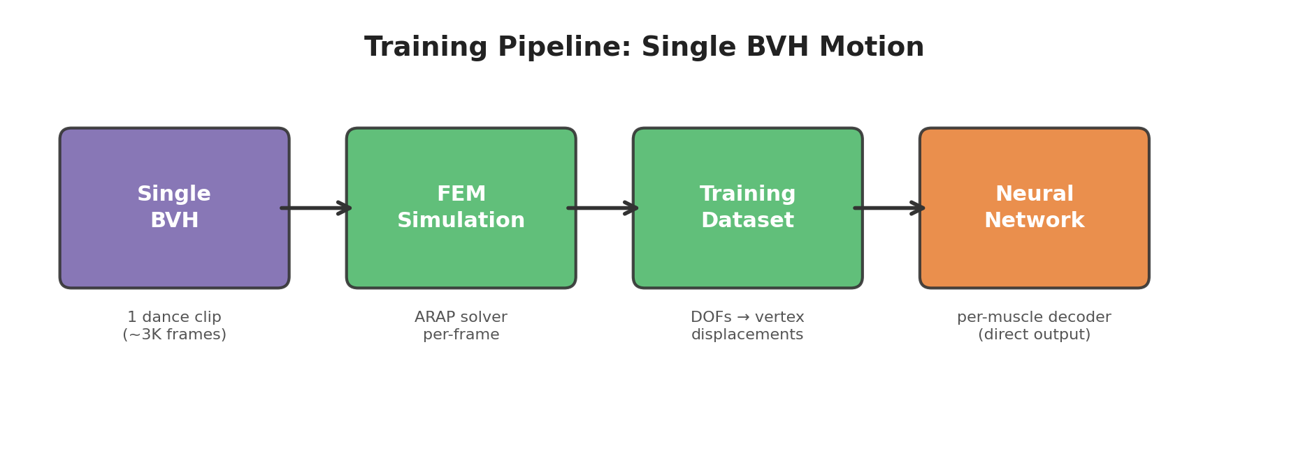
V1: Training from Single BVH Motion
Single dance BVH clip (~3K frames) as training data
FEM (ARAP) simulation bakes per-frame vertex displacements
Input: 4-dim DOFs + velocity (hip 3 + knee 1)
Per-muscle decoder outputs vertex displacements directly (no PCA)

Slide 2
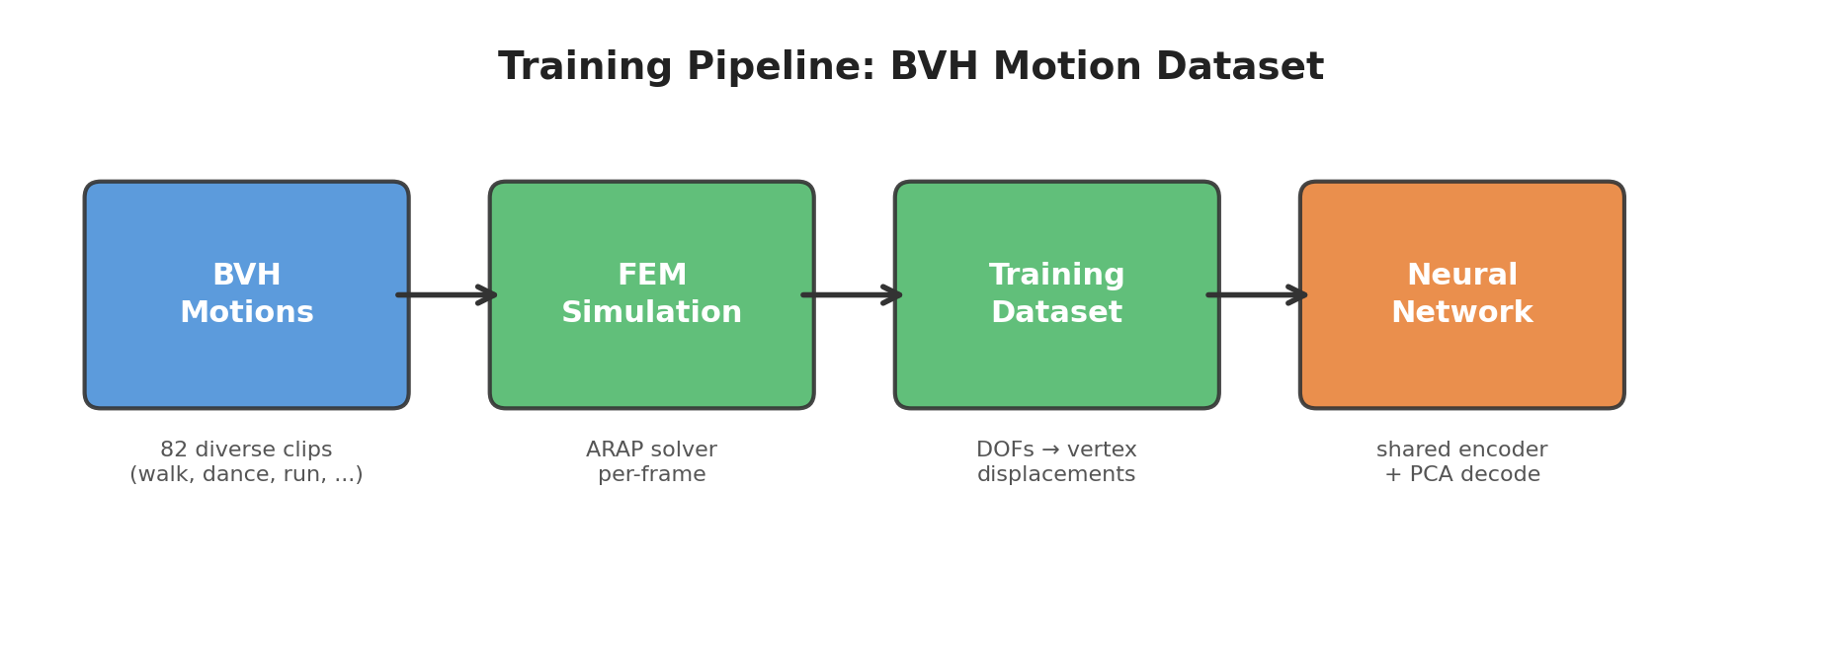
V2: Training from BVH Motion Dataset
82 BVH clips (walk, run, dance, jump, ...) provide diverse motion coverage
FEM (ARAP) simulation bakes per-frame vertex displacements for each muscle
Input: 20-dim feature vector (joint angles + derivatives over sliding window)
Shared encoder + muscle embeddings, PCA output basis, temporal consistency loss

Slide 3
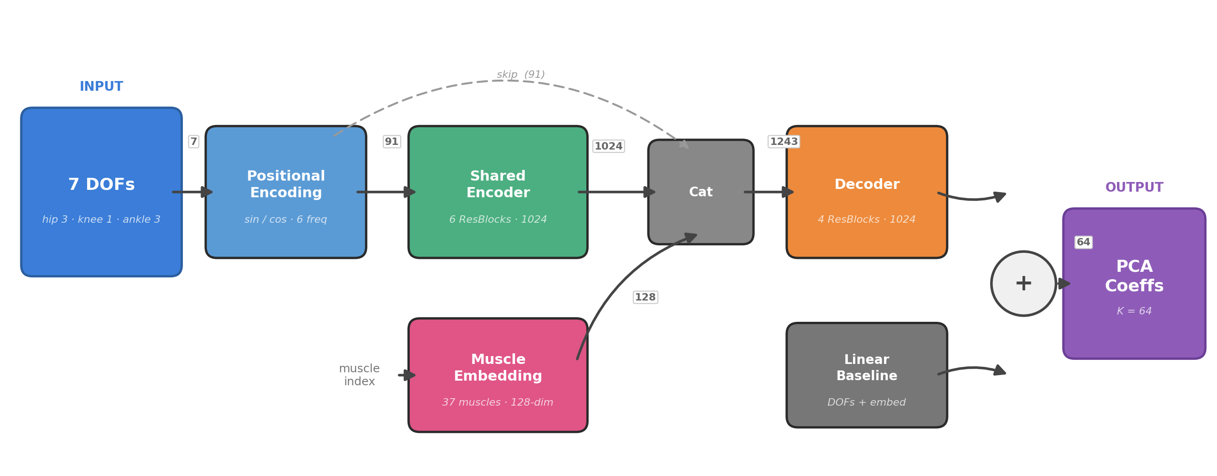
Network Architecture
Shared encoder (6 ResBlocks, 1024-dim) + single decoder conditioned on muscle embedding
Linear baseline + residual: stable training with skip connection from input
~24M parameters, real-time inference at 365 FPS on GPU

Slide 4
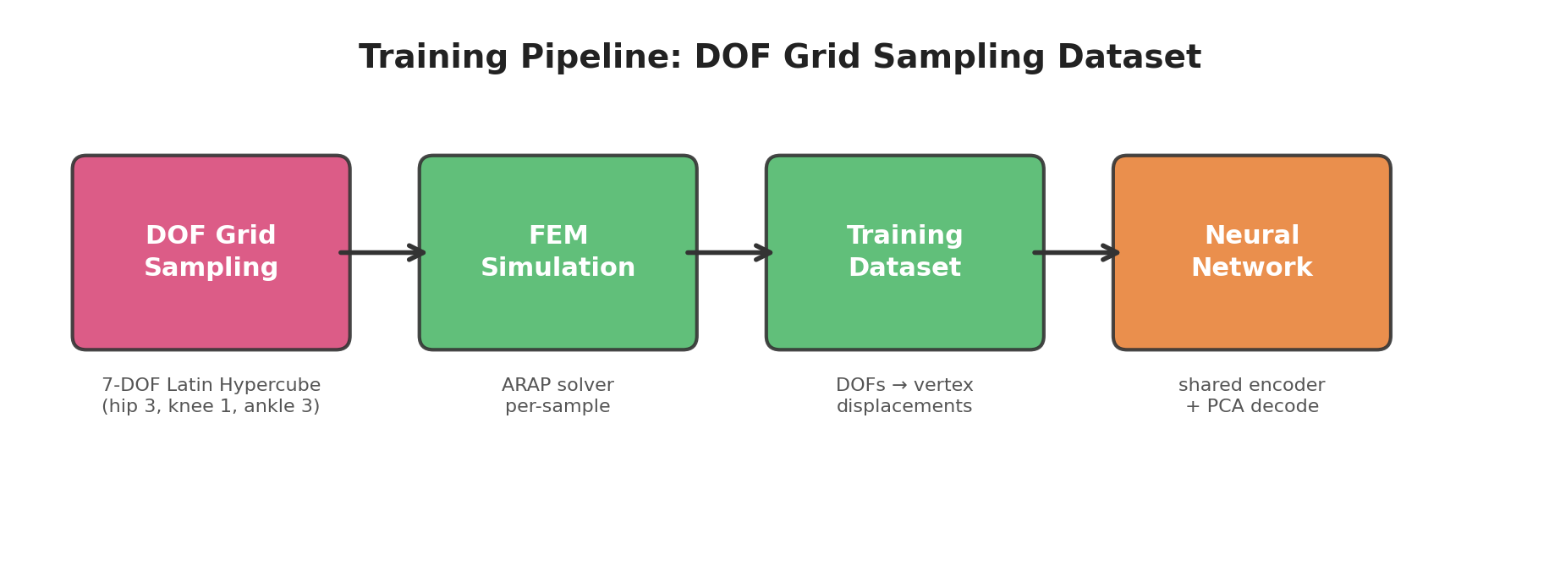
V3: Training from DOF Grid Sampling Dataset
Systematic 7-DOF sampling via Latin Hypercube (hip 3 + knee 1 + ankle 3)
30K samples covering full ROM — no motion clip dependency
Input: 7 raw joint angles (deterministic mapping, no temporal features)
Constraint losses: fixed vertex penalty + inter-muscle distance consistency

