Slide 1

LLOYDS Bank Code Test
Android Application

Slide 2
Index
Coding Test Requirements
Technical Specification
Application Functionality
Application Screens
Unit test
Git Repository Link

Slide 3
Coding Test Requirements
Create an application using public API, demonstrate the following values
performance
readability
maintainability
testability
Scalability
simplicity

Slide 4
Technical Specification
This mobile application was developed natively for Android using the Kotlin programming language. It was built using Android Studio (IDE) and is compatible with Android API level 24 and above.
The application leverages Android Jetpack architecture components, including:
Compose
Coroutines
HiltViewModel
Navigation
Dagger
Retrofit
Coil
Splash
Mockito
These components enhance the app's performance, readability, maintainability, testability, scalability, and simplicity.

Slide 5
Application Functionality
The application utilizes the following public API:
https://newsapi.org/v2/top-headlines
The screens and functionalities developed using this API include:
Splash Screen
Home Screen (News & World News)
Details Screen

Slide 6
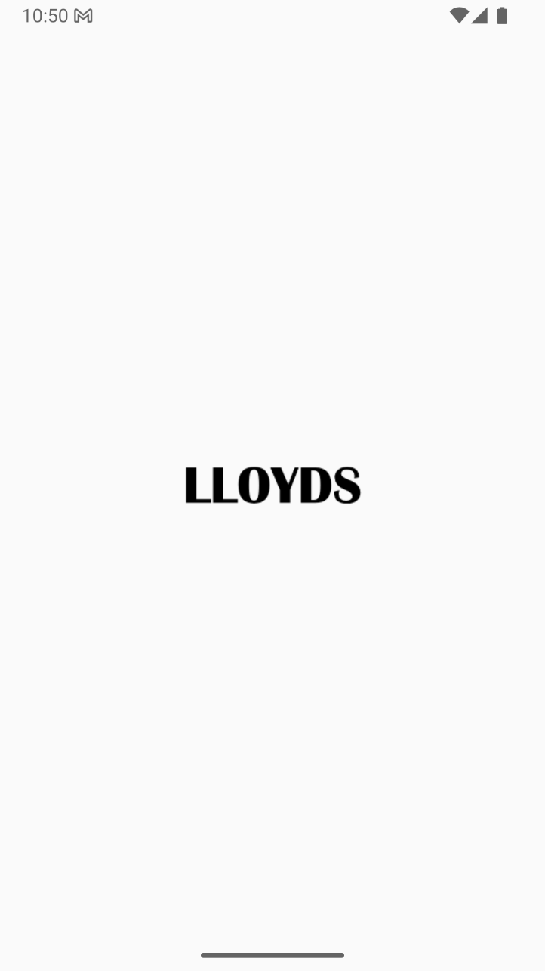
Splash Screen

Slide 7
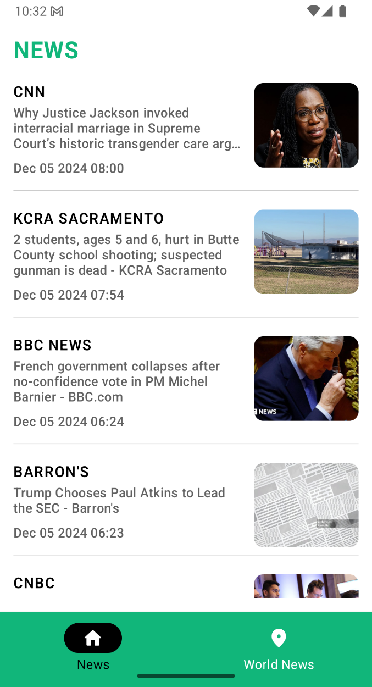
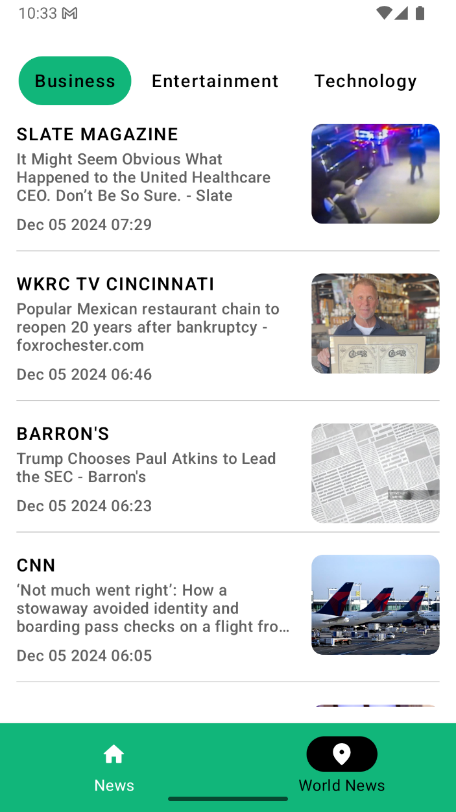
Home Screen
Home screen shown latest news and world News

Slide 8

Details Screen
Details screen contains news content

Slide 9
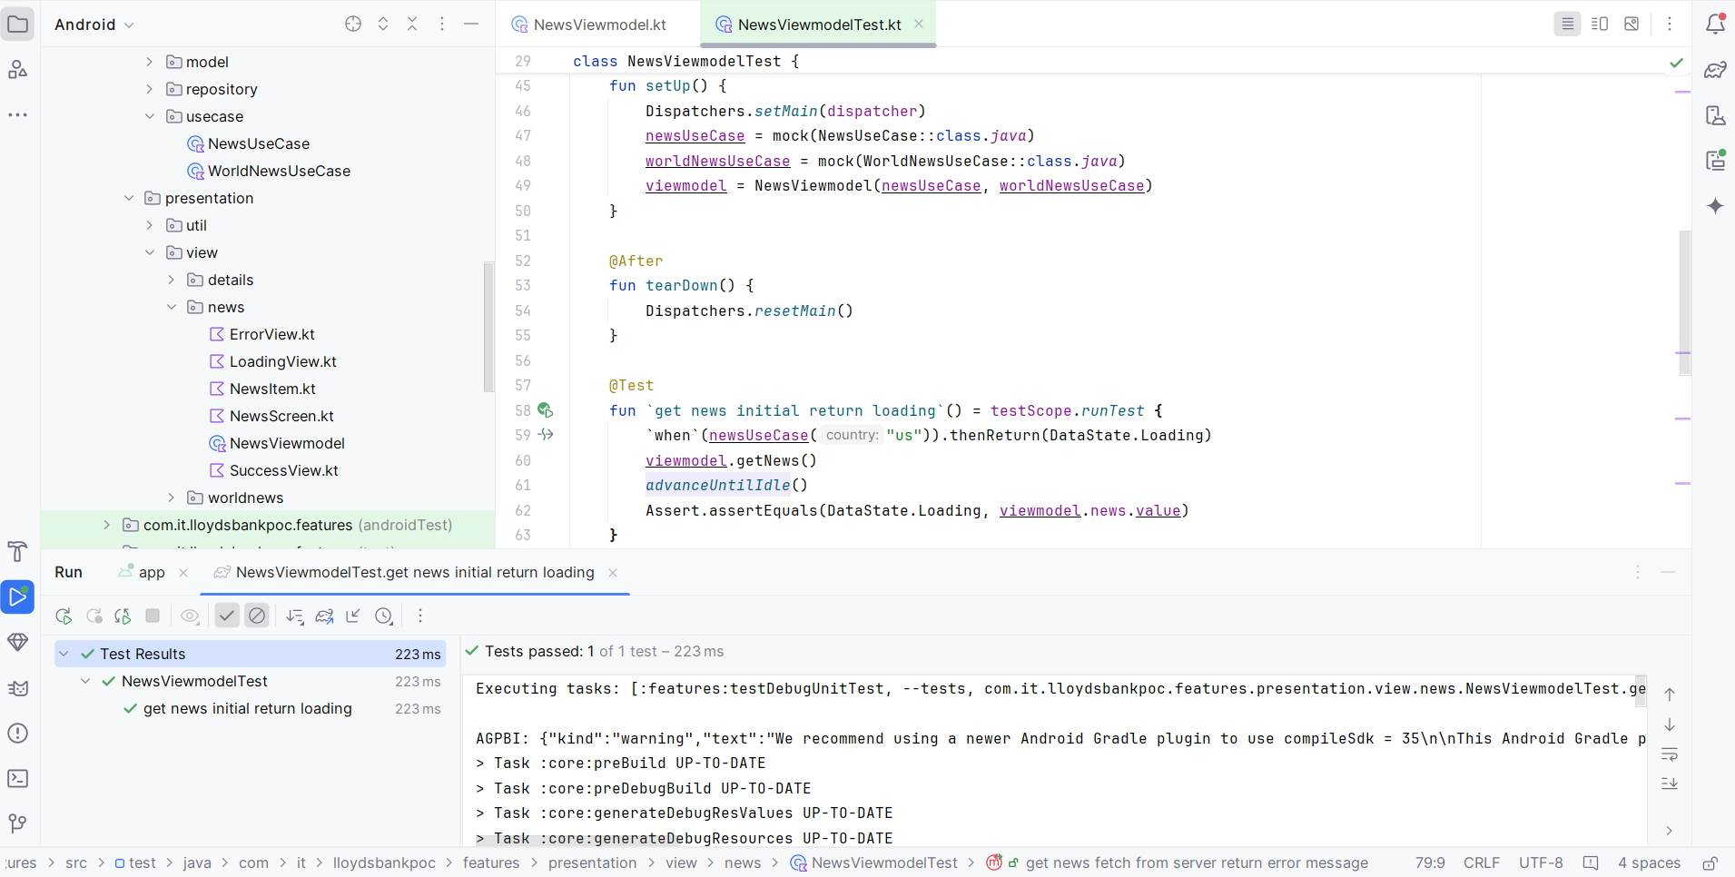
Unit Tests – For verifying a minimal unit of source code.

Slide 10
Git Repository Link
https://github.com/jekambaram1989/code-test.git

Slide 11
Thank You

