Slide 1

LIBRARY SYSTEM by GROUP 4
Prepared and Presented By: Timothy Jake Flordelis,
Jonathan Borisman Tambun,
David Lam Long

Slide 2
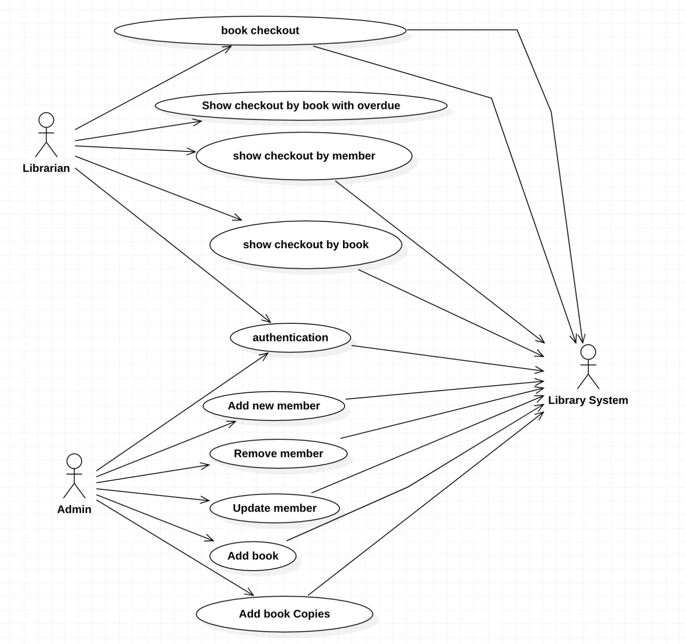
USE-CASE MODEL

Slide 3
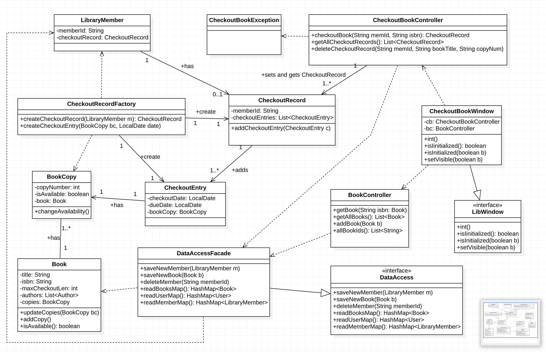
CLASS MODEL – CHECKOUT BOOK

Slide 4
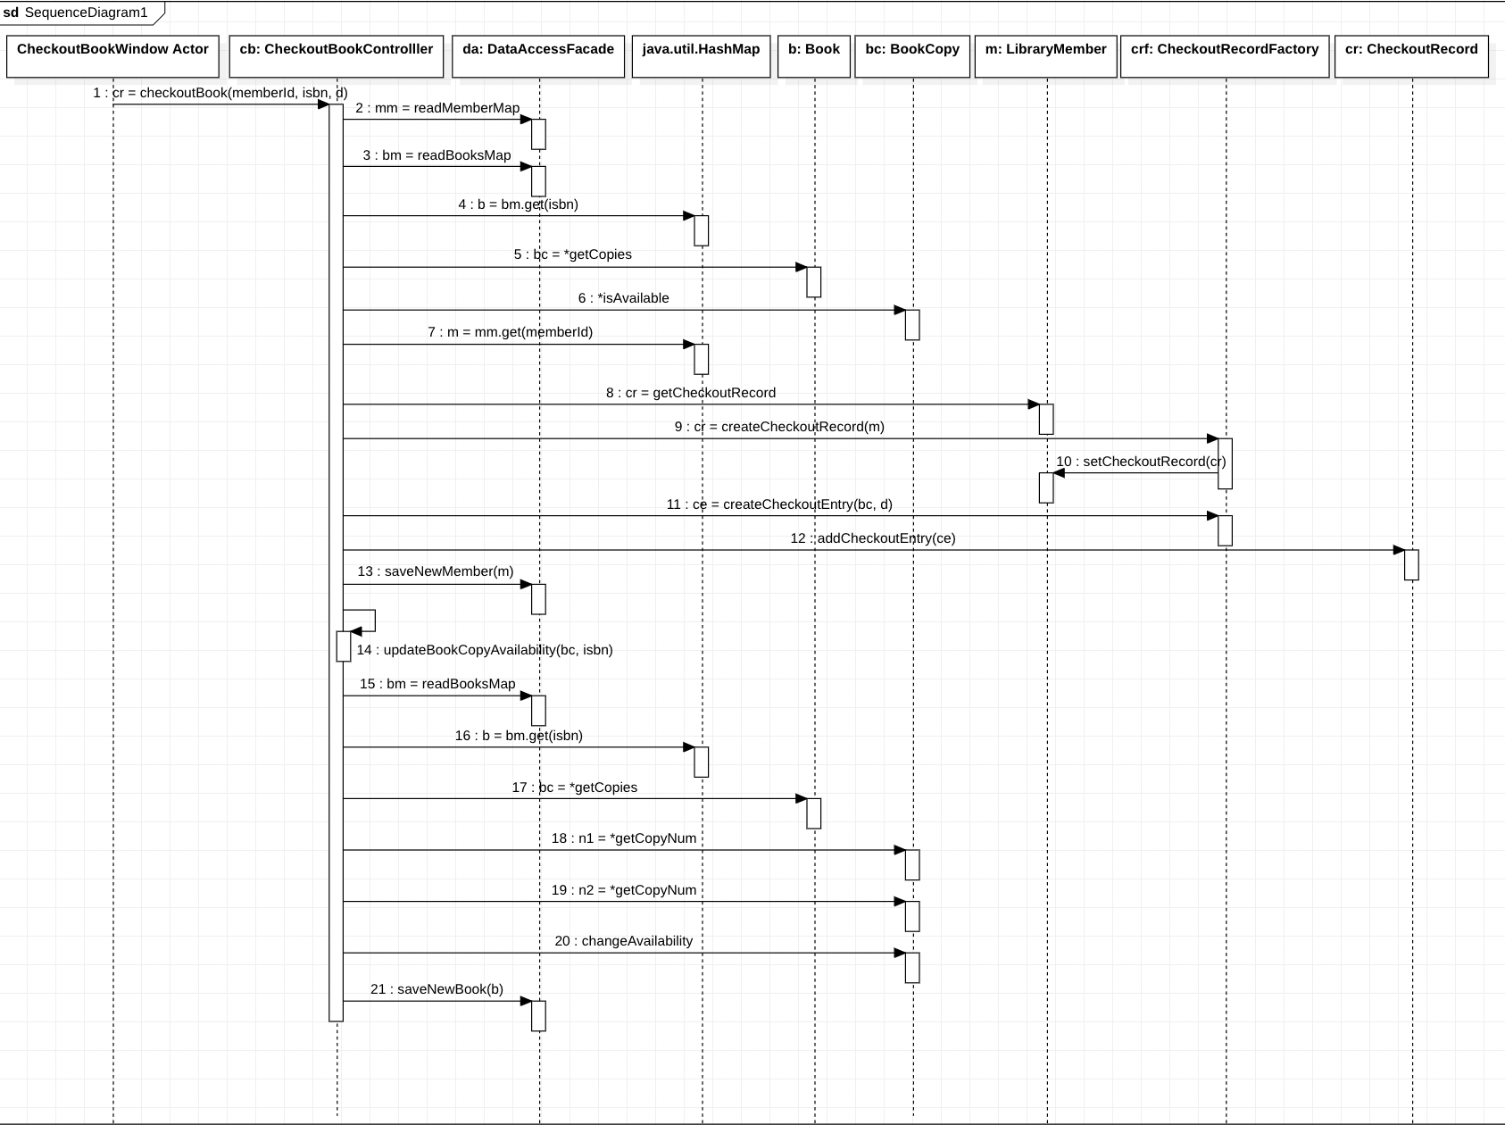
SEQUENCE DIAGRAM – CHECKOUT BOOK

Slide 5
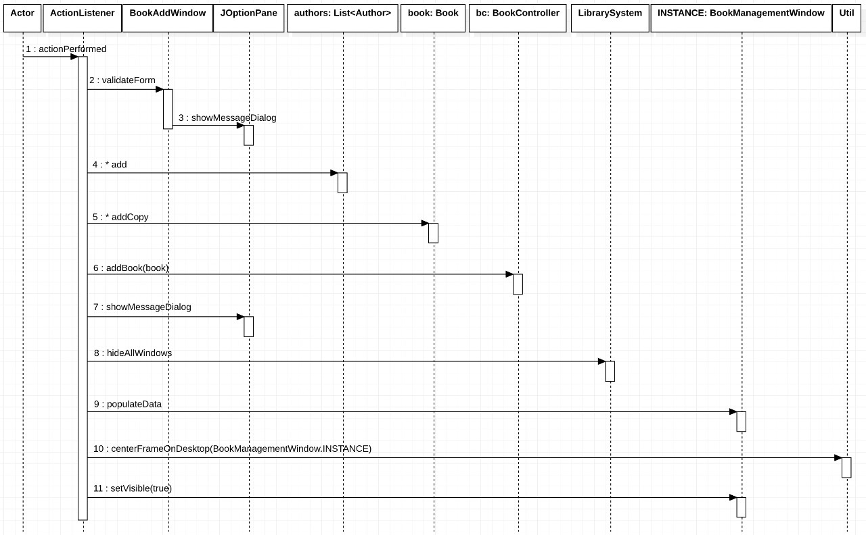
SEQUENCE DIAGRAM – ADD BOOK

Slide 6
WINDOW VALIDATIONS
USER LOGIN
Logging in with an empty or incorrect user ID will display an error dialog that user ID is not found.
Logging in with an empty or incorrect password will display Incorrect Password error dialog.
ADD CHECKOUT BOOK RECORD
Both Library member ID and Book ISBN No. should be filled else an error dialog will be displayed prompting All fields should be filled.
Entering an incorrect a Library member ID will display an error dialog that member ID is not found.
Entering an incorrect Book ISBN No. will display an error dialog that ISBN No. is not found.
Entering a Book ISBN No. that’s no longer available will display an error dialog prompting that this book is no longer available for checkout.
DISCARD CHECKOUT BOOK
Need to select a Checkout Entry in the table when discarding a checkout else will display an error dialog prompting to select an item in the table.

Slide 7
WINDOW VALIDATIONS
ADD LIBRARY MEMBER
All fields must be filled else an error dialog will be displayed prompting to fill all the fields
Phone number should be in correct format else an error dialog will be displayed that the phone number is incorrect.
Zip Code should only be numbers and a maximum of 6 digits else an error dialog will be displayed that the zip code is incorrect.
DELETE LIBRARY MEMBER
Need to select the member in the table when deleting else will display an error dialog prompting to select a member in the table.

Slide 8
WINDOW VALIDATIONS
ADD A BOOK
All fields must be filled including adding at least one author else an error dialog will be displayed prompting to fill all the fields.
Book ISBN number should be unique else an error will be displayed prompting that ISBN already exists
Author’s Phone number should be in correct format else an error dialog will be displayed that the phone number is incorrect.
Author’s Zip Code should only be numbers and a maximum of 6 digits else an error dialog will be displayed that the zip code is incorrect.
ADD A BOOK COPY
Setting book copies should be in numbers else an error dialog will be displayed prompting to enter numeric values

Slide 9

STC Main Points
In developing a new software application or system the first steps that we did as a Team is to know and understand the problem. Gather information and enumerate what are the necessary Use Cases for the Library System software that we’re going to develop. Use noun and verb analysis to analyze and then design the Class Domain Model of the Library System. This we can apply the first of the 5 fundamentals of Progress we’re we first design the software to achieve Stability.
Next is to rethink and make changes of the design by applying the 5 Stages of Change: Pre-contemplation, Contemplation, Preparation, Action, and Maintenance. This is where we try start coding and experiment if we can apply OOP Concepts and Principles like Inheritance and Polymorphism in our Class Model. This is to design and develop the Library System not just for stability but to be Adaptable to future changes as well.

Slide 10
STC Main Points
Later in the development, the team discovered that there are some unnecessary sequence of processes in our system after doing the Sequence Diagram of the Library System. This we can apply Purification where we need to refactor some codes and stop doing programming bad practices. Always remember the S.O.L.I.D. principles in Software Development.
Thinking about the future and the Growth of the Library System is to think that this system will expand its usability and can be Integrated to other systems not just here in the University but to other systems as well. To achieve that again we can apply the 5 stages of change and see if some other concepts and principles in OOP we can apply to have better integration in the Library System. We may apply some new design patterns like the Factory Design Pattern and the Static Factory Methods in achieving this goal. This will help several development teams to work together and separate the Core development and Specific Integration Development and Configuration.

