Slide 1
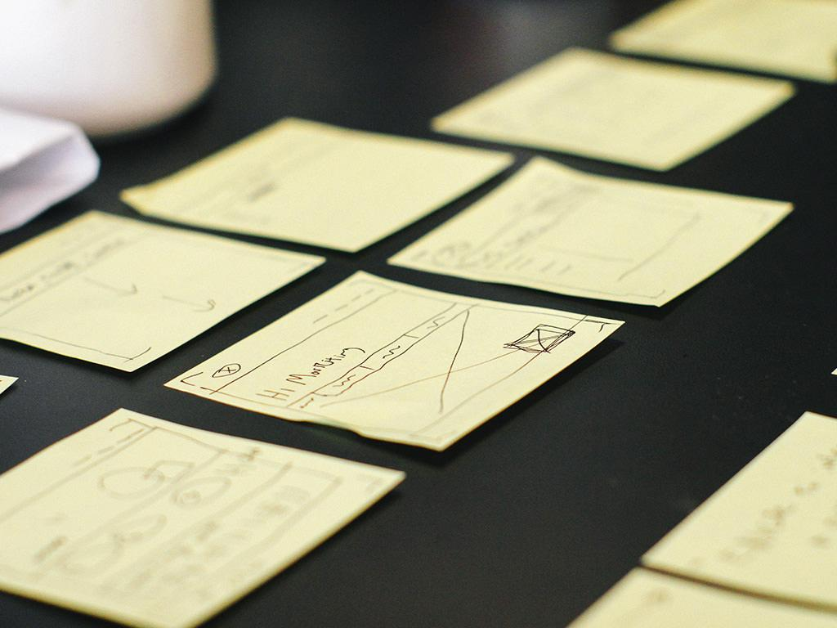
Ataraxia:
Midway
Milestone
Ashwin A.
Claire S.
Katherine E.
Josh L.

Slide 2




Value Proposition
The Team
Learn to be a happier you
Ashwin A.
Claire S.
Josh L.
Katherine E.

Slide 3
Problem Overview
People aren’t aware of what they can be doing to take care of themselves - what makes them happier and what doesn’t

Slide 4
Solution Overview
Ataraxia will help people through the process of learning what works for them and what doesn’t when it comes to taking care of themselves by guiding users to curate their own self-care routine

Slide 5
Overview
HE Evalution Results
Overview of Changes
Prototype Status & Demo

Slide 6
Heuristic Evaluation Results

Slide 7
Difficult to view in progress activities
Why change this? Users had to go to options menu and select “in progress activities” in order to view them
Solution: Redesigned default screen to be activities in progress (if any). Otherwise defaults to “today” screen

Slide 8
Top left button not standardized
Why change this? “x” and back button generally unstandardized (or non existent), sometimes brings you to home screen, other times takes you back a page.
Solution: “x” close pop up screens, and back arrows go to previous page.

Slide 9
Can’t add activities in edit routine screen
Why change this? Users can’t add activities from the edit routine screen. Only place to do this is through discover
Solution: Add the option to add activities from the edit routine screen. Activities currently not in routine are listed in their own category and can be dragged in.

Slide 10
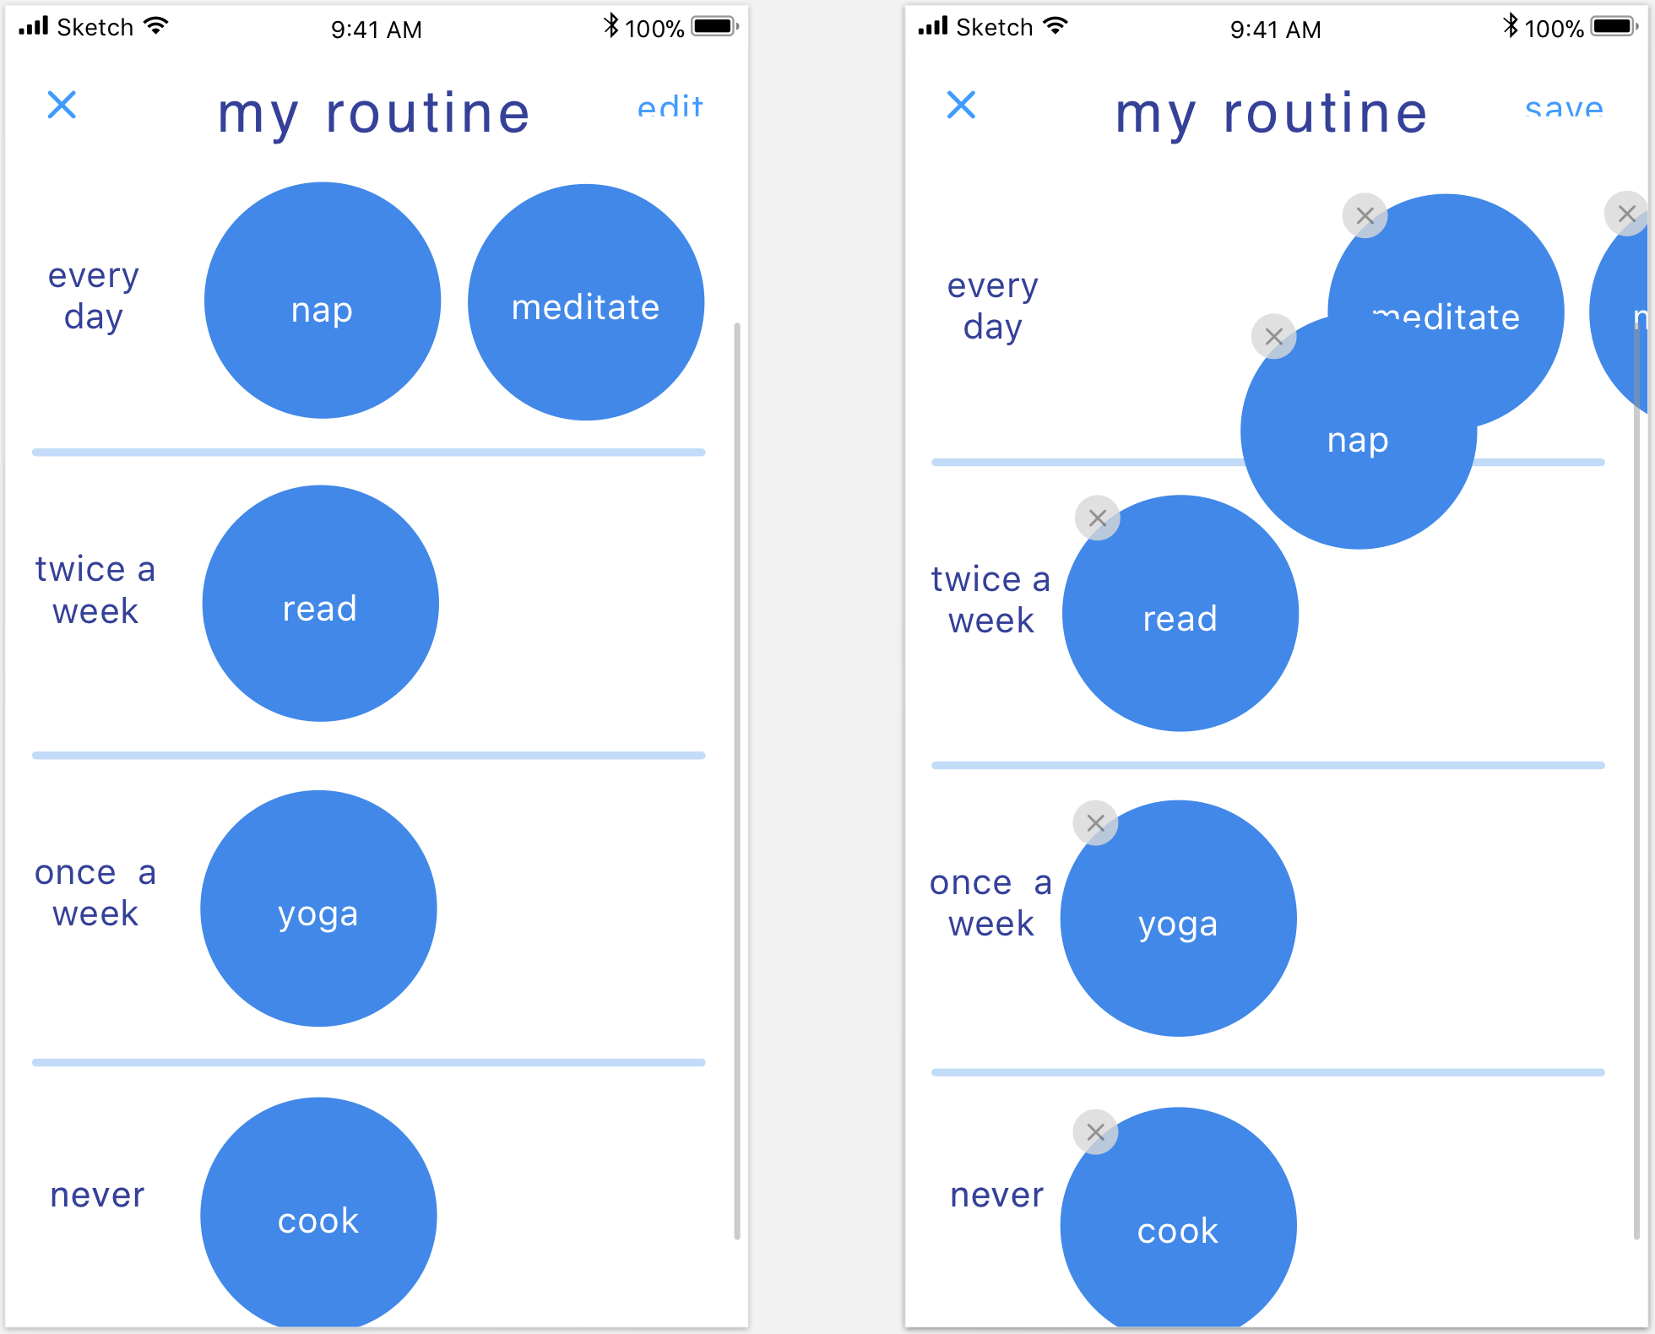
Viewing and editing routine

Slide 11
Non-HE / Other Changes
Changed color scheme to have more contrast
Resources page changed to be more readable and less cluttered
Adding notes now on the same screen during reflection
Options bar removed, replaced single button to access activities / routine

Slide 12
Overview of Revised Design

Slide 13
Overview of Revised Design
More user freedom
Why? This came up often in our HE feedback, where users didn’t have enough flexibility
Revised aesthetics
Why? To enhance user experience and delightfulness

Slide 14
Overview of Revised Design
Increased accessibility to features
Why? To allow for users to easily access common features (i.e: in progress activities)
Easier to view relevant information
Why? Users can better view previous information that may be relevant (i.e: reflections / notes on activities)

Slide 15
Prototype Status

Slide 16
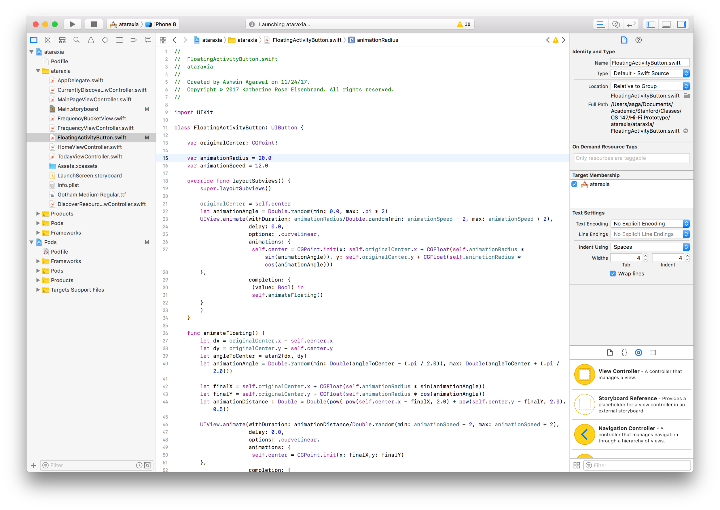
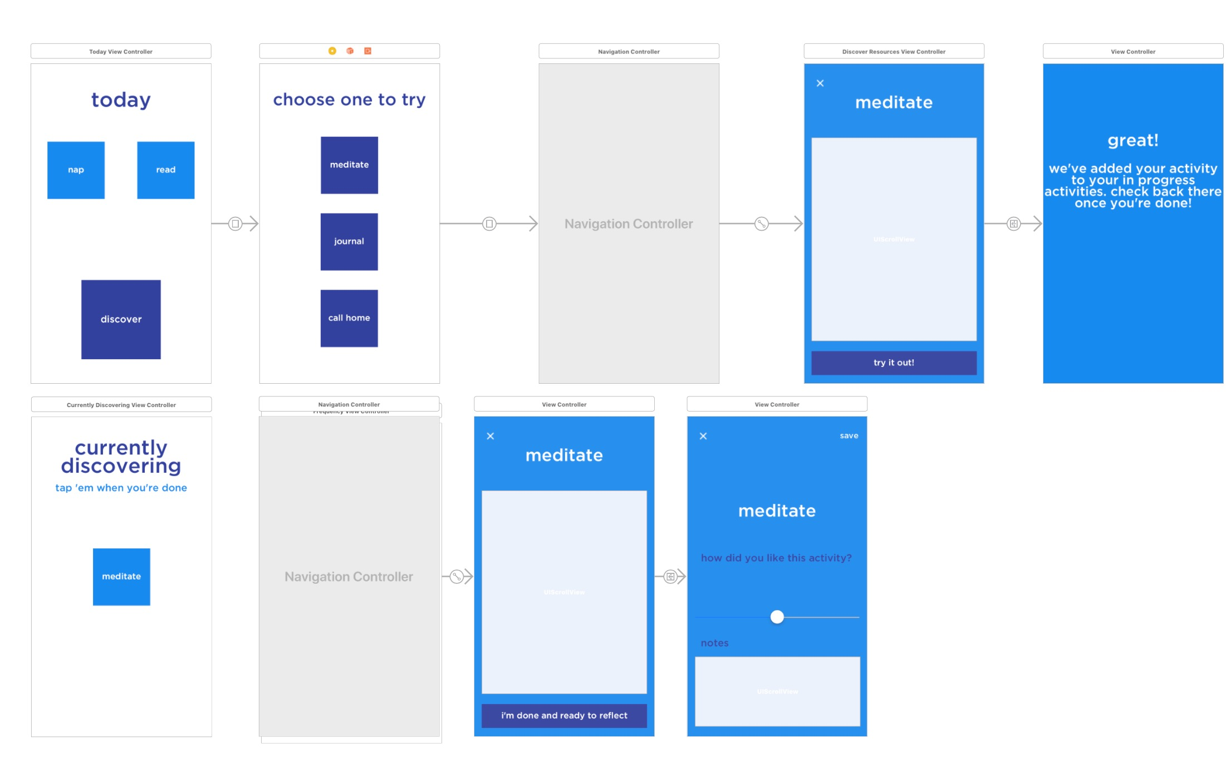

Tools Being Used
Xcode
Storyboard
CocoaPods

Slide 17
Implemented Features
Home screen - today’s activities as well as activities that are in progress
Discover a new activity (simple)
Reflect on an activity (medium)
Backend initialized

Slide 18
Unimplemented Features & Plan
Edit / view routine (complex)
Viewing resources / notes for previous activities
Backend objects not populated
Plan
Use a UICollectionView for routine
Implement a pop-up for viewing notes and resources
Pass the class

Slide 19
Wizard of Oz / Hard-coded Features
Resources display is not dynamically created / updated
Only the “meditate” flow for discovery works
Discoverable activities and today activities are hard-coded
Notes and activities not persistent

Slide 20
Issues & Questions
Do we need floating activity bubbles?
Affordance suggests “click and drag”?
What should we name the screen for in progress activities?
Currently Discovering
Activities I’m Trying Out
In Progress Activities
What should we name the bottom button on the today screen?

Slide 21
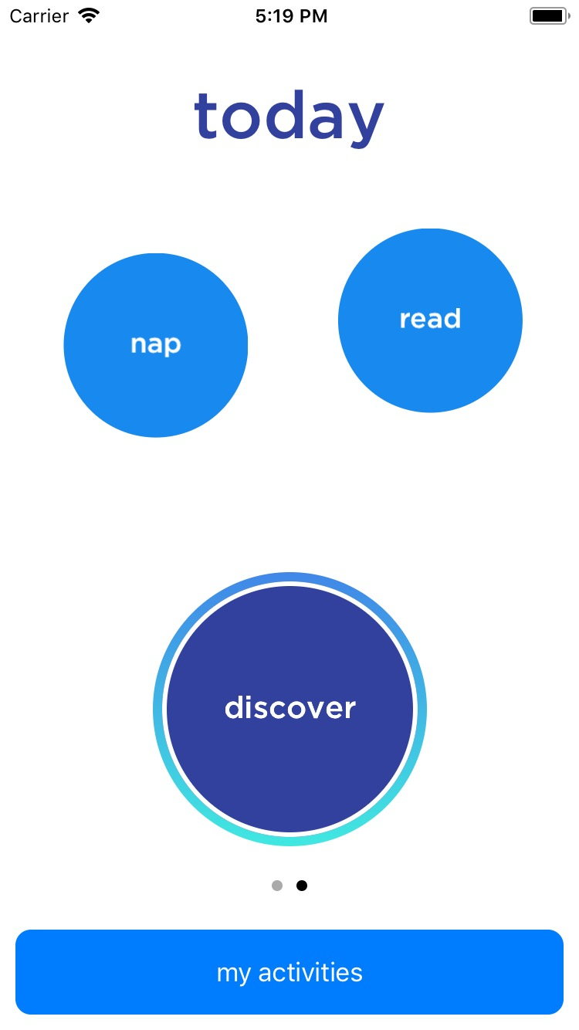
Prototype Demo!

Slide 22
Summary

Slide 23
Summary
Reviewed HE results and made changes based on these results
Mapped out current prototype progress and future plans
Currently on track to finish by 12/8

Slide 24
Questions? :)

