Slide 1
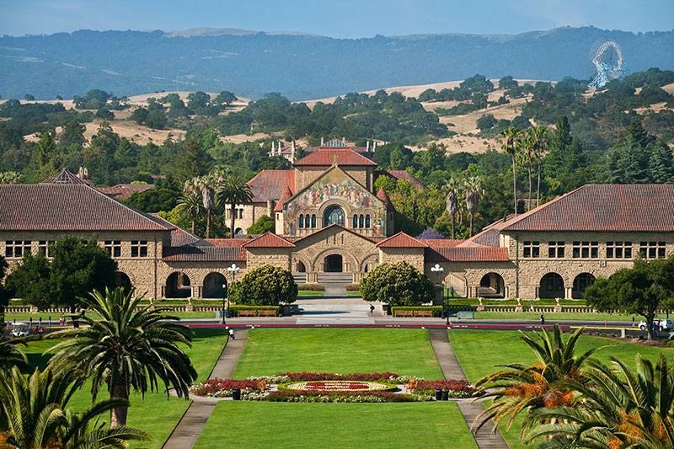
Finite Volume Method for SPM
Le Xu
Julian Cooper
Stanford Energy Control Lab
2022.12.12

Slide 2
CONTENTS
1
Finite volume scheme
2
MATLAB and PYBAMM comparison
3
Mass conservation analysis
4
Conclusions and future steps

Slide 3
FVM-SPM: Finite volume scheme

Slide 4

Finite volume scheme
Electrolyte diffusion equation
General diffusion equation
$$s$$
Φ variable (concentration)
Γ Diffusion coefficient
Solid-phase diffusion equation

Slide 5
Finite volume scheme
Solid-phase diffusion equation
Governing equation
Key step1
Variable substitution
Boundary condition

Slide 6
Finite volume scheme
Solid-phase diffusion equation
Governing equation
Key step1
Variable substitution
Boundary condition

Slide 7
Finite volume scheme
Solid-phase diffusion equation
Governing equation
Key step1
Variable substitution
Boundary condition
Governing equation

Slide 8
Finite volume scheme
Solid-phase diffusion equation
Governing equation
Key step1
Variable substitution
Boundary condition
Boundary condition

Slide 9
Finite volume scheme
Solid-phase diffusion equation
Governing equation
Integrating over the control volume CV gives:
Boundary condition
Application of Gauss theorem gives

Slide 10
Finite volume scheme
Solid-phase diffusion equation
i-th Control volume
Integrating over the control volume CV gives:
r_{i+1/2}
r_{i}
Application of Gauss theorem gives
r_{i-1/2}
Key step2

Slide 11
FVM-SPM: MATLAB and PYBAMM comparison

Slide 12
MATLAB and PYBAMM comparison
1C charge
Voltage
Surface concentration
Average concentration
Accuracy
Model: SPM
Parameters: LG data
PYBAMM (Nr=10)
MATLAB (Nr=10)
RMSE = 0.63 mV
RMSE = 18.9 mol/m3
RMSE = 0.2 mol/m3
RMSE = 0.4 mol/m3
RMSE = 0.3 mol/m3
Pozzato, G., Allam, A., & Onori, S. (2022). Lithium-ion battery aging dataset based on electric vehicle real-driving profiles. Data in Brief.

Slide 13
MATLAB and PYBAMM comparison
2C charge
Voltage
Surface concentration
Average concentration
Accuracy
Model: SPM
Parameters: LG data
PYBAMM (Nr=10)
MATLAB (Nr=10)
RMSE = 0.88 mV
RMSE = 24.5 mol/m3
RMSE = 0.1 mol/m3
RMSE = 0.3 mol/m3
RMSE = 0.3 mol/m3
Pozzato, G., Allam, A., & Onori, S. (2022). Lithium-ion battery aging dataset based on electric vehicle real-driving profiles. Data in Brief.

Slide 14
MATLAB and PYBAMM comparison
4C charge
Voltage
Surface concentration
Average concentration
Accuracy
Model: SPM
Parameters: LG data
PYBAMM (Nr=10)
MATLAB (Nr=10)
RMSE = 1.2 mV
RMSE = 26.2 mol/m3
RMSE = 0.1 mol/m3
RMSE = 0.2 mol/m3
RMSE = 0.2 mol/m3
Pozzato, G., Allam, A., & Onori, S. (2022). Lithium-ion battery aging dataset based on electric vehicle real-driving profiles. Data in Brief.

Slide 15
MATLAB and PYBAMM comparison
1C charge
Voltage
Surface concentration
Average concentration
Model: SPM
Ref: FDM-SPM (Nr=100)
Convergence speed
Voltage: FDM>FVM
Average Cs: FVM>FDM

Slide 16
MATLAB and PYBAMM comparison
2C charge
Voltage
Surface concentration
Average concentration
Model: SPM
Ref: FDM-SPM (Nr=100)
Convergence speed
Voltage: FDM>FVM
Average Cs: FVM>FDM

Slide 17
MATLAB and PYBAMM comparison
4C charge
Voltage
Surface concentration
Average concentration
Model: SPM
Ref: FDM-SPM (Nr=100)
Convergence speed
Voltage: FDM>FVM
Average Cs: FVM>FDM

Slide 18
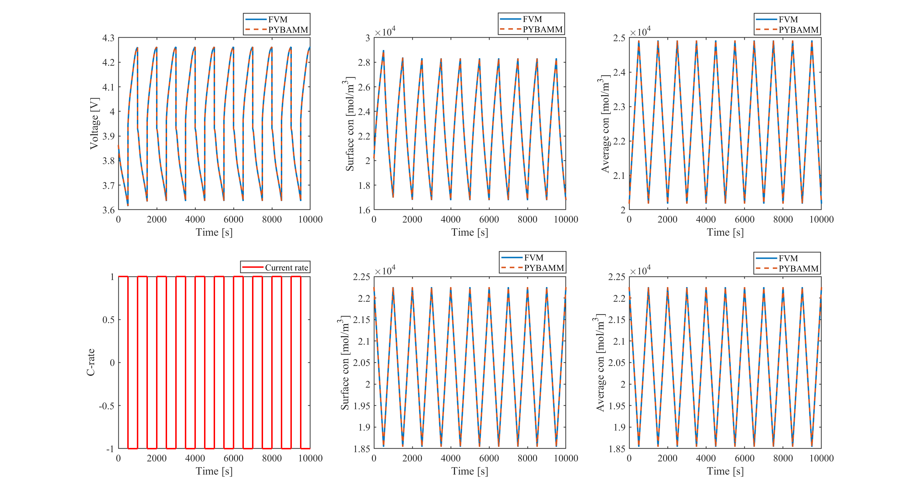
MATLAB and PYBAMM comparison
1C-1C cycling
Voltage
Surface concentration
Average concentration
Accuracy
Model: SPM
Parameters: LG data
PYBAMM (Nr=5)
MATLAB (Nr=5)
RMSE = 0.4 mV
RMSE = 16.01 mol/m3
RMSE = 0.09 mol/m3
Pozzato, G., Allam, A., & Onori, S. (2022). Lithium-ion battery aging dataset based on electric vehicle real-driving profiles. Data in Brief.
RMSE = 0.07 mol/m3
RMSE = 0.07 mol/m3

Slide 19
MATLAB and PYBAMM comparison
1C-1C cycling
2C-2C cycling
4C-4C cycling
C-rate | RMSE of Voltage [mV] | RMSE of surface concentration [mol/m³] |  | RMSE of average concentration [mol/m³]
 |  | Cathode | Anode | Cathode | Anode
1C-1C | 0.41 | 16.23 | 0.08 | 0.09 | 0.08
2C-2C | 0.38 | 15.41 | 0.08 | 0.09 | 0.08
4C-4C | 0.45 | 12.08 | 0.06 | 0.11 | 0.06

Slide 20
FVM-SPM: Mass conservation analysis

Slide 21
Mass conservation analysis
Mass conservation
Cathode
Anode
Model: SPM
ΔCs=107
ΔCs=34
ΔCs=1
ΔCs=30
ΔCs=0
FDM (Nr=5)
C-rate: 4C-4C
Mass is not conserved in FDM

Slide 22
Mass conservation analysis
Mass conservation
Cathode
Anode
Model: SPM
FVM (Nr=5)
C-rate: 4C-4C
Mass is conserved in FVM

Slide 23
Mass conservation analysis
C1
C2
C3
C9
C10
C1-C2: First and second cycle
C2-C3: Second and third cycle
C9-C10: ninth and tenth cycle
C-rate | Cycle | FDM Nr=5 |  | FVM Nr=5
 |  | Difference in cathode [mol/m³] | Difference in anode [mol/m³] | Difference in cathode [mol/m³] | Difference in anode [mol/m³]
1C-1C | C1-C2 | 46.03 | 7.48 | 0.00 | 0.00
 | C2-C3 | 4.80 | 0.00 | 0.00 | 0.00
 | C9-C10 | 0.00 | 0.00 | 0.00 | 0.00
2C-2C | C1-C2 | 80.00 | 14.96 | 0.00 | 0.00
 | C2-C3 | 21.09 | 0.00 | 0.00 | 0.00
 | C9-C10 | 0.01 | 0.00 | 0.00 | 0.00
4C-4C | C1-C2 | 106.41 | 29.92 | 0.00 | 0.00
 | C2-C3 | 34.36 | 0.00 | 0.00 | 0.00
 | C9-C10 | 1.10 | 0.00 | 0.00 | 0.00
Mass is conserved in FVM

Slide 24
Mass conservation analysis
Re-identification
Model: SPM
FVM (Nr=5)
FDM (Nr=5)
C-rate: 2C-2C
Ref: FVM (Nr=100)
Method | RMSE of Voltage [mV]
FDM Nr=5 | 49
FVM Nr=5 | 65

Slide 25
Mass conservation analysis
Re-identification
Model: SPM
FVM (Nr=5)
FDM (Nr=5)
C-rate: 2C-2C
Ref: FVM (Nr=100)
Method | RMSE of Voltage [mV]
 | Before re-identification | After re-identification
FDM Nr=5 | 49 | 18
FVM Nr=5 | 65 | 16

Slide 26
Mass conservation analysis
Re-identification
FVM
FDM
Before re-identification
ΔCs=80
Before re-identification
ΔCs=0
After re-identification
After re-identification
ΔC=0
ΔCs=66

Slide 27
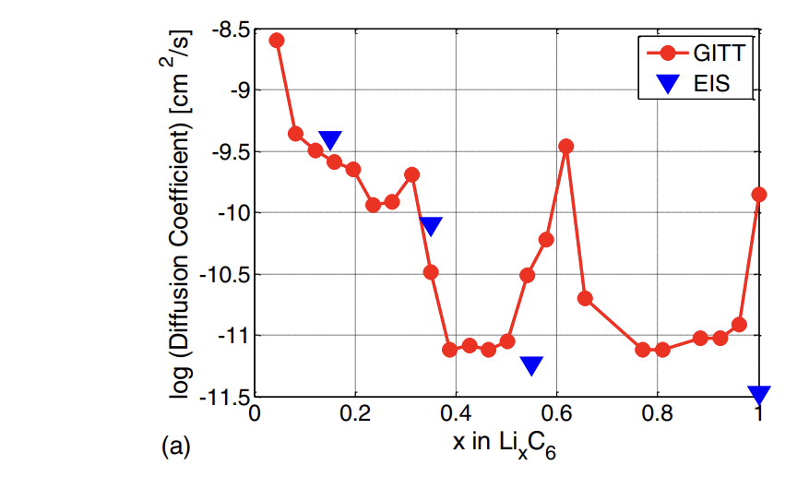
Conclusions and future steps
Conclusions
Under low discrete nodes number (e.g., Nr=5), mass is not conserved in FDM
Mass is always conserved in FVM
The convergence speed of FVM is slower than FDM
1. Can be improved using higher order scheme
2. Can be improved by re-identifying parameters
Future steps
Non-constant Ds
Ds=f(soc)
Outline of the paper
[1] Ecker, Madeleine, et al. "Parameterization of a physic-chemical model of a lithium-ion battery I-determination of parameters." Journal of the Electrochemical Society, 2015.
[2] Landesfeind, J. and Gasteiger, H.A. Temperature and Concentration Dependence of the Ionic Transport Properties of Lithium-Ion Battery Electrolytes. Journal of The Electrochemical Society, 2019.
[3] Kieran O‘Regan, et al. “Thermal-electrochemical parameters of a high energy lithium-ion cylindrical battery.” Electrochimica Acta,2022.

Slide 28
Conclusions and future steps
Discussion
Current rate for simulation
Now: 1C, 2C, 4C
Suggest: 1/20C, 1/2C, 1C, 2C
Cycling current profiles
Now: Constant (e.g., 1C-1C)
Suggest: Constant, Dynamic

Slide 29

Thanks
E-mail: lexu1209@stanford.edu

