Slide 1
Norlin Walk
Aidan Bohenick, Jeong Min Lee, Dalton Morrow, Michael Tang, Owen Wattenmaker

Slide 2
What is it?

Slide 3


NorlinWalk

Slide 4
How it works

Slide 5
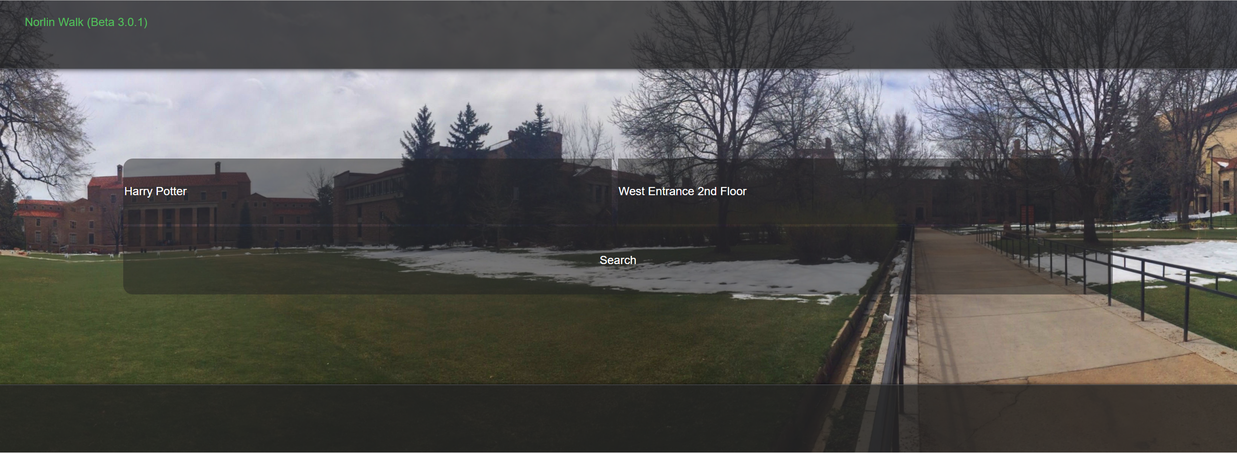
Norlin Walk
Type in a book
Select a starting position
Follow the arrows

Slide 6


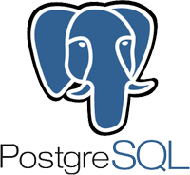
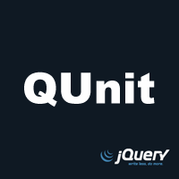
Tools Used
Purpose | Tool | Rating
Project Tracker | Github | 5
VCS Repository | Github | 4
Database | PostgreSQL | 2
Testing | Qunit | 5
Auto-Documenter | jsdoc | 2
Deployment Environment | Heroku | 5
JSDoc

Slide 7
Methodology
Agile
Peer Review

Slide 8
Challenges
Having to switch from using SQL to PostgreSQL
Reformatting panoramas
Connecting client to server
Learning PHP
Norlin does not have an API
No premade database
Using javascript to make a graph

Slide 9
Demo
Norlin Walk Demo

