Slide 1
EX 2-2
edge detection

Slide 2

2d difference operators
Image gradient
$∇f=\left[\frac{∂f}{∂x},\frac{∂f}{∂y}\right]$
Edge strength
$\left|\left|∇f\right|\right|=\sqrt{{\left(\frac{∂f}{∂x}\right)}^{2}+{\left(\frac{∂f}{∂y}\right)}^{2}}$
Second derivative
$∇^{2}f=\frac{∂^{2}f}{∂x^{2}}+\frac{∂^{2}f}{∂y^{2}}$

Slide 3
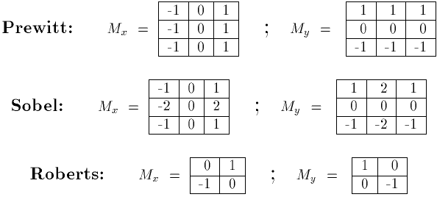






2d difference operators
$$G_{x}$$
$$G_{y}$$
$$G_{x}$$
$$G_{y}$$
$$G_{x}$$
$$G_{y}$$

Slide 4
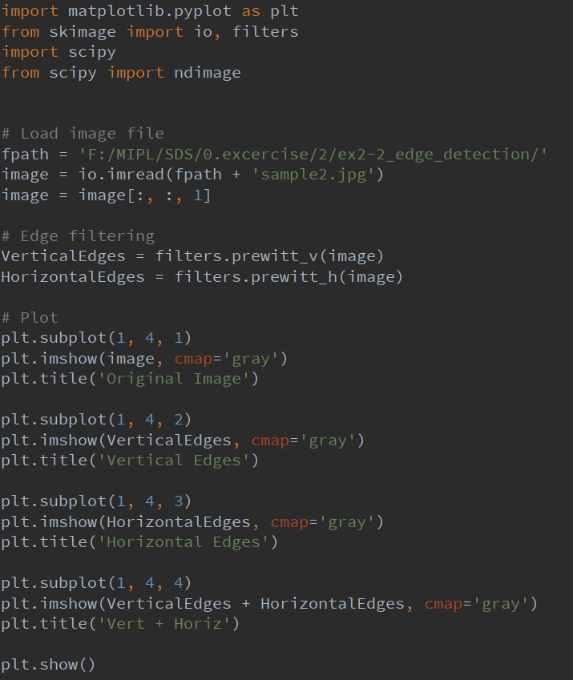
filter & edge
Edge gradient using Prewitt operator

Slide 5
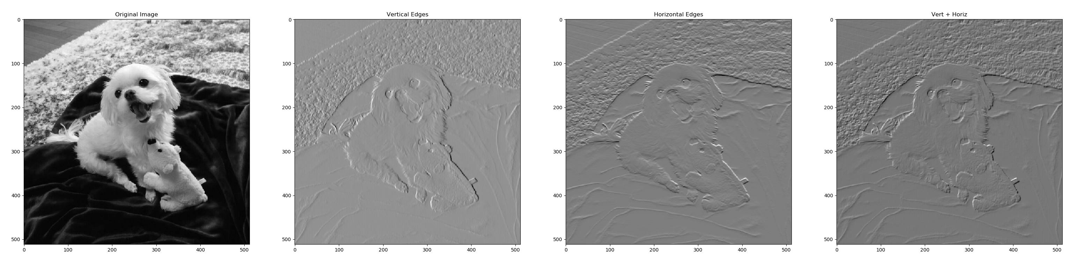
filter & edge
Edge gradient using Prewitt operator

Slide 6
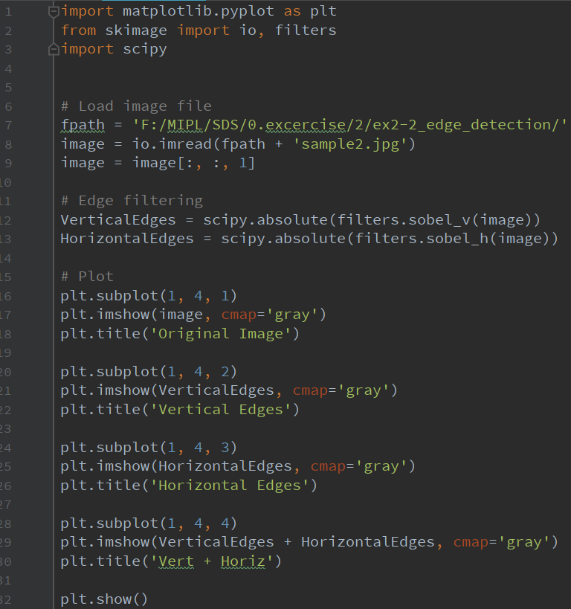
filter & edge
Edge strength using Sobel operator

Slide 7
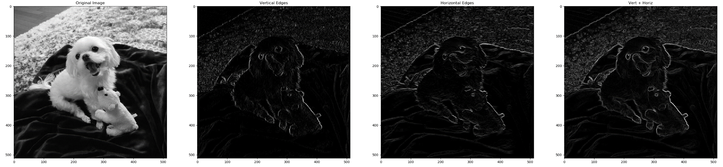
filter & edge
Edge strength using Sobel operator

Slide 8
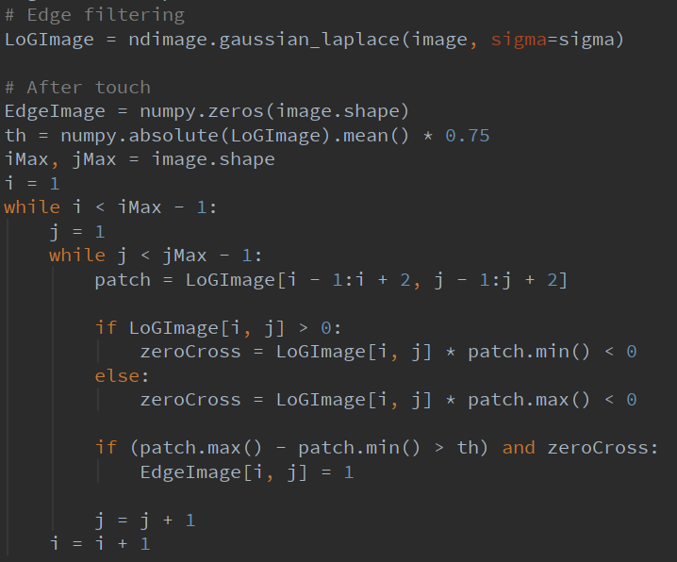
filter & edge
Second derivative using Laplacian of Gaussian
Algorithm
Compute LoG
Compute zero crossings on LoG
Compute a threshold for local LoG difference
Edge pixels = zero crossing && local difference > threshold

Slide 9
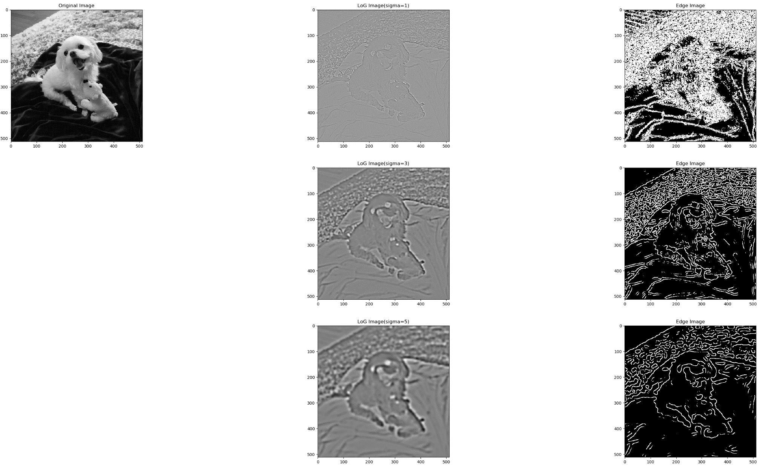
filter & edge
Second derivative using Laplacian of Gaussian

Slide 10
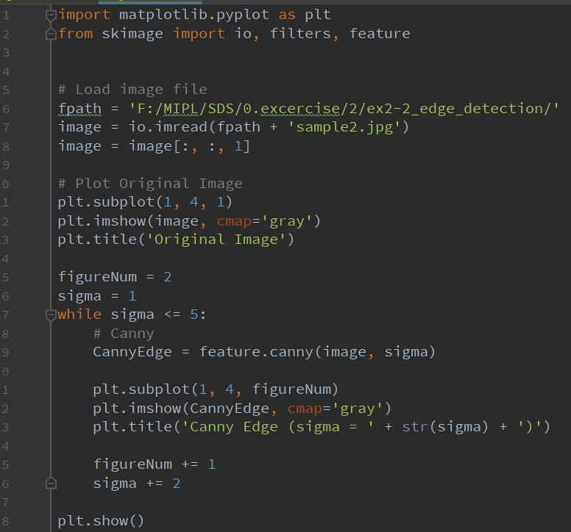
Canny
Canny Edge Detection Algorithm
Canny Algorithm
Gaussian Smoothing (optional)
Gradient calculation
Non-maximum suppression
Hysteresis thresholding

Slide 11
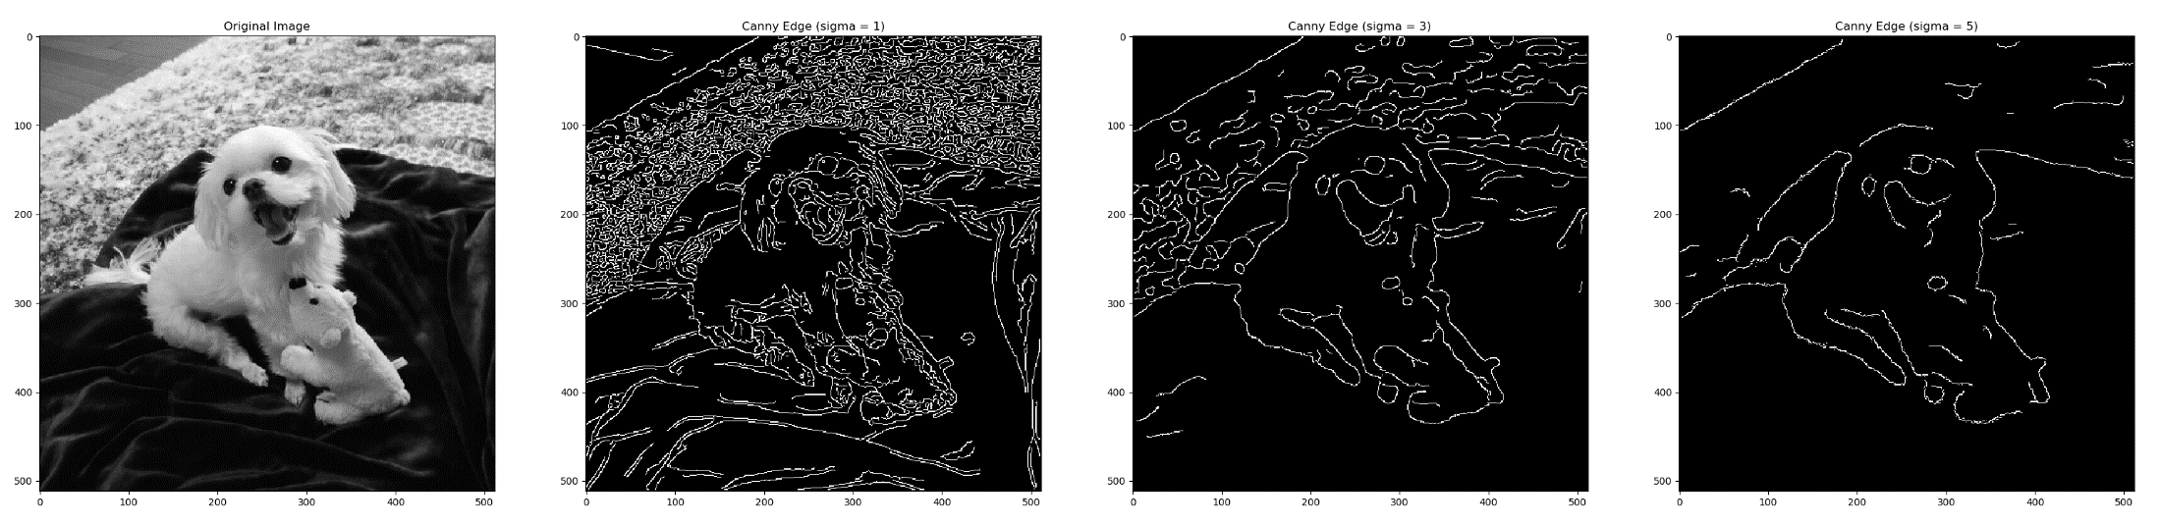
Canny

