Slide 1
Assignment

Slide 2
overall flow
Objective
Classify face images into 2 classes using HOG-based features
Use multiple classifiers (ex. SVM, decision tree, …)
Problems
Fill the blanks in the assignment.ipynb (Colab) or assignment.py (PyCharm)
Discuss the results
Submit your work to mipl.hw@gmail.com

Slide 3
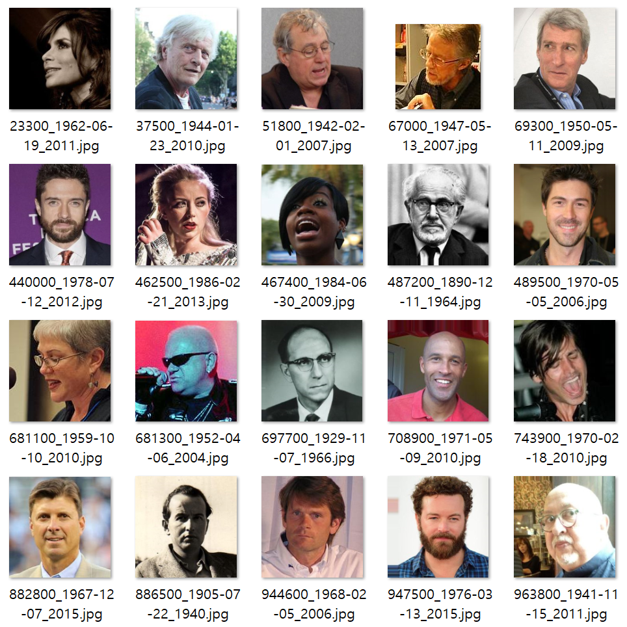
The Wikipedia Dataset

Slide 4
Detailed Flowchart
Given data
Binary class (male, female)
4000 training + 4000 test images
Training step
Convert training images to grayscale
Extract HOG features from normalized training images
Train each classifier using the HOG-based features
Test step
Convert test images to grayscale
Extract HOG features from normalized test images
Classify the test data using the HOG-based features

