Slide 1
ex 1-1
PYCHARM BASICs

Slide 2
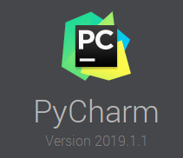
PyCharm
JetBrains: PyCharm
The Python IDE for developers (IDE: integrated Development Environment)
Coding assistance
Code editor
Code navigation
Refactoring
Developer tools
Debugging, testing and profiling
DB tools
… and so on

Slide 3
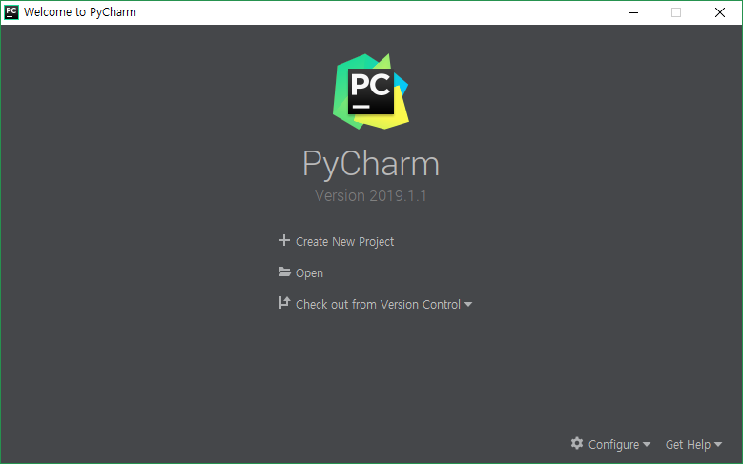
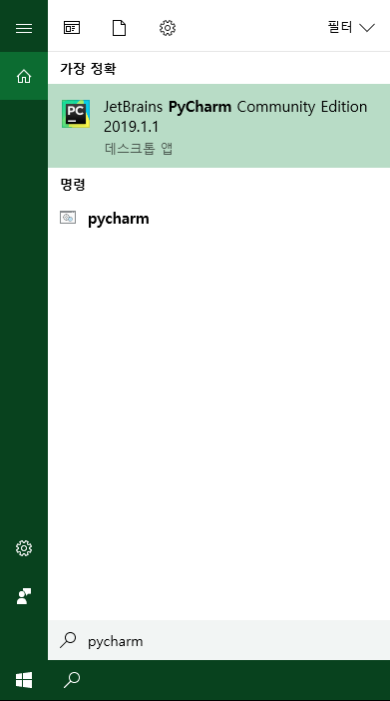
pycharm – RUn

Slide 4
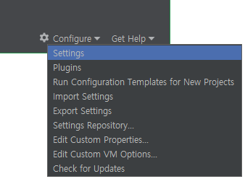
Pycharm – initial settings

Slide 5
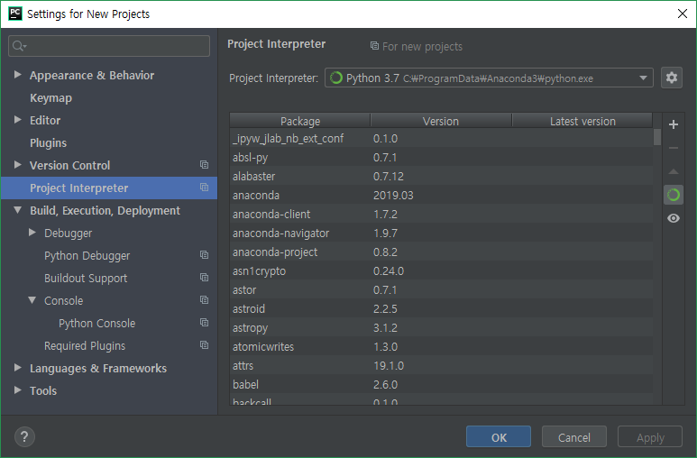
Pycharm – Initial settings
Notes:
or, Users\user\Anaconda3~

Slide 6
Pycharm – New project

Slide 7
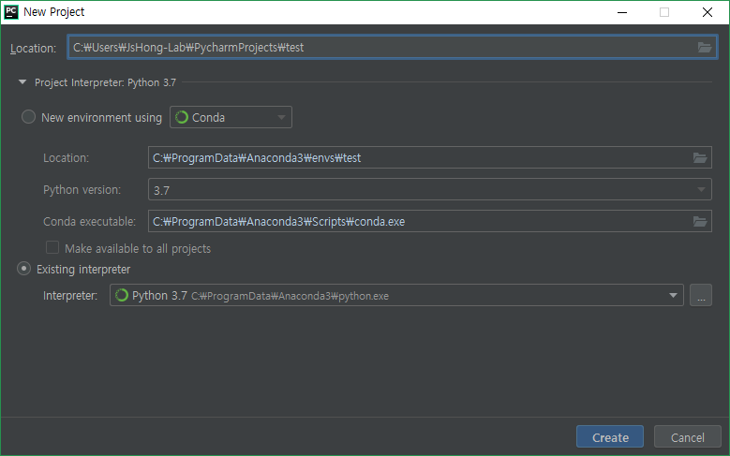
Pycharm – New project

Slide 8
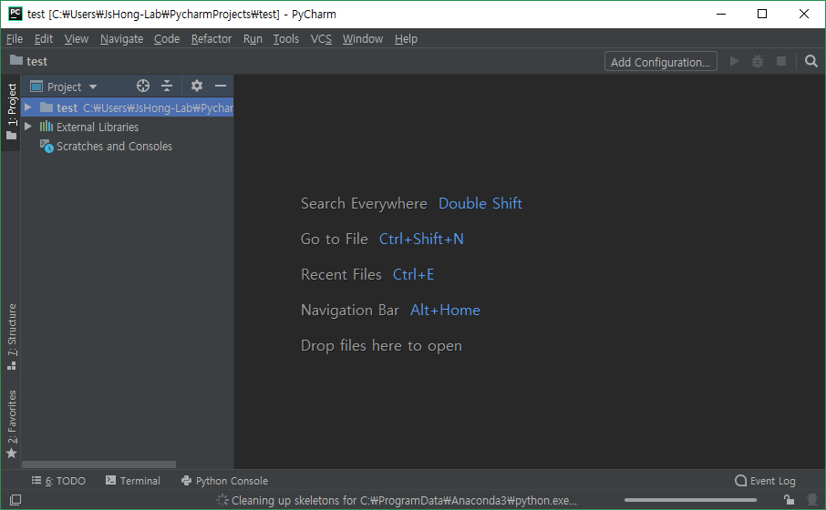
Pycharm – Main

Slide 9
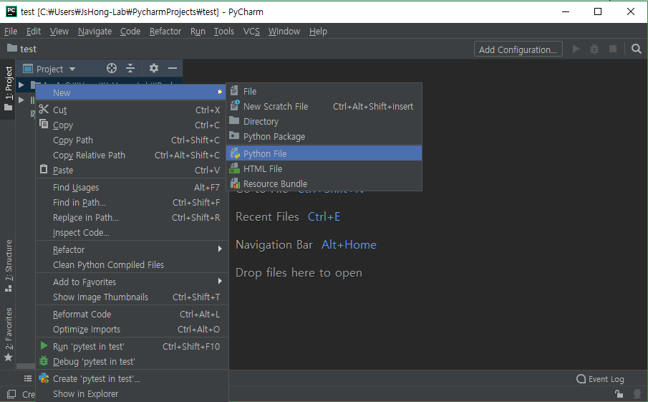
Pycharm – New python file

Slide 10
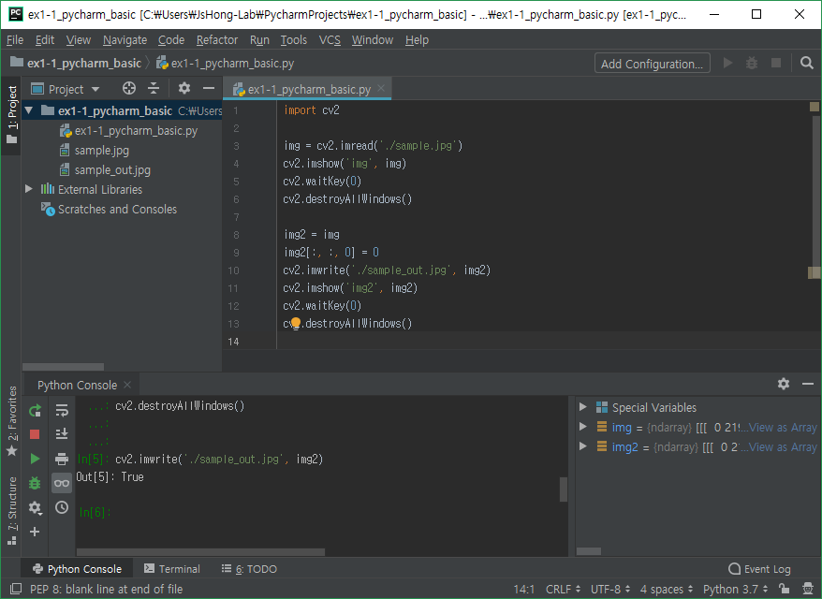
Example – cv2
Notes:
need to install opencv-python

