Slide 1
EX 2-1
edge detection

Slide 2

2d difference operators
Image gradient (first derivative)
$∇f=\left[\frac{∂f}{∂x},\frac{∂f}{∂y}\right]$
Edge strength
$\left|\left|∇f\right|\right|=\sqrt{{\left(\frac{∂f}{∂x}\right)}^{2}+{\left(\frac{∂f}{∂y}\right)}^{2}}$
Second derivative
$∇^{2}f=\frac{∂^{2}f}{∂x^{2}}+\frac{∂^{2}f}{∂y^{2}}$

Slide 3
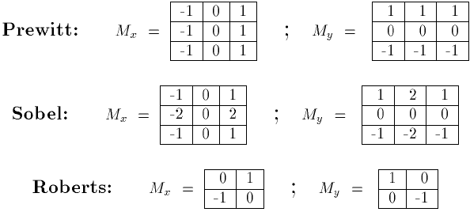






2d difference operators
$$G_{x}$$
$$G_{y}$$
$$G_{x}$$
$$G_{y}$$
$$G_{x}$$
$$G_{y}$$

Slide 4



2d difference operators
$$G_{x}$$
$$G_{y}$$
-1
0
1
1
1
1
-1
0
1
-1
0
1
1
1
1
0
0
0
-1
0
1
-1
0
1
0
0
0
-1
-1
-1
-1
0
1
-1
-1
-1

Slide 5
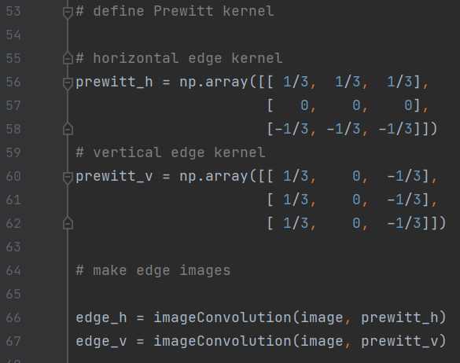
filter & edge
Edge gradient using Prewitt operator (without skimage module)

Slide 6
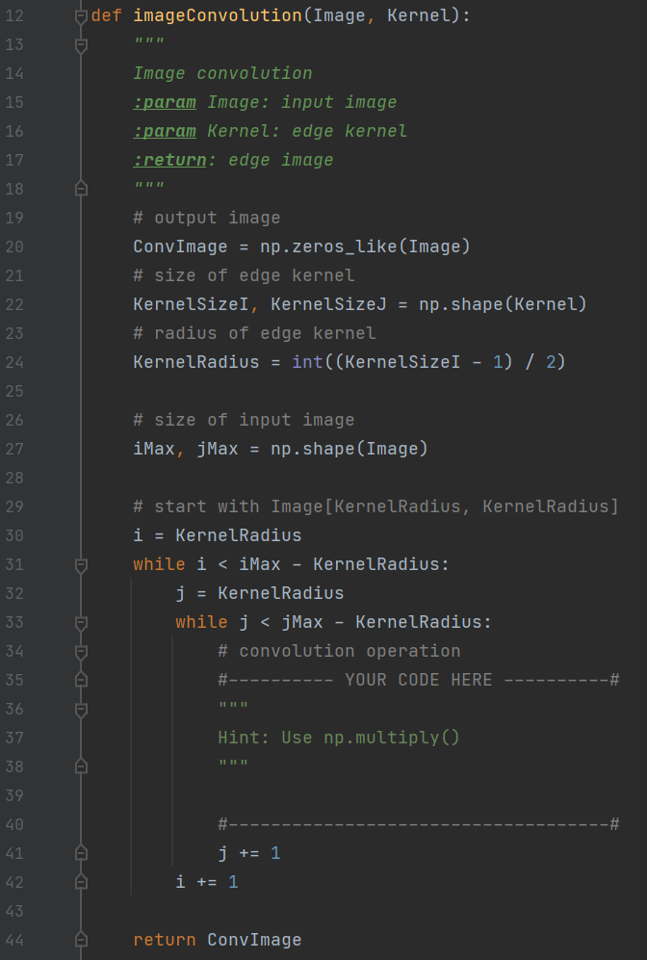
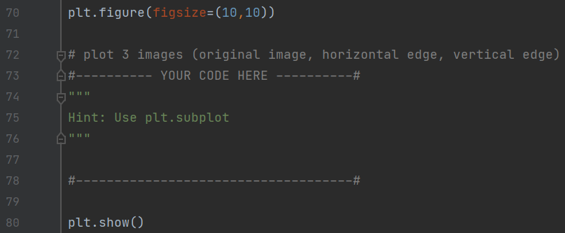
filter & edge
Edge gradient using Prewitt operator (without skimage module)

Slide 7
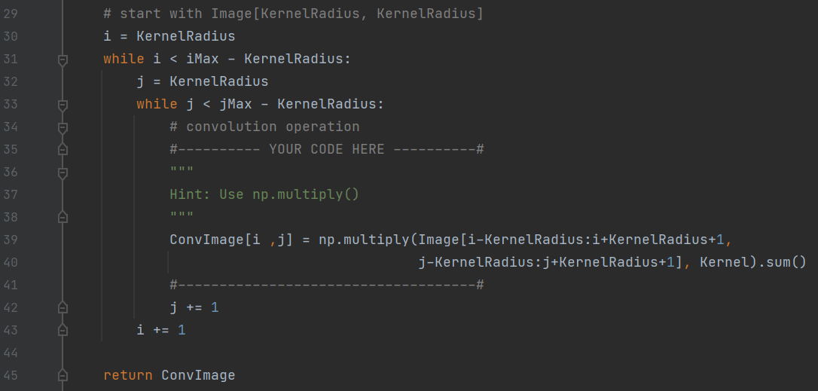
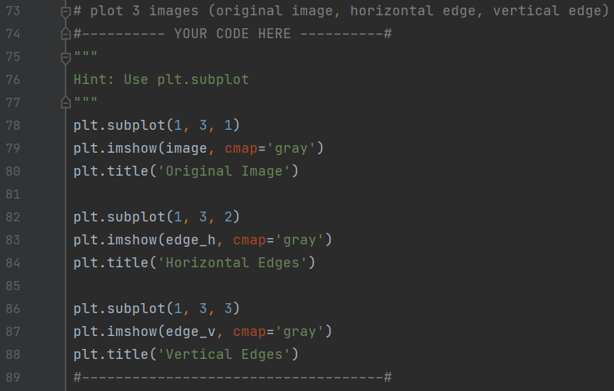
filter & edge
Edge gradient using Prewitt operator (without skimage module)

Slide 8
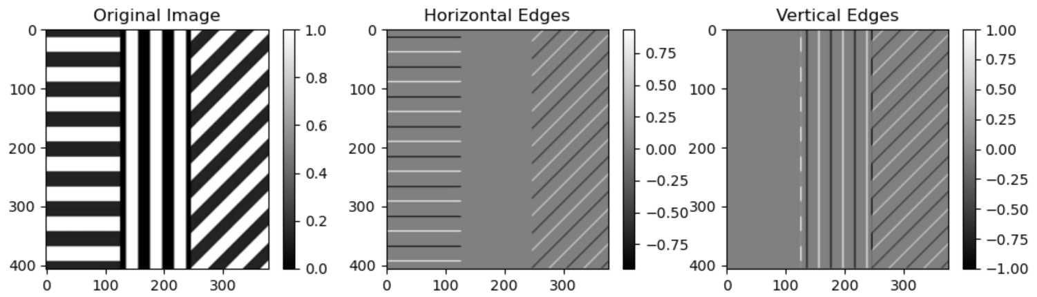
filter & edge
Edge gradient using Prewitt operator (without skimage module)

Slide 9
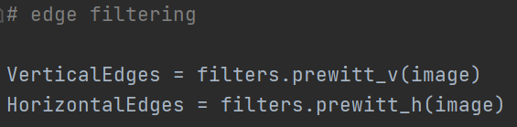
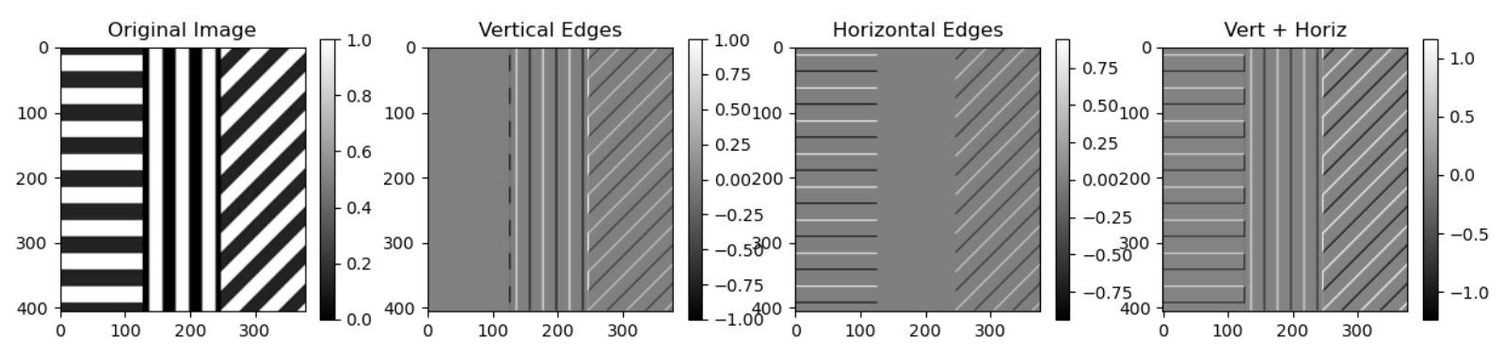
filter & edge
Edge gradient using Prewitt operator (with skimage module)

Slide 10
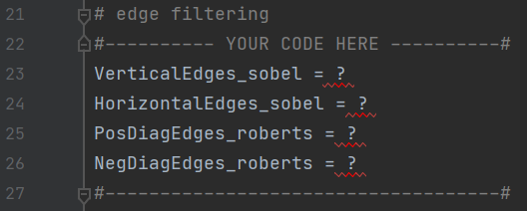
filter & edge
Edge gradient using Sobel and Roberts operator (with skimage module) https://scikit-image.org/docs/dev/api/skimage.filters.html

Slide 11
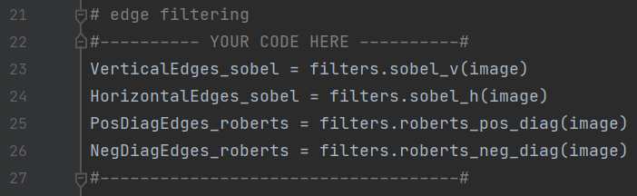
filter & edge
Edge gradient using Sobel and Roberts operator (with skimage module) https://scikit-image.org/docs/dev/api/skimage.filters.html

Slide 12
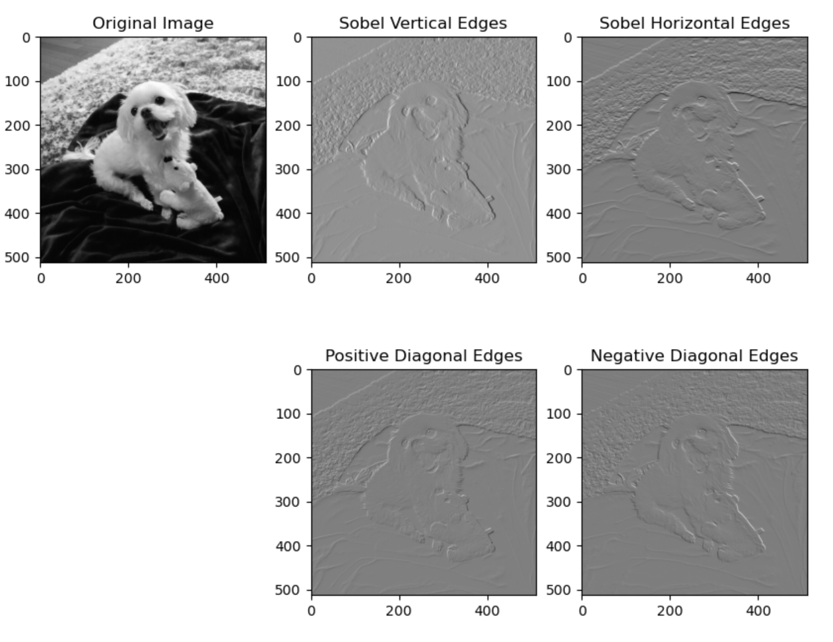
filter & edge
Edge gradient using Sobel and Roberts operator

Slide 13
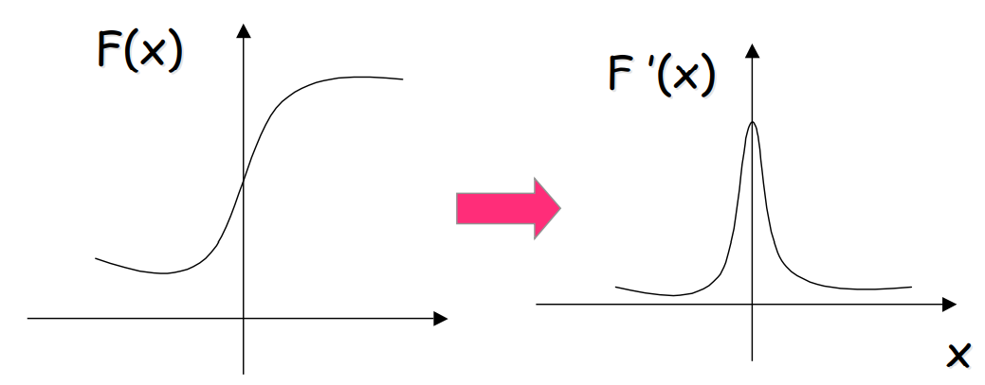
filter & edge
Recall: First derivative filters Sharp changes in gray level of the input image correspond to “peaks or valleys” of the first derivative of the input image.

Slide 14
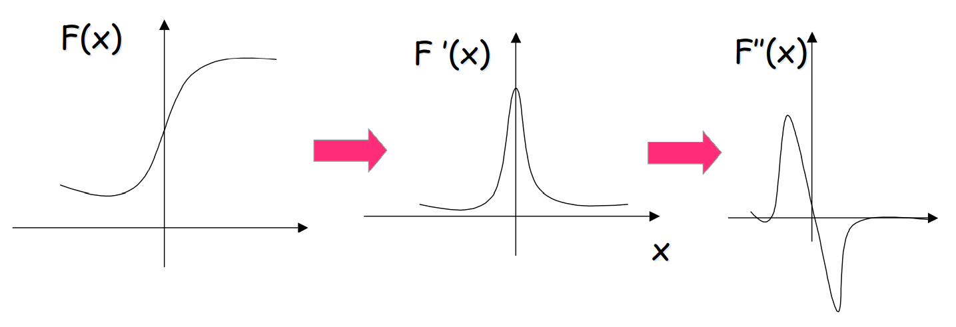
filter & edge
Second derivative filters “Peaks or valleys” of the first derivative of the input signal, correspond to “zero-crossings” of the second derivative of the input image.

Slide 15
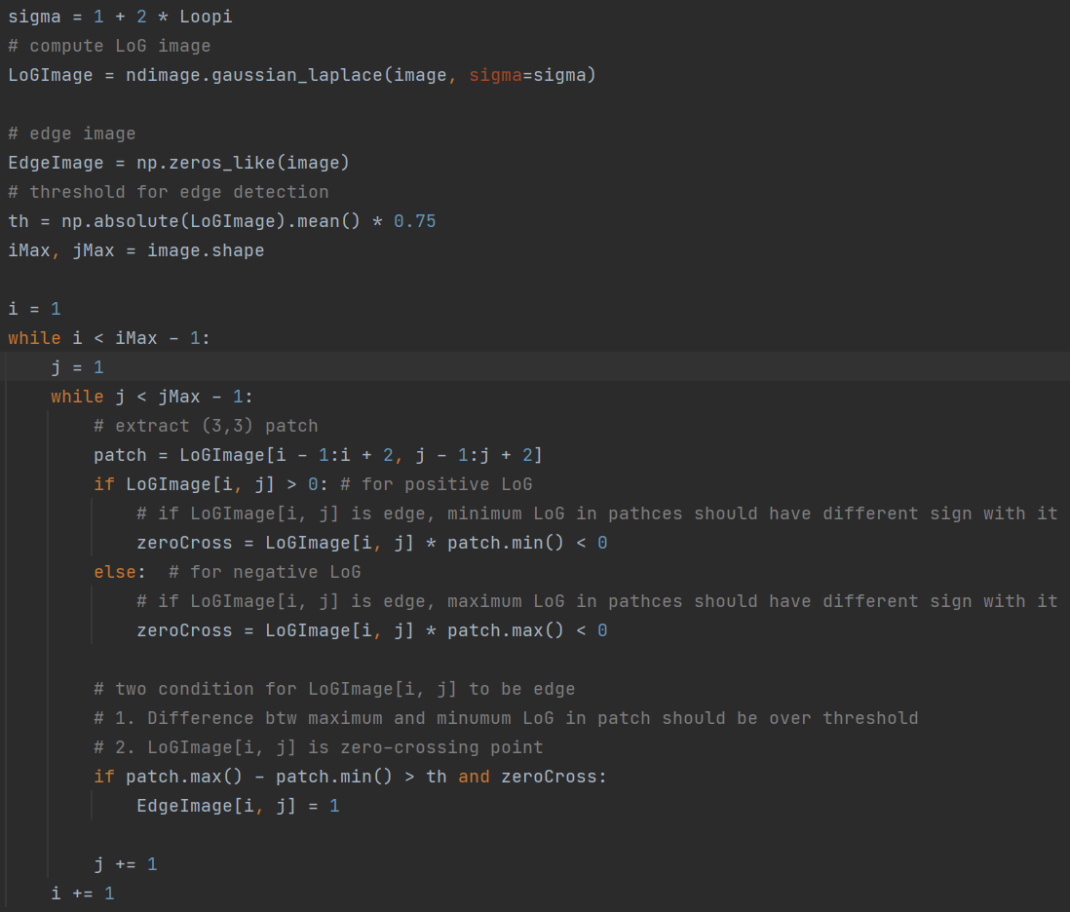
filter & edge
Second derivative using Laplacian of Gaussian
Algorithm
Compute LoG
Compute zero crossings on LoG
Compute a threshold for local LoG difference
Edge pixels = zero crossing && local difference > threshold

Slide 16
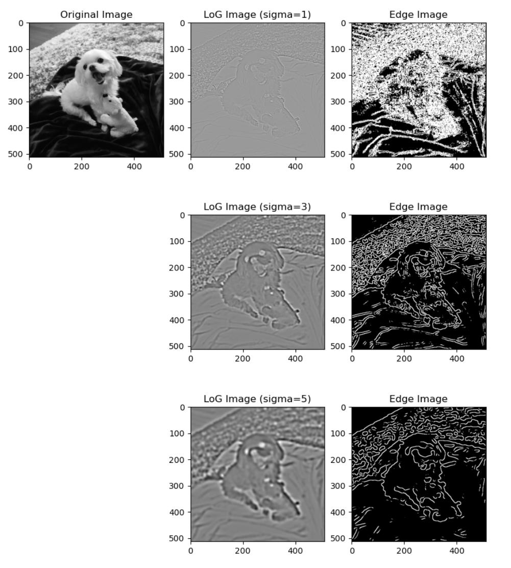
filter & edge
Second derivative using Laplacian of Gaussian

Slide 17
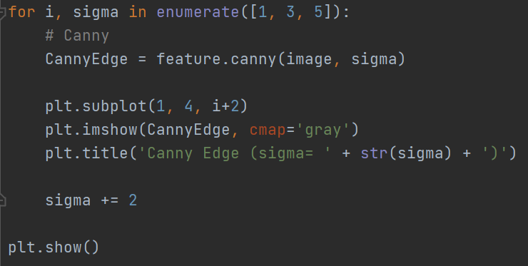
Canny
Canny Edge Detection Algorithm
Canny Algorithm
Gaussian Smoothing (optional)
Gradient calculation
Non-maximum suppression
Hysteresis thresholding

Slide 18
Canny
Canny Edge Detection Algorithm
Canny Algorithm
Gaussian Smoothing (optional)
Gradient calculation
Non-maximum suppression
Hysteresis thresholding

Slide 19
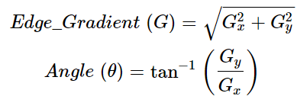
Canny
Canny Edge Detection Algorithm
Canny Algorithm
Gaussian Smoothing (optional)
Gradient calculation
Non-maximum suppression
Hysteresis thresholding
Gradient direction is always perpendicular to edges.

Slide 20
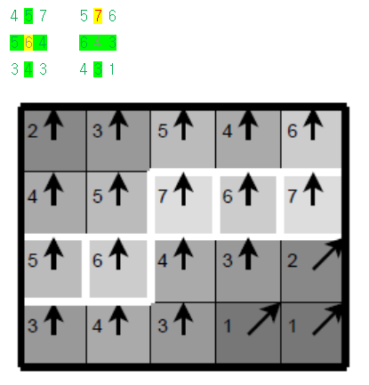
Canny
Canny Edge Detection Algorithm
Canny Algorithm
Gaussian Smoothing (optional)
Gradient calculation
Non-maximum suppression
Hysteresis thresholding

Slide 21
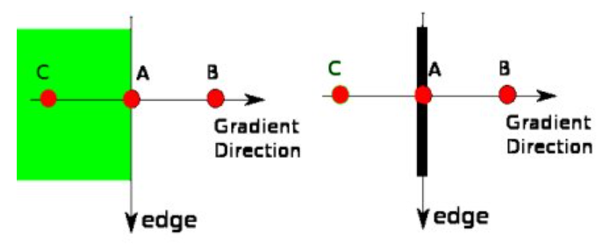
Canny
Canny Edge Detection Algorithm
Canny Algorithm
Gaussian Smoothing (optional)
Gradient calculation
Non-maximum suppression
Hysteresis thresholding

Slide 22

Canny
Canny Edge Detection Algorithm
Strong edges
Canny Algorithm
Gaussian Smoothing (optional)
Gradient calculation
Non-maximum suppression
Hysteresis thresholding
Weak edges
No edges

Slide 23
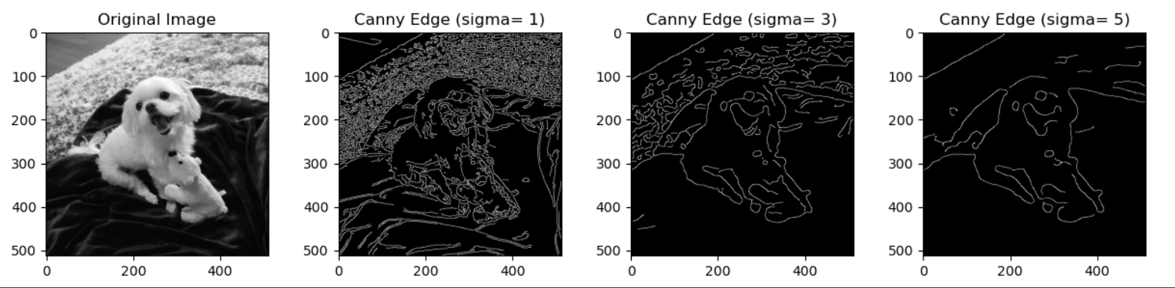
Canny

Slide 24
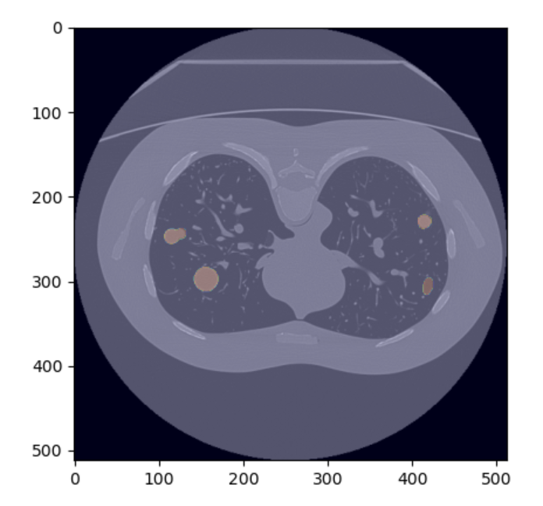
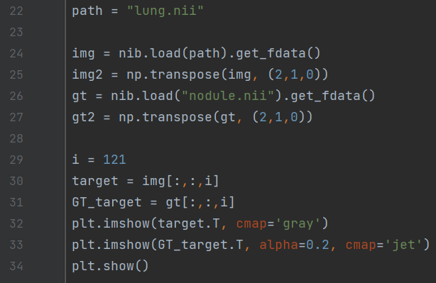
eXAMPLE
Lung nodule segmentation

Slide 25
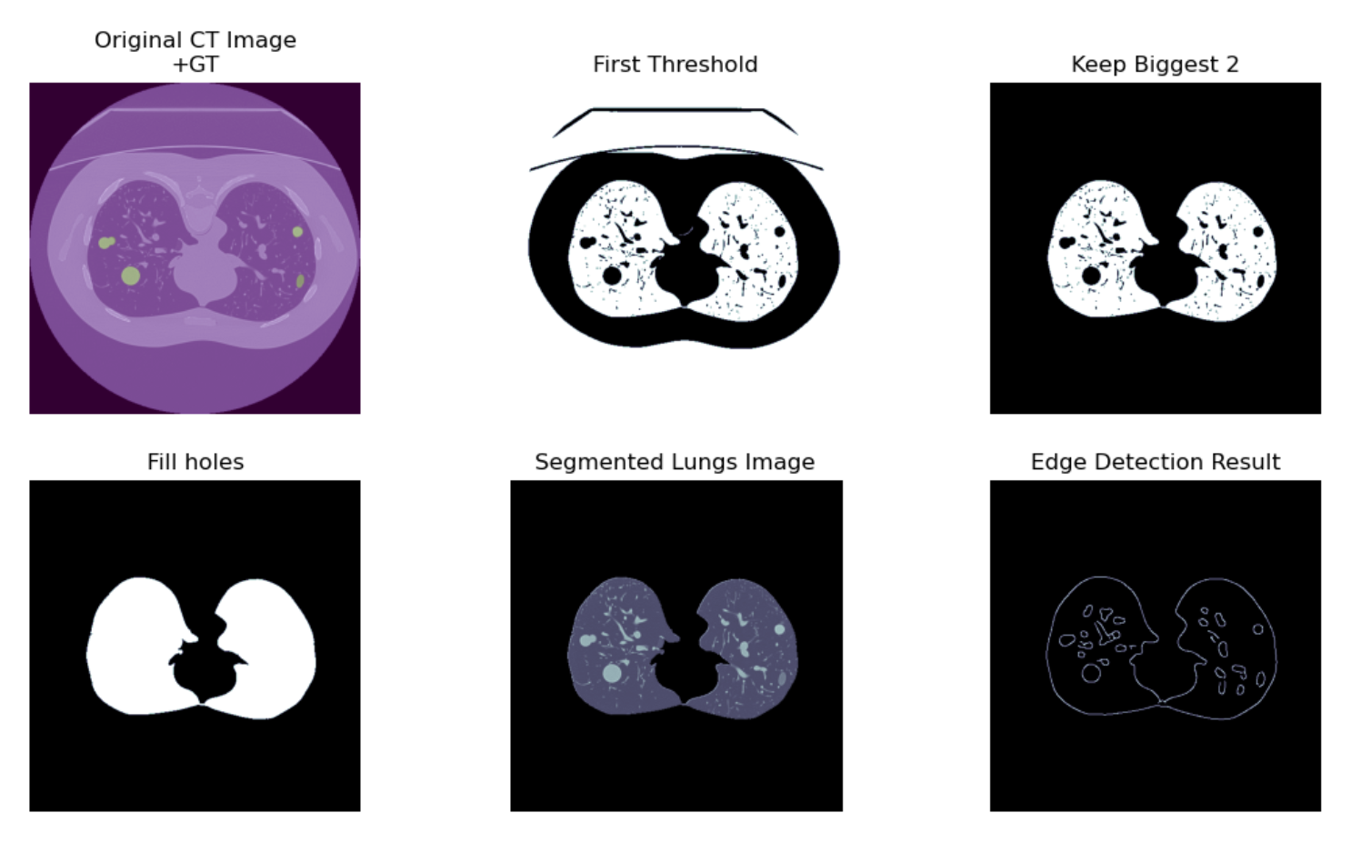
eXAMPLE
Lung nodule segmentation

Slide 26
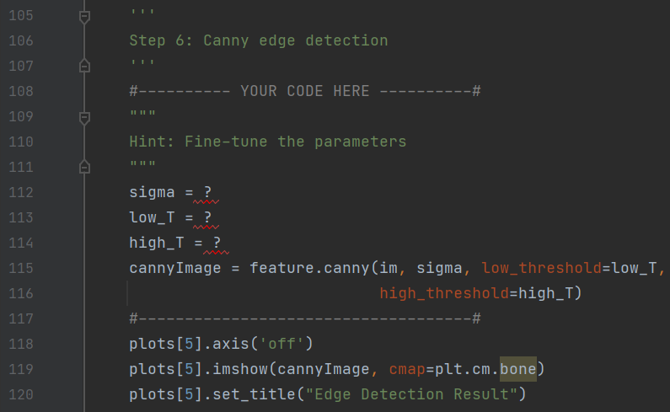
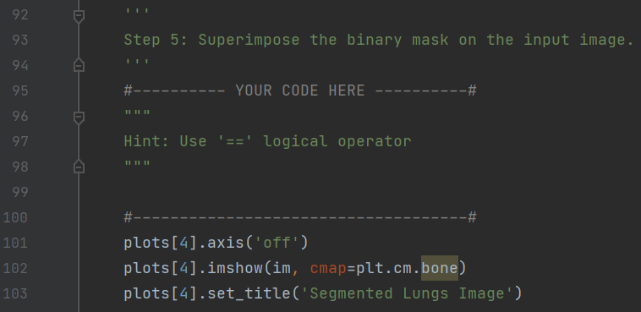
eXAMPLE
Lung nodule segmentation

Slide 27
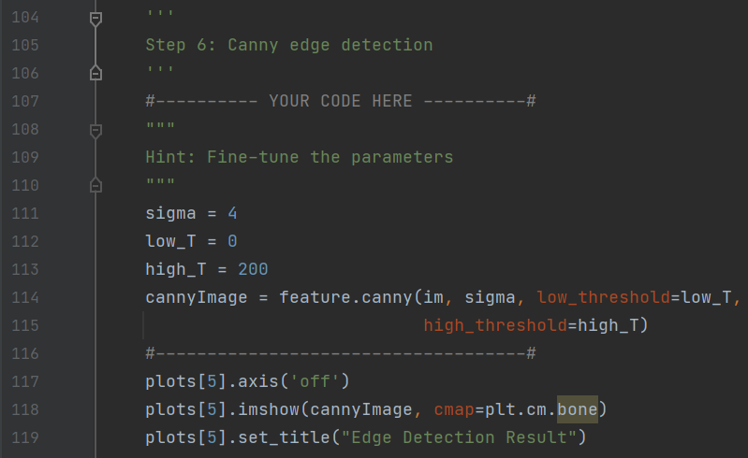
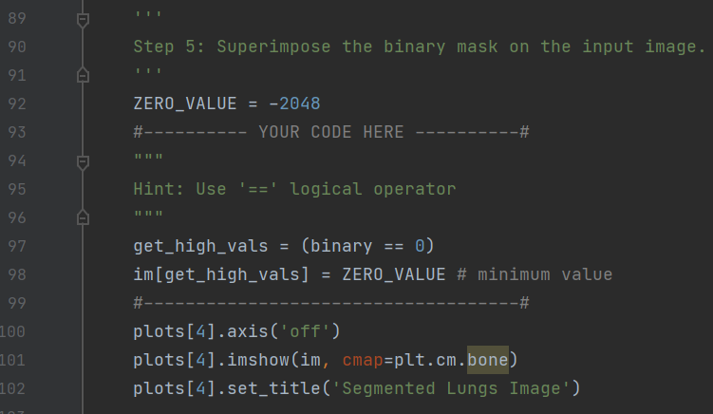
eXAMPLE
Lung nodule segmentation

