Slide 1
EX 1-3
Photometric stereo

Slide 2
Photometric stereo
Albedo = Reflection coefficient
The ratio of the total reflected power to the total incident power
Surface Normal Map

Slide 3
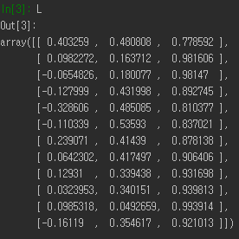
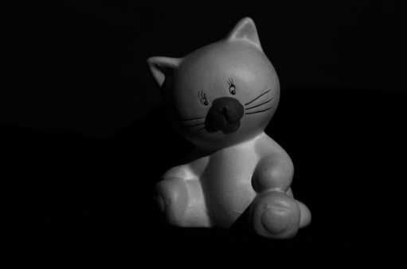
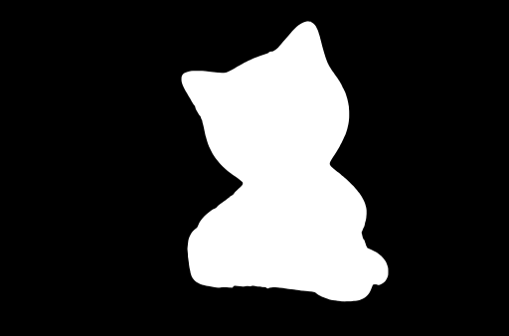

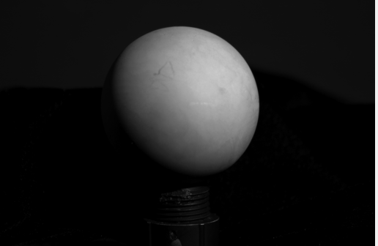
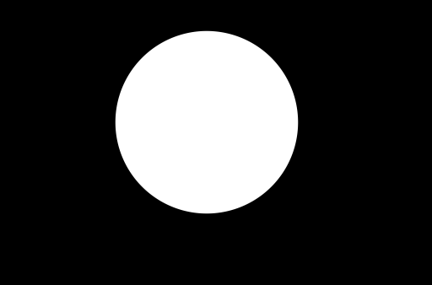
Dataset
ex)
I = scipy.io.loadmat('cat_image.mat')['I']
mask = scipy.io.loadmat('cat_mask.mat')['mask']
L = scipy.io.loadmat('cat_light.mat')['L']
Cat
N x M x 12 matrix (cat_image.mat)
12 light directions (cat_light.mat)
1 object mask (cat_mask.mat)
Ball
N x M x 12 matrix (ball_image.mat)
12 light directions (ball_light.mat)
1 object mask (ball_mask.mat)
ex)
I = scipy.io.loadmat(‘ball_image.mat')['I’]
mask = scipy.io.loadmat(‘ball_mask.mat')['mask’]
L = scipy.io.loadmat('ball_light.mat')['L']

Slide 4

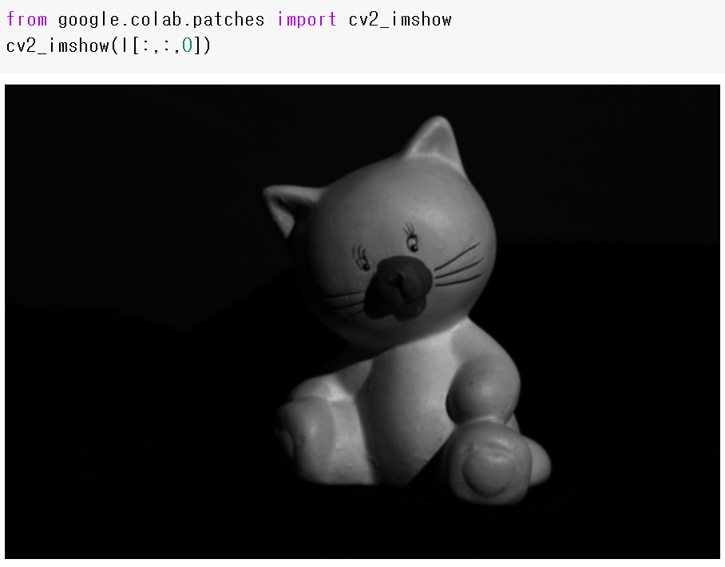
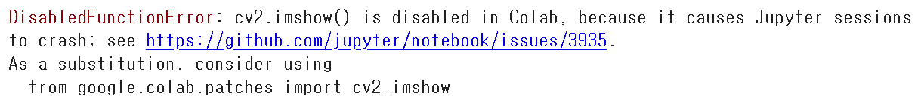
Visualize Dataset
Load data
Visualize images with the first light sources
I = scipy.io.loadmat('cat_image.mat')['I'] mask = scipy.io.loadmat('cat_mask.mat')['mask'] L = scipy.io.loadmat('cat_light.mat')['L']
cv2.imshow('test', I[:,:,0]) cv2.waitKey(0) cv2.destroyAllWindows()
<TASK>
Visualize images with other light sources and also the mask image

Slide 5
ALBEDO & SURFACE NORMAL

Slide 6
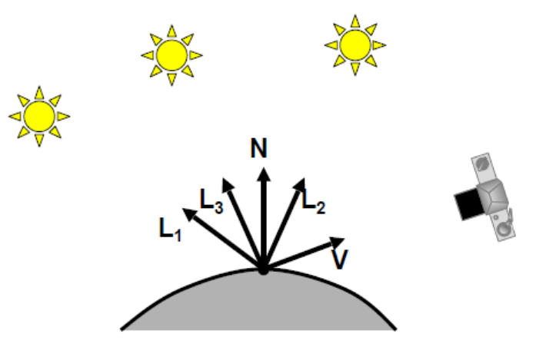


Albedo & Surface Normal
Shape from shading
$I=k_{d}N∙L$
$I$: image
$k_{d}$: reflection coefficient
$N$: surface normal
$L$: light direction
$$I_{1}=k_{d}N∙L_{1}$$
$$I_{2}=k_{d}N∙L_{2}$$
$$I_{3}=k_{d}N∙L_{3}$$
$$\left[I_{1} I_{2} I_{3}\right]=k_{d}N^{T}[L_{1} L_{2} L_{3}]$$

Slide 7




Albedo & Surface Normal
$\left[I_{1} I_{2} I_{3}\right]=k_{d}N^{T}[L_{1} L_{2} L_{3}]$
Solve the equations using least squares: $I=GL$ $IL^{T}=GLL^{T}$ $G=\left(IL^{T}\right){\left(LL^{T}\right)}^{−1}$ $k_{d}=\left|\left|G\right|\right|$ $N=\frac{1}{k_{d}}G$
$$I$$
$$G$$
$$L$$
Albedo
Surface normal

Slide 8


Albedo & Surface Normal
Calculate pixel-wise normal vector and albedo
$I=GL$ $IL^{T}=GLL^{T}$ $G=\left(IL^{T}\right){\left(LL^{T}\right)}^{−1}$ $k_{d}=\left|\left|G\right|\right|$ $N=\frac{1}{k_{d}}G$
def pixelnorm(image, light): # image.shape = 12 pixel values at a selected location per each image # light.shape = (12, 3) three light directions (x, y, z) # image = image.T fail = 0 A = light.T.dot(light) b = light.T.dot(image) g = np.linalg.inv(A).dot(b) R = np.linalg.norm(g, ord=2) # Albedo N = np.divide(g, R) # Normal vector if np.linalg.norm(image, ord=2) < 1.0E-06: print('Warning: Pixel intensity is zero') N[0] = 0.0 N[1] = 0.0 N[2] = 0.0 R = 0.0 fail = 1 return N, R, fail
1st image
I
L
12th image

Slide 9

Albedo & Surface Normal
def normal_map(image, light, mask): nrows = image.shape[0] # get size of image ncols = image.shape[1] numimage = image.shape[2] surfnorm = np.zeros((nrows, ncols, 3)) # Initialize albedo = np.zeros((nrows, ncols)) for i in range(0, nrows): for j in range(0, ncols): surfnorm[i, j, 0] = 0.0 # initialize normal(x) surfnorm[i, j, 1] = 0.0 # initialize normal(x) surfnorm[i, j, 2] = 1.0 # initialize normal(z) albedo[i, j] = 0.0 # initialize albedo for i in range(0, nrows): for j in range(0, ncols): if mask[i,j] > 0: # calculate only on the object area temp = np.zeros((numimage)) for im in range(0, numimage): temp[im] = np.double(image[i, j, im]) NP, R, fail = pixelnorm(temp, light) # pixel-wise output surfnorm[i, j, 0] = NP[0] surfnorm[i, j, 1] = NP[1] surfnorm[i, j, 2] = NP[2] albedo[i, j] = R maxval = np.max(albedo) if maxval > 0: albedo = albedo / maxval return surfnorm, albedo
Expand to the whole image
1st image
lightMatrix
images
12th image

Slide 10
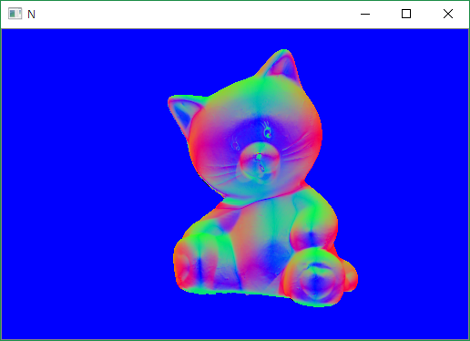
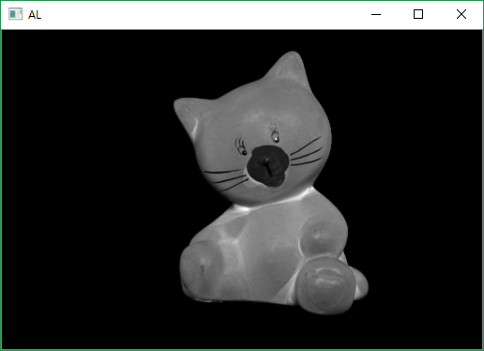
Albedo & Surface Normal
Outputs
N, AL = normal_map(I, L, mask) b, g, r = cv2.split(N) # img to bgr N = cv2.merge([r, g, b]) # bgr to rgb and merge cv2.imshow('N', N) cv2.imshow('AL', AL) cv2.waitKey(0) cv2.destroyAllWindows()

Slide 11
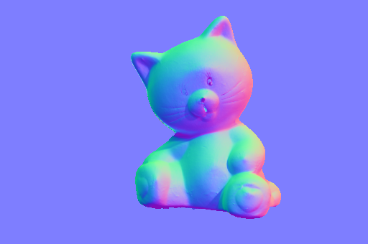
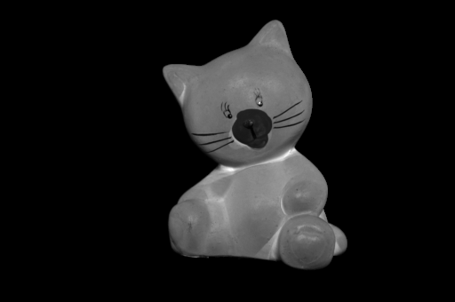
Albedo & Surface Normal
Outputs
N = cv2.normalize(N, None, 0, 255, cv2.NORM_MINMAX, cv2.CV_8UC3)
cv2_imshow(N)
AL = cv2.normalize(AL, None, 0, 255, cv2.NORM_MINMAX, cv2.CV_8UC1)
cv2_imshow(AL)

Slide 12
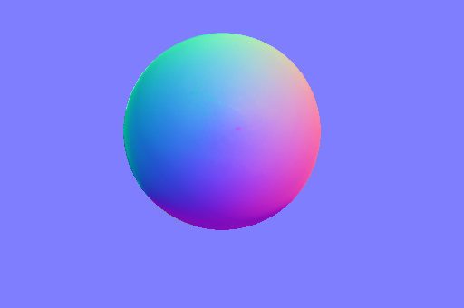
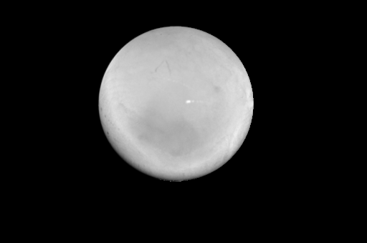
Albedo & Surface Normal
Outputs
N = cv2.normalize(N, None, 0, 255, cv2.NORM_MINMAX, cv2.CV_8UC3)
cv2_imshow(N)
AL = cv2.normalize(AL, None, 0, 255, cv2.NORM_MINMAX, cv2.CV_8UC1)
cv2_imshow(AL)

