Slide 1
EX 1-2
Transformation

Slide 2

image transformation
$g\left(x,y\right)=T\left[f\left(x,y\right)\right]$
X=Row, Y=Column
Rigid-body transformation
Translation + Rotation
Affine transformation
Translation + Rotation + Scaling + Shearing
Package
matplotlib, skimage, scipy, numpy

Slide 3
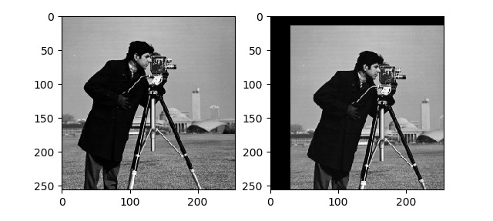
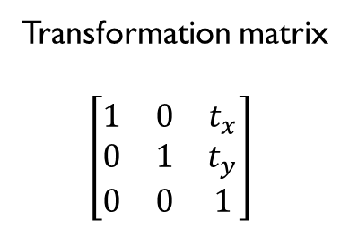
Translation
Transformation matrix
$\left[\begin{matrix}1 & 0 & t_{x} \\ 0 & 1 & t_{y} \\ 0 & 0 & 1\end{matrix}\right]$

Slide 4
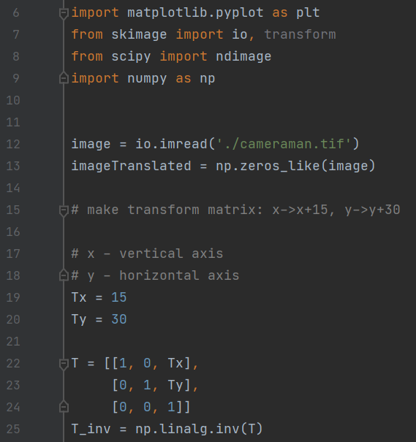
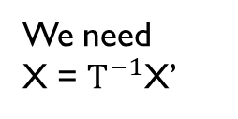
Translation
Define transformation matrix
T for X’ = TX
We need X = $T^{−1}$X’

Slide 5
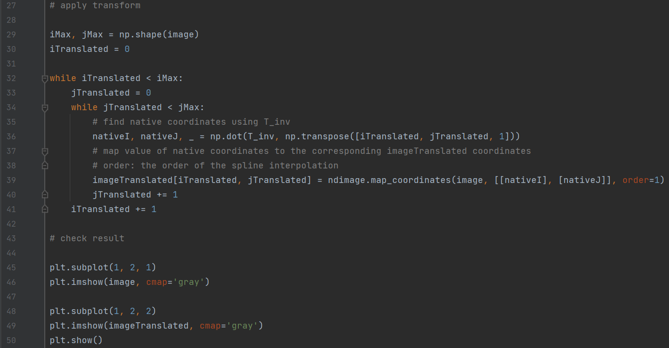

Translation
Apply transform
X = $T^{−1}$X’
Interpolation

Slide 6
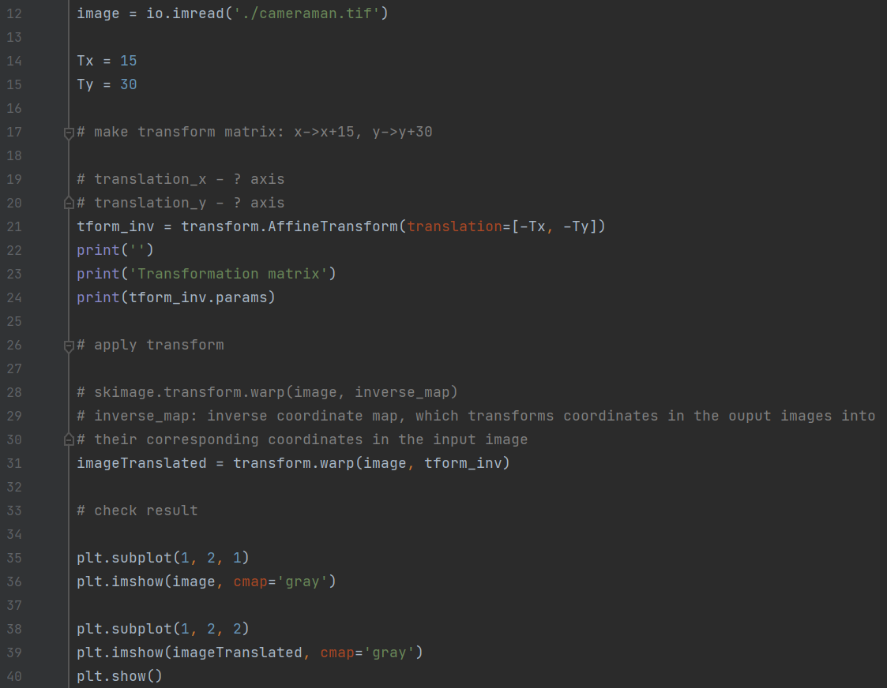
Translation
Additional work : Simple way!

Slide 7
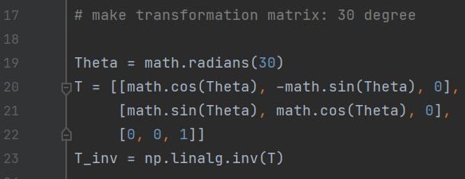

Rotation
Define transformation matrix
Transformation matrix
$$\left[\begin{matrix}\cos{θ} & −\sin{θ} & 0 \\ \sin{θ} & \cos{θ} & 0 \\ 0 & 0 & 1\end{matrix}\right]$$

Slide 8
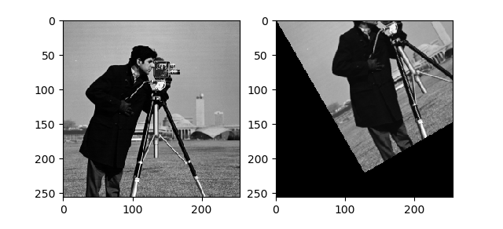
Rotation

Slide 9
Rotation
Can we rotate the image around the image center?

Slide 10
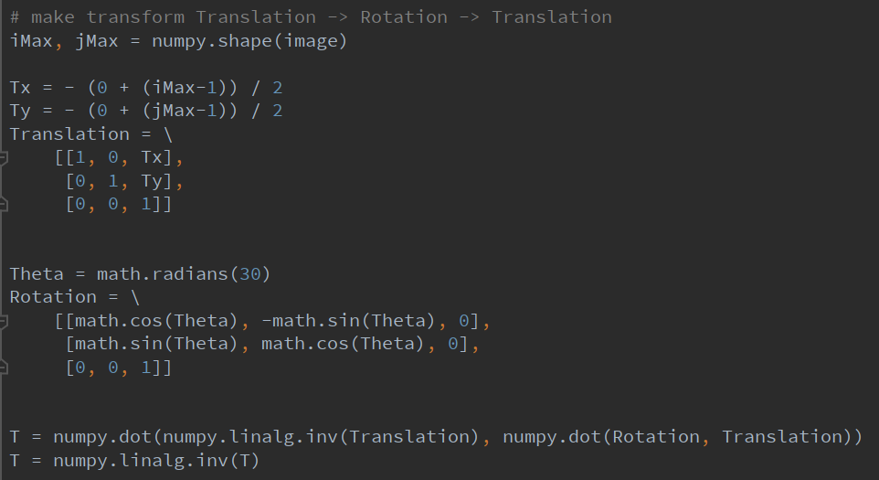
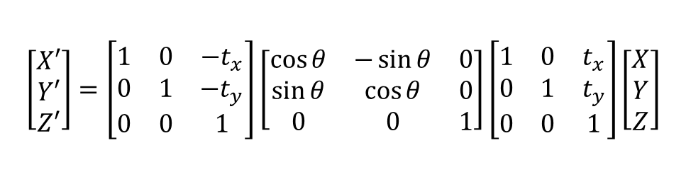
Rotation (AROUND Image center)
Define transformation matrix
Center→Origin translation
$$\left[\begin{matrix}X′ \\ Y′ \\ Z′\end{matrix}\right]=\left[\begin{matrix}1 & 0 & −t_{x} \\ 0 & 1 & −t_{y} \\ 0 & 0 & 1\end{matrix}\right]\left[\begin{matrix}\cos{θ} & −\sin{θ} & 0 \\ \sin{θ} & \cos{θ} & 0 \\ 0 & 0 & 1\end{matrix}\right]\left[\begin{matrix}1 & 0 & t_{x} \\ 0 & 1 & t_{y} \\ 0 & 0 & 1\end{matrix}\right]\left[\begin{matrix}X \\ Y \\ Z\end{matrix}\right]$$
Order matter!!

Slide 11
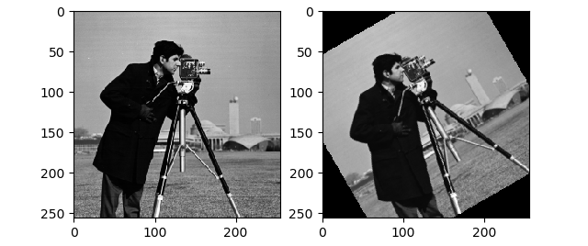
Rotation (by Image center)

Slide 12
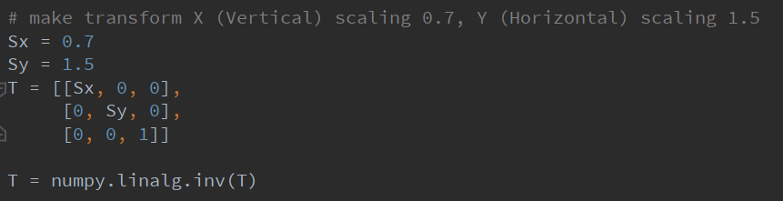

Scaling
Define transformation matrix
Transformation matrix
$$\left[\begin{matrix}s_{x} & 0 & 0 \\ 0 & s_{y} & 0 \\ 0 & 0 & 1\end{matrix}\right]$$

Slide 13
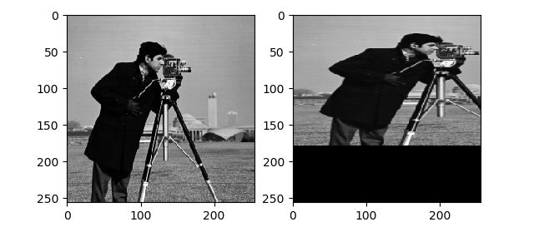
Scaling

Slide 14
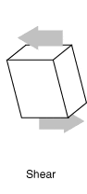
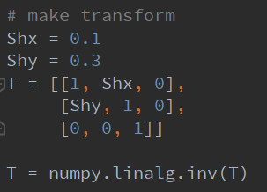

Shearing
Define transformation matrix
Transformation matrix
$$\left[\begin{matrix}1 & sh_{y} & 0 \\ sh_{x} & 1 & 0 \\ 0 & 0 & 1\end{matrix}\right]$$

Slide 15
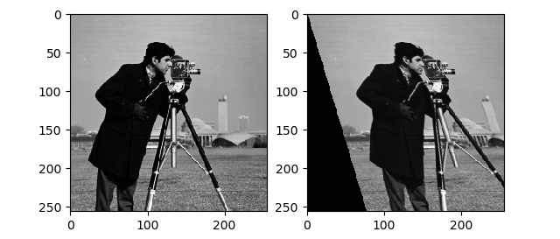
Shearing

Slide 16
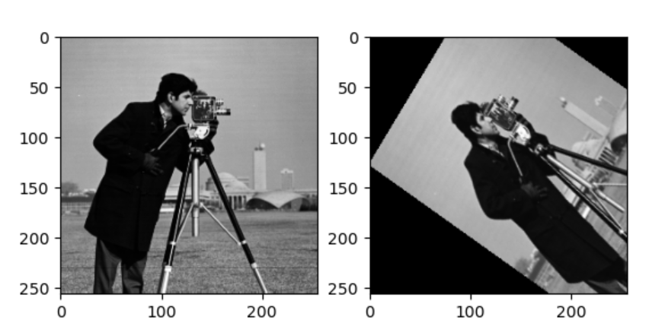
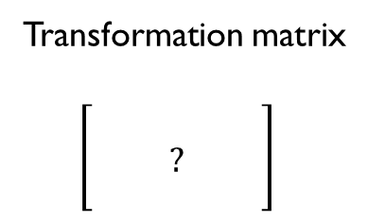
Example
Transformation matrix
$$\left[\begin{matrix} & & \\ & ? & \\ & & \end{matrix}\right]$$

Slide 17
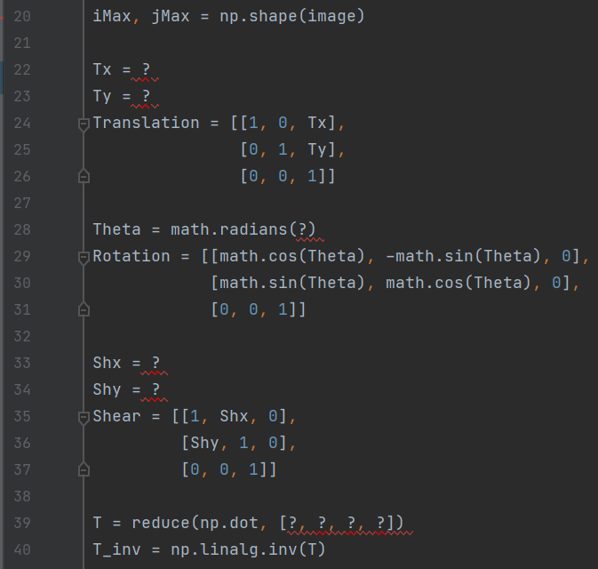
Example

Slide 18
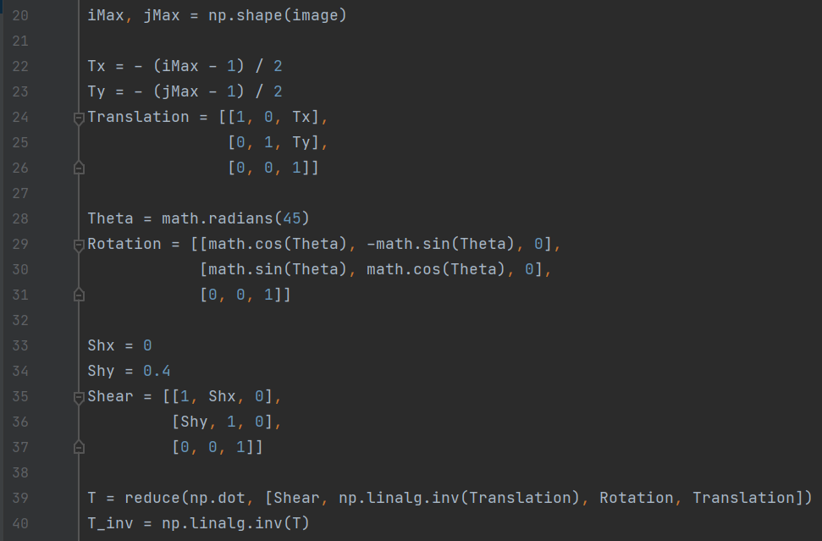
Example - SOLUTON

