Slide 1
EX 1-4
Filters

Slide 2
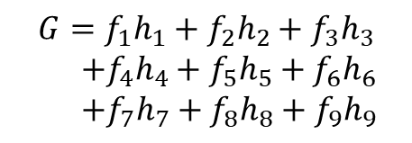

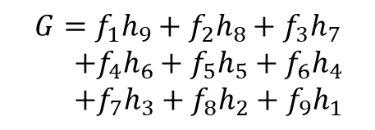
filtering
Correlation filter
$G\left[i,j\right]=\sum_{u=−k}^{k}{\sum_{v=−k}^{k}{H\left[u,v\right]F\left[i+u,j+v\right]}}$
Convolution filter
$G\left[i,j\right]=\sum_{u=−k}^{k}{\sum_{v=−k}^{k}{H\left[u,v\right]F\left[i−u,j−v\right]}}$
Image
Kernel
f₁ | f₂ | f₃
f₄ | f₅ | f₆
f₇ | f₈ | f₉
h₁ | h₂ | h₃
h₄ | h₅ | h₆
h₇ | h₈ | h₉
$$G=f_{1}h_{1}+f_{2}h_{2}+f_{3}h_{3}$$ $+f_{4}h_{4}+f_{5}h_{5}+f_{6}h_{6}$ $+f_{7}h_{7}+f_{8}h_{8}+f_{9}h_{9}$
*
Image
Kernel
X-, Y-flip
f₁ | f₂ | f₃
f₄ | f₅ | f₆
f₇ | f₈ | f₉
h₉ | h₈ | h₇
h₆ | h₅ | h₄
h₃ | h₂ | h₁
$$G=f_{1}h_{9}+f_{2}h_{8}+f_{3}h_{7}$$ $+f_{4}h_{6}+f_{5}h_{5}+f_{6}h_{4}$ $+f_{7}h_{3}+f_{8}h_{2}+f_{9}h_{1}$
*

Slide 3
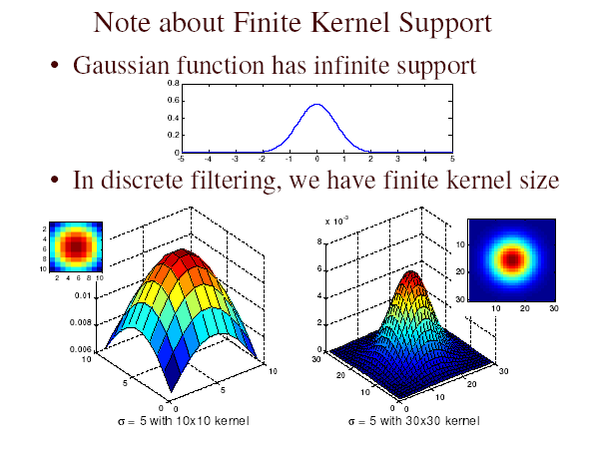
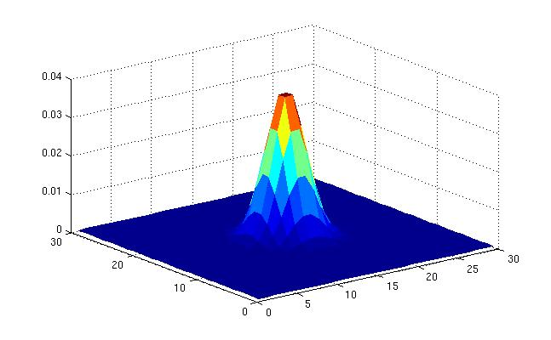
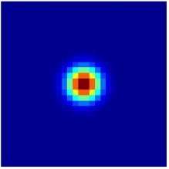
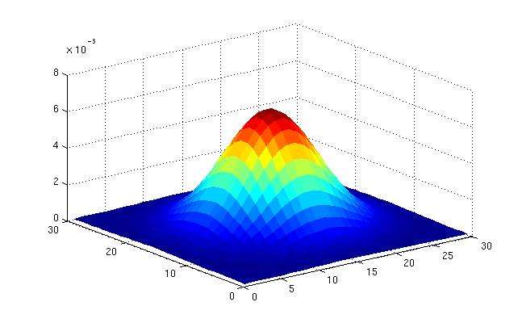
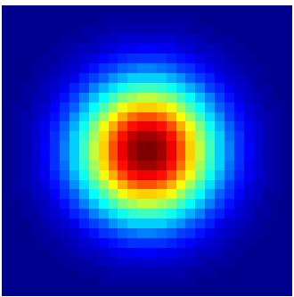




Filtering
Size of kernel
Variance of kernel
$σ=5$ with $10×10$ kernel
$σ=5$ with $30×30$ kernel
$σ=2$ with $30×30$ kernel
$σ=5$ with $30×30$ kernel

Slide 4
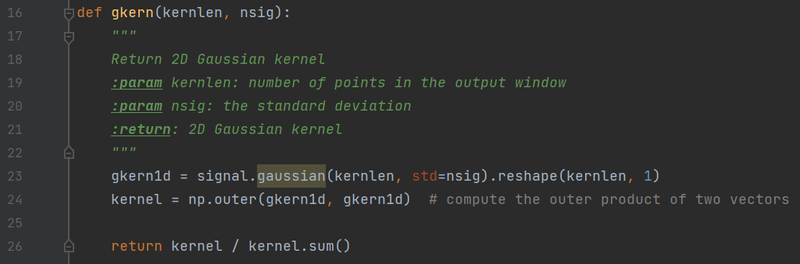
Filtering
Gaussian Kernel Calculation

Slide 5
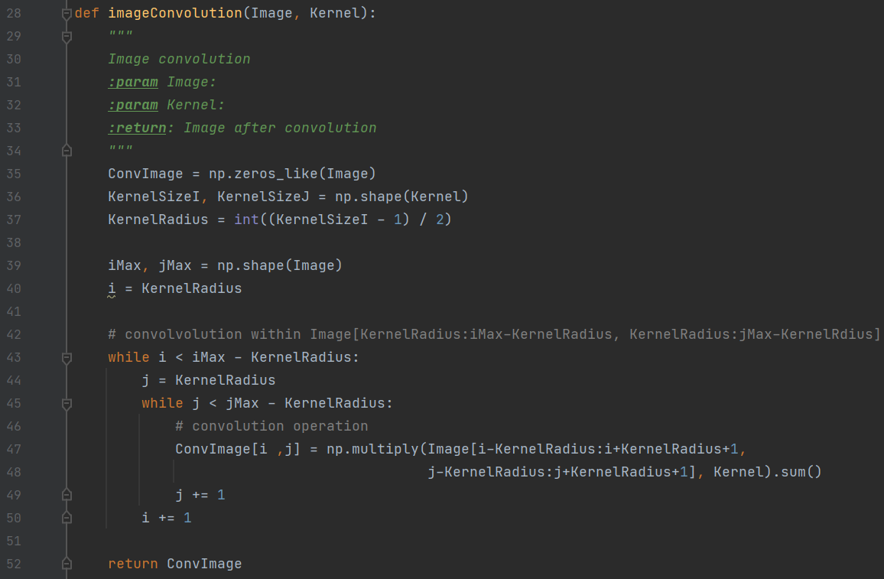
Filtering
Convolution

Slide 6
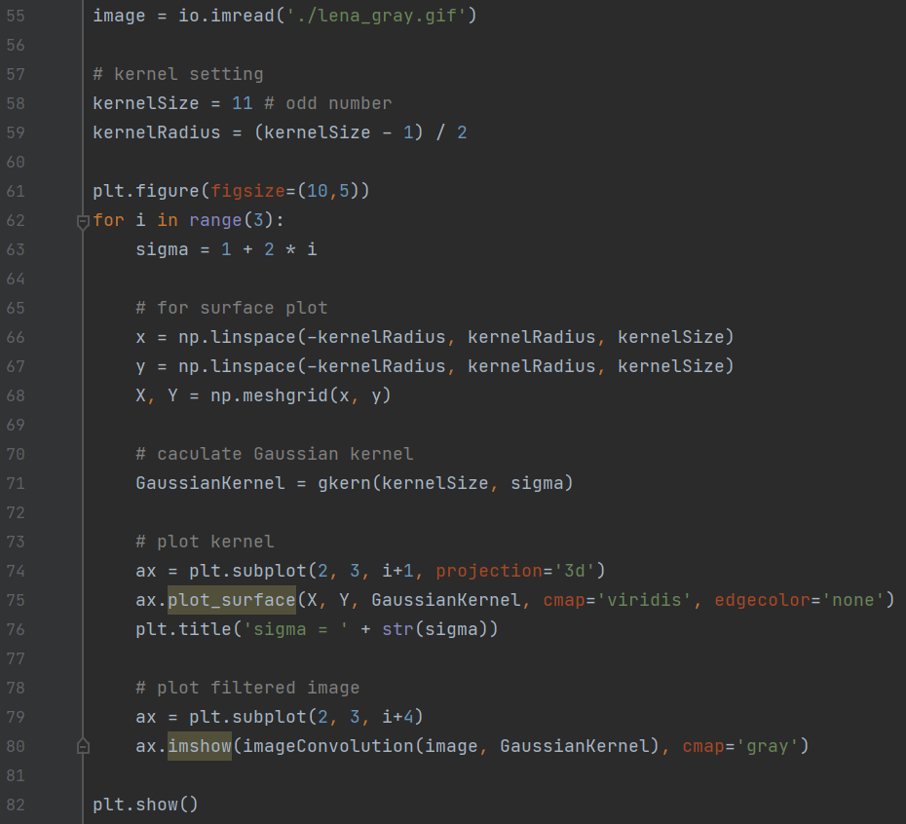
Filtering
Gaussian filtering – kernel size fixed, sigma = 1,3,5

Slide 7
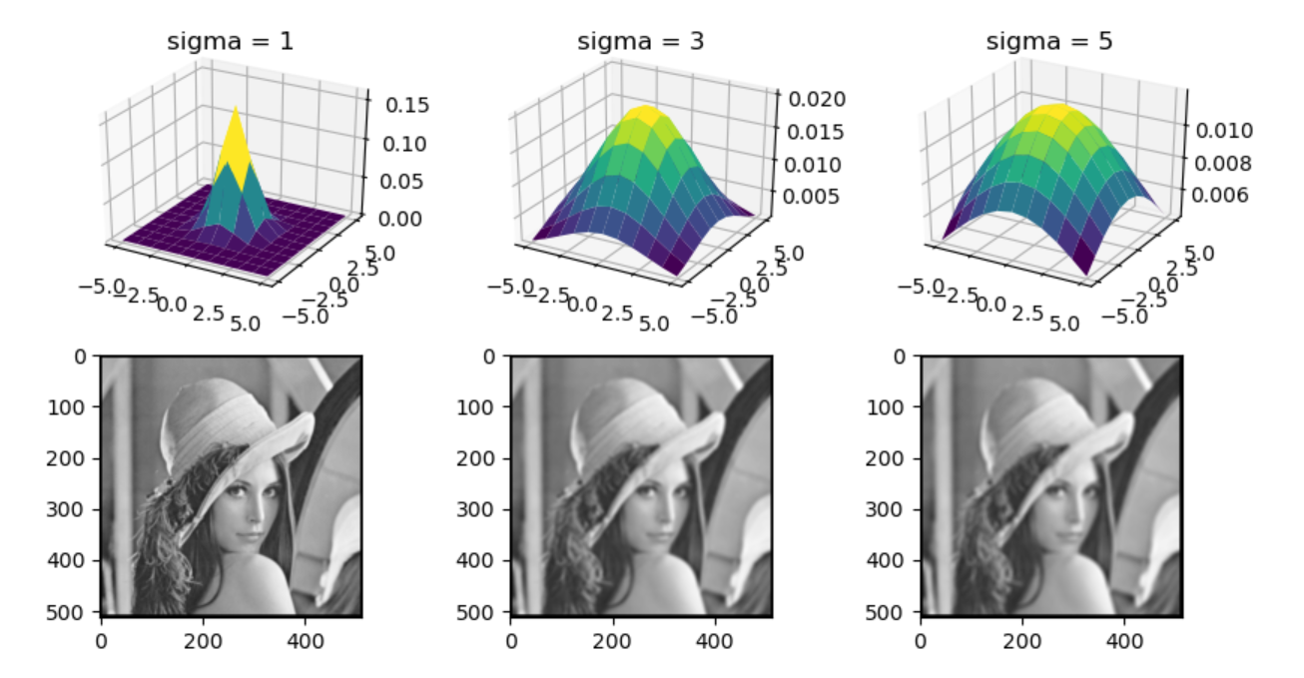
Filtering
Gaussian filtering – kernel size fixed, sigma = 1,3,5

Slide 8
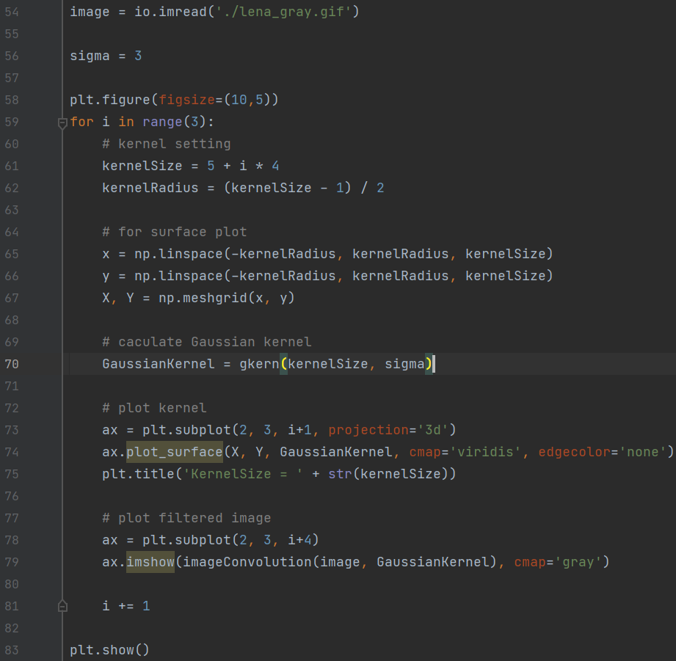
Filtering
Gaussian filtering – sigma fixed, Kernel Size = 5, 9, 13

Slide 9
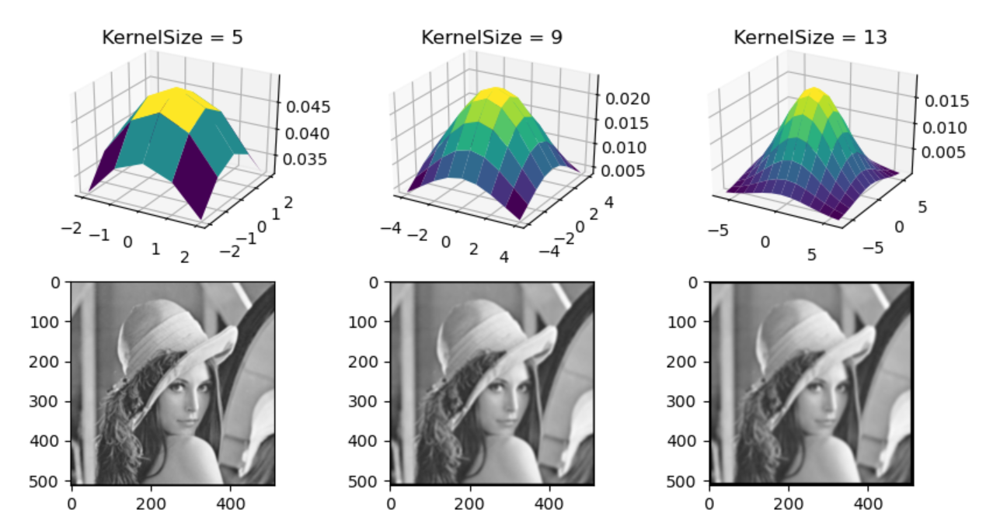
Filtering
Gaussian filtering – sigma fixed, Kernel Size = 5, 9, 13

Slide 10
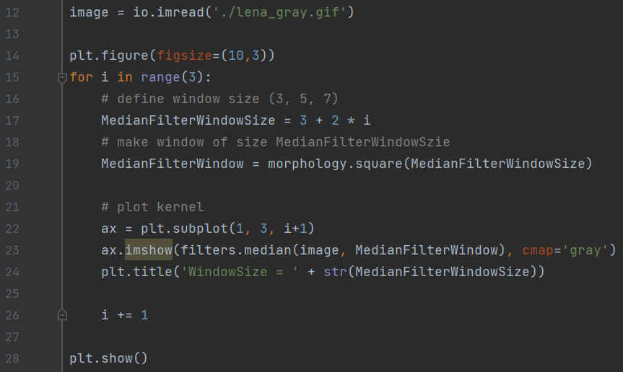
Filtering
Median filter – window size = 3, 5, 7

Slide 11
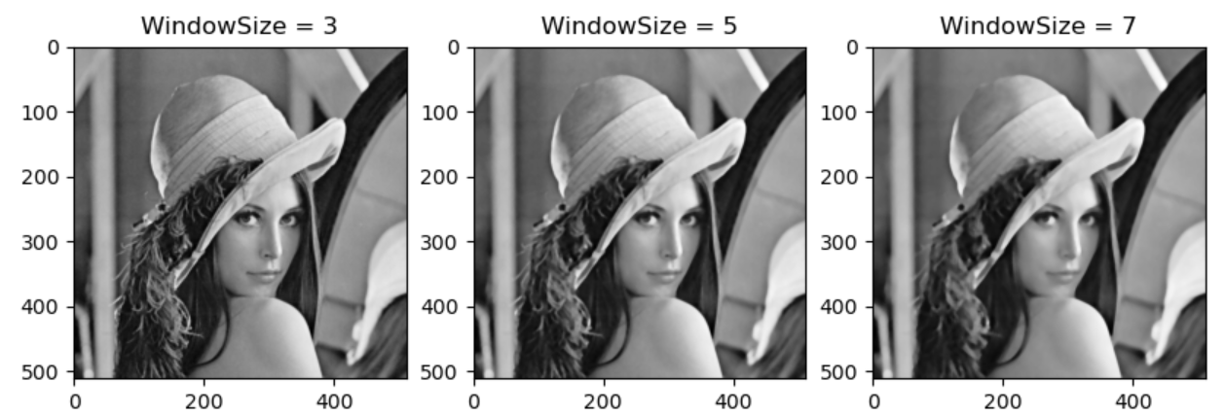
Filtering
Median filter – window size = 3, 5, 7

Slide 12


Filtering
High-boost filtering (sharpening the image)
Blur the image.
Subtract the blurred image from the original image. The output image will have most of the high-frequency components.
Adding these components back to the original will enhance the high-frequency components.

Slide 13
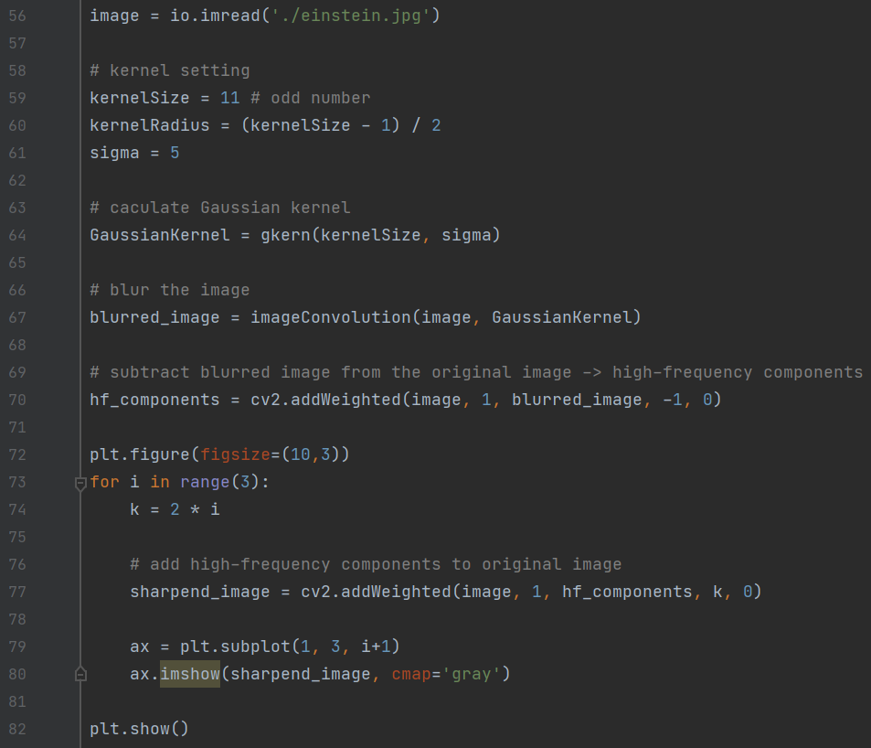
Filtering
High-boost filtering (sharpening the image)

Slide 14
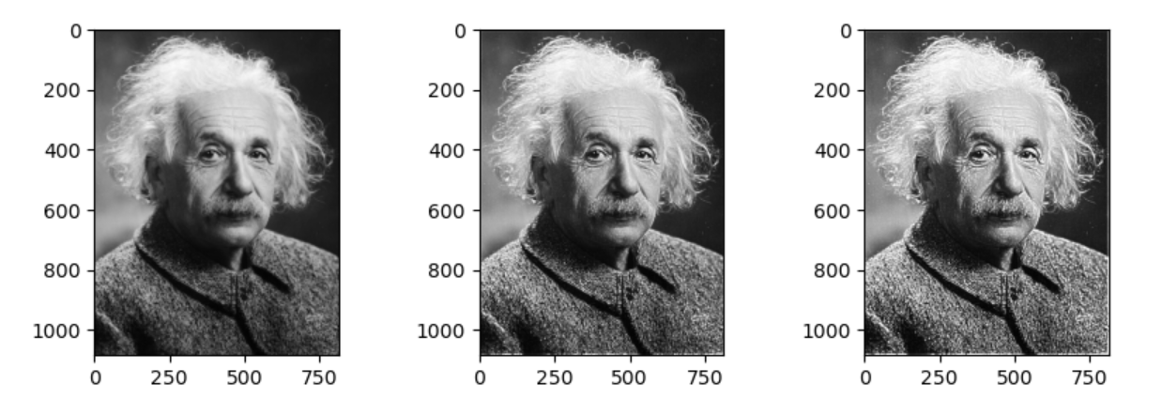
Filtering
High-boost filtering (sharpening the image)

Slide 15
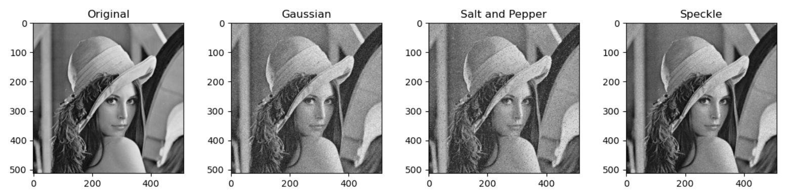
Filtering
Application: Denoising Type of noise: Gaussian, Salt and Pepper, Speckle

Slide 16
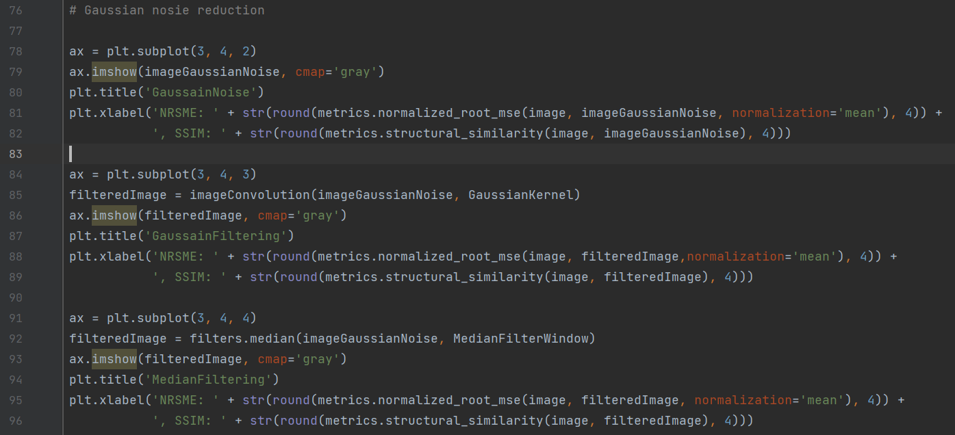
example
Application: Denoising (Gaussian noise) Similarity measure: NRMSE(normalized RMSE), SSIM (Structural similarity)

Slide 17
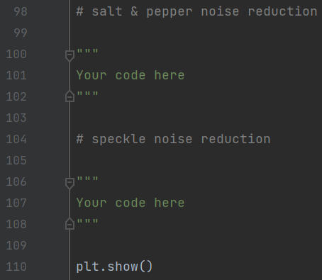
Example
Do it yourself! Denoise Salt& Pepper and Speckle noises

Slide 18
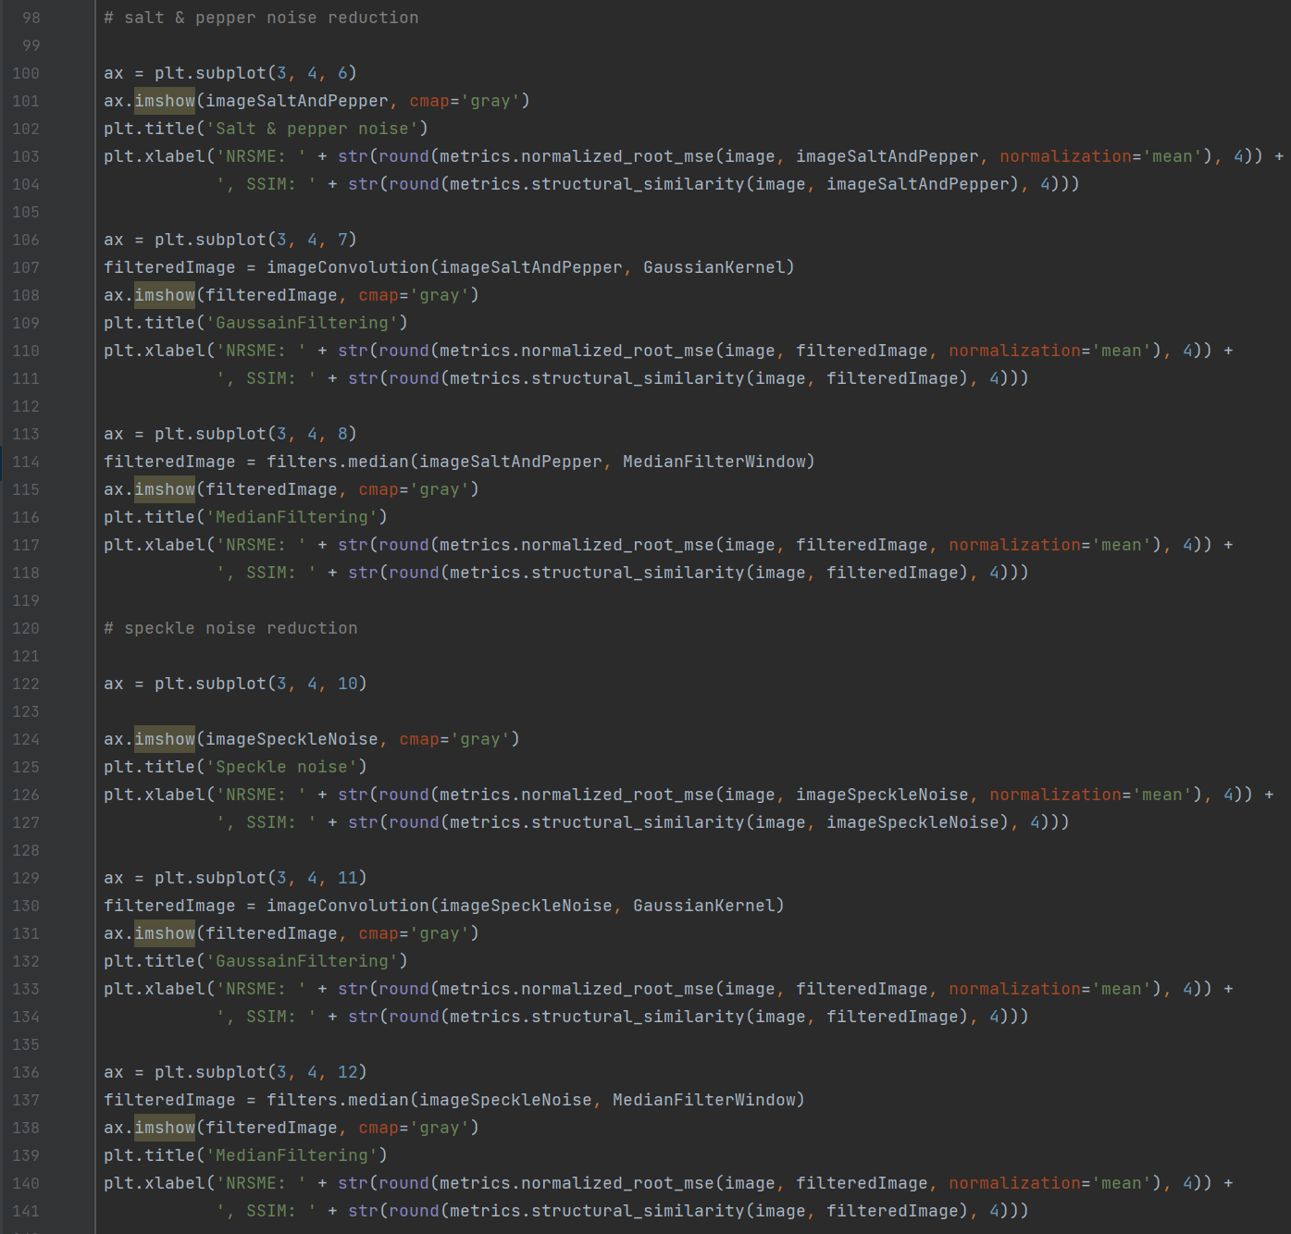
Example - solution

Slide 19
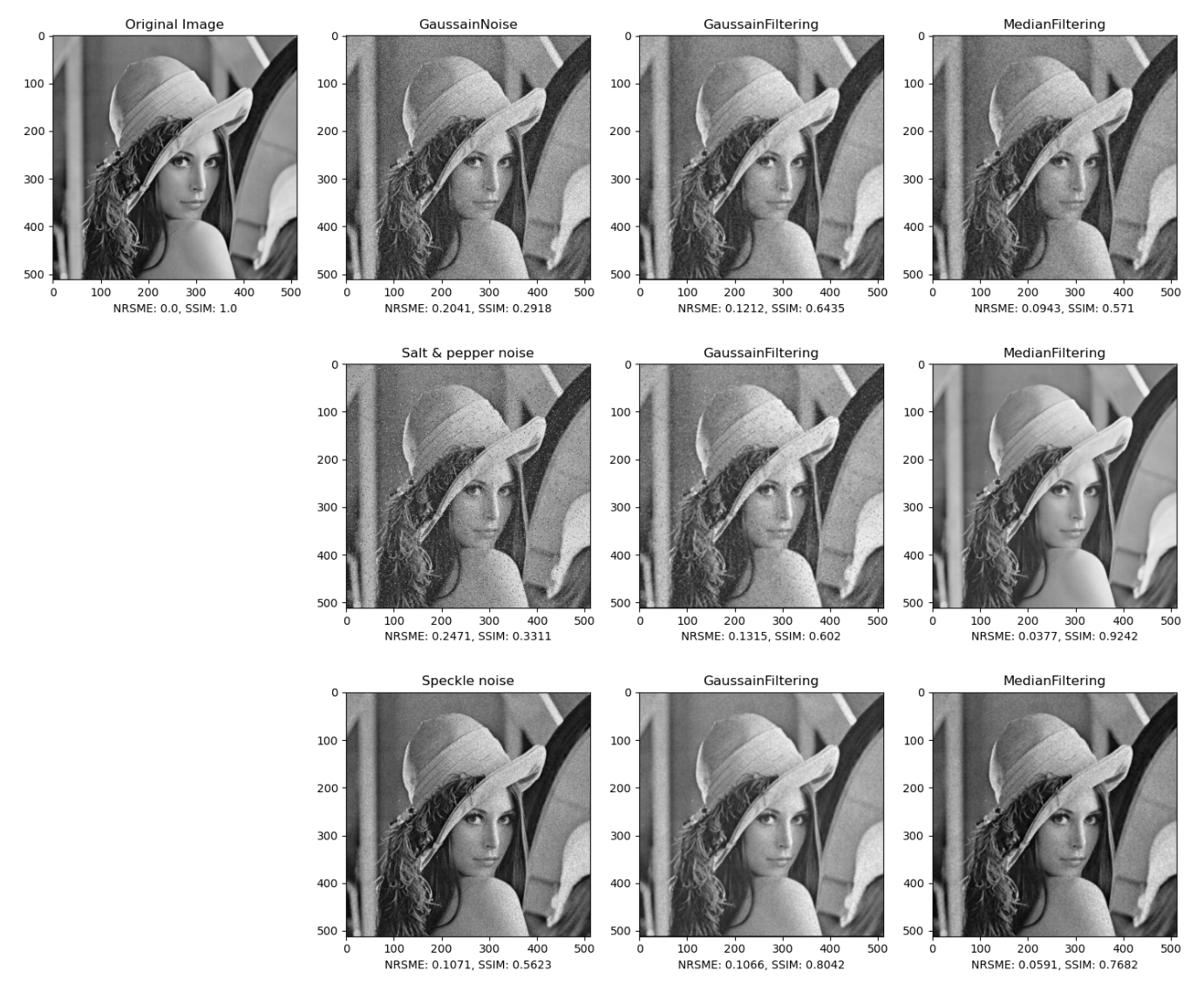
Example - solution

