Slide 1
EX 2-1
edge detection

Slide 2

2d difference operators
Image gradient (first derivative)
$∇f=\left[\frac{∂f}{∂x},\frac{∂f}{∂y}\right]$
Edge strength
$\left|\left|∇f\right|\right|=\sqrt{{\left(\frac{∂f}{∂x}\right)}^{2}+{\left(\frac{∂f}{∂y}\right)}^{2}}$
Second derivative
$∇^{2}f=\frac{∂^{2}f}{∂x^{2}}+\frac{∂^{2}f}{∂y^{2}}$

Slide 3
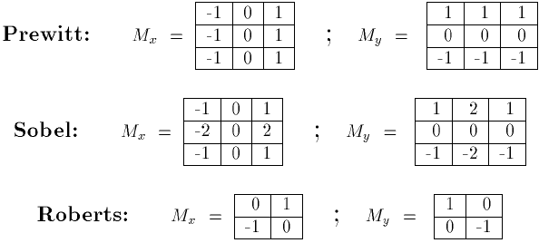






2d difference operators
$$G_{x}$$
$$G_{y}$$
$$G_{x}$$
$$G_{y}$$
$$G_{x}$$
$$G_{y}$$

Slide 4



2d difference operators
$$G_{x}$$
$$G_{y}$$
-1
0
1
-1
0
1
1
1
1
-1
0
1
-1
0
1
0
0
0
-1
0
1
-1
-1
-1
-1
0
1
1
1
1
0
0
0
-1
-1
-1

Slide 5
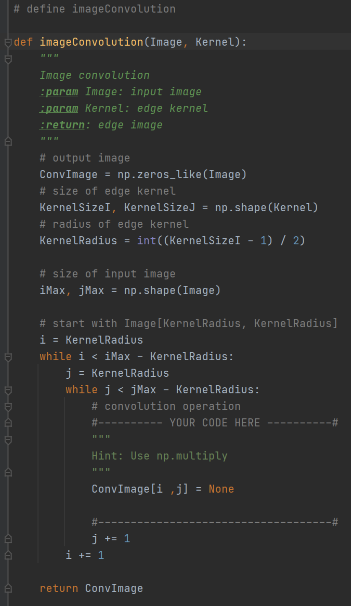
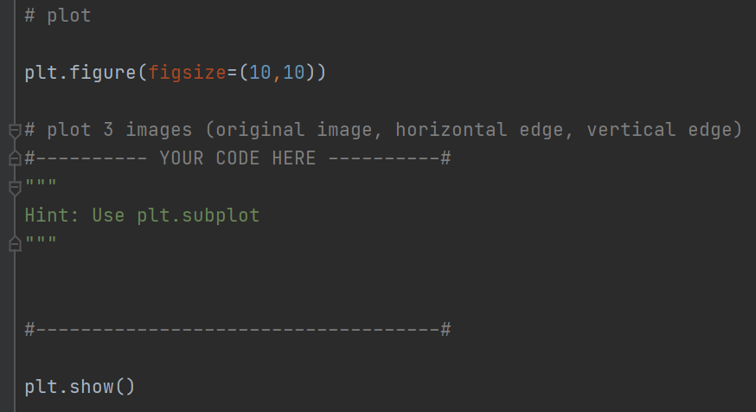
filter & edge
Edge gradient using Prewitt operator (without skimage module)

Slide 6
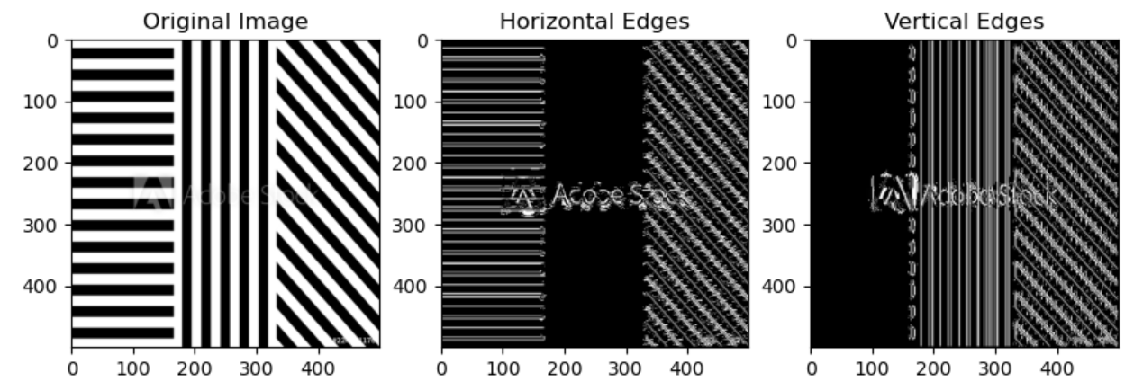
filter & edge
Edge gradient using Prewitt operator (without skimage module)

Slide 7
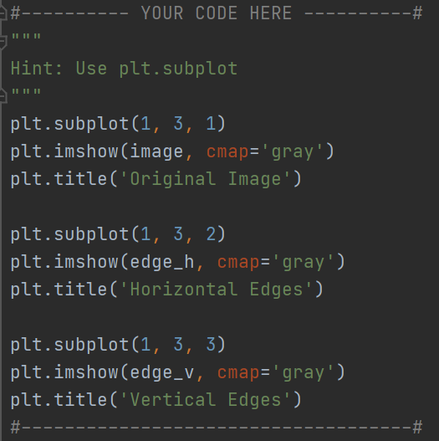
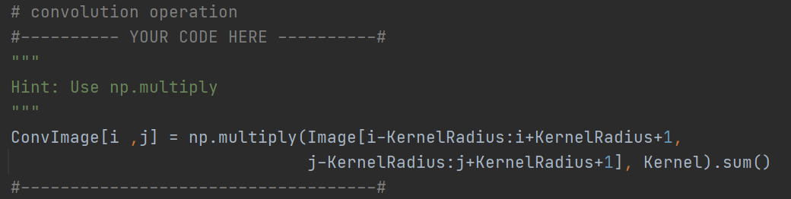
filter & edge
Edge gradient using Prewitt operator (without skimage module)

Slide 8
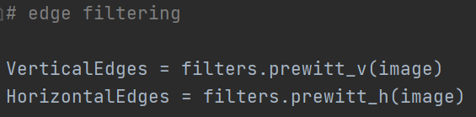
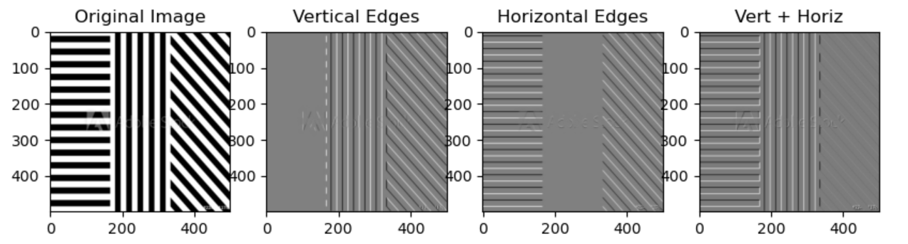
filter & edge
Edge gradient using Prewitt operator (with skimage module)
Why ??

Slide 9




filter & edge
Edge gradient using Prewitt operator (with skimage module)

Slide 10
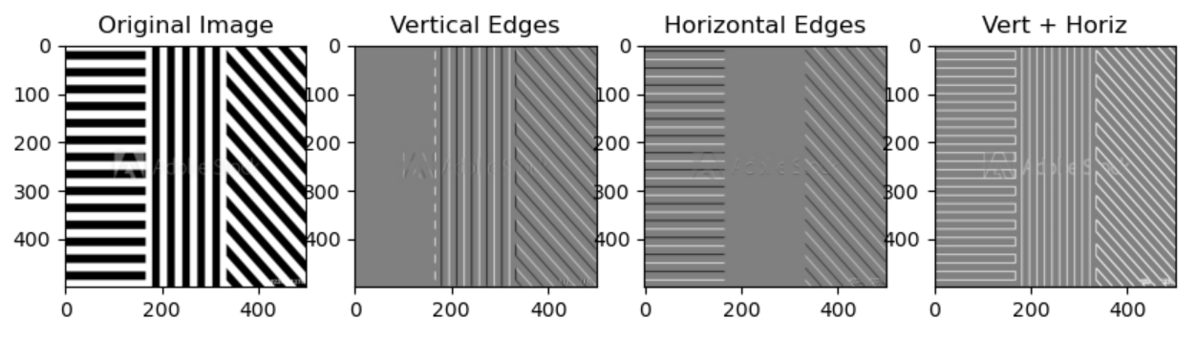
filter & edge
Edge gradient using Prewitt operator (with skimage module)

Slide 11
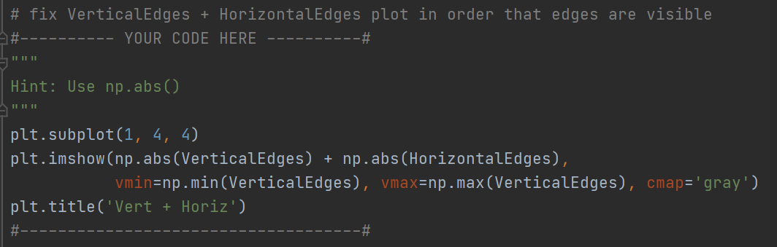
filter & edge
Edge gradient using Prewitt operator (with skimage module)

Slide 12
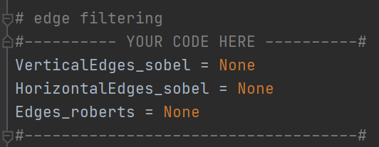
filter & edge
Edge gradient using Sobel and Roberts operator (with skimage module) https://scikit-image.org/docs/dev/api/skimage.filters.html

Slide 13
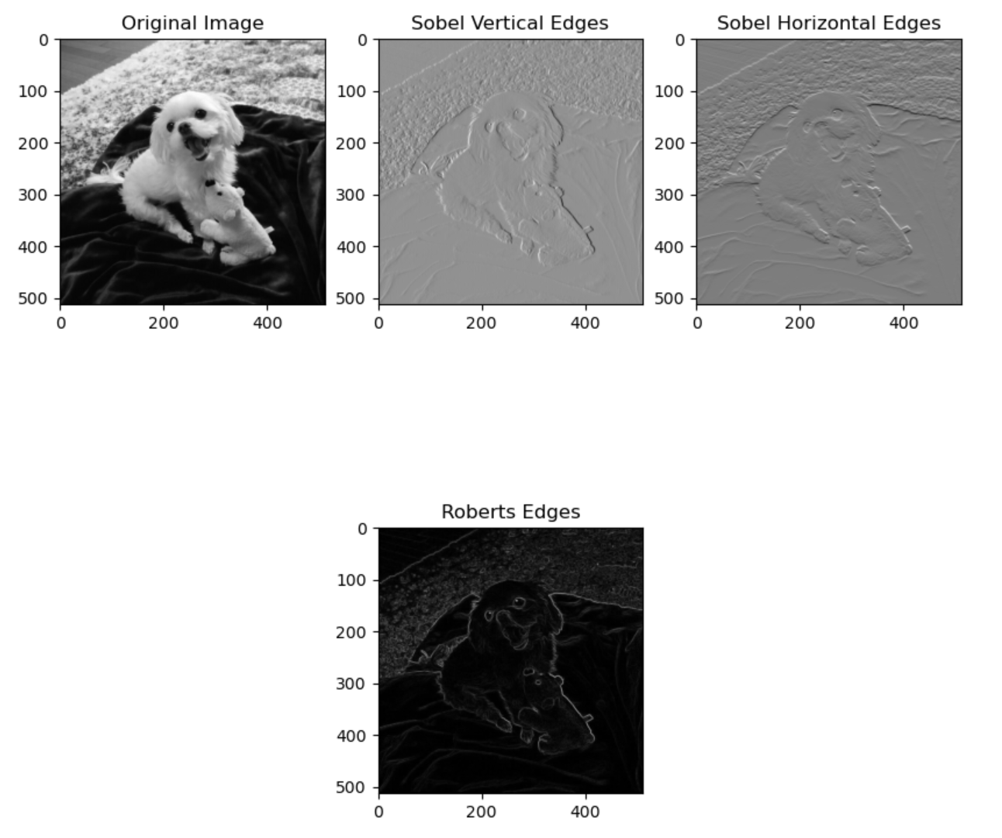
filter & edge
Edge gradient using Sobel and Roberts operator

Slide 14
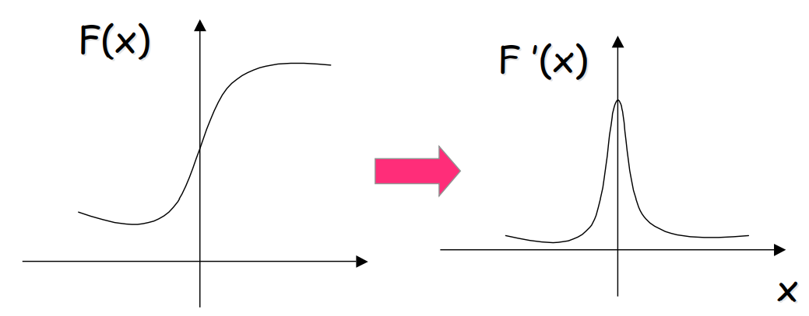
filter & edge
Recall: First derivative filters Sharp changes in gray level of the input image correspond to “peaks or valleys” of the first derivative of the input image.

Slide 15
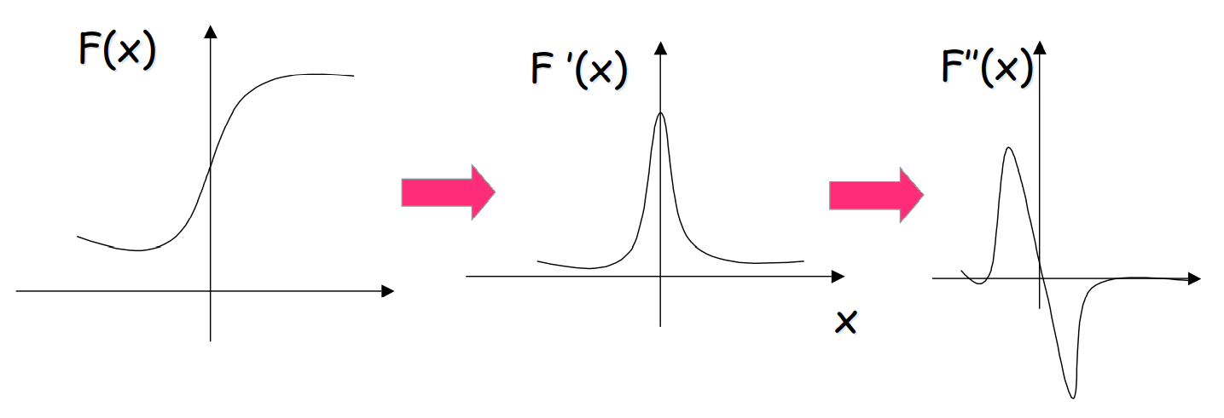
filter & edge
Second derivative filters “Peaks or valleys” of the first derivative of the input signal, correspond to “zero-crossings” of the second derivative of the input image.

Slide 16
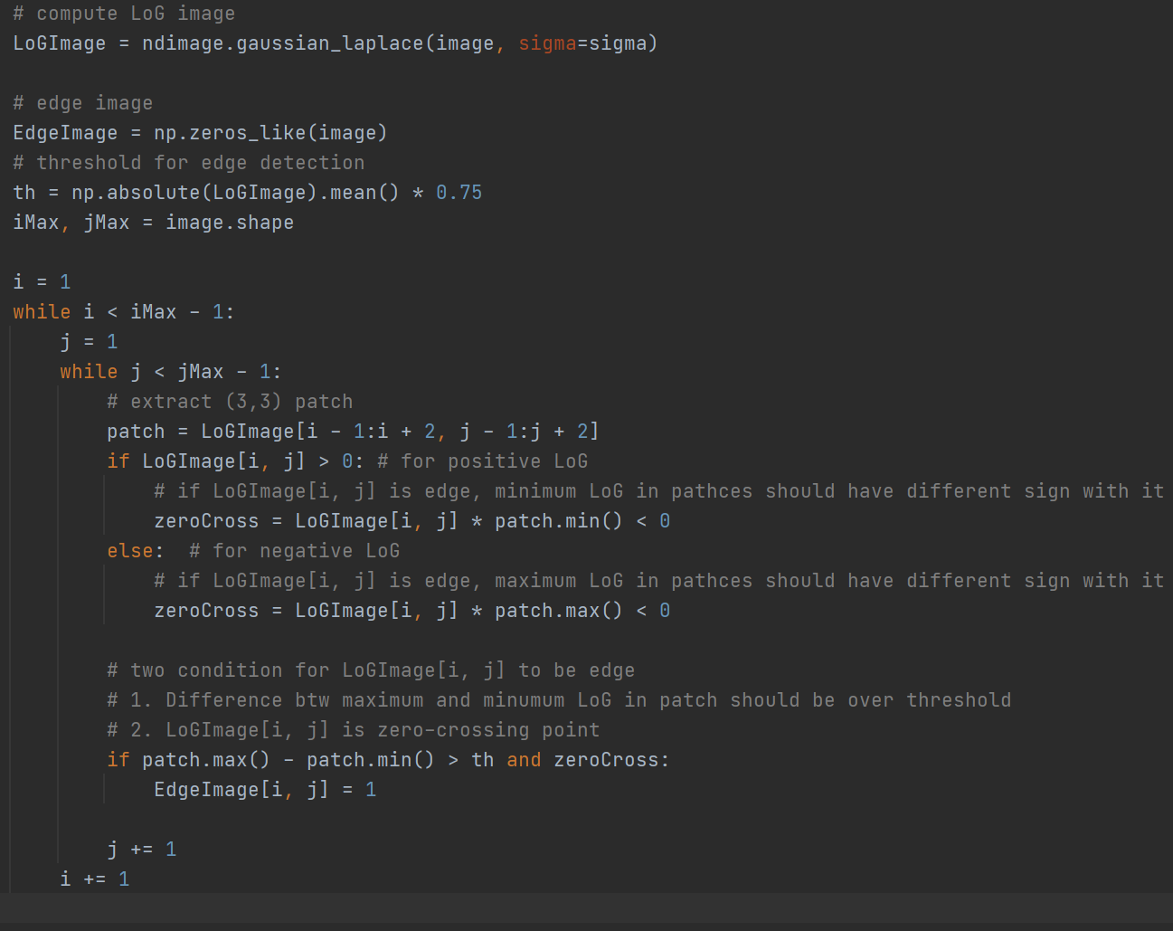
filter & edge
Second derivative using Laplacian of Gaussian
Algorithm
Compute LoG
Compute zero crossings on LoG
Compute a threshold for local LoG difference
Edge pixels = zero crossing && local difference > threshold

Slide 17
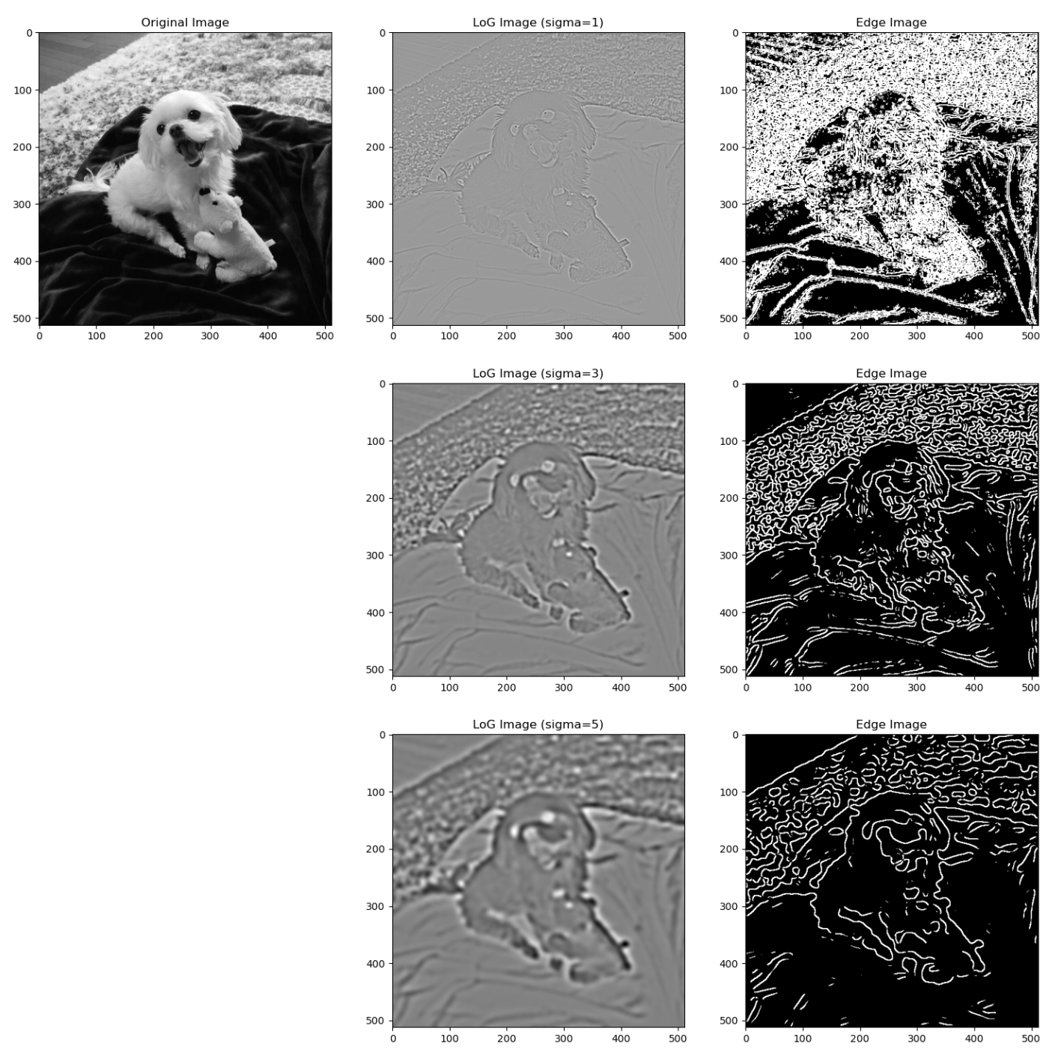
filter & edge
Second derivative using Laplacian of Gaussian

Slide 18
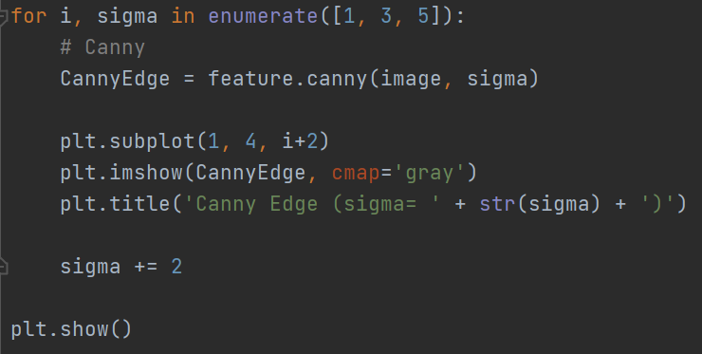
Canny
Canny Edge Detection Algorithm
Canny Algorithm
Gaussian Smoothing (optional)
Gradient calculation
Non-maximum suppression
Hysteresis thresholding

Slide 19
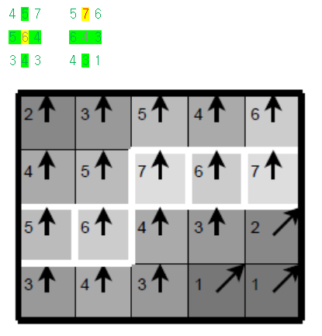
Canny
Canny Edge Detection Algorithm
Canny Algorithm
Gaussian Smoothing (optional)
Gradient calculation
Non-maximum suppression
Hysteresis thresholding

Slide 20
Canny
Canny Edge Detection Algorithm
Strong edges
Canny Algorithm
Gaussian Smoothing (optional)
Gradient calculation
Non-maximum suppression
Hysteresis thresholding
Weak edges
No edges

Slide 21
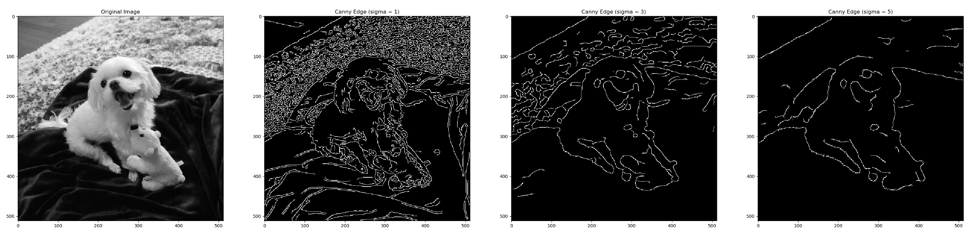
Canny

