Slide 1
EX 2-2
lpf / hpf

Slide 2
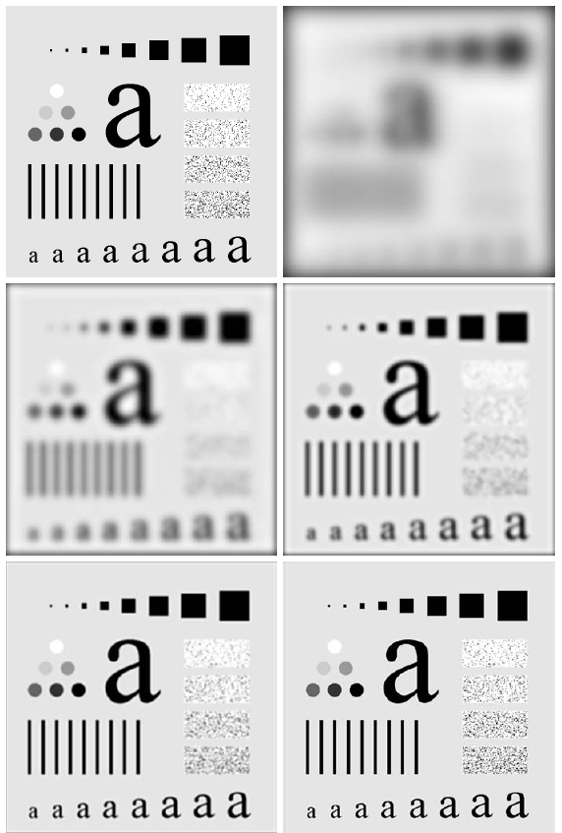
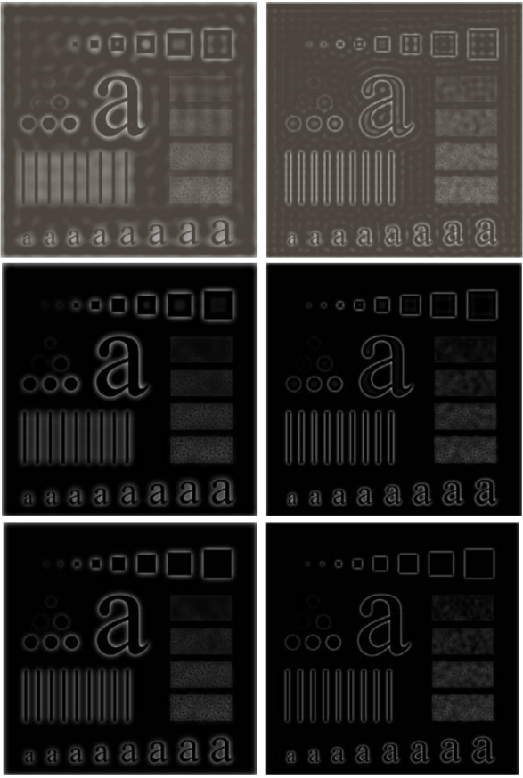
filters
Low-pass filter (LPF)
Smoothing effect
High-pass filter (HPF)
Edge detection effect

Slide 3
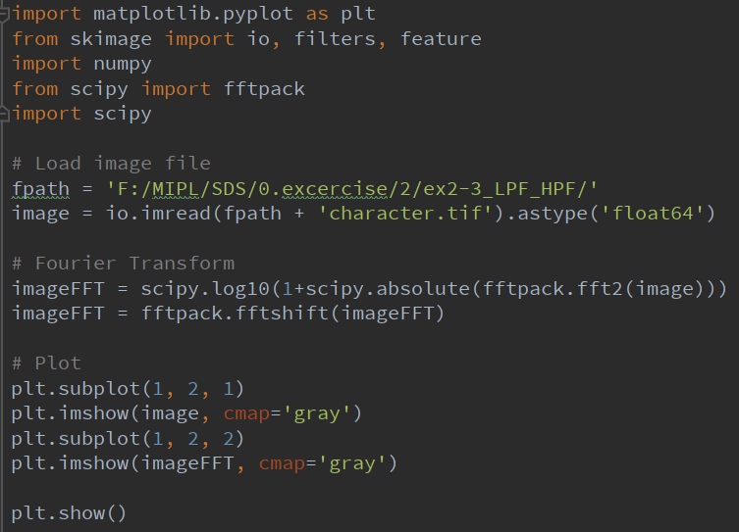
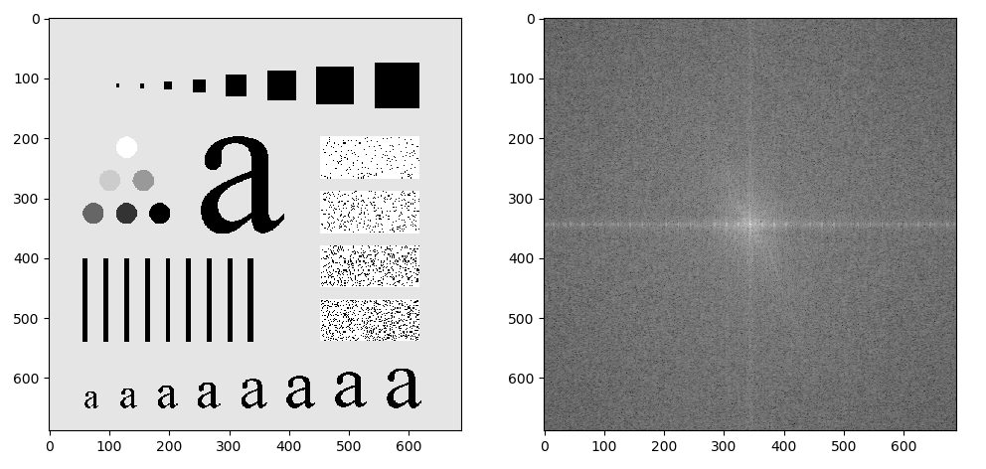
Fourier Transform

Slide 4

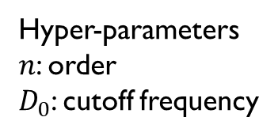
BLPF
Butterworth LPF (BLPF)
BLPF transfer function
Filter displayed as an image
Filter radial cross section
$$H\left(u,v\right)=\frac{1}{1+{\left[\frac{D\left(u,v\right)}{D_{0}}\right]}^{2n}}$$
Hyper-parameters
$n$: order
$D_{0}$: cutoff frequency

Slide 5
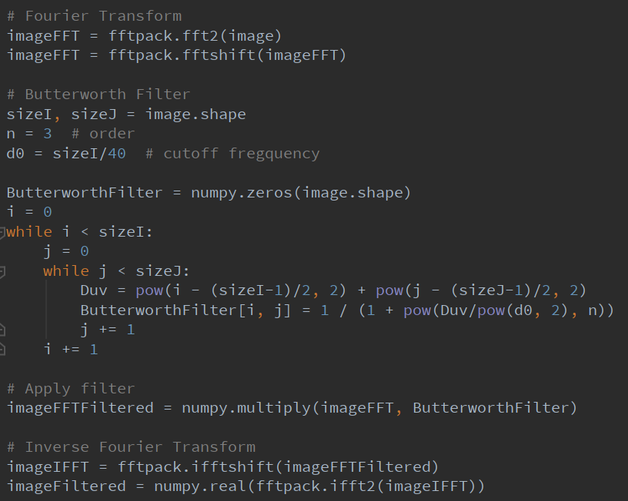
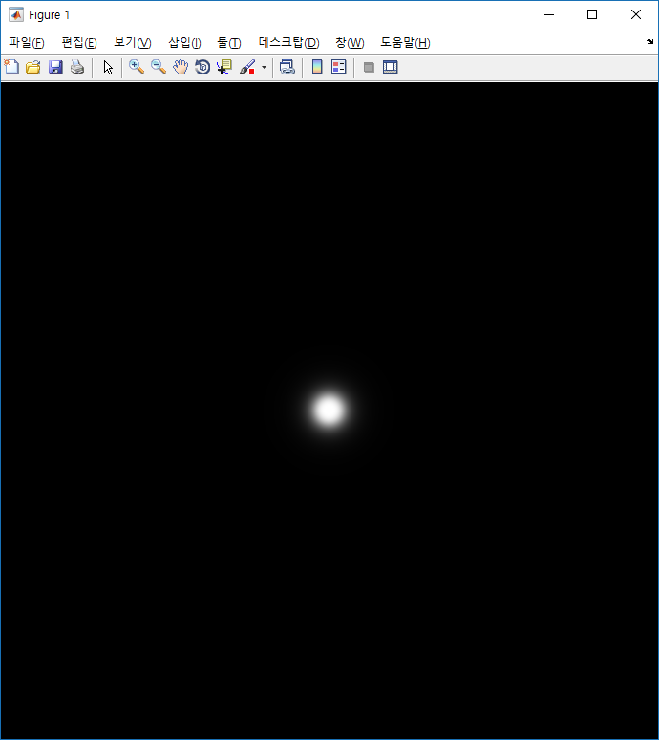
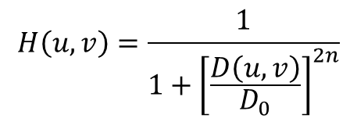
BLPF
Implementation of applying BLPF
$$H\left(u,v\right)=\frac{1}{1+{\left[\frac{D\left(u,v\right)}{D_{0}}\right]}^{2n}}$$

Slide 6
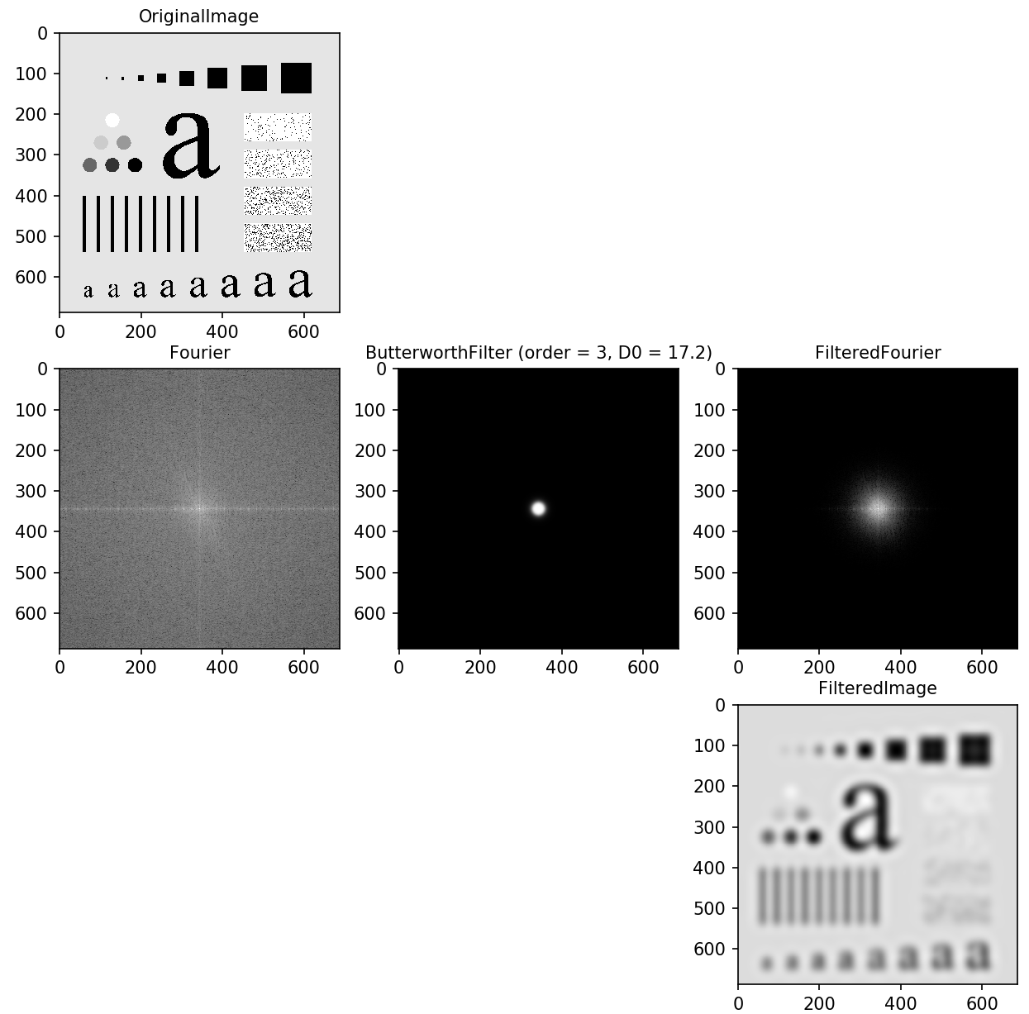
blpf

Slide 7
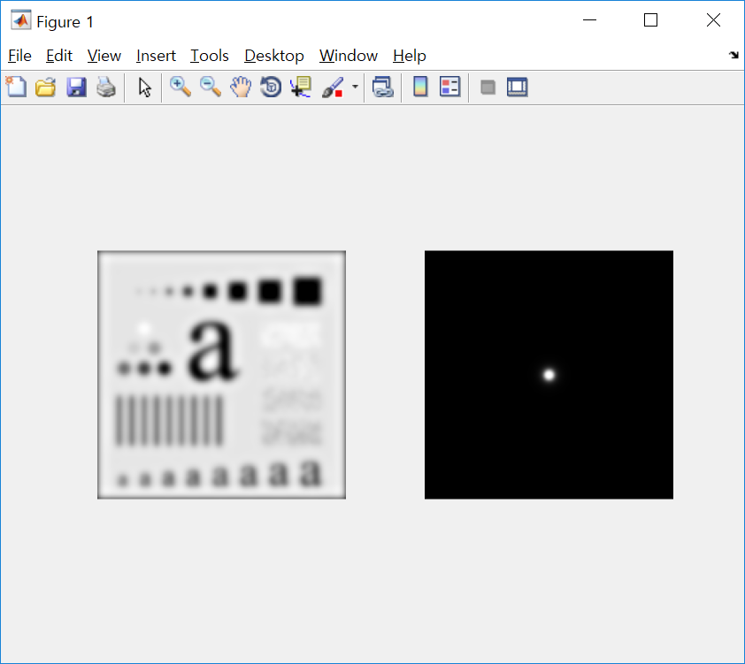







BLPF
Change the order (fix cut-off frequency = 30)
$$n=2$$
$$n=5$$
$$n=10$$
$$n=30$$
More ringing

Slide 8
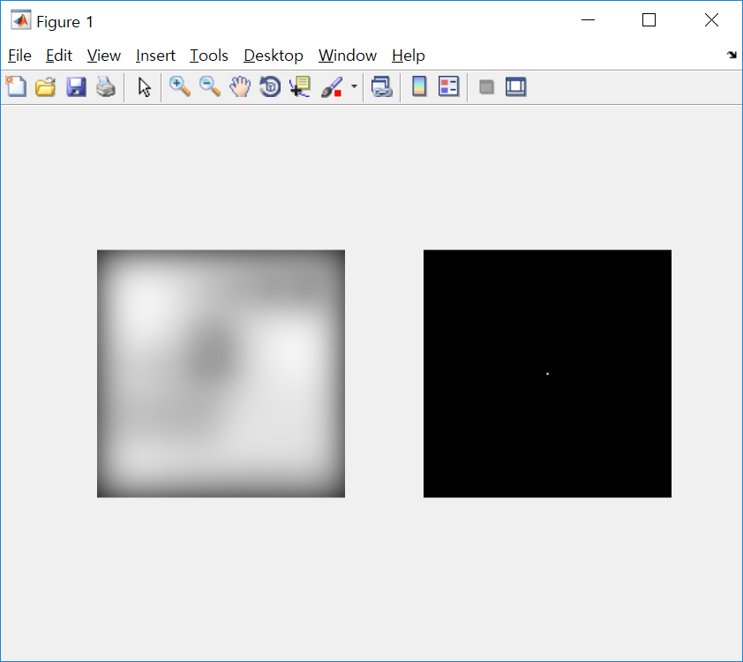







BLPF
Change the cut-off frequency (fix order = 2)
$$D_{0}=5$$
$$D_{0}=15$$
$$D_{0}=30$$
$$D_{0}=80$$
Less smoothing

Slide 9
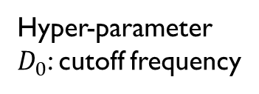
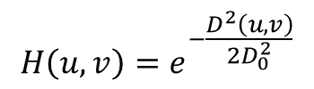
GLPF
Gaussian LPF (GLPF)
BLPF transfer function
Filter displayed as an image
Filter radial cross section
$$H\left(u,v\right)=e^{−\frac{D^{2}\left(u,v\right)}{2D_{0}^{2}}}$$
Hyper-parameter
$D_{0}$: cutoff frequency

Slide 10
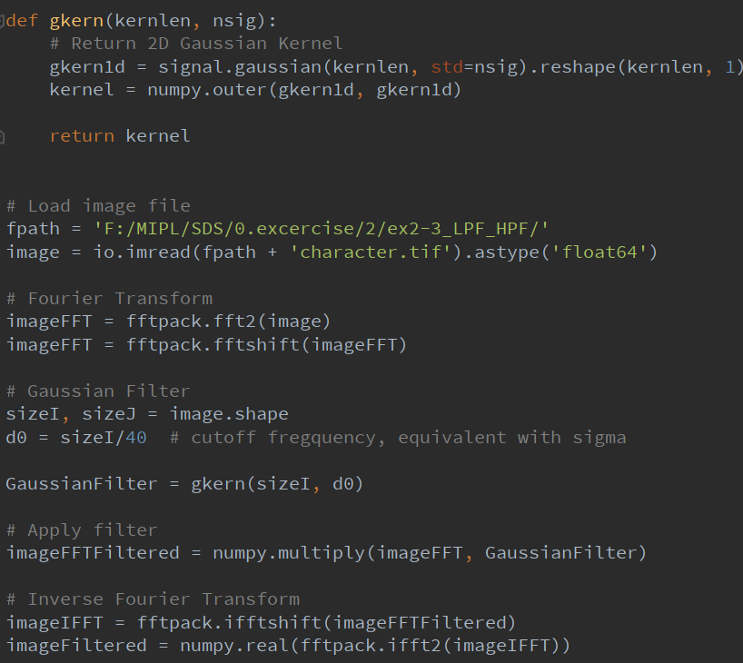
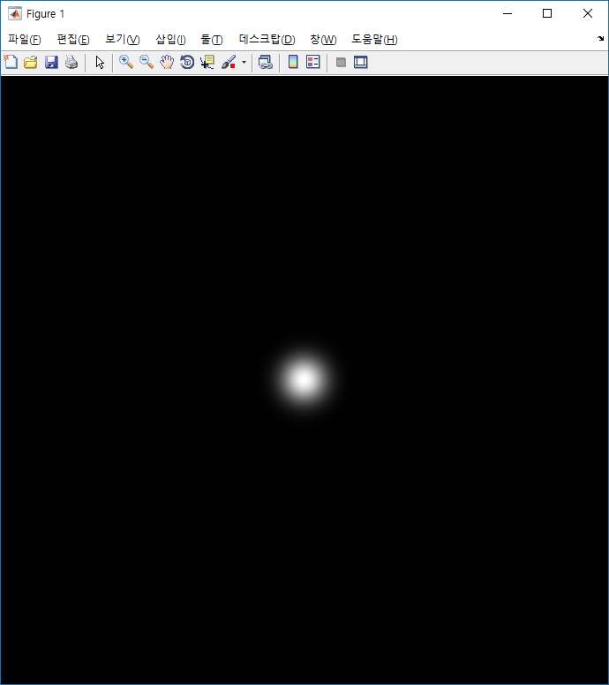
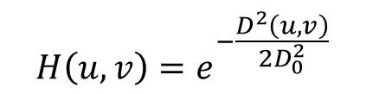
GLPF
$$H\left(u,v\right)=e^{−\frac{D^{2}\left(u,v\right)}{2D_{0}^{2}}}$$

Slide 11

GLPF

Slide 12
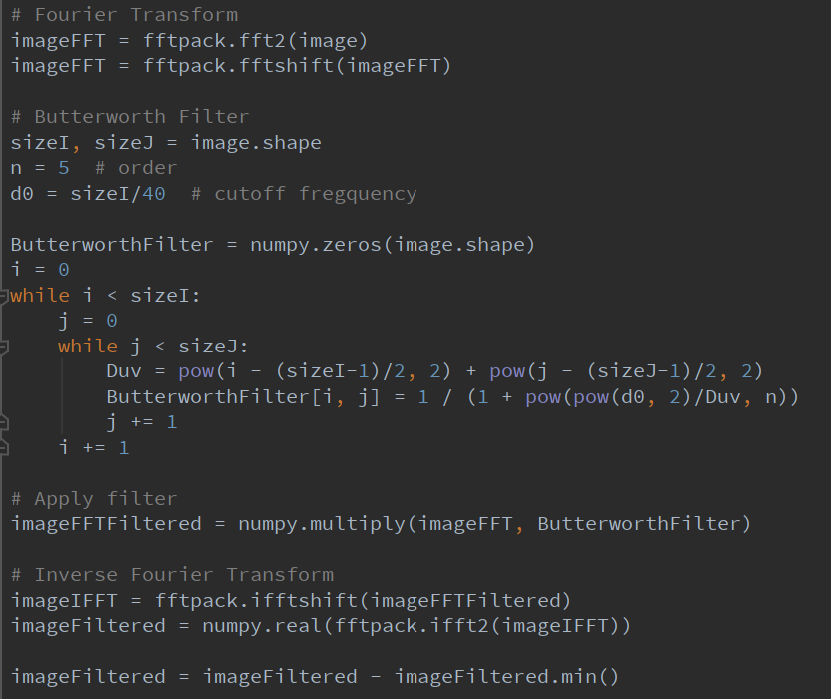
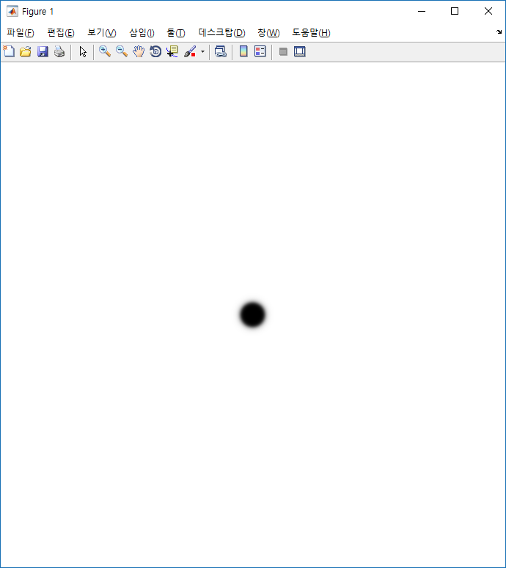
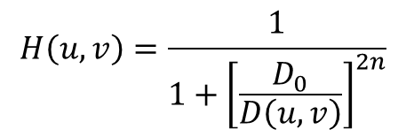
BHPF
$$H\left(u,v\right)=\frac{1}{1+{\left[\frac{D_{0}}{D\left(u,v\right)}\right]}^{2n}}$$

Slide 13
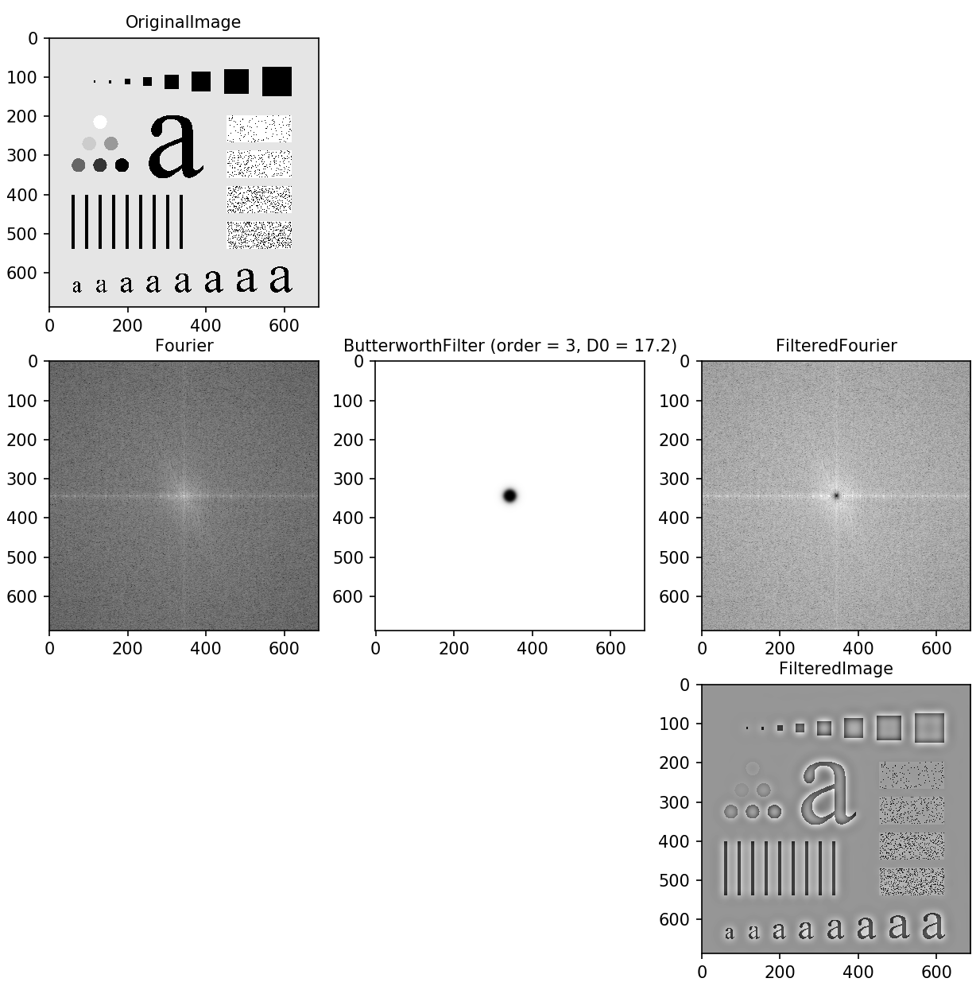
BHPF

Slide 14
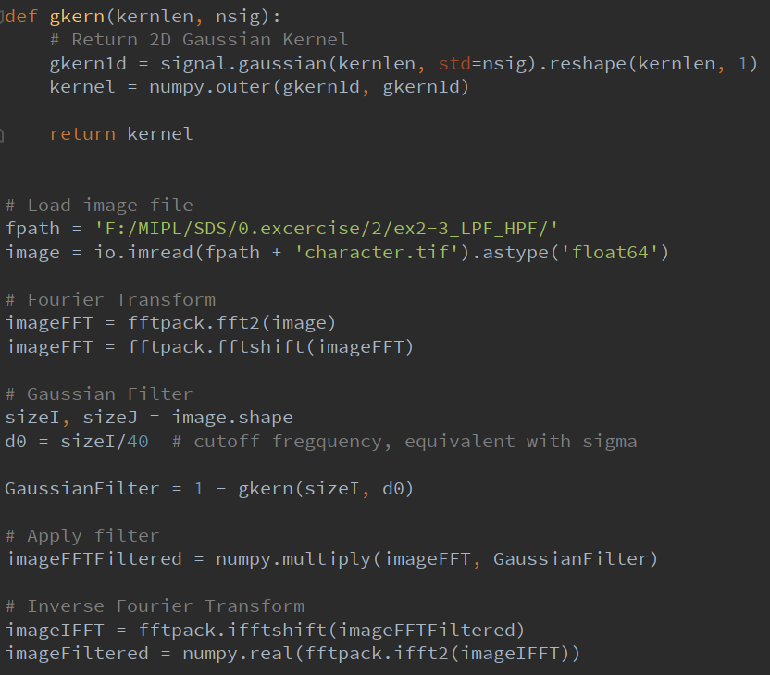
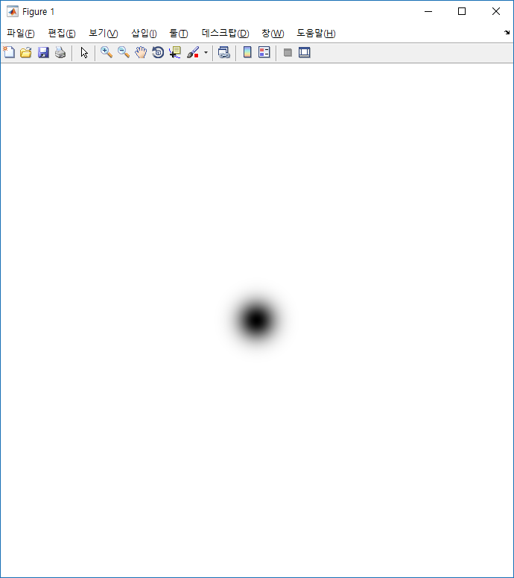
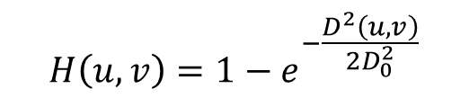
GHPF
$$H\left(u,v\right)=1−e^{−\frac{D^{2}\left(u,v\right)}{2D_{0}^{2}}}$$

Slide 15
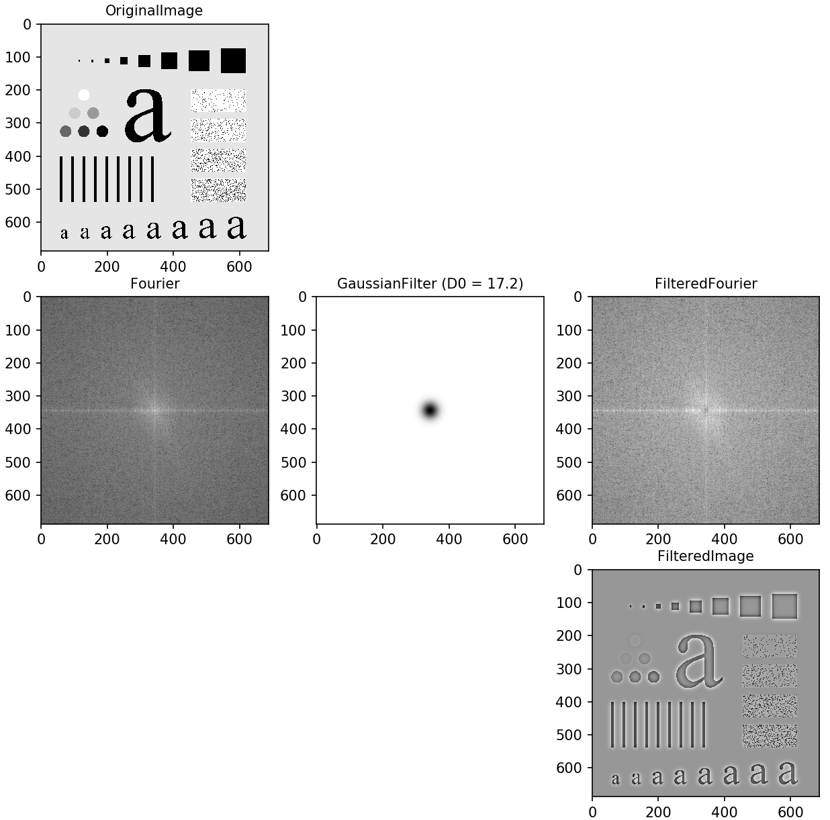
GHPF

Slide 16
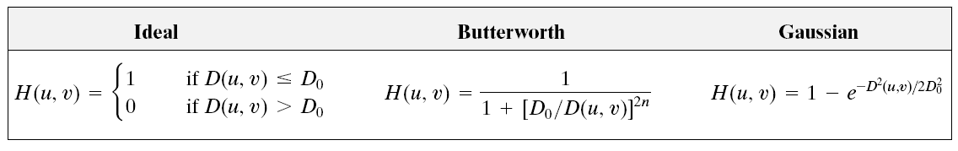
Temporal filtering
Perform LPF / HPF yourself
with different hyper-parameters

