Slide 1
EX 2-3
ImagE Pyramids

Slide 2
Objectives
Gaussian Pyramid
Laplacian Pyramid
Image reconstruction using Laplacian pyramids

Slide 3
GAUSSIAN PYRAMID

Slide 4
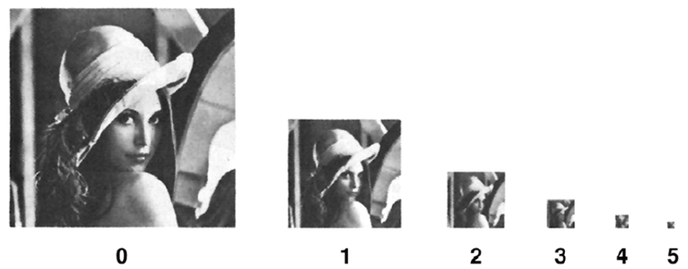
Gaussian pyramid

Slide 5
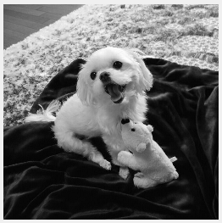
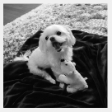
Gaussian pyramid
output = cv2.pyrDown(input)
[input]
[output]

Slide 6
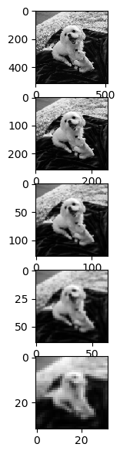
Gaussian pyramid
Gaussian Pyramid
# Gaussian pyramid level = 4 g_pyr = [] for current_level in range(level): if current_level < 1: g = cv2.pyrDown(img) g_pyr.append(g) else: g = cv2.pyrDown(g_pyr[current_level-1]) g_pyr.append(g) plt.subplot(151), plt.imshow(img, 'gray') plt.subplot(152), plt.imshow(g_pyr[0], 'gray') plt.subplot(153), plt.imshow(g_pyr[1], 'gray') plt.subplot(154), plt.imshow(g_pyr[2], 'gray') plt.subplot(155), plt.imshow(g_pyr[3], 'gray') plt.show()

Slide 7
LAPLACIAN PYRAMID

Slide 8
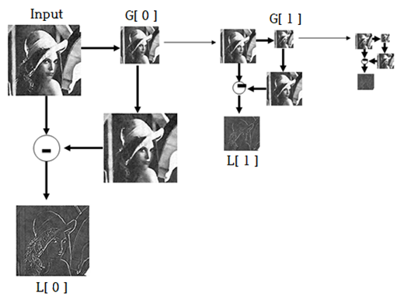
Laplacian Pyramid

Slide 9
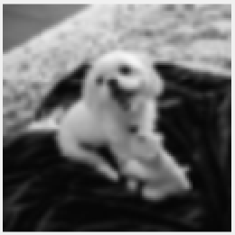
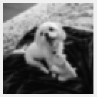
Laplacian Pyramid
output = cv2.pyrUp(input)
[input]
[output]

Slide 10
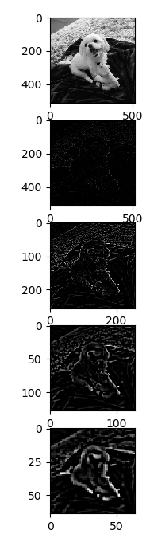
Laplacian Pyramid
Laplacian Pyramid
# Laplacian pyramid level = 4 l_pyr = [] for current_level in range(level): if current_level < 1: fg = cv2.pyrUp(g_pyr[current_level]) lap = cv2.subtract(img, fg) l_pyr.append(lap) else: fg = cv2.pyrUp(g_pyr[current_level]) lap = cv2.subtract(g_pyr[current_level-1], fg) l_pyr.append(lap) plt.subplot(511), plt.imshow(img, 'gray') plt.subplot(512), plt.imshow(l_pyr[0], 'gray') plt.subplot(513), plt.imshow(l_pyr[1], 'gray') plt.subplot(514), plt.imshow(l_pyr[2], 'gray') plt.subplot(515), plt.imshow(l_pyr[3], 'gray') plt.show()

Slide 11
IMAGE Reconstruction using LAPLACIAN pyramid

Slide 12
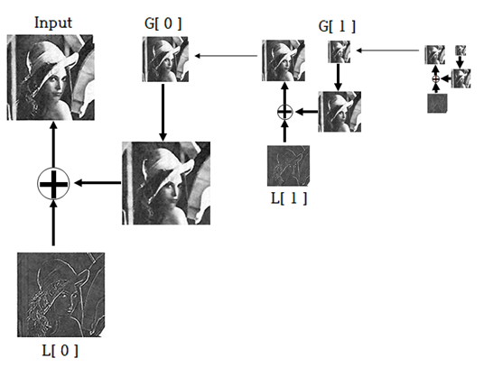
Reconstruction using pyramids

Slide 13
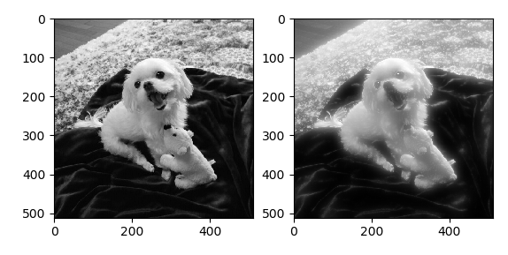
Reconstruction using pyramids
Reconstruction Pyramid
""" Reconstruction using pyramid """ # Reconstruction using pyramids level = 4 r_pyr = g_pyr[level-1] for current_level in range(level): r_pyr = cv2.pyrUp(r_pyr) r_pyr = cv2.add(r_pyr, l_pyr[level-current_level-1]) plt.subplot(121), plt.imshow(img, 'gray') plt.subplot(122), plt.imshow(r_pyr, 'gray') plt.show()

Slide 14
Fusing

Slide 15


Fusing

Slide 16
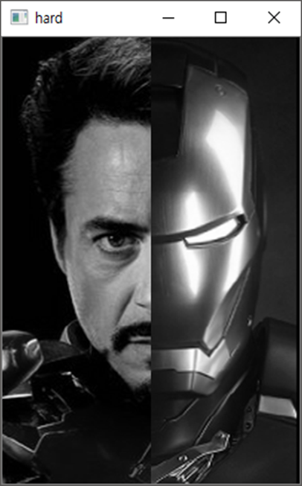
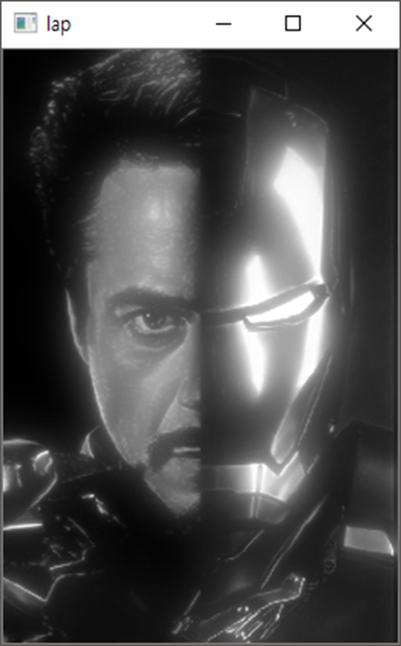
Fusing

