Slide 1
HTTP COOKIES
Cookies: Server stores ID information (cookie) on the client‘s computer.
Every time the client connects to the server, the client adds this information to the request.
  Purpose: To tell the server that you returned to that Web page.
  Lifetime
    Session – not written to file system
    Persistent – written to user preferences
  Only returns cookie to requesting domain
    can only be read by the server that gave it to you.
  Cookie must be specified by content
  No special characters permitted in cookie
Demonstration
  http://cookiedemo.com/

Slide 2
HTTP Cookie types
Session
  Temporary – exists only in memory and is deleted when the browser closes
Persistent
  Saved to disk so that it can be used each time the user visits the site which set the cookie
  Limited by Max-Age and same-origin policy
Secure
  If the secure attribute is enabled then a cookie may only be sent via HTTPS
HttpOnly
  Only sent via HTTP and HTTPS.
  Non HTTP APIs such as JavaScript cannot access these cookies
  Note: this does not protect against XSS
Third-party
  If a web page embeds content from other (third party) domains then they can set and read cookies
  Often used as tracking cookies
Supercookie
  Not really a cookie, but similar in that it is inserted as a header field
  Inserted by ISPs, through interception of traffic
  Purpose: selling information about origin of requests to advertisers

Slide 3
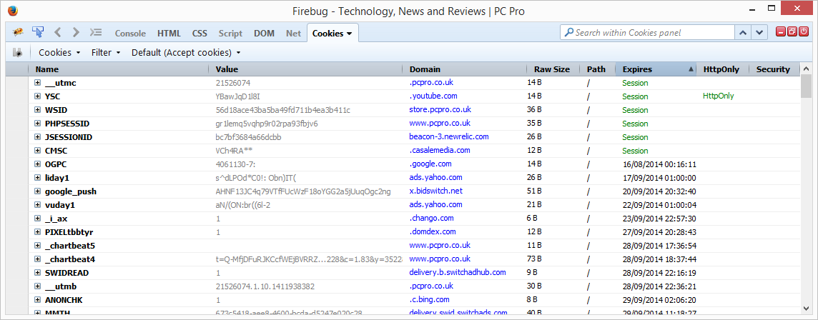
COOKIE EXAMPLEs

Slide 4
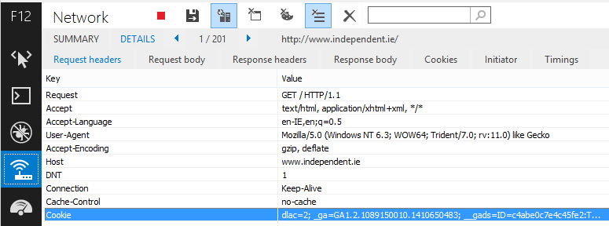
Setting a Cookie
A WWW server will request the client to set a cookie as part of its response
  Set-Cookie directive

Slide 5
Setting a Cookie
Cookie values are set using name-value pairs
  E.g. cookie name month and value 9
Default attributes are:
  Domain (Domain of server
  Path (restrict path for domain – e.g. make cookie valid only for /accounts)
  Expiration time
  Max-age

Slide 6
HTTP COOKIES
Privacy Issues
  Pro
    Remember who you are and your preferences
    Session tracking
  Con
    When developer is not careful
      store password, credit card info, etc…
    When people abuse them
      track information about you
http://www.f-secure.com/sw-desc/tracking_cookie.shtml

Slide 7
SESSION MANAGEMENT (PHP/ JAVA/ ASP.NET/ ETC.
Session tracking API built on top of URL rewriting or cookies
  Look up HttpSession object associated with current request (or create new one)
    All cookie/URL rewriting mechanics hidden
  Look up information associated with a session
  Associate information with a session

Slide 8
MODIFIED URL
All otherwise unrelated HTTP request are assigned a unique identification number (Session ID)
Before sending a web page to a client, all links within the page that do not point to a different server are extended by an ID as parameter.
When the client uses this link, the ID will be sent back as a parameter to the server.
Example
  Link moodle.it-tallaght.ie/index.php is changed to moodle.it-tallaght.ie/index.php?id=000291.
For more information look at the following URL;
http://www.yourhtmlsource.com/sitemanagement/urlrewriting.html

Slide 9
MODIFIED URL
All otherwise unrelated HTTP request are assigned a unique identification number (Session ID)
Before sending a web page to a client, all links within the page that do not point to a different server are extended by an ID as parameter.
When the client uses this link, the ID will be sent back as a parameter to the server.
Example
  Link moodle.it-tallaght.ie/index.php is changed to moodle.it-tallaght.ie/index.php?id=000291.
For more information look at the following URL;
http://www.yourhtmlsource.com/sitemanagement/urlrewriting.html

Slide 10
HIDDEN FIELDS
Store session values as Form Fields
  <input type=“hidden” name=“session” value=“11232477”>
  Send to client
  When form is submitted, sent back to server
Can be read by viewing Page Source
  Can also be modified
ASP.NET View State
  <input type="hidden" name="__VIEWSTATE” value="dDwtNTI0ODU5MDE1Ozs+ZBCF2ryjMpeVgUrY2eTj79HNl4Q=" />
When to use?

Slide 11
SESSION MANAGEMENT (PHP/ JAVA/ ASP.NET/ ETC.
Session tracking API built on top of URL rewriting or cookies
  Look up HttpSession object associated with current request (or create new one)
    All cookie/URL rewriting mechanics hidden
  Look up information associated with a session
  Associate information with a session

