Slide 1

Timesheet App
Jelena Stefanović

Slide 2
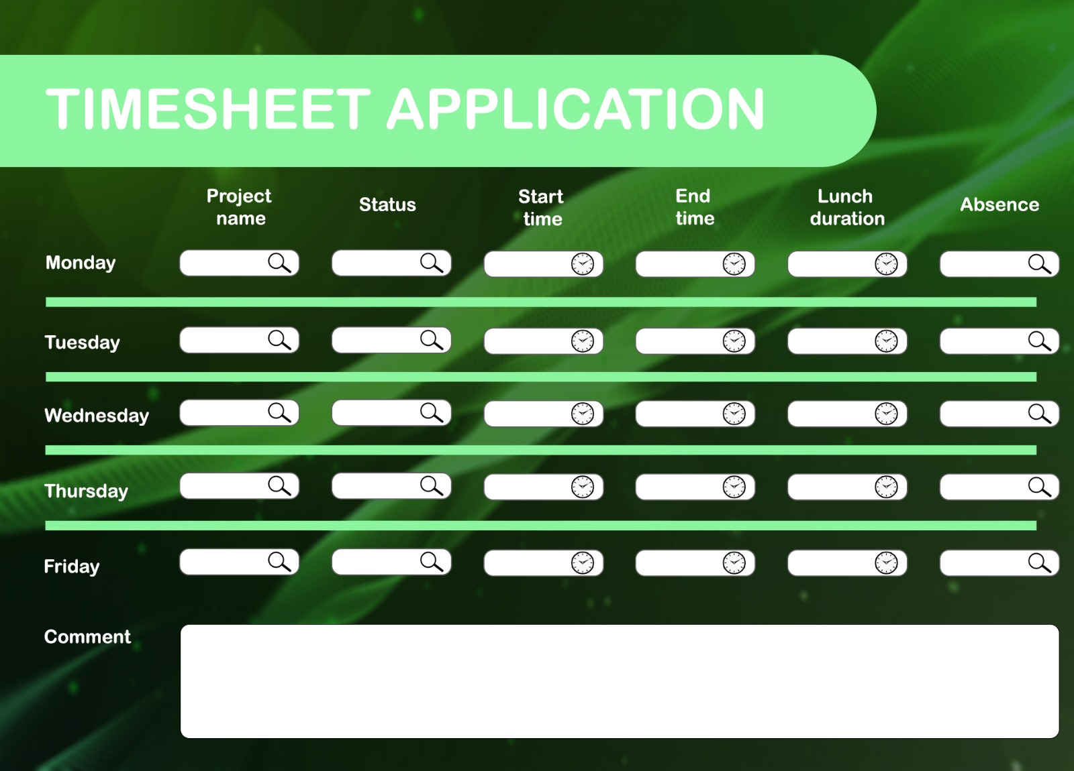
Timesheet application design

Slide 3

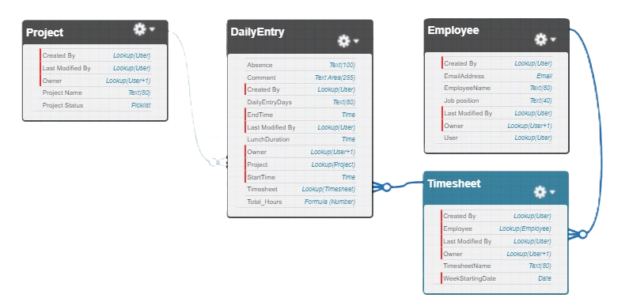
Timesheet Data Model

Slide 4
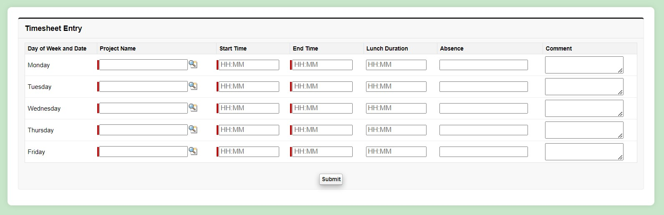
Visualforce page

Slide 5
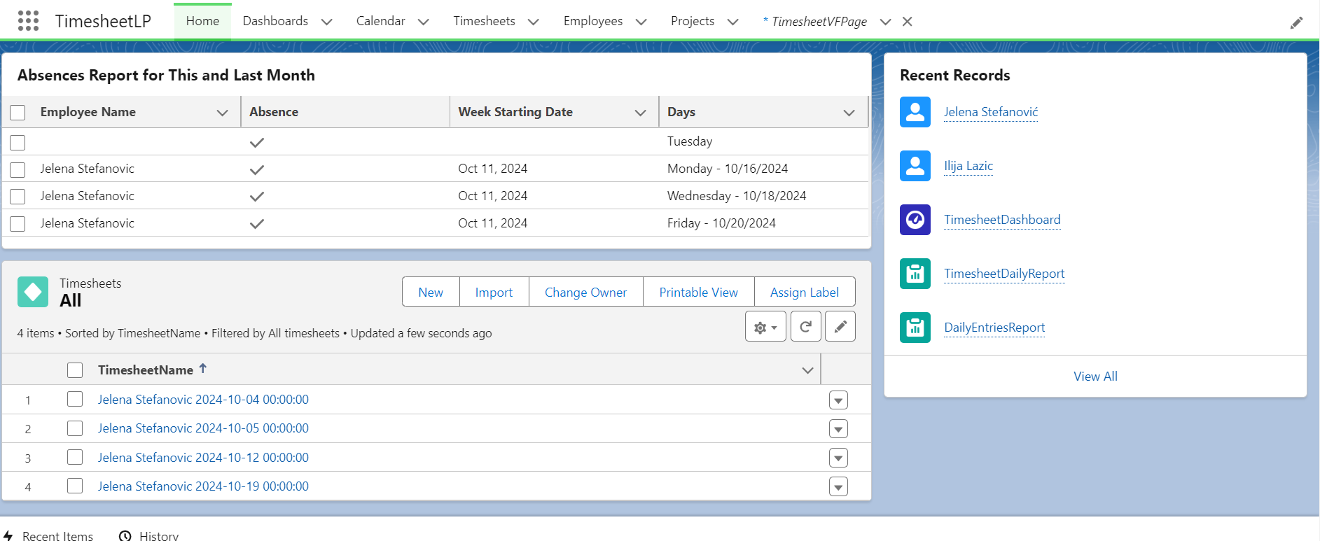
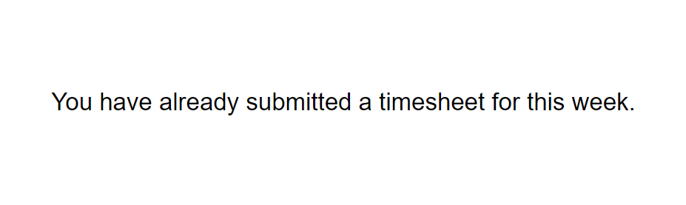
After clicking the "Submit" button, one of the following may happen:
Successful Submission: You will be redirected to the home page, indicating your timesheet has been submitted.
Already Submitted: A message will appear saying, "You have already submitted a timesheet for this week."

Slide 6
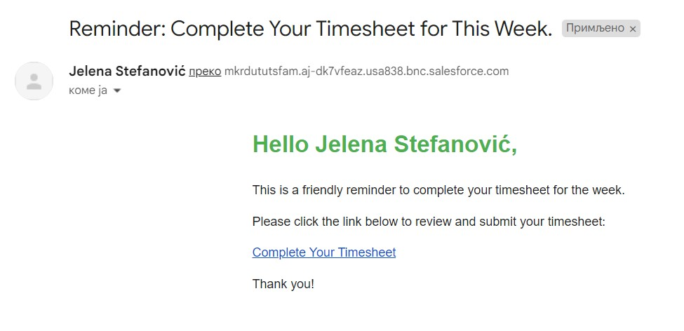
Email template

Slide 7
Lightning page
Home
Dashboards
Calendar
Timesheets
Employees
Projects

Slide 8
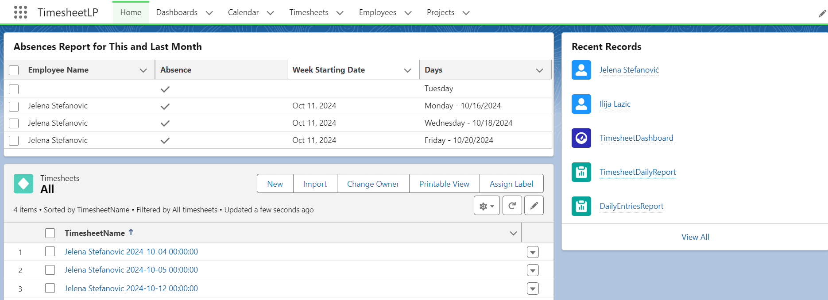
Lightning Home tab

Slide 9
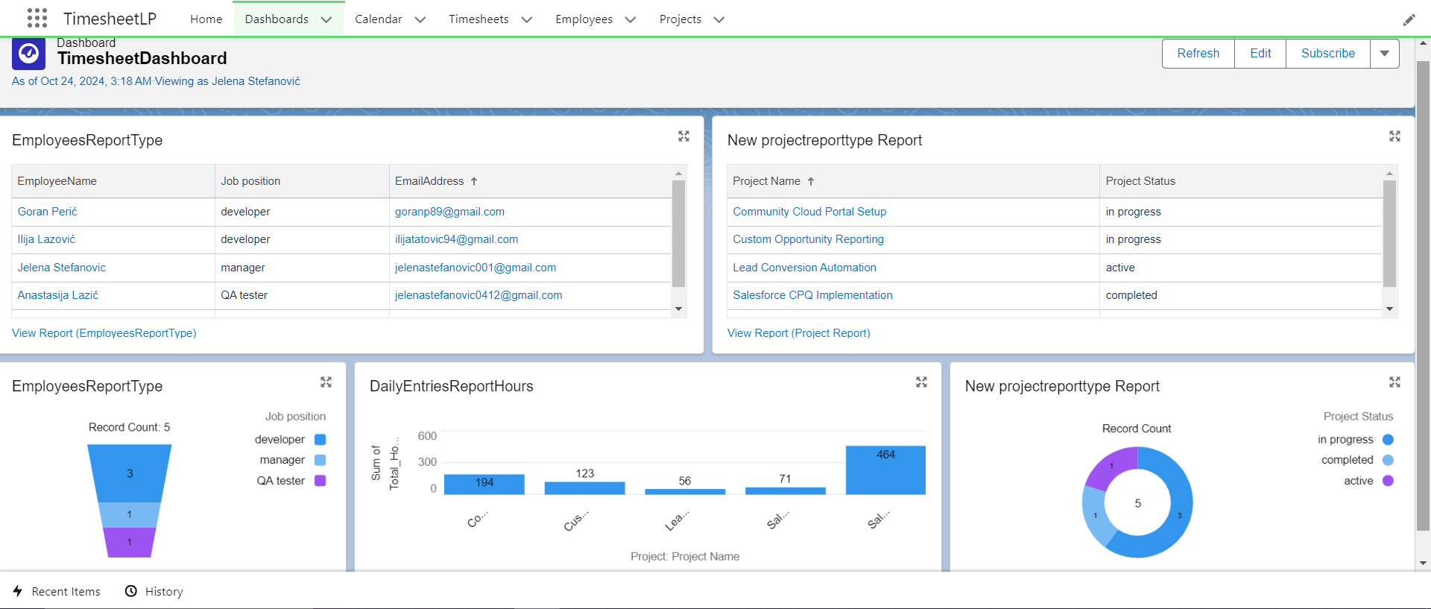
Lightning Dashboard tab

Slide 10
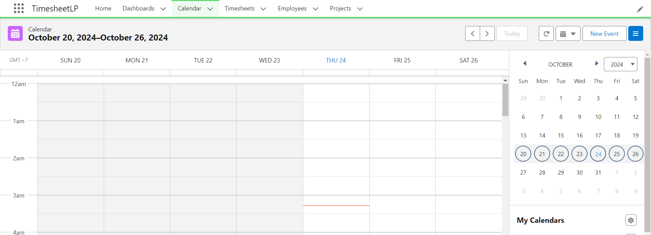
Lightning Calendar tab

Slide 11
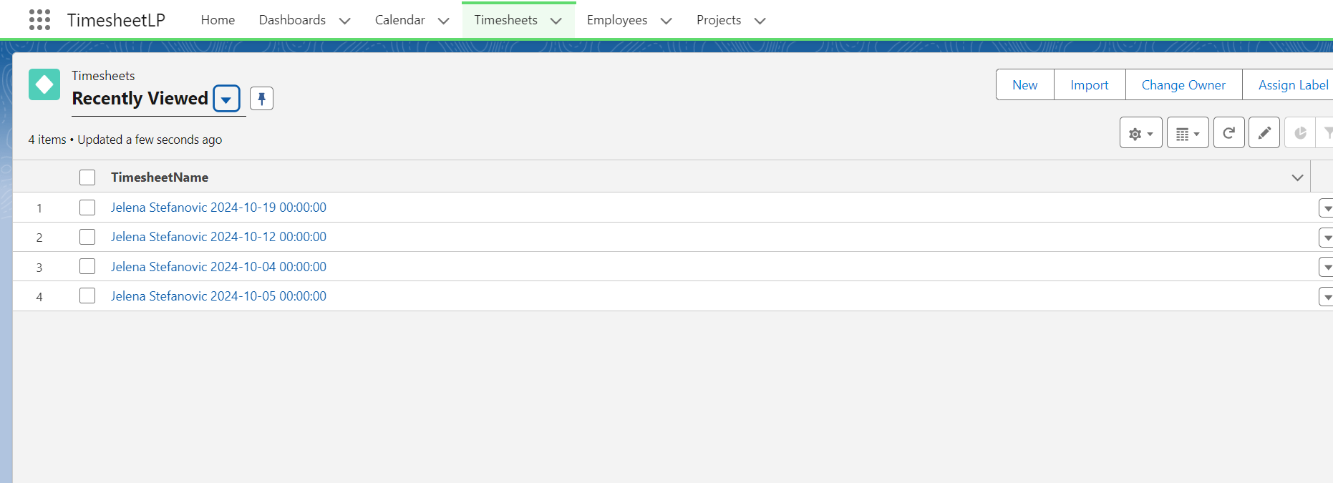
Lightning Timesheets tab

Slide 12
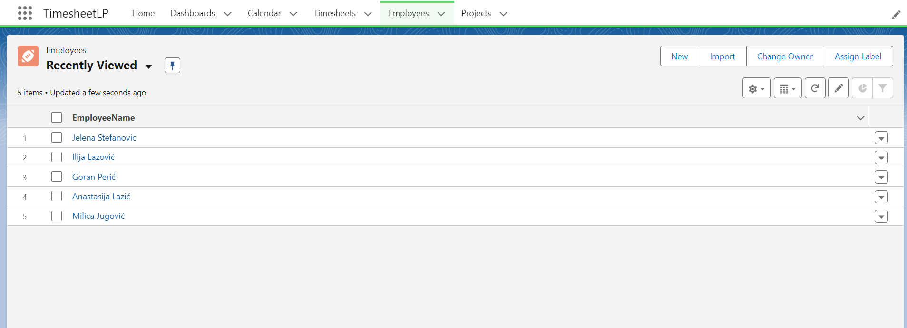
Lightning Employees tab

Slide 13
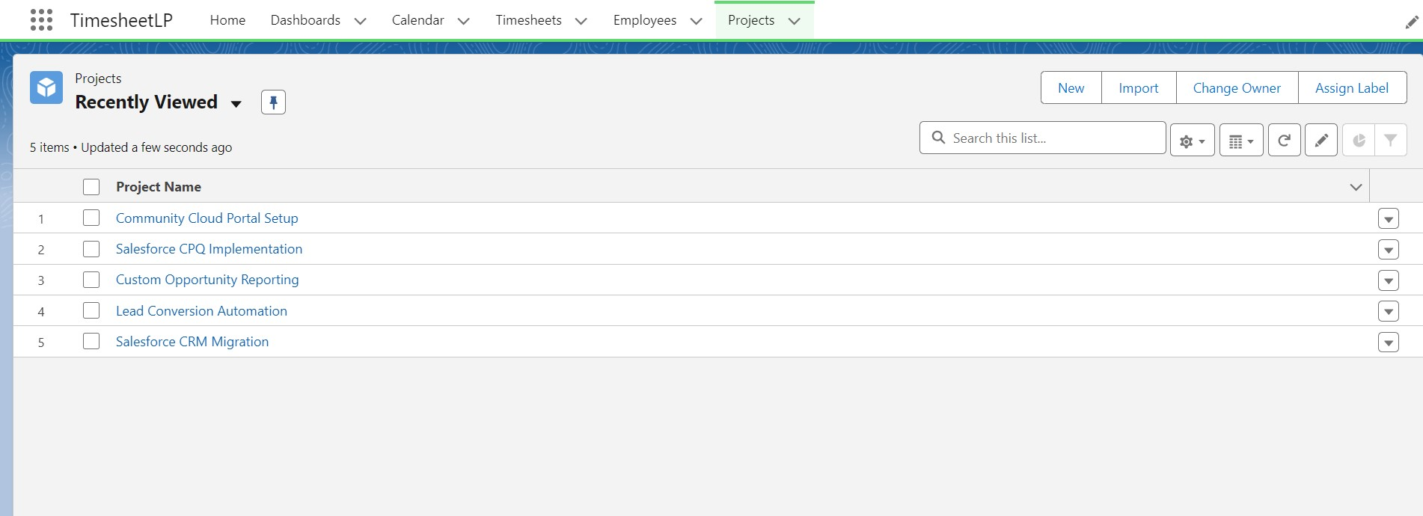
Lightning Projects tab

Slide 14
The end

