Slide 1
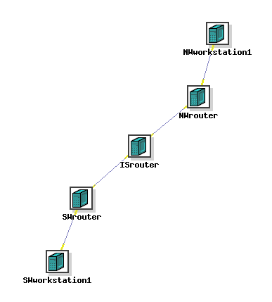
172.16.16.2
network address: 172.16.16.0
netmask: 255.255.255.248
172.16.16.1
network address: 2.4.6.8
netmask: 255.255.255.248
2.4.6.10
2.4.6.9
3.5.7.17
3.5.7.18
network address: 3.5.7.16
netmask: 255.255.255.248
10.0.0.1
network address: 10.0.0.0
netmask: 255.255.255.248
10.0.0.2

