Slide 1
Slim Framework

Slide 2
Micro frameworks
What is micro framework
A micro framework is a term used to refer to minimalistic web applications frameworks.
It is contrasted with full-stack framework also called enterprise frameworks.
It lacks most of the functionality which is common to expect in a full fledged web application framework, such as;
Accounts, authentication, authorization, roles, etc.
Database abstraction via a object-relational mapping.
Web template engine.
Examples
Camping for Ruby
Grape for Ruby
Sinatra for Ruby
Scalatra for Scala
Bottle for Python
Flask for Python
For PHP:
Silex
Slim
Lumen
Phalcon
Tonic
Limonade

Slide 3
Slim Framework
Slim is an ideal tool to create APIs that consume, repurpose, or publish data.
You can even build full-featured web applications with user interfaces.
Slim is one of the fastest micro RESTful frameworks available.
Slim has very little code. In fact, you can read and understand its source code in only an afternoon!
Good documentation
Provides you with every feature this kind of framework should have, and nothing more, which is great
Unlike a lot of other frameworks Slim has a very large following, basically a lot of resources are available online, from original website plus a lot of 3rd party content, including youtube tutorials
At its core, Slim is a dispatcher that receives an HTTP request, invokes an appropriate callback routine, and returns an HTTP response. That’s it.

Slide 4
System Requirements
Installation
PHP >= 5.3.0
Web server with URL rewriting
Composer Install
curl -s https://getcomposer.org/installer | php
Create a composer.json file in your project root:
{ "require": { "slim/slim": "2.*" } }
Install via composer: php composer.phar install
<?php
require 'vendor/autoload.php';
Manual Install
<?php require 'Slim/Slim.php'; \Slim\Slim::registerAutoloader();

Slide 5
Hello World
$app = new \Slim\Slim();
$app->get('/hello-world', function () { echo "Hello, world!"; });
$app->run();
Hello, world!

Slide 6
Routing
GET Routes
$app->get('/hello', function () { echo "Hello!"; });
Parameters
$app->get('/hello/:firstName/:lastName, function ($firstName, $lastName) { echo "Hello, $firstName $lastName!"; });
$app->get('/article/:id', function ($id) {
// Do something
});
$app->get('/hello/:names+', function ($names) {
});
$app->get('/hello/:firstName(/:lastName)', function ($firstName, $lastName = "") {
});
$app->get('/tag/:topic(/:page)', function ($topic, $page = 0) {
});

Slide 7
Routing
Conditions
$app->get('/article/:id', function ($id) { // Do something })->conditions(array(
'id' => '[0-9]+'
));
Application wide route conditions
\Slim\Route::setDefaultConditions(array( 'firstName' => '[a-zA-Z]{3,}',
'id' => '[0-9]+' ));
Route Name and URL For
//Create a named route
$app->get('/hello/:name, function ($name) { echo "Hello $name!"; })->name('hello');
//Generate a URL for the named route $url = $app->urlFor('hello', array('name' => 'Pera'));

Slide 8
Routing
POST Routes
$app->post('/article/:id', function ($id) { //Create article
});
PUT Routes
$app->put('/article/:id, function ($id) { //Update article identified by $id
});
DELETE Routes
$app->delete('/article/:id, function ($id) { //Delete article identified by $id
});
OPTIONS Routes
$app->options('/article/:id', function ($id) { //Return response headers
});
PATCH Routes
$app->patch('/article/:id, function ($id) { // Patch article with given ID
});

Slide 9
View
$app->render('hello.twig', array(
'firstName' => 'Pera',
'lastName' => 'Zdera')
);
<html>
<head></head>
<body>
<div>Hello, {{ firstName }} {{ lastName }}</div>
<body>
</html>
Setting Data
$app->view->setData('firstName', 'Miki');
$app->view->setData(array( 'firstName' => 'Mini', 'lastName' => 'Maus' ));
Appending Data
$app->view->appendData(array( 'lastName' => 'Dugousko' ));
Appending Twig
$app = new \Slim\Slim(array( 'view' => new Twig() ));
$app->view(new Twig());

Slide 10
Environment, Request, Response
// Environment object, data from $_SERVER
$app->environment();
// Request object, with data from request which client sends to server
$app->request;
// Response object, with data from response which server sends to client
$app->response;

Slide 11
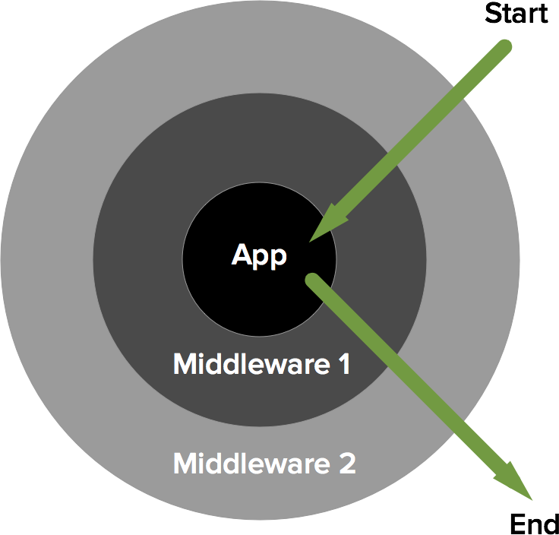
Middleware

Slide 12
Middleware
Create Middleware
class ExampleMiddleware extends \Slim\Middleware { public function call() { // Get reference to application $app = $this->app;
// Do something // Run inner middleware and application $this->next->call();
// Do something
} }
Add Middleware
$app->add(new \ExampleMiddleware());

Slide 13
HTTP Cache
ETag
$app->get('/foo', function () use ($app) { $app->etag('unique-id'); });
// If-None-Match
Last Modified
$app->get('/foo', function () use ($app) { $app->lastModified(strtotime('2015-10-29 15:30:00'));});
// If-Modified-Since
Expires
$app->get('/foo', function () use ($app) { $app->etag('unique-resource-id'); $app->expires('+1 week'); echo "This will be cached client-side for one week"; });
// Expires
Notes:
halt helper method in etag and lastModified

Slide 14
Error Handling
A Slim application respects your existing error_reporting setting;
A Slim application only handles errors and exceptions generated inside the Slim application;
A Slim application converts errors into ErrorException objects and throws them;
A Slim application uses its built-in error handler if its debug setting is true; otherwise, it uses the custom error handler.
Debug Mode
$app = new \Slim\Slim(array( 'debug' => true ));
//Enable debugging (on by default) $app->config('debug', true); //Disable debugging $app->config('debug', false);

Slide 15
Error Handling
Custom Error
// Set custom error handler
$app->error(function (\Exception $e) use ($app) { $app->render('error.php'); });
// Invoke custom error handler
$app->error();
Not Found
// Set not found handler
$app->notFound(function () use ($app) { $app->render('404.html'); });
// Invoke not found handler
$app->notFound();

Slide 16
Additional Components
Twig
Monolog
Guzzle
Assetic
Predis
Pimple

Slide 17
Slim Framework 2 vs 3
PHP version
PHP >= 5.3.0
PHP version
PHP >= 5.5.0
Slim now utilizes a new, more powerful router ( https://github.com/nikic/FastRoute )!
PSR 7 request objects which implements PSR 7 ServerRequestInterface
PSR 7 response objects which implements PSR 7 ResponseInterface
Flash messages have been removed (?)
Hooks have been removed
Optional slim/twig-view PHP component
Optional standalone slimphp/Slim-HttpCache PHP component

