Slide 2
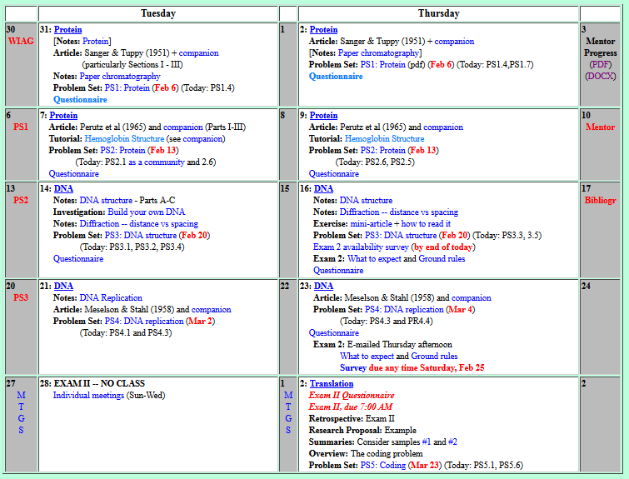
Welcome to Molecular Biology Through Discovery Tuesday, 14 February 2017

Slide 3
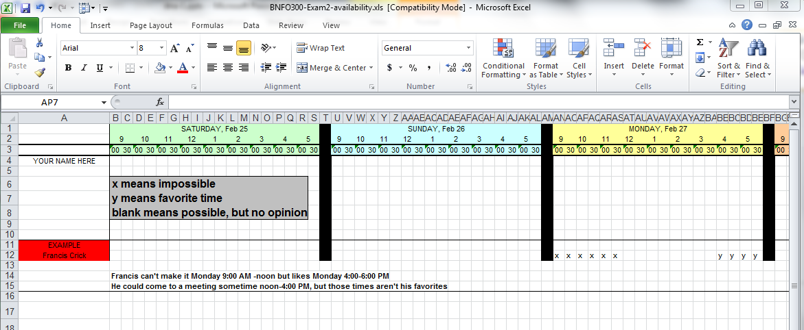

Slide 4

Welcome to Molecular Biology Through Discovery Tuesday, 14 February 2017
Could you speak about the upcoming bibliography and what you expect of it?

Slide 5
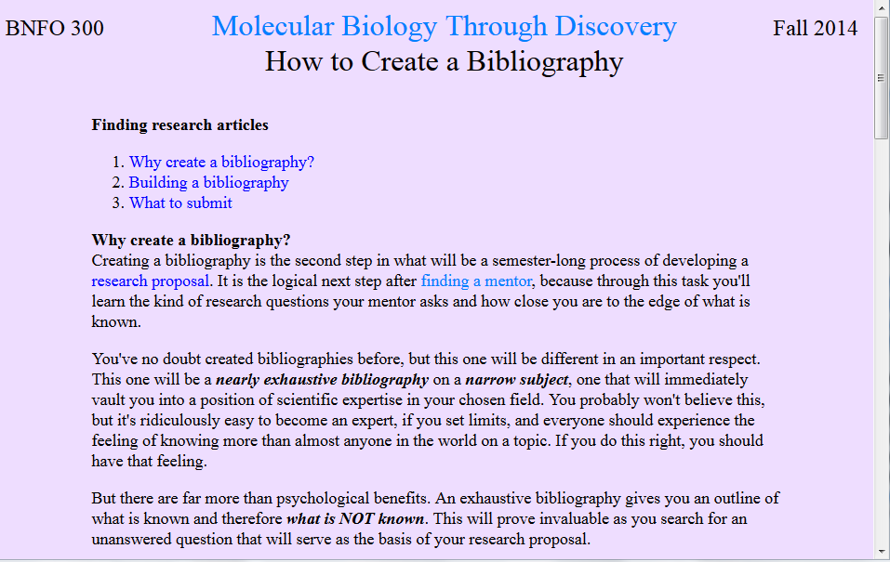

Slide 6
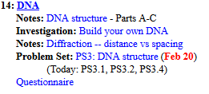
Welcome to Molecular Biology Through Discovery Tuesday, 14 February 2017

Slide 7
18 Sep 2013
NH₂
NH₂
O
NH₂
N
N
N
N
NH
NH
N
N
N
N
O
N
O
N
O
O
O
O
O
P
-
P
O
O
-
O
O
O
O
O
-
P
O
O
P
O
-
O
O
I got the hydrogen bonds to line up, however the backbone was spaced out unless the nucleotides were cramped together.
From the nucleotides shown above, construct a double-stranded DNA fragment with the sequence ACTG.
You may:
duplicate (Ctrl-d)
horizontal flip (Alt-hgoh)
vertical flip (Alt-hgov)
and/or rotate (Alt-hgor)
the nucleotides, but you may not change the relative positions of their atoms.
I'm not 100% sure if the commands provided are mac compatible so I manually did my vertical flips.

Slide 8
O
O
-
P
O
O
NH₂
O
N
N
N
NH
O
N
N
N
O
N
NH
O
O
O
O
N
P
-
P
NH₂
I think I need some more practice
-
O
O
O
O
O
O
NH₂
O
O
P
N
P
-
O
-
O
O
N
O
N
O
NH₂
N
N
O
N
N
N
NH
NH₂
N
N
From the nucleotides shown above, construct a double-stranded DNA fragment with the sequence ACTG.
You may duplicate, flip, and/or rotate the nucleotides, but you may not change the relative positions of their atoms.
NH₂
O
N
O
O
N
O
O
P
N
P
-
O
-
O
O
O
O
O
O
-
P
N
O
O
NH
O

Slide 9
Welcome to Molecular Biology Through Discovery Tuesday, 14 February 2017

Slide 10
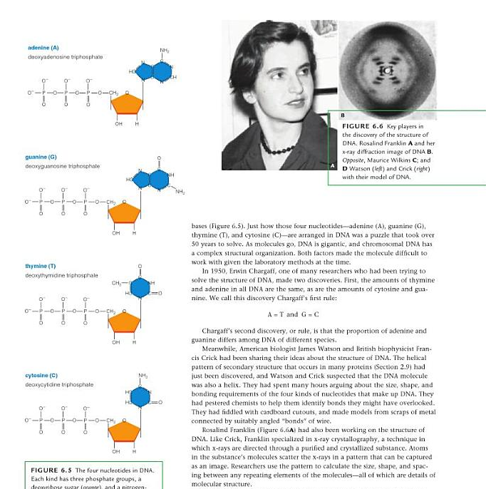
The Double Helix
Biology Today and Tomorrow
Starr, Evers, and Starr (2010)

Slide 11
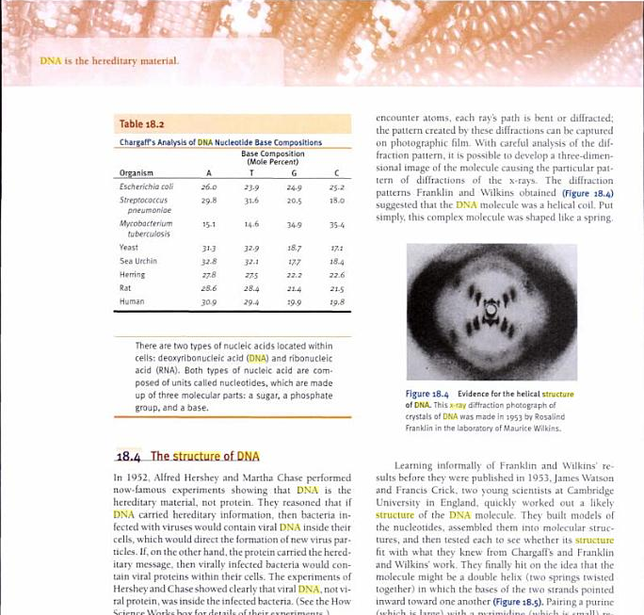
The Double Helix
Biology: Understanding Life
Alters (2000)

Slide 12
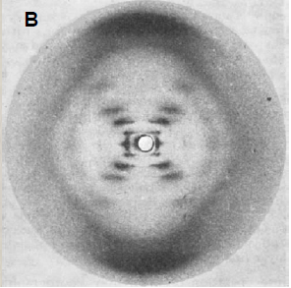

The Double Helix
E. How can the helical structure of DNA and internucleotide distance be discerned from Franklin and Gosling's x-ray photograph?

Slide 13
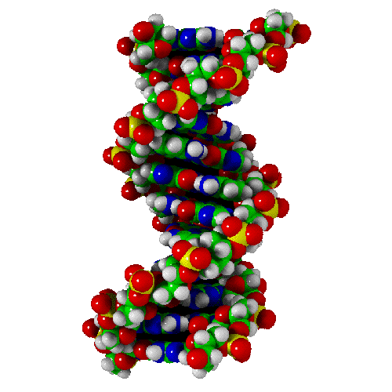
The Double Helix
E. How can the helical structure of DNA and internucleotide distance be discerned from Franklin and Gosling's x-ray photograph?

Slide 14
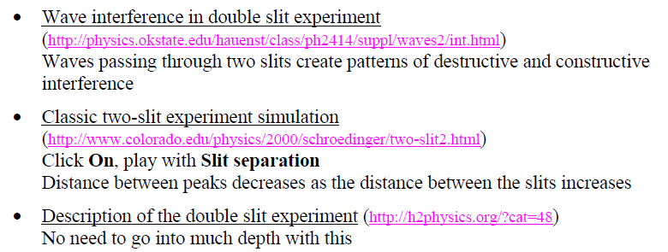
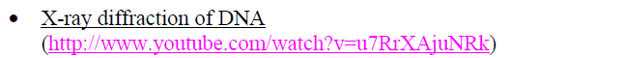
The Double Helix
1. How does X-ray diffraction work?

Slide 15
The Double Helix
1. How does X-ray diffraction work?
2. What is a lattice?
I am having a hard time picturing what SQ7 is asking. I can't figure out how tightening the helix would change the diffraction pattern.
Could we talk about SQ8. I can't follow how they concluded it was 10 nucleotides per turn.

Slide 16
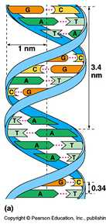
DNA Structure X-ray Diffraction
How does
lead to
X-ray diffraction image
Structural model of DNA

Slide 17
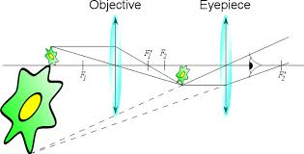
DNA Structure X-ray Diffraction
What is it?
A micrograph?

Slide 18
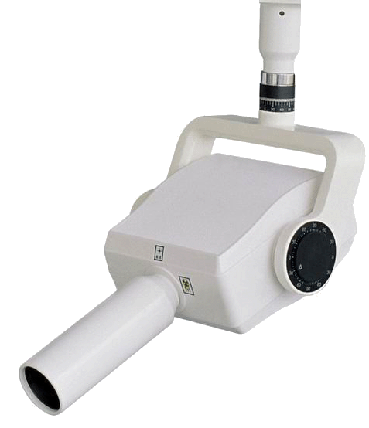
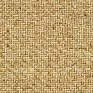
DNA Structure X-ray Diffraction
What is it?
X-ray source
DNA fiber (slowly rotating)
film

Slide 19
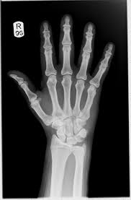
DNA Structure X-ray Diffraction
What is it?
X-ray source
DNA fiber (slowly rotating)
film
A silhouette?

Slide 20
DNA Structure X-ray Diffraction
What is it?
X-ray source
DNA fiber (slowly rotating)
A silhouette?

Slide 21
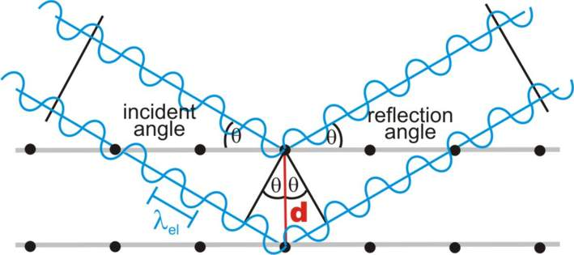
DNA Structure X-ray Diffraction
What is it?
?
Information not representation

Slide 22
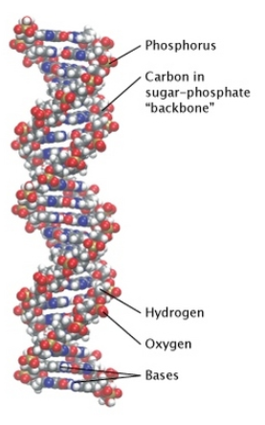
What do x-rays bounce off of?
Electrons
NH₂
N
N
O
O
O
P
-
O
O

Slide 23
What do x-rays bounce off of?
Electrons
NH₂
P
N
N
C,H,O
O
O
O
Which atom is the best reflector?
P
-
O
O
C,H,O,N

Slide 24
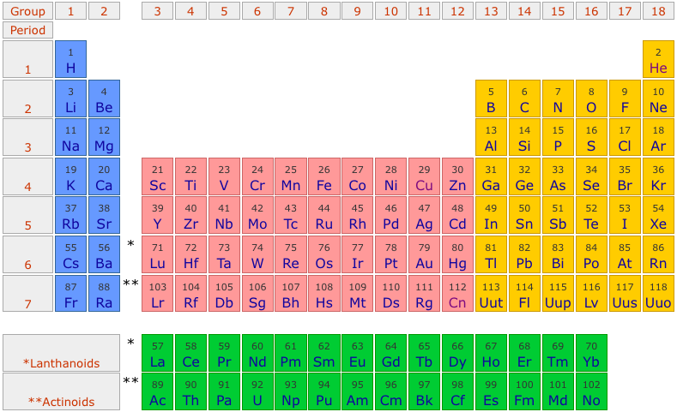
What do x-rays bounce off of?

Slide 25
What do x-rays bounce off of?
Electrons
NH₂
P
N
N
C,H,O
O
O
O
P
-
O
O
C,H,O,N

Slide 26
What do x-rays bounce off of?
Electrons
NH₂
P
N
N
O
O
O
P
-
O
O

Slide 27
What do x-rays bounce off of?
Electrons

Slide 28
What do x-rays bounce off of?
Electrons
?
equivalent positions?

Slide 29
What do x-rays bounce off of?
Electrons
equivalent positions?

Slide 30
What do x-rays bounce off of?
Electrons

Slide 31
What do x-rays bounce off of?
Electrons
equivalent positions?

Slide 32

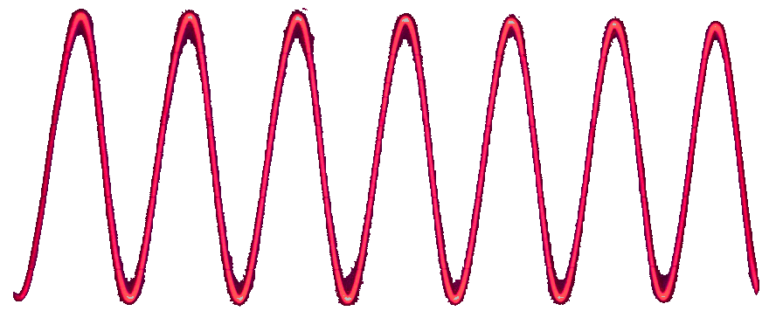
DNA Structure Intuitive Approach
~3 nanometer
1 wavelength ( = λ)

Slide 33
DNA Structure Intuitive Approach
~3 nanometer
1 wavelength ( = λ)

Slide 34
DNA Structure Intuitive Approach
Physical distance
Diffraction distance
Diffraction angle

Slide 35
DNA Structure Intuitive Approach
Qualitative (SQ7): squashing → Δdiffraction?
Quantitative (SQ8): Source of 10 nt/helical turn?
Diffraction distance
Diffraction angle

Slide 36
Welcome to Molecular Biology Through Discovery Tuesday, 14 February 2017

Slide 37
18 Sep 2013
NH₂
NH₂
O
NH₂
N
N
N
N
NH
NH
N
N
N
N
O
N
O
N
O
O
O
O
O
P
-
P
O
O
-
O
O
O
O
O
-
P
O
O
P
O
-
O
O
I got the hydrogen bonds to line up, however the backbone was spaced out unless the nucleotides were cramped together.
From the nucleotides shown above, construct a double-stranded DNA fragment with the sequence ACTG.
You may:
duplicate (Ctrl-d)
horizontal flip (Alt-hgoh)
vertical flip (Alt-hgov)
and/or rotate (Alt-hgor)
the nucleotides, but you may not change the relative positions of their atoms.

Slide 38

Physical Distance vs Diffraction Angle
Me
1N
1S
2N
2S
3N
3S
4N
4S
5N
5S
6N
6S
7S

Slide 39
Physical Distance vs Diffraction Angle
Me
Connect to: https://vcu.zoom.us/j/2504526209
1N
1S
2N
A
B
C
D
2S
3N
3S
4N
E
F
G H
4S
5N
5S
6N
I J
K
L
6S
7S

Slide 40
Why is there a patch of hydrophobic amino acids on lactate dehydrogenase?
Your group’s considered opinion (conclusion)
Justification (result / method)
Organized on a slide or page (to be shared – Zoom)
One intentional error

Slide 42

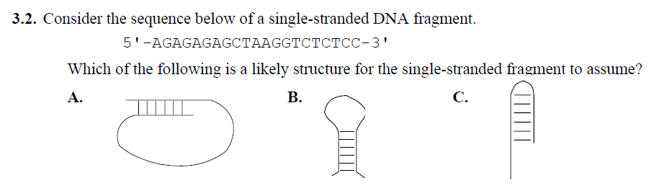

Slide 43
PS3, problems 2, 1, 4
Me
1N
1S
2N
2S
3N
3S
4N
4S
5N
5S
6N
6S
7S

Slide 44
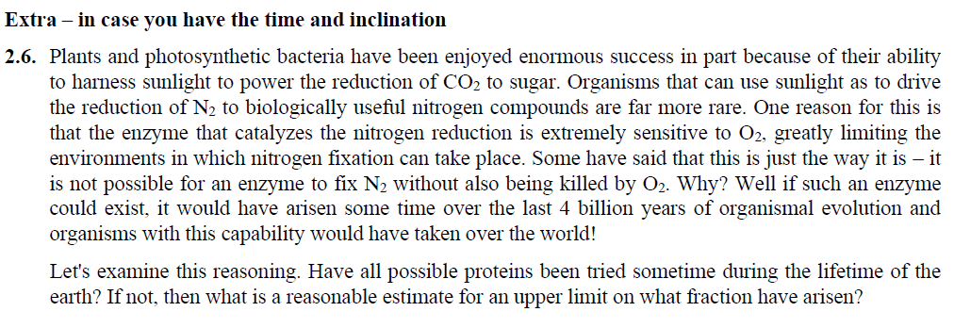
Fermi Problems
Could we address what the extra credit. I didn't really understand what it was asking me to do.
What is the question? What do you need?

Slide 46
DNA Structure Intuitive Approach
~3 nanometer
1 wavelength ( = λ)

Slide 47
DNA Structure Intuitive Approach
~1 cm
~3 nanometer
1 wavelength ( = λ)

Slide 48
DNA Structure Intuitive Approach
~1 cm
~3 nanometer
2 wavelengths ( = λ)

Slide 49
DNA Structure Intuitive Approach
~1 cm
~3 nanometer
1 wavelength ( = λ)

Slide 50
DNA Structure Intuitive Approach
~1 cm
~3 nanometer
1 wavelength ( = λ)

Slide 51
DNA Structure Intuitive Approach
~1 cm
~3 nanometer
1 wavelength ( = λ)

Slide 52
DNA Structure Simple Mathematical Approach
~1 cm
θ
θ
φ
φ
~3 nanometer
θ
θ
d
1 wavelength ( = λ)
= d
Sin θ
Sin θ
n
= 2d
= λ

Slide 53
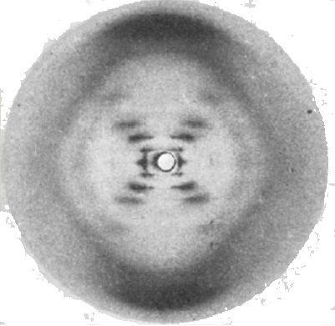
DNA Structure Simple Mathematical Approach
~1 cm
θ
θ
φ
φ
~3 nanometer
θ
θ
d
1 wavelength ( = λ)
= d
Sin θ
Sin θ
n
= 2d
= λ

