Slide 2
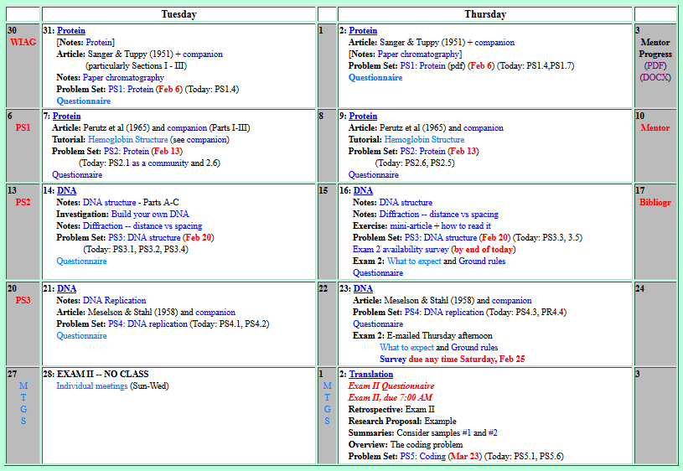

Welcome to Molecular Biology Through Discovery Tuesday, 21 February 2017
When will we know the meeting schedule for exam 2?

Slide 3
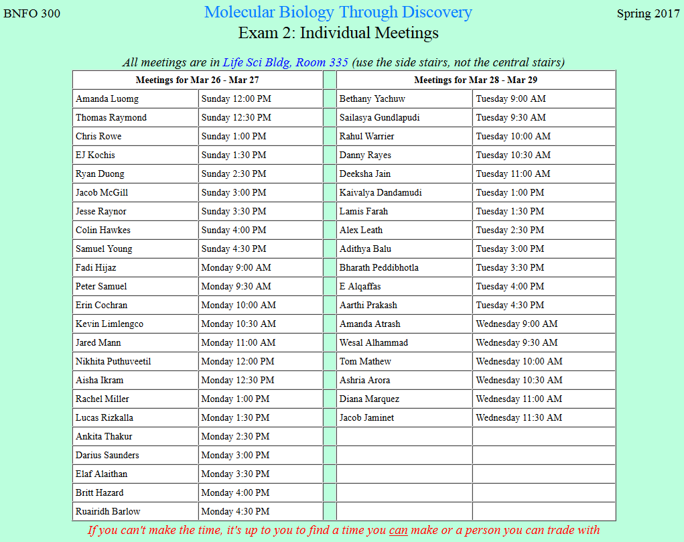

Slide 4

Welcome to Molecular Biology Through Discovery Tuesday, 21 February 2017
Regarding problem 3.3 part b...would it have been productive to include an assumption about the GC content of the sequence given in order to determine the chance of finding the palindromic sequence next? Was the next appearance of the palindrome supposed to be based on a completely randomly generated sequence of bases, or would a weighted estimate based on the make up of the given sequence have produced a better estimate?

Slide 5

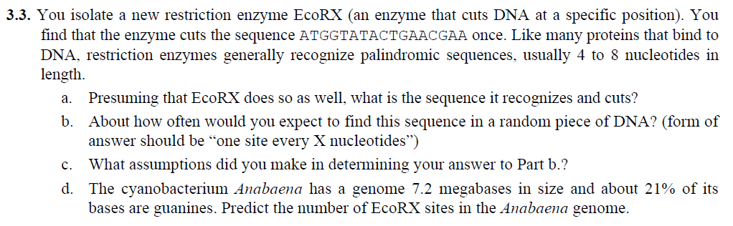

Slide 6
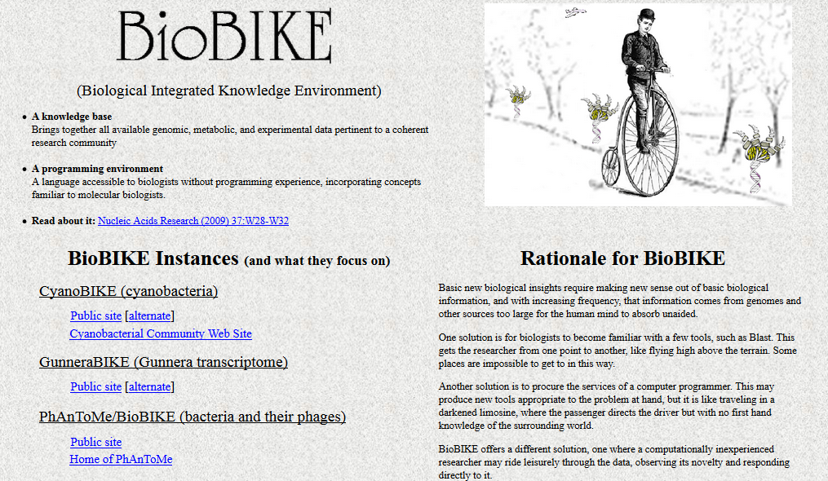

Slide 7
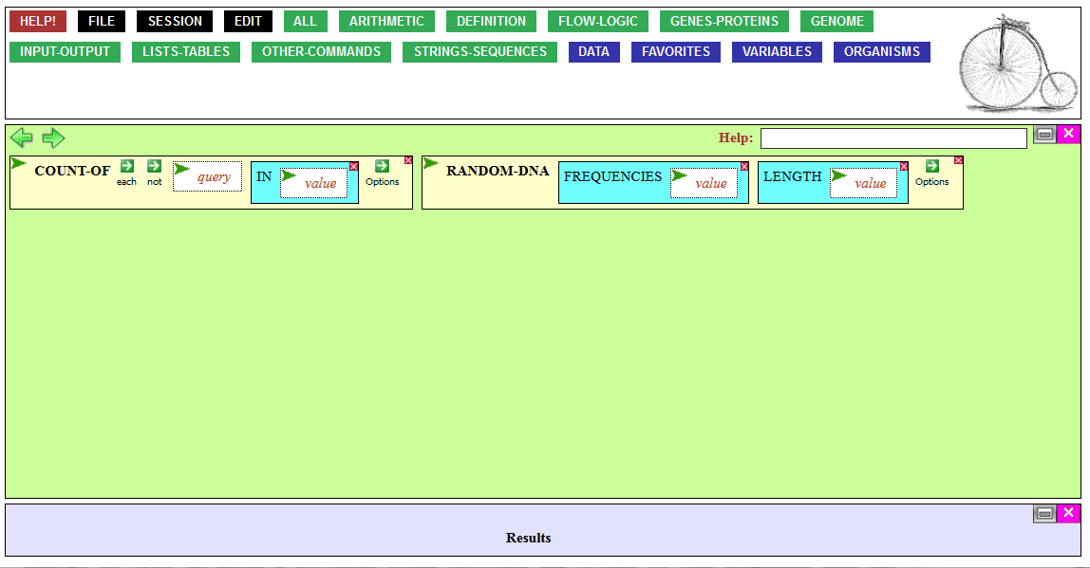

Slide 8

Find the palindromes
Me
1N
1S
2N
2S
3N
3S
4N
4S
5N
5S
6N
6S
7S

Slide 9
Find the palindromes
Me
Connect to: https://vcu.zoom.us/j/2504526209
1N
1S
2N
A
B
C
D
2S
3N
3S
4N
E
F
G H
4S
5N
5S
6N
I J
K
L
6S
7S

Slide 10
Welcome to Molecular Biology Through Discovery Tuesday, 21 February 2017
Regarding problem 3.3 part b...would it have been productive to include an assumption about the GC content of the sequence given in order to determine the chance of finding the palindromic sequence next? Was the next appearance of the palindrome supposed to be based on a completely randomly generated sequence of bases, or would a weighted estimate based on the make up of the given sequence have produced a better estimate?

Slide 11
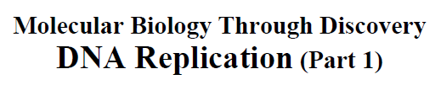
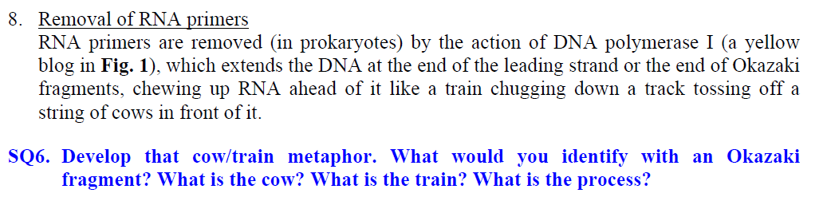
I didn't get the cow/train metaphor.
A cow / train example would be helpful
I would like to discuss a little more about proofreading if possible.

Slide 12
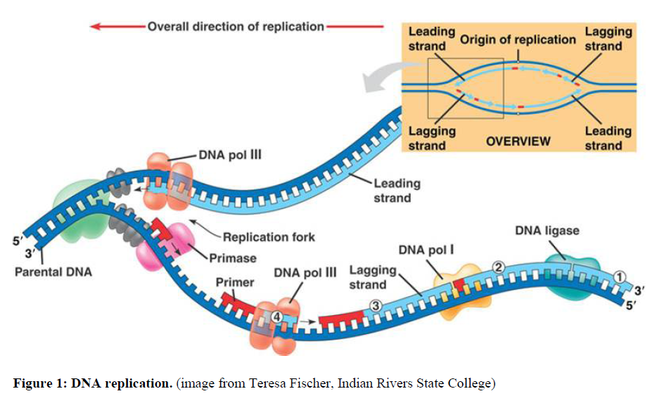
DNA replication
I would like to discuss a little more about proofreading if possible.
SQ3. What is the orientation of the upper parental strand?

Slide 13
DNA replication
I would like to discuss a little more about proofreading if possible.
SQ3. ...of the lower parental strand and its associated new strand?

Slide 14
DNA replication
I would like to discuss a little more about proofreading if possible.
SQ4. Would you describe the overall direction of repli- cation as 5' to 3'? 3' to 5'?

Slide 15
DNA replication
I would like to discuss a little more about proofreading if possible.
SQ2. Identify the regions composed of RNA and those composed of DNA...

Slide 16
DNA replication
I would like to discuss a little more about proofreading if possible.
SQ2. Where is the RNA primer for the strand labeled 'Leading strand'?
Why so complicated?

Slide 17
DNA replication
I would like to discuss a little more about proofreading if possible.
A
T
O
NH₂
NH
N
N
O
N
N
O
O
N
-
P
O
O
O
O
NH₂
-
P
O
N
O
NH₂
N
NH
N
N
O
N
O
O
N
-
P
O
N
O
O
O
A
G
-
P
O
O

Slide 18
DNA replication
I would like to discuss a little more about proofreading if possible.
SQ6. Develop that cow/train metaphor...

Slide 19
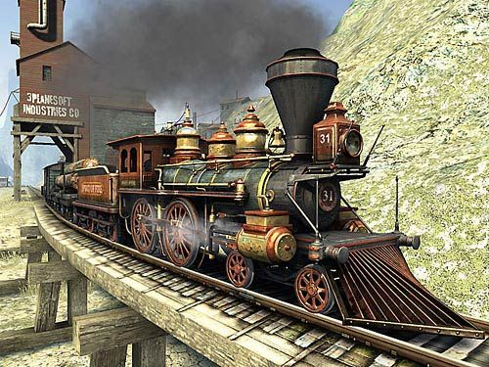
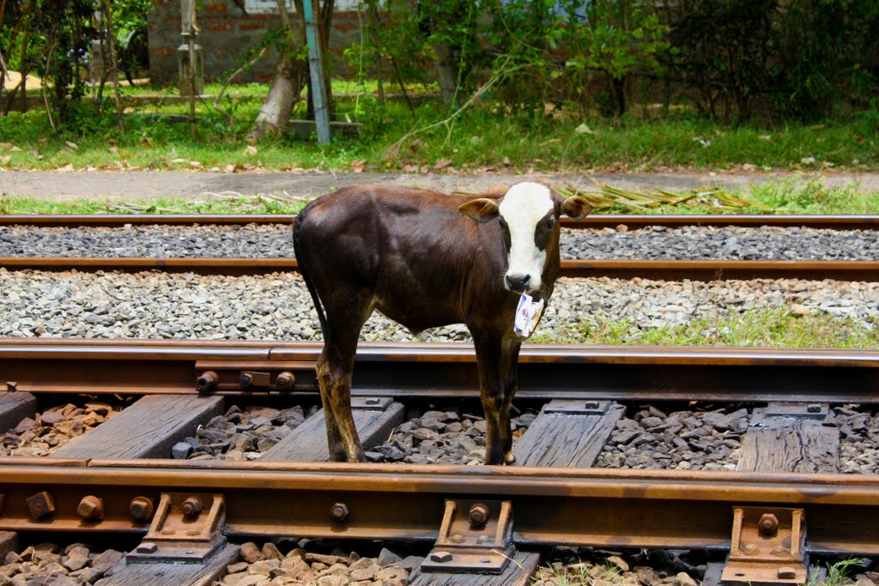
DNA replication
I would like to discuss a little more about proofreading if possible.

Slide 20
I feel fairly comfortable with all of these topics.
I am pretty comfortable with these topics.
Comfortable

Slide 21

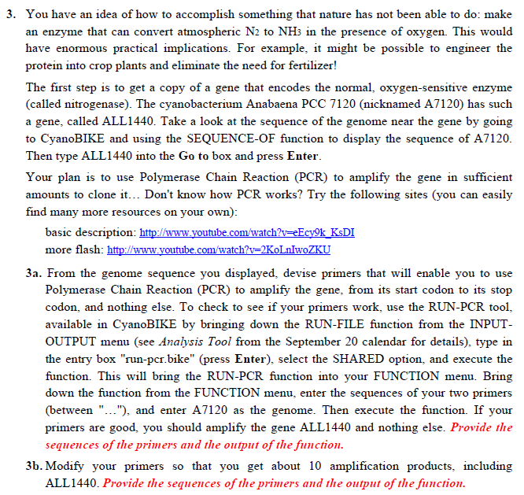

Slide 22
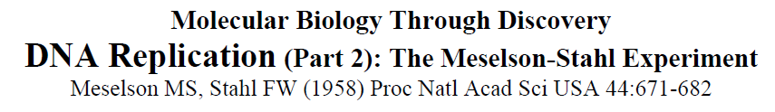
Going over fig. 4 in class would probably help me

Slide 23
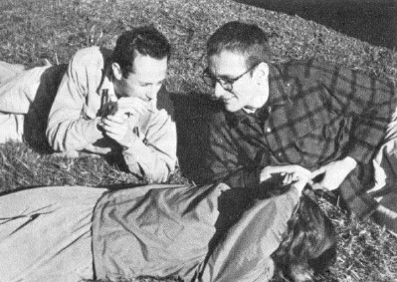
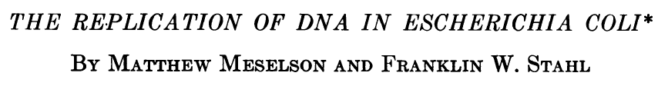
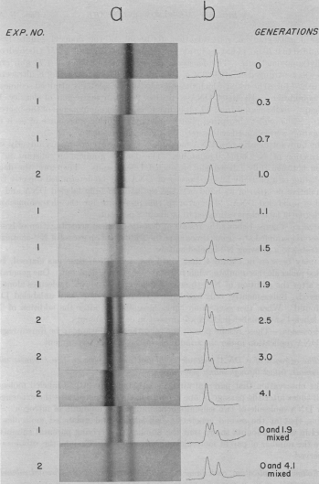
Im not quite sure the difference between experiment 1/2...
SQ13. What would you expect from Fig. 4 at 1 generation in each of the three models of DNA replication mentioned above (conservative, semiconservative,
dispersive)?
SQ14. Same question as SQ13 but
at 2 generations.

Slide 24
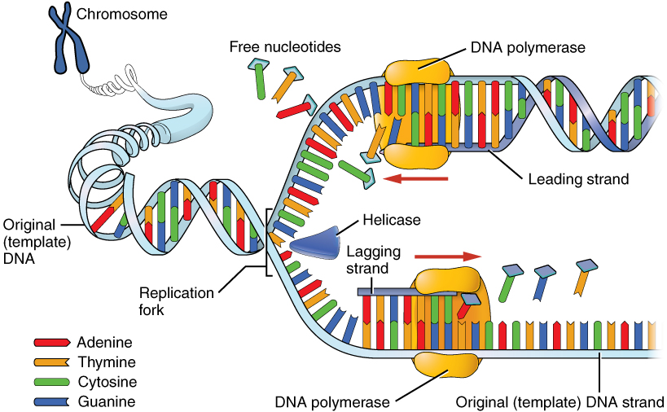
I would definitely like to go over…the critical differences between the three featured models of DNA replication.
SQ1: Why is it necessary for the DNA to unwind in order for replication to take place?

Slide 25
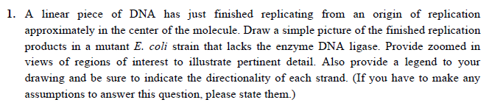

Slide 26
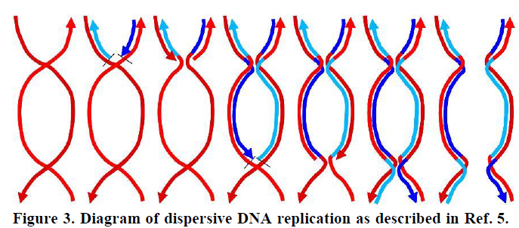
I would definitely like to go over…the critical differences between the three featured models of DNA replication.
Label 5’ and 3’ ends

Slide 27

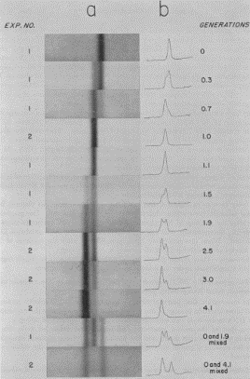
To do:
Problem Set 4, Question 3:
Problem Set 4, Question 1:
Meselson & Stahl notes, Fig. 3:
Label 5’ and 3’ ends
Meselson & Stahl notes, SQ13 & 14

Slide 28
PS3, problems 1,2,3,4,5
Me
Connect to: https://vcu.zoom.us/j/2504526209
1N
1S
2N
A
B
C
D
2S
3N
3S
4N
E
F
G H
4S
5N
5S
6N
I J
K
L
6S
7S

Slide 29
Find the palindromes
Your group’s considered opinion (conclusion)
Justification (result / method)
Organized on a slide or page (to be shared – Zoom)
One intentional error

Slide 31
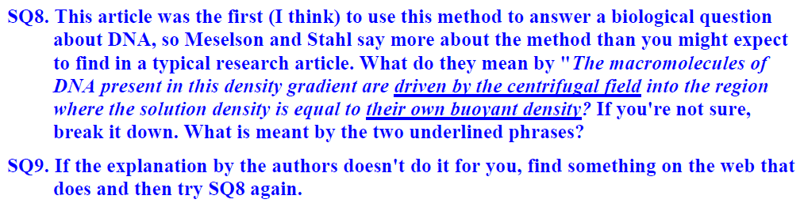

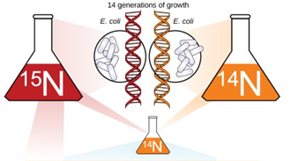



Slide 32



