Slide 2
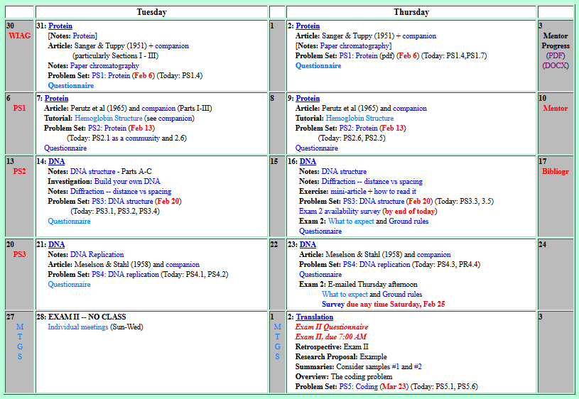
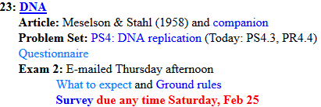

Welcome to Molecular Biology Through Discovery Thursday, 23 February 2017
For those of us with weekend appointments, are we going to be able to get into the building?

Slide 3
Welcome to Molecular Biology Through Discovery Thursday, 23 February 2017

Slide 4
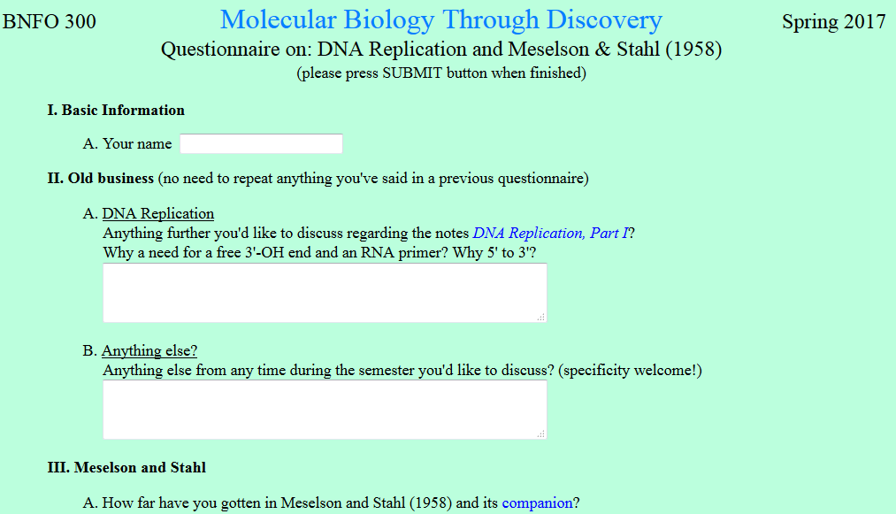
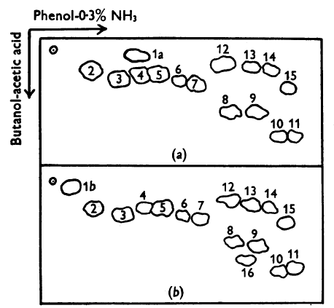
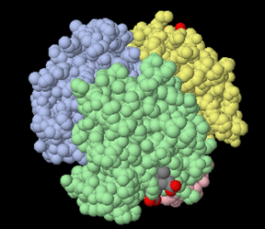
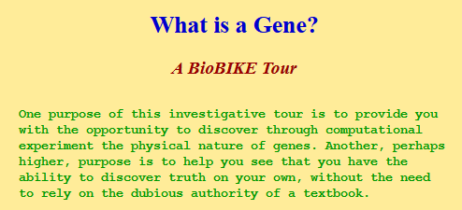
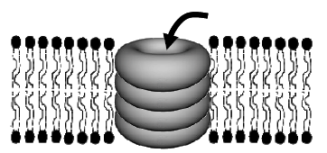

Slide 5
…Rule #1 in the notes. If everything occurs 5' to 3', why does the rule say that nucleotides get added to the 3'-OH end…?
And why is 3'-OH needed?

Slide 6
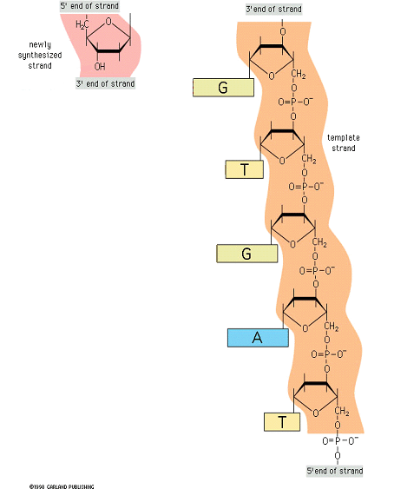

DNA replication Why 5’ to 3’?

Slide 7
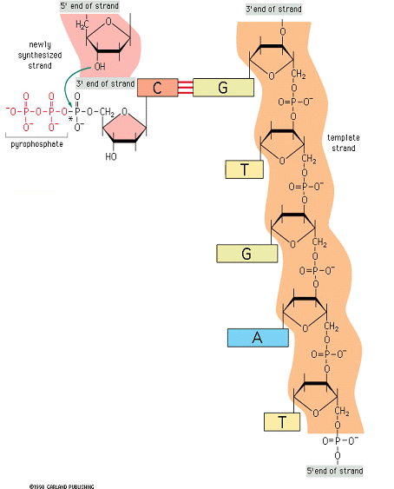
DNA replication Why 5’ to 3’?
Why couldn’t nucleotide fly on anywhere?

Slide 8
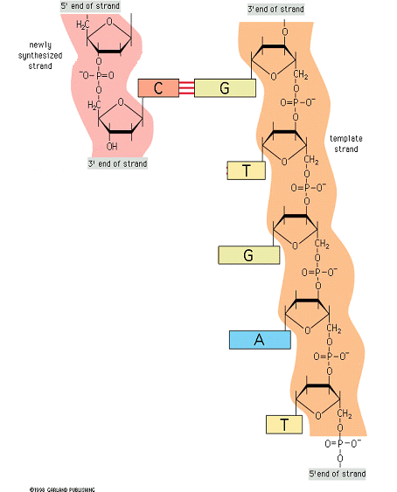
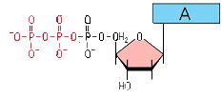
DNA replication Why 5’ to 3’?

Slide 9
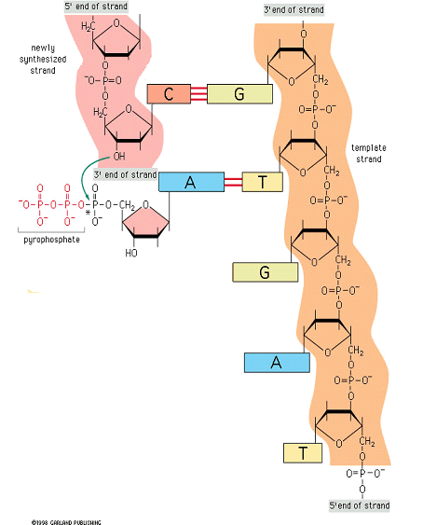
DNA replication Why 5’ to 3’?

Slide 10
DNA replication Why 5’ to 3’?
5’
3’
Left
Right
…Rule #1 in the notes. If everything occurs 5' to 3', why does the rule say that nucleotides get added to the 3'-OH end…?

Slide 11
DNA replication Why 3’OH?
And why is 3'-OH needed?

Slide 12
DNA replication Why 3’OH?
How to make replication go 3’ to 5’?

Slide 13
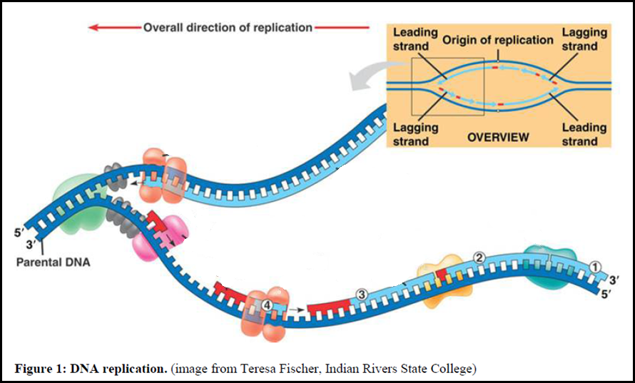
DNA replication Why 3’OH?
5’
3’
3’
5’
3’
5’
3’
5’

Slide 14
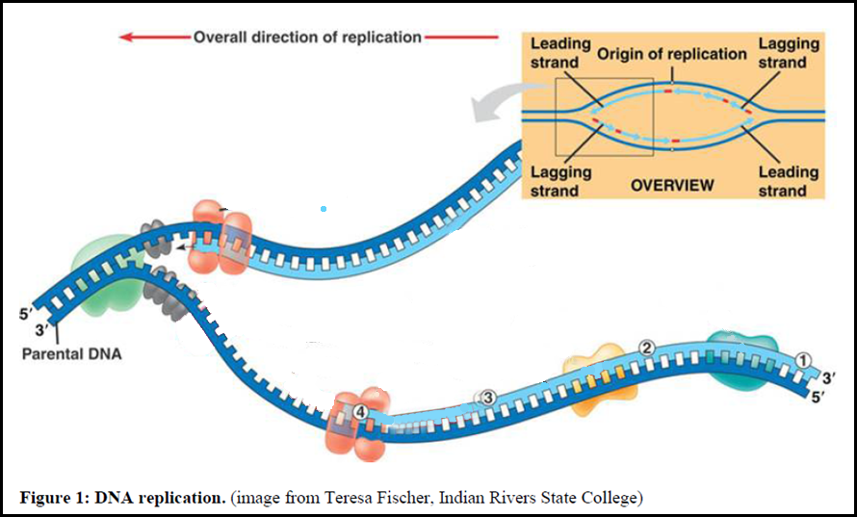
DNA replication Why 3’OH?
5’
3’
3’
5’

Slide 15
DNA replication Why 3’OH?
How to make replication go 3’ to 5’?

Slide 16
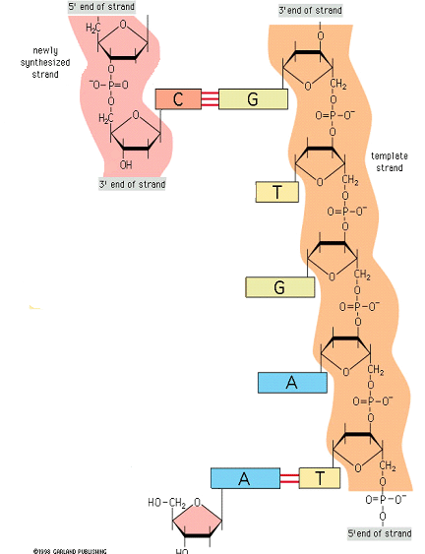

DNA replication Why 3’OH?
T
OH

Slide 17
DNA replication Why 3’OH?
T
OH

Slide 18
DNA replication Why 3’OH?
How to make replication go 3’ to 5’?
T
5’dTTP
OH

Slide 19
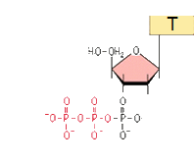
DNA replication Why 3’OH?
How to make replication go 3’ to 5’?
3’dTTP
3’dGTP
3’dCTP
3’dATP

Slide 20
Welcome to Molecular Biology Through Discovery Thursday, 23 February 2017

Slide 21
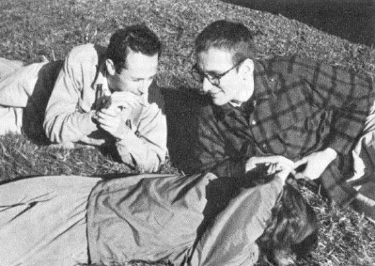
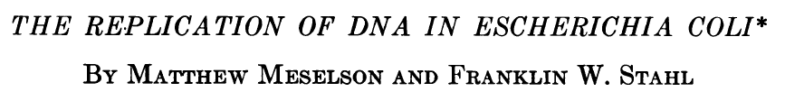
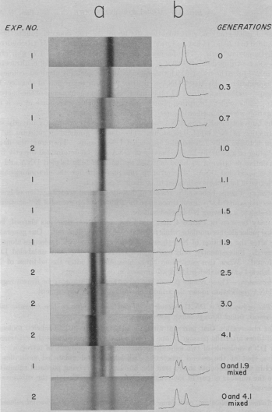
I've found the difference between exp 1/2 in the experimental methods section, but I'm not sure how that would make a difference in examining fig 4.

Slide 22
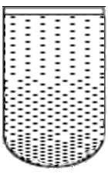
I would also benefit from going over the properties of cesium chloride that helps cause the density gradient when centrifuged with DNA.
Why CsCl? Why not NaCl?

Slide 23
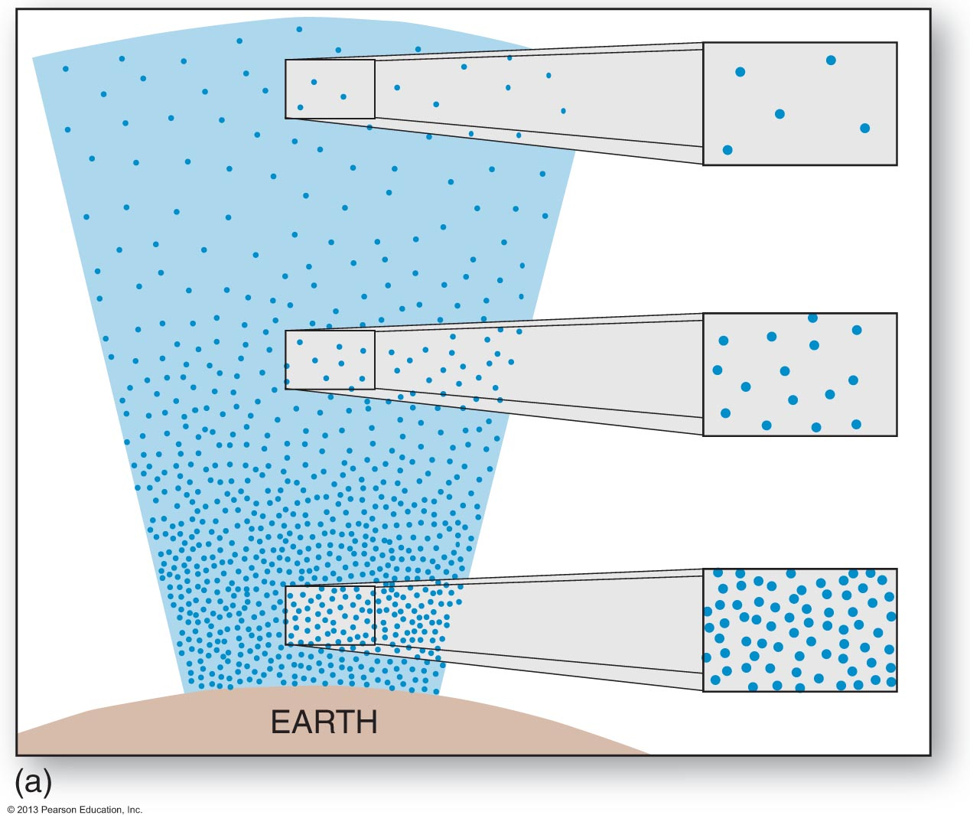
Does it matter: H₂ vs O₂?
g r a v i t y
d i f f u s I on

Slide 24
Does it matter: NaCl vs CsCl?
g f o r c e
d i f f u s I on
DNA

Slide 25
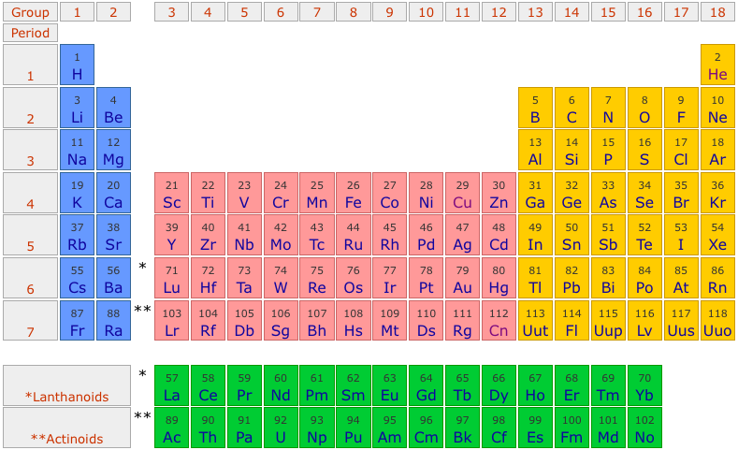
Does it matter: NaCl vs CsCl?

Slide 26
Does it matter: NaCl vs CsCl?
g f o r c e
d i f f u s I on
DNA

Slide 27
Welcome to Molecular Biology Through Discovery Thursday, 23 February 2017

Slide 28

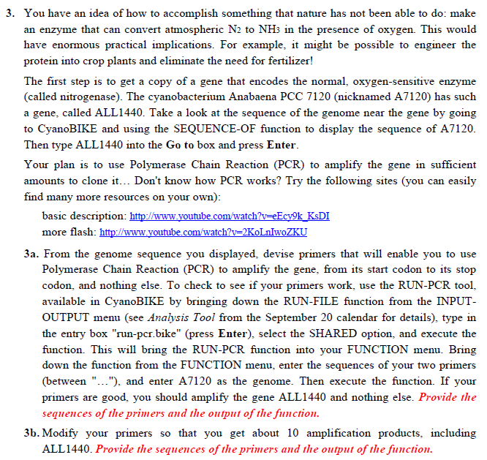

Slide 29
DNA replication Why 3’OH?
5’
3’
3’
5’
3’
5’
3’
5’

Slide 30

Find the palindromes
Me
1N
1S
2N
2S
3N
3S
4N
4S
5N
5S
6N
6S
7S

Slide 31
Find the palindromes
Me
Connect to: https://vcu.zoom.us/j/2504526209
1N
1S
2N
A
B
C
D
2S
3N
3S
4N
E
F
G H
4S
5N
5S
6N
I J
K
L
6S
7S

Slide 32
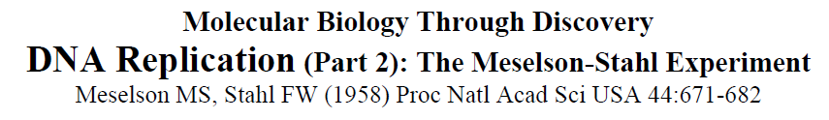
Going over fig. 4 in class would probably help me

Slide 33
SQ13. What would you expect from Fig. 4 at 1 generation in each of the three models of DNA replication mentioned above (conservative, semiconservative,
dispersive)?
SQ14. Same question as SQ13 but
at 2 generations.

Slide 34
PS3, problems 1,2,3,4,5
Me
Connect to: https://vcu.zoom.us/j/2504526209
1N
1S
2N
A
B
C
D
2S
3N
3S
4N
E
F
G H
4S
5N
5S
6N
I J
K
L
6S
7S

Slide 35
Find the palindromes
Your group’s considered opinion (conclusion)
Justification (result / method)
Organized on a slide or page (to be shared – Zoom)
One intentional error

