Slide 1
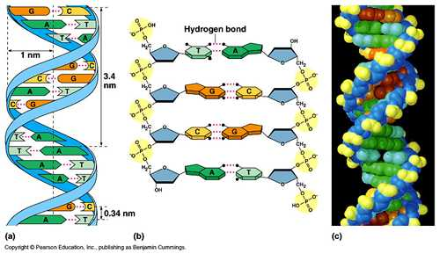

DNA Structure
How does
lead to
X-ray diffraction image
In this presentation I focus just on why:
diffraction image physical model
spacing between spots distance between atoms
spacing between spots distance between atoms
Structural model
of DNA

Slide 2
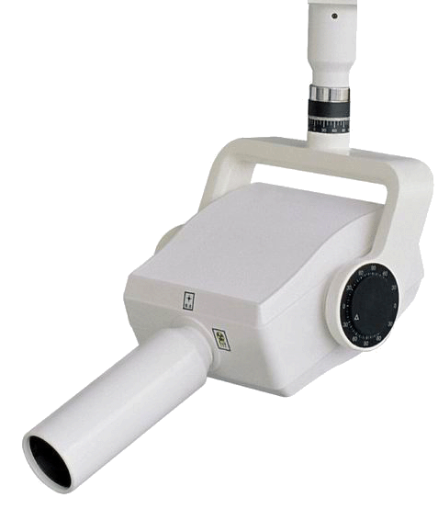

DNA Structure
Intuitive Approach
X-ray source
DNA fiber
(slowly rotating)
film
A beam of X-rays with a wavelength close to 1 nm is aimed at a fiber of DNA (~a million aligned molecules). Most of the beam passes unhindered to the center of the film, but some is reflected off of the fiber and exposes a different part of the film. The fiber is rotated to capture all possible reflections.

Slide 3

DNA Structure
Intuitive Approach
~1 meter
~3 nanometer
Here’s a vastly blown up view of a small part of the DNA fiber.
You’re seeing only one molecule of the fiber and a very tiny part of that. The molecule continues in both directions.

Slide 4
DNA Structure
Intuitive Approach
~1 meter
~3 nanometer
The molecule can be considered a lattice of atoms. Five atoms are shown here, along with five others in equivalent positions.

Slide 5
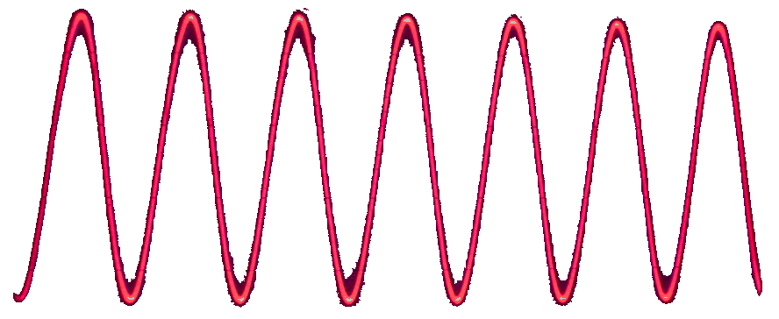
DNA Structure
Intuitive Approach
~3 nanometer
I’ve paused the wave so that you can notice that the peaks and troughs of the two waves line up. Now, notice what happens when the waves bounce off
of spaced atoms.
Watch the x-ray beam hit the lattice. I’ve shown two waves, in phase and with the same wavelength.

Slide 6
DNA Structure
Intuitive Approach
~1 cm
~3 nanometer
Note that the bottom wave lags behind, but the two waves remain in phase (peaks and troughs in lockstep).

Slide 7
DNA Structure
Intuitive Approach
~1 cm
~3 nanometer
Since the waves are in phase, their intensities add to each other and a spot
is produced on the film. If they were not in phase, they would interfere and there would not be a spot at that position.

Slide 8
DNA Structure
Intuitive Approach
~1 cm
~3 nanometer
1 wavelength
( = λ)
We can highlight two regions where the two waves travel the same distance.
That leaves the bottom wave with an extra segment.
Since the two waves are in phase before and after the extra segment, that segment must be one or more complete wavelengths (let’s say just one).

Slide 9
DNA Structure
Intuitive Approach
~1 cm
~3 nanometer
1 wavelength
( = λ)
I’ve simplified the diagram, replacing the waves with straight lines, but nothing essential has changed.
Now consider, what will happen if you pull on the central dot to increase the distance from the dot above?

Slide 10
DNA Structure
Intuitive Approach
~1 cm
~6 nanometer
This seems plausible. You pull the dot down, and the stretching makes the angle more sharp and the spot rise.
Plausible, but WRONG!
The extra segment is now bigger than one wavelength!
1 wavelength
( = λ)

Slide 11
DNA Structure
Intuitive Approach
~1 cm
~3 nanometer
This is more like it. The extra segment is still one wavelength.
But to make this happen,
the angle has become more shallow, and the spot drops.
1 wavelength
( = λ)

Slide 12
DNA Structure
Simple Mathematical Approach
~1 cm
θ
θ
~3 nanometer
1 wavelength
( = λ)
The angles marked θ are the same, because the x-ray beam bounces like a ball off a wall: the angle of incidence = the angle of reflection.
Some may find a simple mathematical proof more convincing.

Slide 13
DNA Structure
Simple Mathematical Approach
~1 cm
θ
θ
~3 nanometer
θ
θ
1 wavelength
( = λ)
And so are the bottom two angles (as you can work out from the parallel lines

Slide 14
DNA Structure
Simple Mathematical Approach
~1 cm
θ
θ
~3 nanometer
θ
θ
d
θ
θ
1 wavelength
( = λ)
And so are the inner two angles (as you can work out from the similar right triangles).
Now we have enough to calculate the length of the extra segment.

Slide 15
DNA Structure
Simple Mathematical Approach
~1 cm
θ
θ
~3 nanometer
θ
θ
d
1 wavelength
( = λ)
= d
Sin θ
The right half of the segment equals the hypotenuse, d, of the right triangle times sin θ.

Slide 16
DNA Structure
Simple Mathematical Approach
~1 cm
θ
θ
~3 nanometer
θ
θ
d
1 wavelength
( = λ)
= d
Sin θ
And both halves is twice that, all of which equals one wavelength, λ.
= 2d
Sin θ
= λ

Slide 17
DNA Structure
Simple Mathematical Approach
~1 cm
θ
θ
~3 nanometer
θ
θ
d
1 wavelength
( = λ)
= d
Sin θ
Since the wave length of the x-ray beam is constant, increasing d means decreasing Sin θ (and θ) and vice versa.
= 2d
Sin θ
= λ

Slide 18
DNA Structure
Simple Mathematical Approach
~1 cm
And therefore:
diffraction image physical model
spacing between spots distance between atoms
spacing between spots distance between atoms
θ
θ
~3 nanometer
θ
θ
d
1 wavelength
( = λ)
= d
Sin θ
We can make the equation more general by noting that the two waves will remain in phase with any number of wavelengths, so…
= 2d
Sin θ
= λ

Slide 19
DNA Structure
Simple Mathematical Approach
~1 cm
θ
θ
~3 nanometer
θ
θ
d
1 wavelength
( = λ)
So a given distance, d, will produce a family of reflections, with n having values of 1, 2, 3,….
= 2d
Sin θ
n
= λ

Slide 20
DNA Structure
Simple Mathematical Approach
~1 cm
θ
θ
~3 nanometer
θ
θ
d
1 wavelength
( = λ)
And since the wavelength is known, you can determine the distance between atoms just with a ruler to measure the spacing between spots.
= 2d
Sin θ
n
= λ

Slide 21
DNA Structure
Simple Mathematical Approach
~1 cm
θ
θ
~3 nanometer
θ
θ
d
This is called the Bragg equation, used to determine interatomic distances.
1 wavelength
( = λ)
Lawrence Bragg was director of the Cavendish Lab in Cambridge, where Watson and Crick worked.
= 2d
Sin θ
n
= λ

Slide 22
DNA Structure
How does
lead to
X-ray diffraction image
In this presentation I focus just on why:
diffraction image physical model
spacing between spots distance between atoms
spacing between spots distance between atoms
Structural model
of DNA

