Slide 2


Slide 3


Slide 4

Welcome to the
VCU Review Panel
on Molecular
Biology Research
Tuesday, May 2, 2016

Slide 5
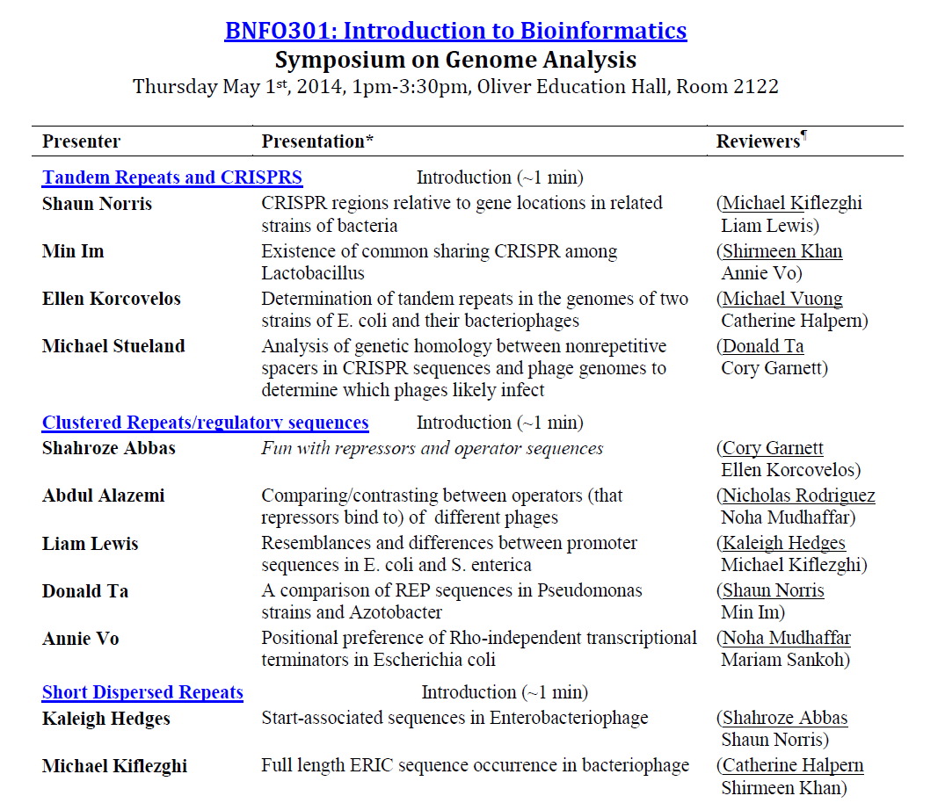
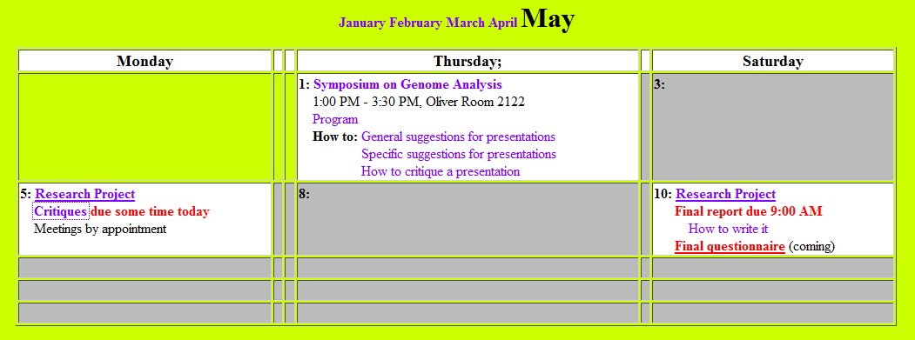
Individual presentations
At 4 minute - warning
At 5 minutes - cutoff
1-2 min questions

