Slide 2
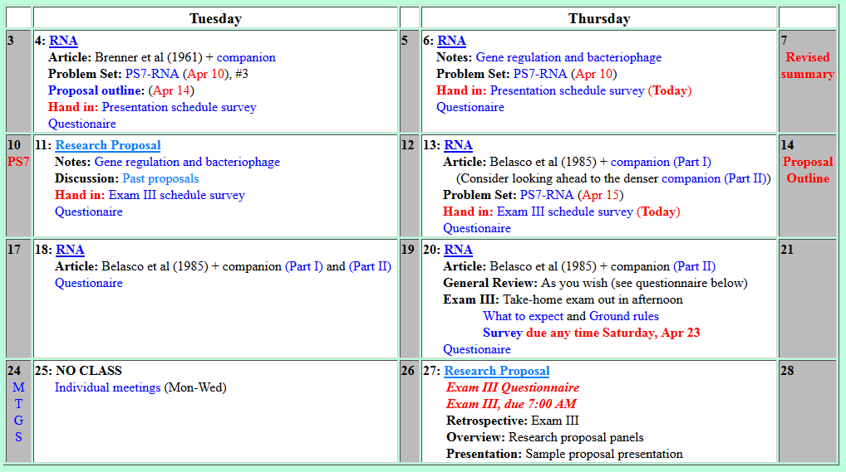
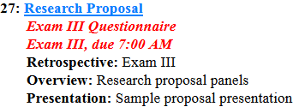
Welcome to Molecular Biology Through Discovery Thursday, 27 April 2017

Slide 3
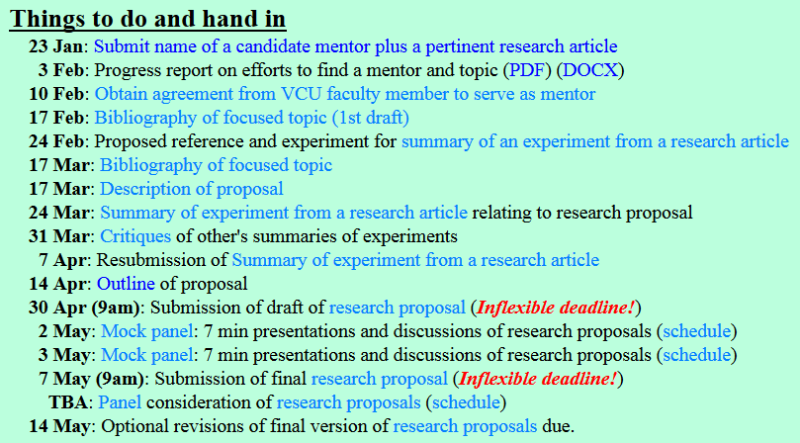

Slide 4
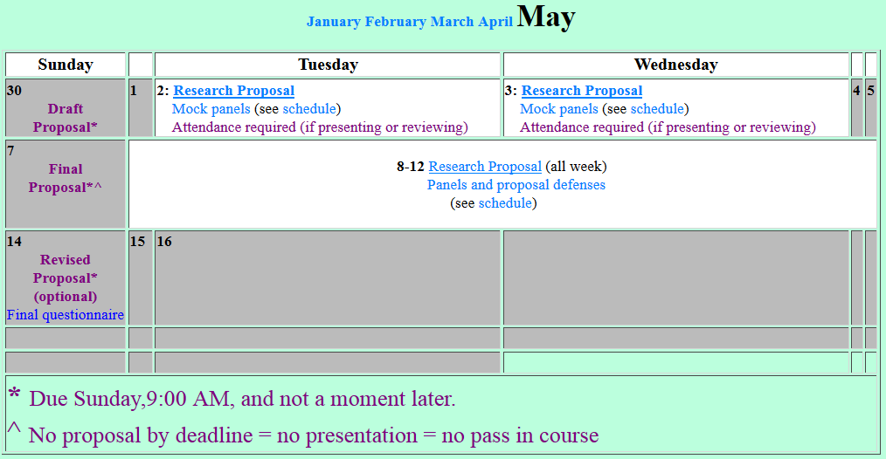

Slide 6
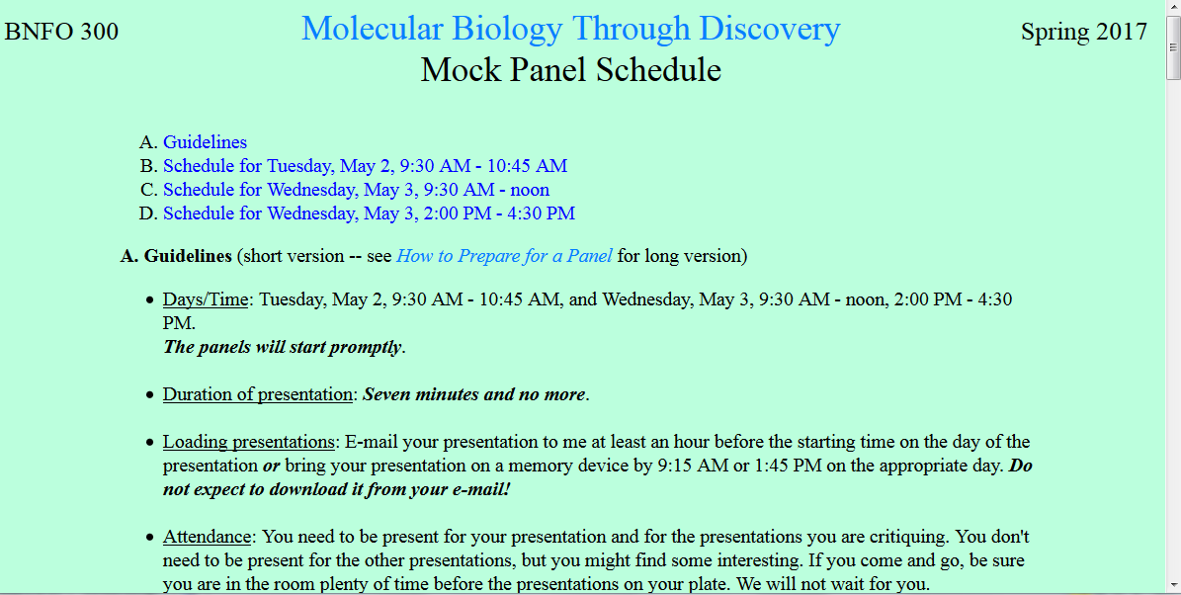

Slide 7
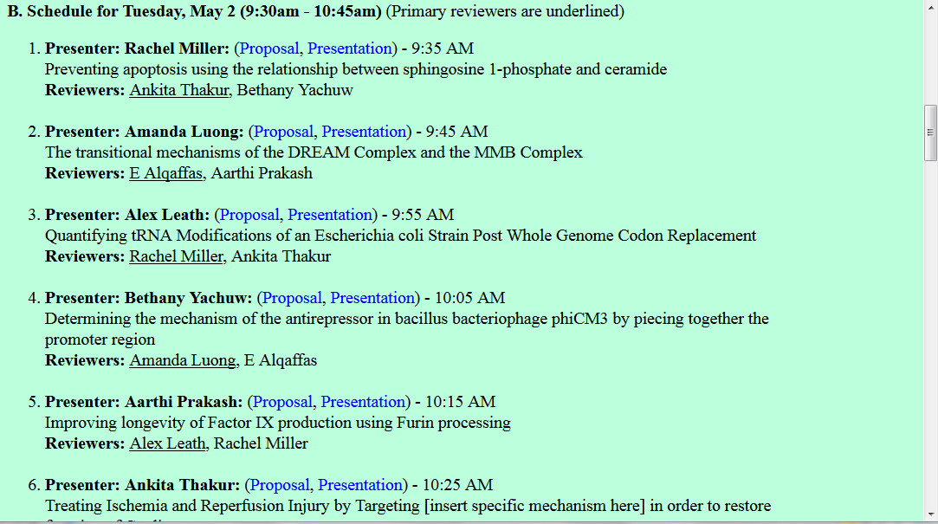

Slide 8
Welcome to Molecular Biology Through Discovery Thursday, 27 April 2017

Slide 9
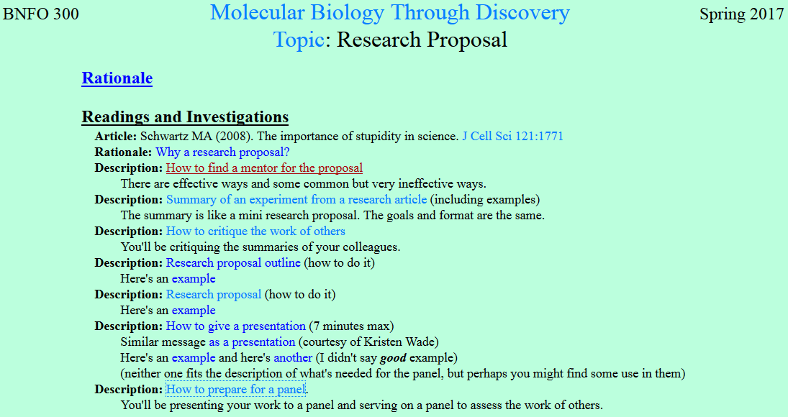

Slide 10
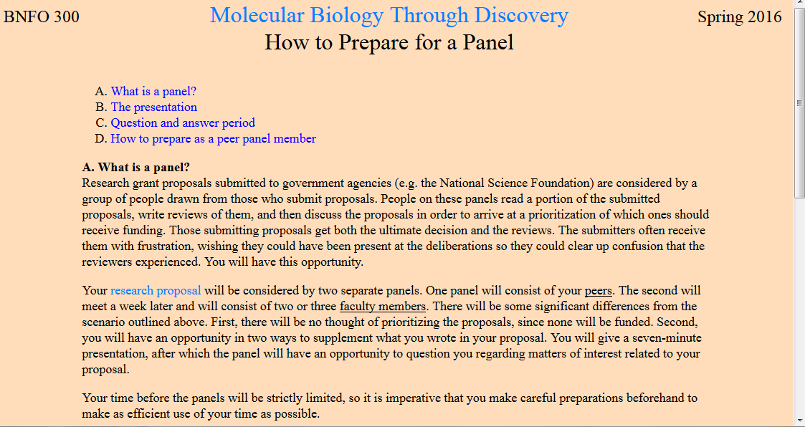

Slide 12
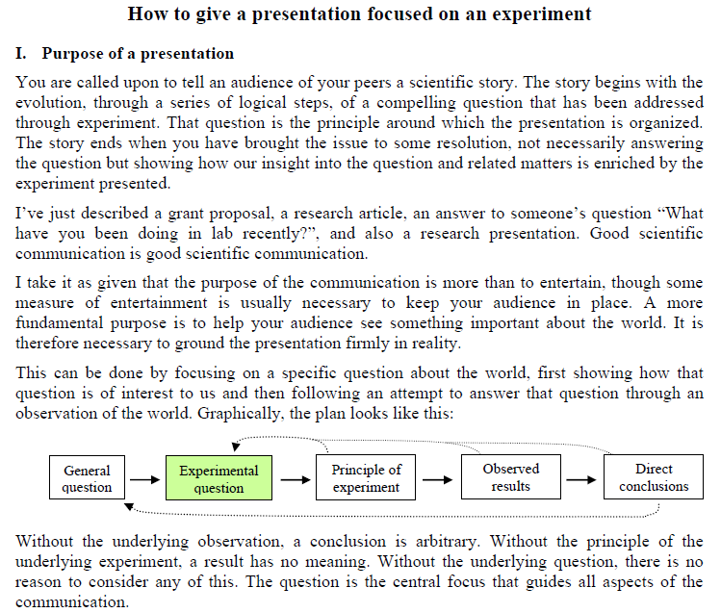

Slide 14
Welcome to Molecular Biology Through Discovery Thursday, 27 April 2017

Slide 15
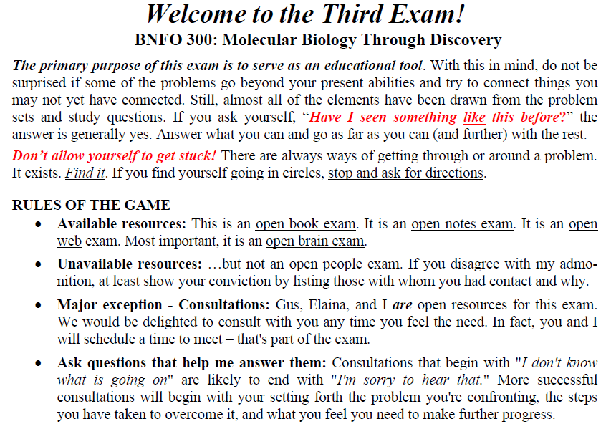

…it's really frustrating and stressful having so many things due for one class.

Slide 16
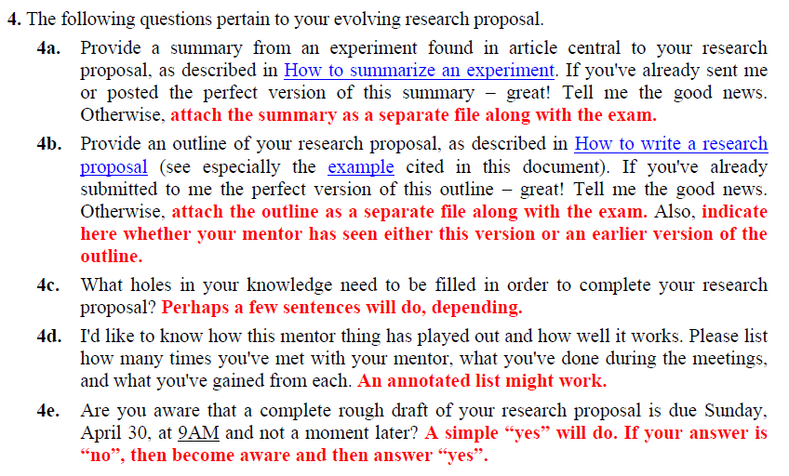

Slide 17
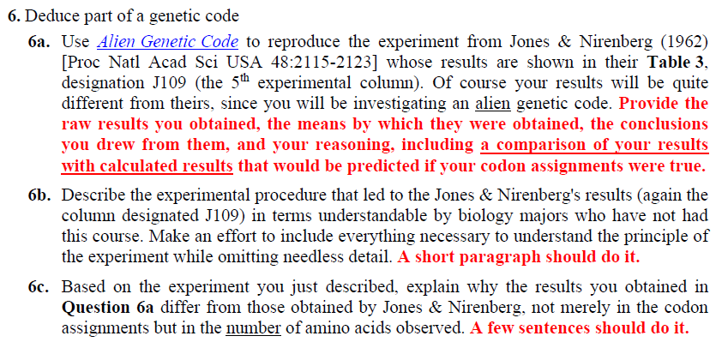

Slide 18
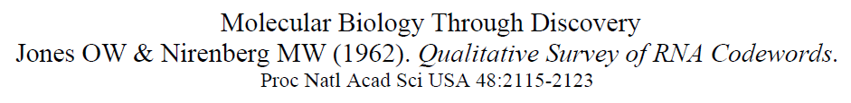
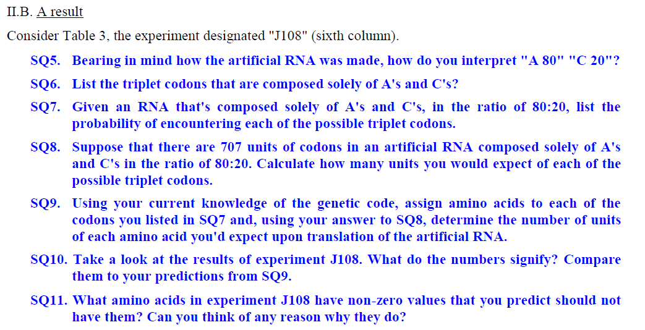


Slide 19
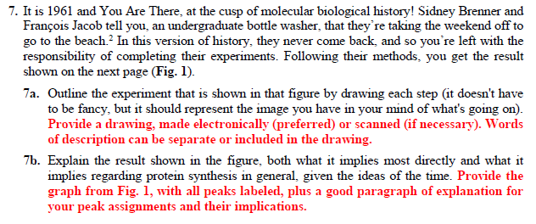

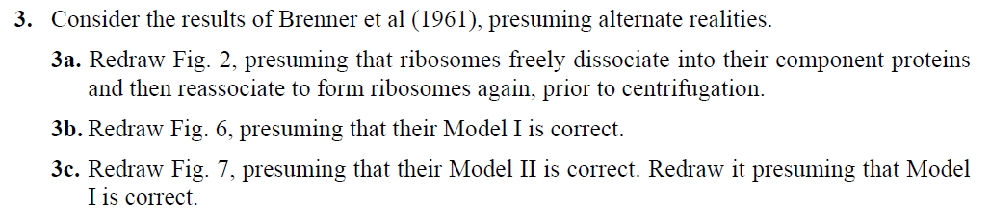
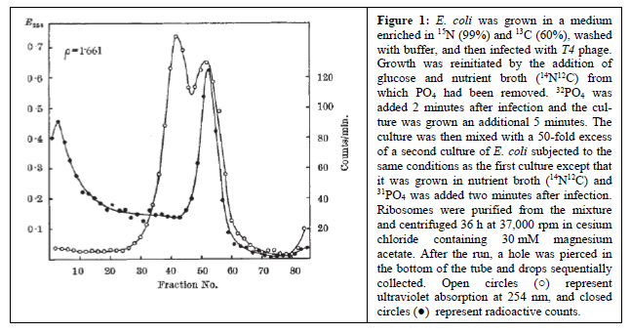

Slide 20
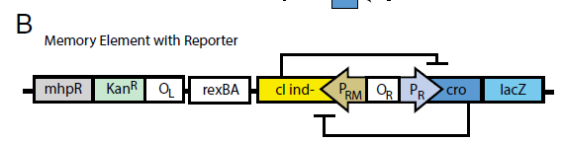
Question 8. This was the question I found interesting.
I… would like to go over… how to find the -10 region in the OL sequence from 8c.

Slide 21
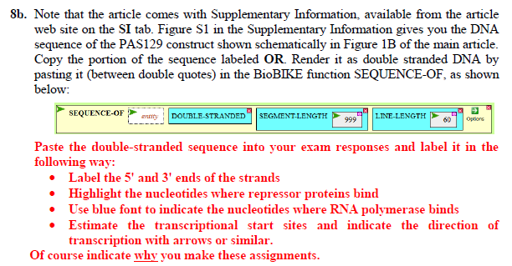
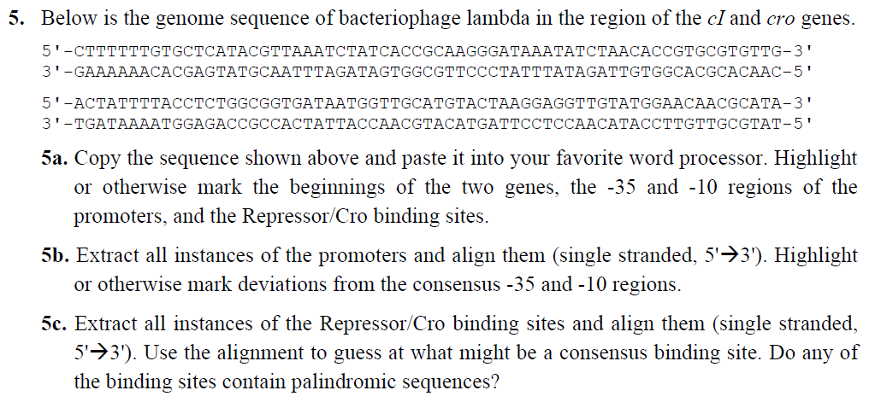

Slide 22
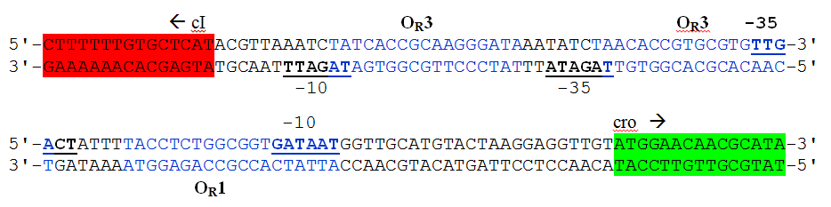
O_{R}

Slide 23

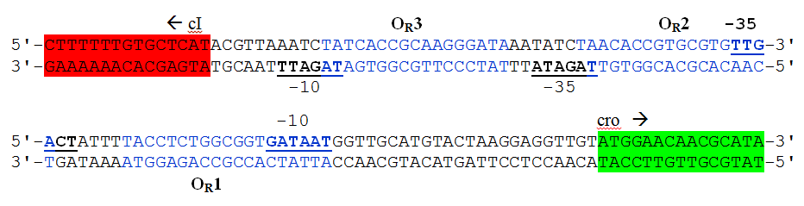
O_{R}

Slide 24
Question 8. This was the question I found interesting.
I… would like to go over… how to find the -10 region in the OL sequence from 8c.

Slide 25
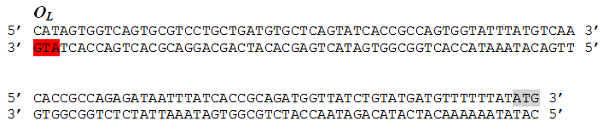
O_{R}

Slide 26
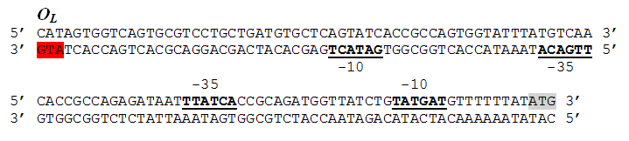
O_{R}

Slide 27
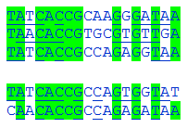
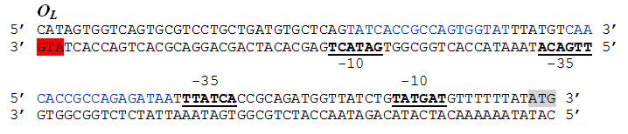
O_{R}
O_{L}

Slide 28
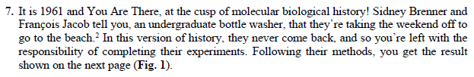

Slide 29
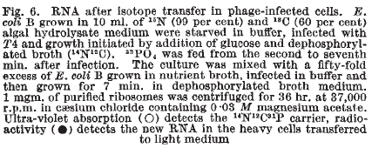
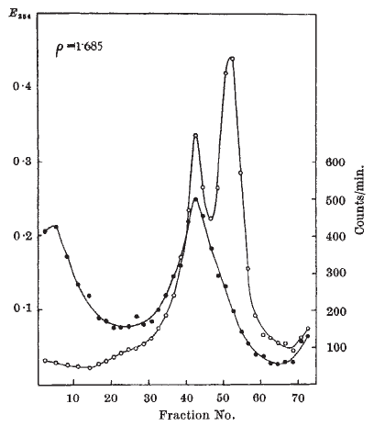
Brenner et al (1961)

Slide 30
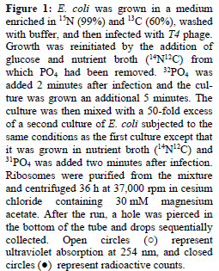
Brenner et al (1961)

Slide 31
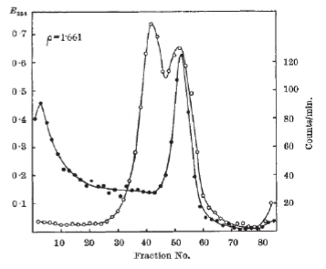
Exam Reality
Brenner et al (1961)

Slide 33
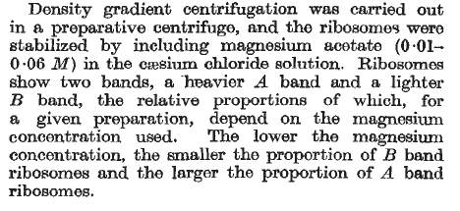

Brenner et al (1961)
A
B
A
B

Slide 34
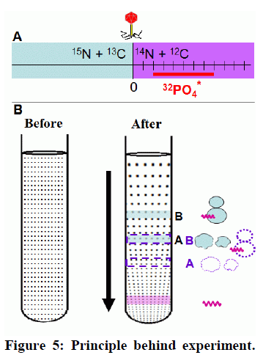
Brenner et al (1961)
A
B
A
B

Slide 35
Brenner et al (1961)

Slide 36
Brenner et al (1961)
A
B
A
B

Slide 37

Brenner et al (1961)
A
B
14
12
14
12
¹⁵N + ¹³C
¹⁴N + ¹²C
0

