Slide 1
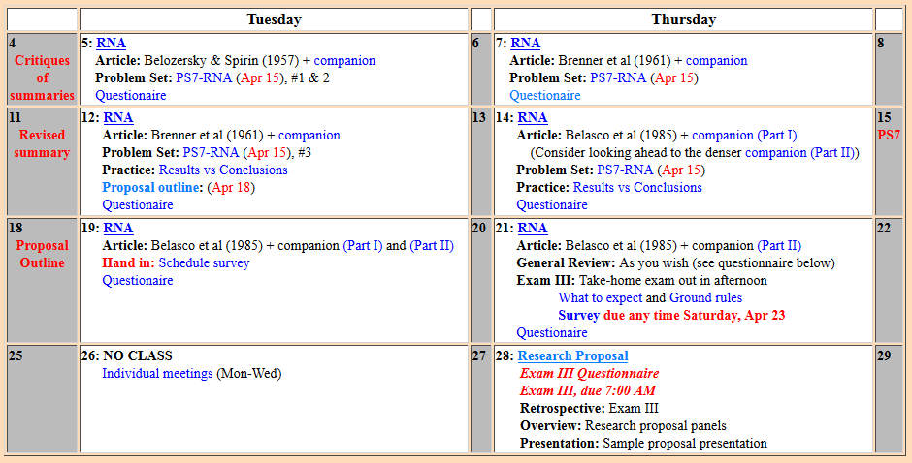
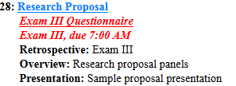
Welcome to Molecular Biology Through Discovery Thursday, 28 April 2016 Research Proposal and Exam III

Slide 2
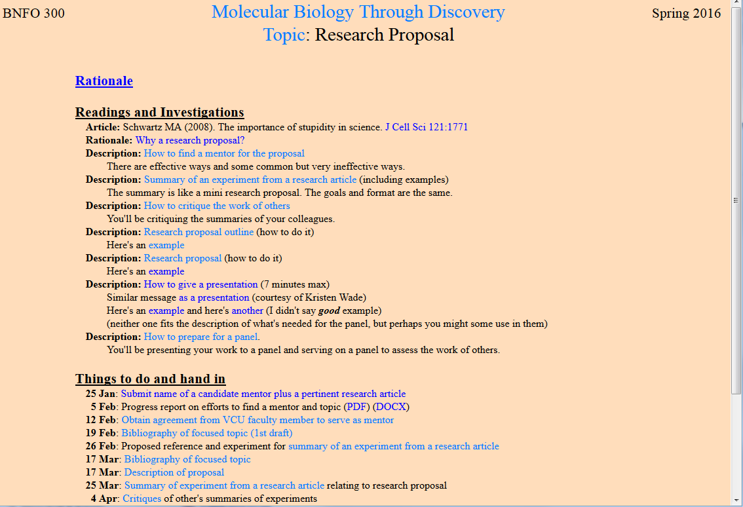
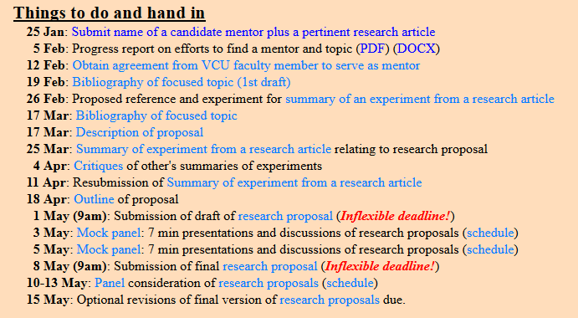

Slide 3
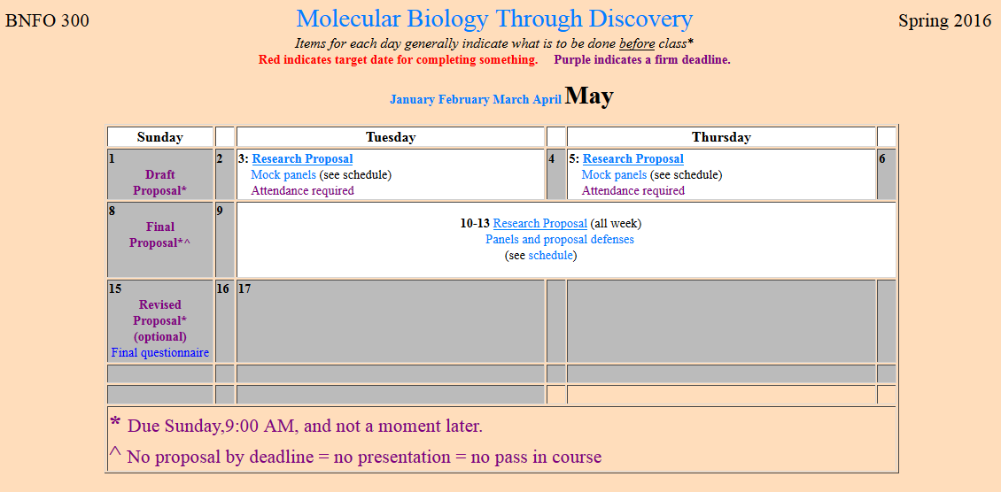
Research Proposal

Slide 4
Research Proposal

Slide 5
Welcome to Molecular Biology Through Discovery Thursday, 28 April 2016 Research Proposal and Exam III

Slide 6
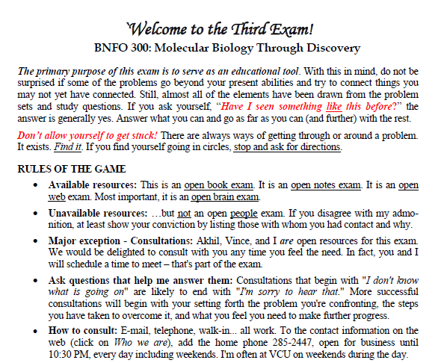

Slide 7
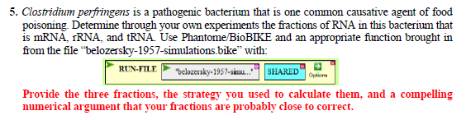
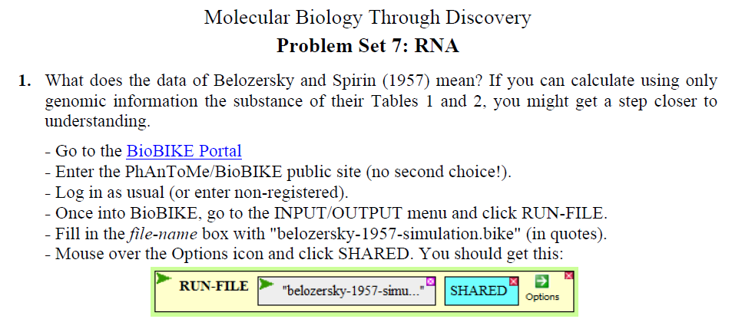

Slide 9
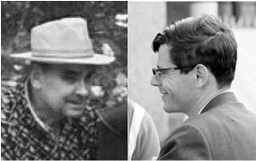
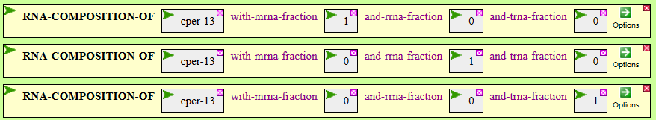
A C G U mRNA 39.6 10.6 18.8 31.0 rRNA 27.6 21.3 30.4 20.7 tRNA 20.1 24.6 31.3 24.0

Slide 10
A C G U mRNA 39.6 10.6 18.8 31.0 rRNA 27.6 21.3 30.4 20.7 tRNA 20.1 24.6 31.3 24.0 B&S 28.1 22.0 29.5 20.4

Slide 11
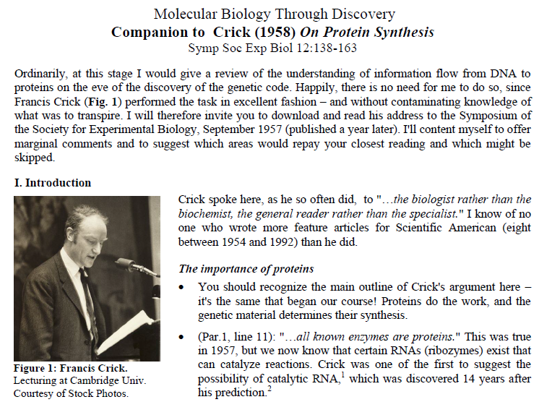

Slide 12
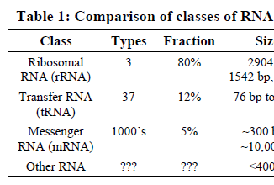
Why these numbers?

Slide 13
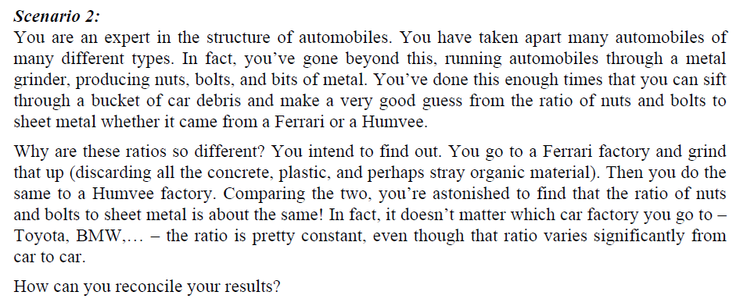
Why so much rRNA?

Slide 14
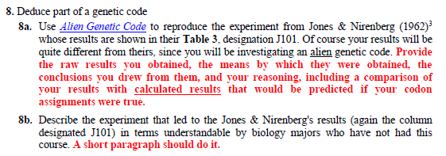



Slide 15
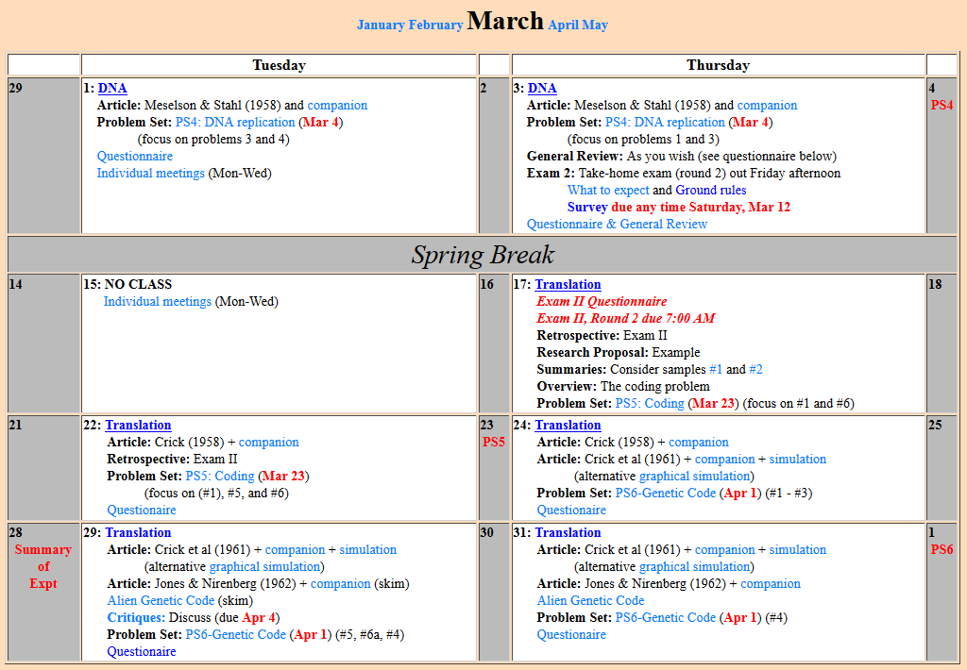

Slide 16
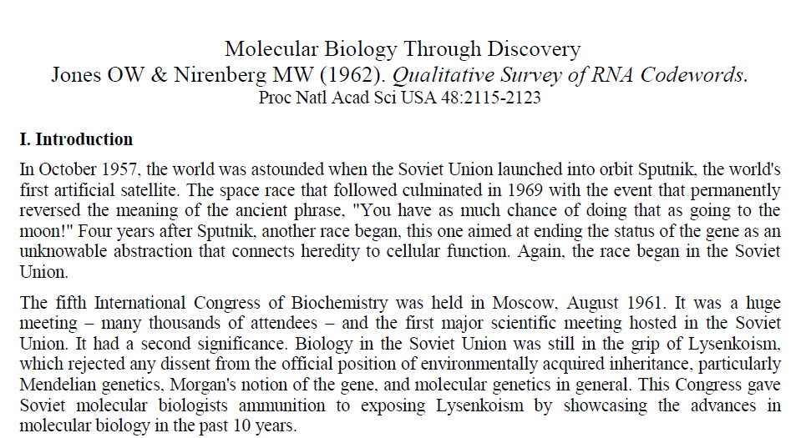
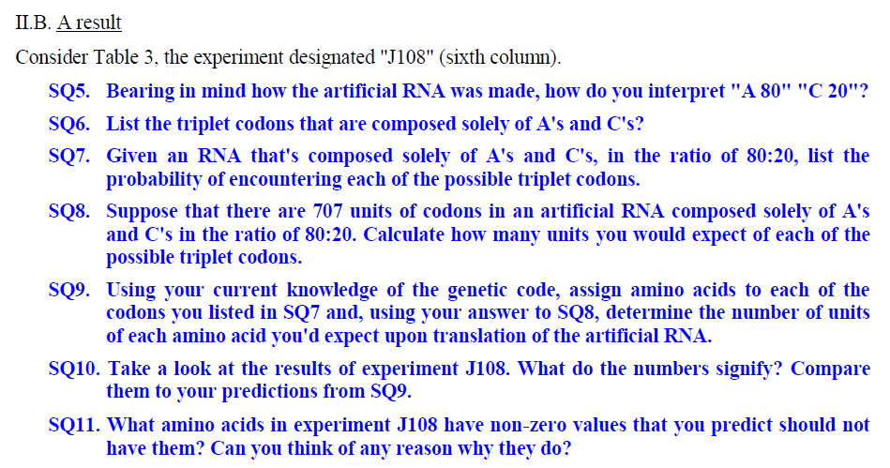

Slide 17
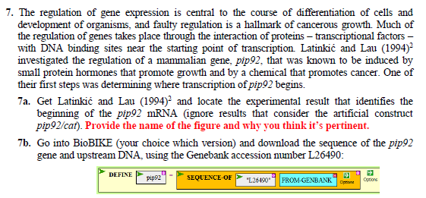

Slide 18
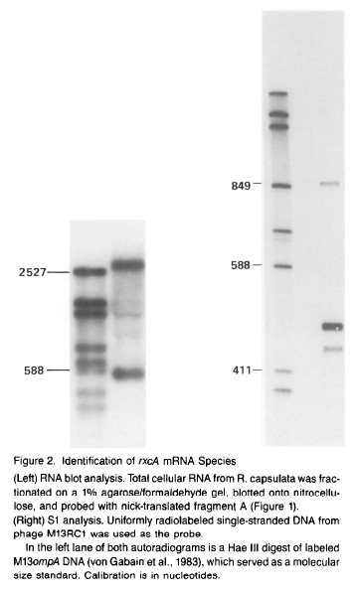
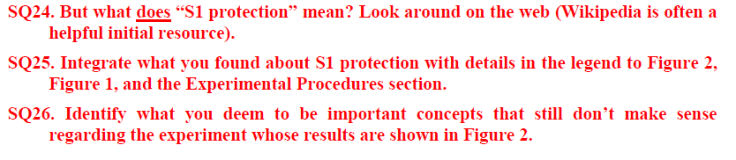
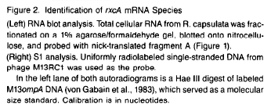
(Companion, Part 1)

Slide 19
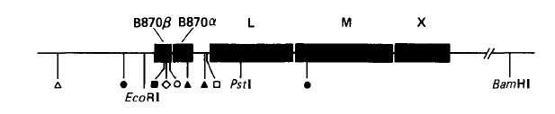
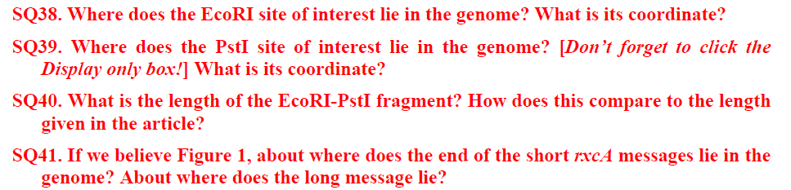

Figure 1
(Companion, Part 2)

Slide 20
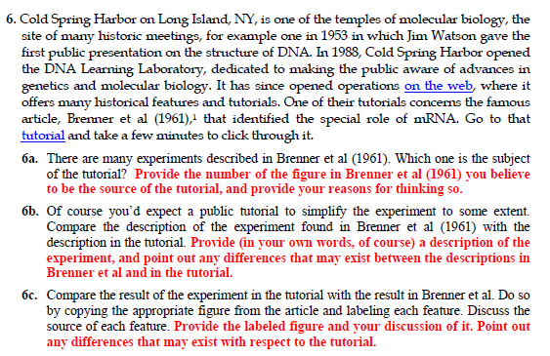

Slide 21
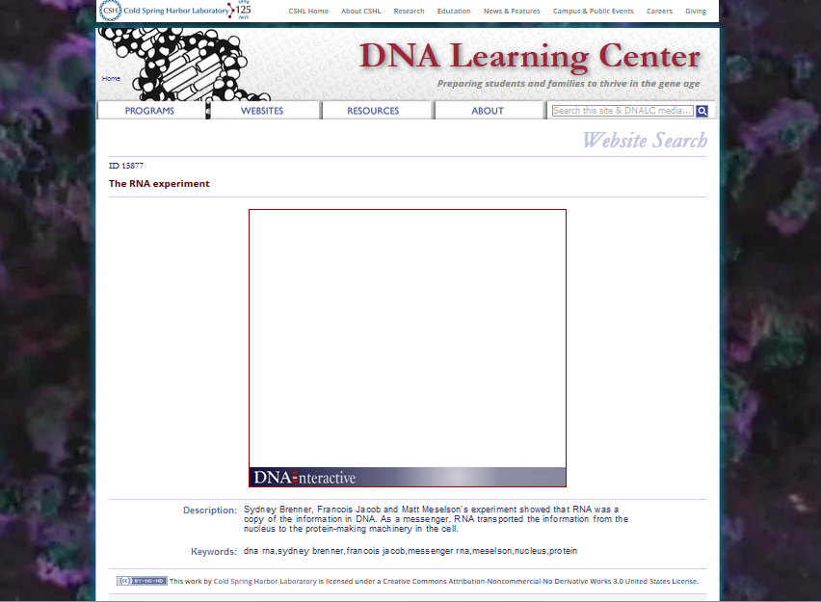
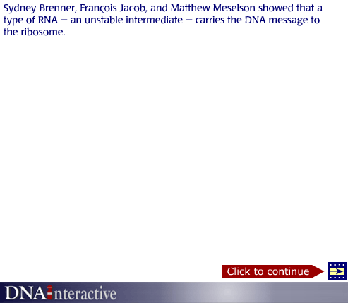
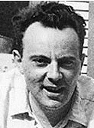
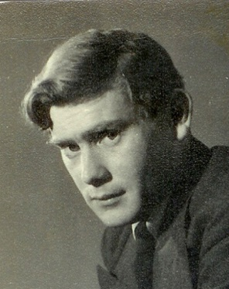
Francoise Jacob
Sydney Brenner

Slide 22
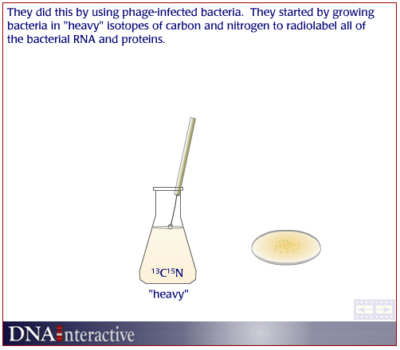
Cold Spring Harbor Tutorial
bacteria + ¹³C¹⁵N

Slide 23
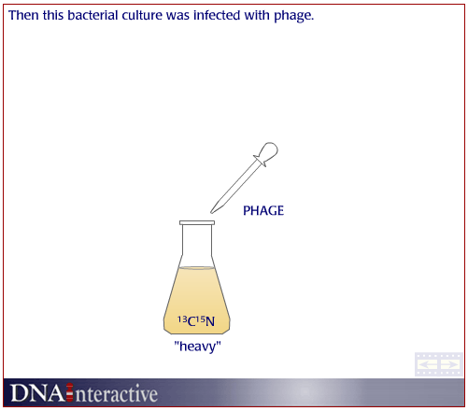
Cold Spring Harbor Tutorial
bacteria + ¹³C¹⁵N
+ phage

Slide 24
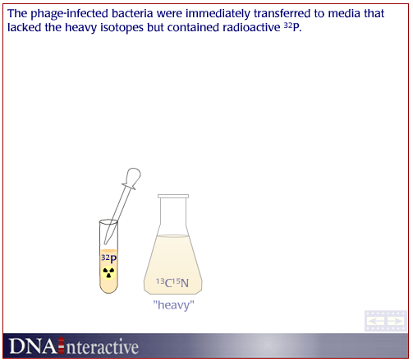
Cold Spring Harbor Tutorial
bacteria + ¹³C¹⁵N
+ phage
shift to ¹²C¹⁴N
+ ³²PO₄

Slide 25
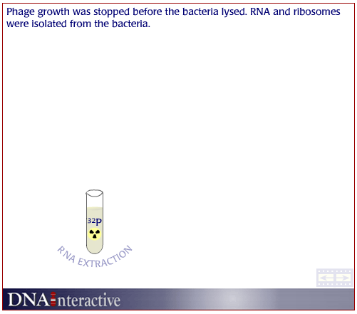
Cold Spring Harbor Tutorial
bacteria + ¹³C¹⁵N
+ phage
shift to ¹²C¹⁴N
+ ³²PO₄

Slide 26
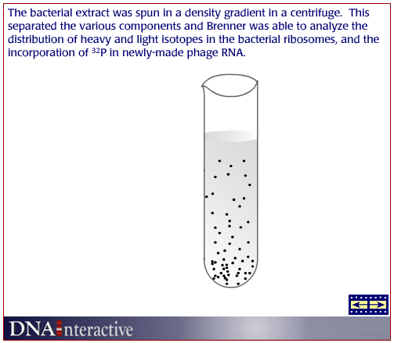
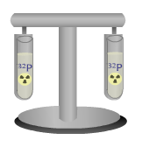
Cold Spring Harbor Tutorial
bacteria + ¹³C¹⁵N
+ phage
shift to ¹²C¹⁴N
+ ³²PO₄
centrifuge in CsCl

Slide 27
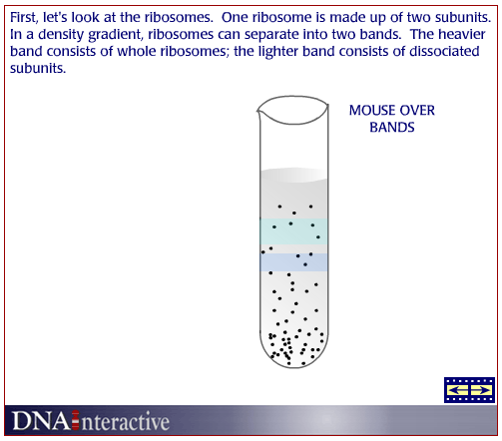
Cold Spring Harbor Tutorial
bacteria + ¹³C¹⁵N
+ phage
shift to ¹²C¹⁴N
+ ³²PO₄
centrifuge in CsCl

Slide 28
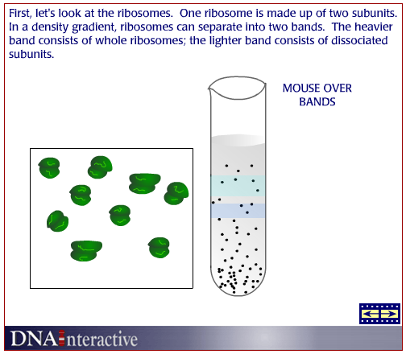
Cold Spring Harbor Tutorial
bacteria + ¹³C¹⁵N
+ phage
shift to ¹²C¹⁴N
+ ³²PO₄
centrifuge in CsCl

Slide 29
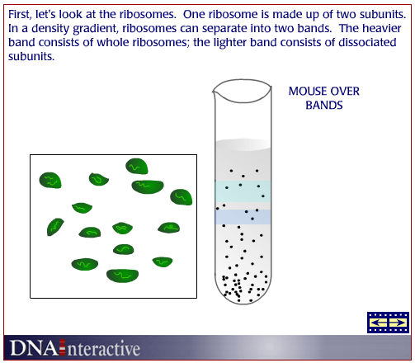
Cold Spring Harbor Tutorial
bacteria + ¹³C¹⁵N
+ phage
shift to ¹²C¹⁴N
+ ³²PO₄
centrifuge in CsCl

Slide 30
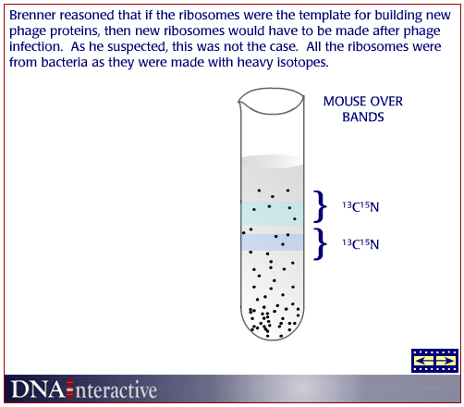
Cold Spring Harbor Tutorial
bacteria + ¹³C¹⁵N
+ phage
shift to ¹²C¹⁴N
+ ³²PO₄
centrifuge in CsCl

Slide 31
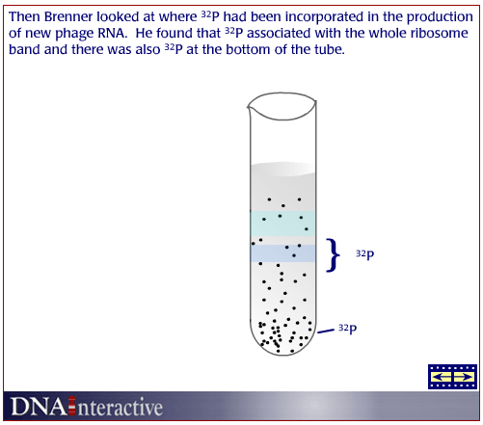
Cold Spring Harbor Tutorial
bacteria + ¹³C¹⁵N
+ phage
shift to ¹²C¹⁴N
+ ³²PO₄
centrifuge in CsCl

Slide 32
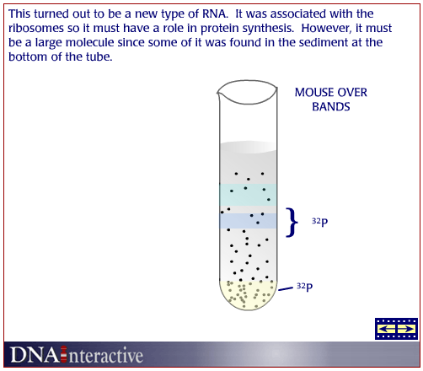
Cold Spring Harbor Tutorial
bacteria + ¹³C¹⁵N
+ phage
shift to ¹²C¹⁴N
+ ³²PO₄
centrifuge in CsCl

Slide 33
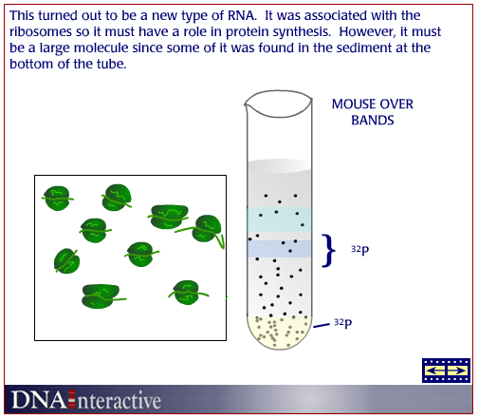
Cold Spring Harbor Tutorial
bacteria + ¹³C¹⁵N
+ phage
shift to ¹²C¹⁴N
+ ³²PO₄
centrifuge in CsCl

Slide 34
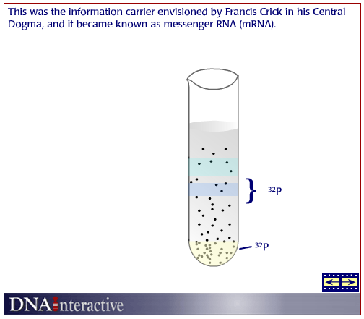
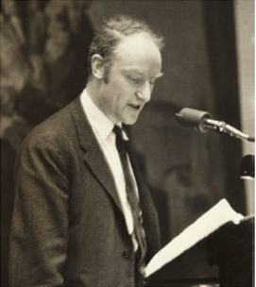
Cold Spring Harbor Tutorial
bacteria + ¹³C¹⁵N
+ phage
shift to ¹²C¹⁴N
+ ³²PO₄
centrifuge in CsCl

Slide 36
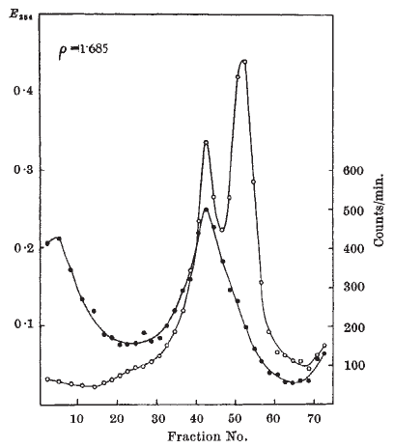
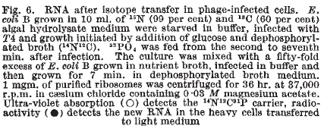
Brenner et al (1961)
Tutorial
bacteria + ¹³C¹⁵N
+ phage
shift to ¹²C¹⁴N
+ ³²PO₄
centrifuge in CsCl

Slide 37
Brenner et al (1961)

Slide 38
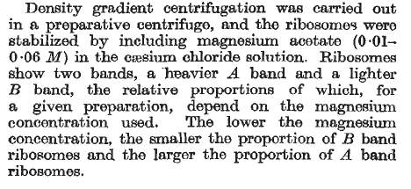

Brenner et al (1961)
A
B
A
B

Slide 39
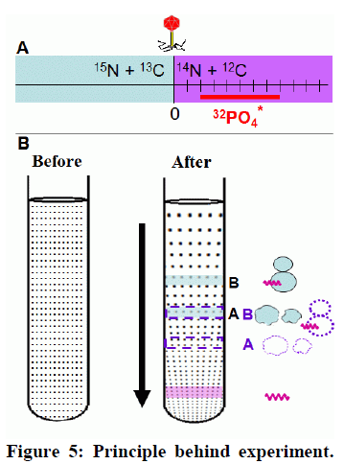
Brenner et al (1961)
A
B
A
B

Slide 40
Brenner et al (1961)
Tutorial
bacteria + ¹³C¹⁵N
+ phage
shift to ¹²C¹⁴N
+ ³²PO₄
centrifuge in CsCl

Slide 41
Brenner et al (1961)
A
B
A
B

Slide 42

Brenner et al (1961)
A
B
14
12
14
12
¹⁵N + ¹³C
¹⁴N + ¹²C
0

Slide 43
Cold Spring Harbor Tutorial
bacteria + ¹³C¹⁵N

Slide 44
Cold Spring Harbor Tutorial
bacteria + ¹³C¹⁵N
+ phage

Slide 45
Cold Spring Harbor Tutorial
bacteria + ¹³C¹⁵N
+ phage
shift to ¹²C¹⁴N
+ ³²PO₄

Slide 46
Cold Spring Harbor Tutorial
bacteria + ¹³C¹⁵N
+ phage
shift to ¹²C¹⁴N
+ ³²PO₄

Slide 47
Cold Spring Harbor Tutorial
bacteria + ¹³C¹⁵N
+ phage
shift to ¹²C¹⁴N
+ ³²PO₄
centrifuge in CsCl

Slide 48
Cold Spring Harbor Tutorial
bacteria + ¹³C¹⁵N
+ phage
shift to ¹²C¹⁴N
+ ³²PO₄
centrifuge in CsCl

Slide 49
Cold Spring Harbor Tutorial
bacteria + ¹³C¹⁵N
+ phage
shift to ¹²C¹⁴N
+ ³²PO₄
centrifuge in CsCl

Slide 50
Cold Spring Harbor Tutorial
bacteria + ¹³C¹⁵N
+ phage
shift to ¹²C¹⁴N
+ ³²PO₄
centrifuge in CsCl

Slide 51
Cold Spring Harbor Tutorial
bacteria + ¹³C¹⁵N
+ phage
shift to ¹²C¹⁴N
+ ³²PO₄
centrifuge in CsCl

Slide 52
Cold Spring Harbor Tutorial
bacteria + ¹³C¹⁵N
+ phage
shift to ¹²C¹⁴N
+ ³²PO₄
centrifuge in CsCl

Slide 53
Cold Spring Harbor Tutorial
bacteria + ¹³C¹⁵N
+ phage
shift to ¹²C¹⁴N
+ ³²PO₄
centrifuge in CsCl

Slide 54
Cold Spring Harbor Tutorial
bacteria + ¹³C¹⁵N
+ phage
shift to ¹²C¹⁴N
+ ³²PO₄
centrifuge in CsCl

Slide 55
Cold Spring Harbor Tutorial
bacteria + ¹³C¹⁵N
+ phage
shift to ¹²C¹⁴N
+ ³²PO₄
centrifuge in CsCl

Slide 56
Francoise Jacob
Sydney Brenner

Slide 57
Welcome to Molecular Biology Through Discovery Thursday, 28 April 2016 Research Proposal and Exam III

