Slide 2


Slide 3

Welcome to the
VCU Review Panel on Molecular Biology Research
Tuesday, May 2, 2016

Slide 4
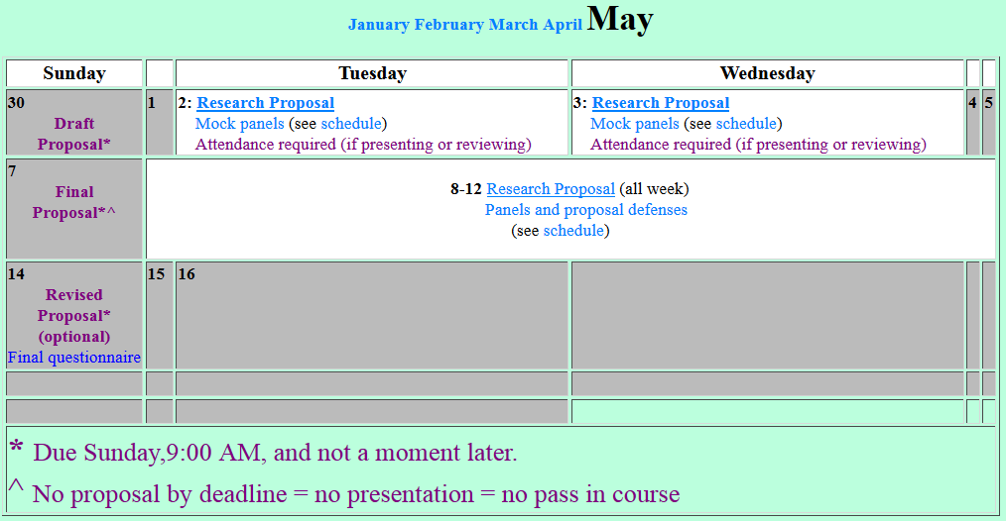

Slide 5
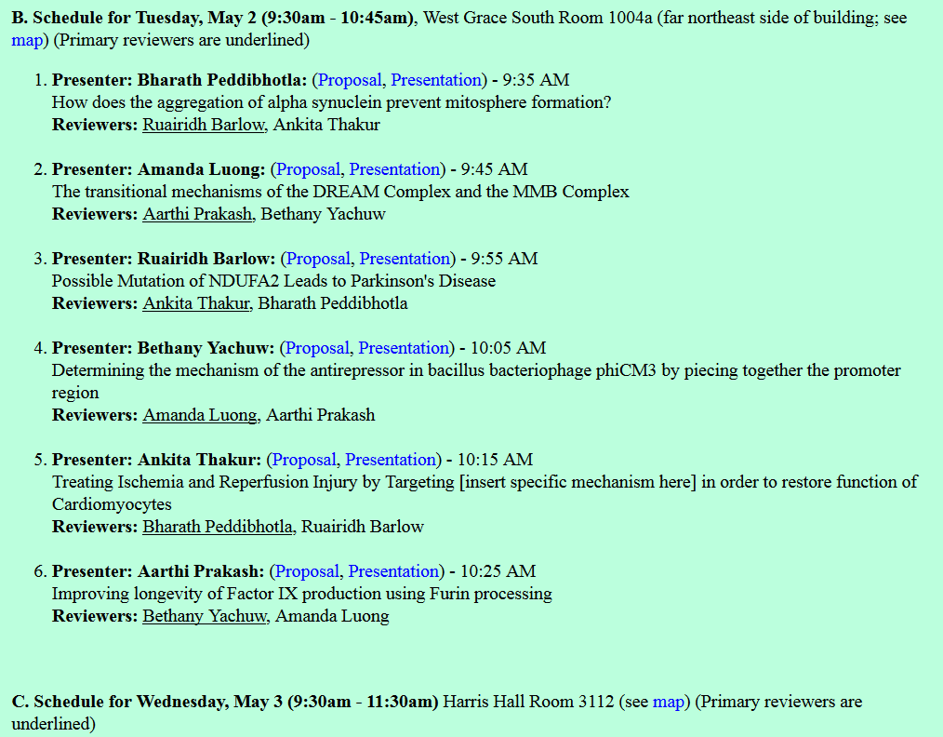
Individual presentations
At 6 minute - warning
At 7 minutes - cutoff
~2 min questions

Slide 6


